Slide 1

Business Office Travel Training
Presented January, 2025

Slide 2
TRAVEL AUTHORIZATION
All conference and travel expenses should be pre-approved by appropriate administrators 45 days in advance of travel dates.
Please refer to Hartnell Travel Guidelines for full travel details
Out of state travel must be pre-approved by the President/Superintendent.

Slide 3
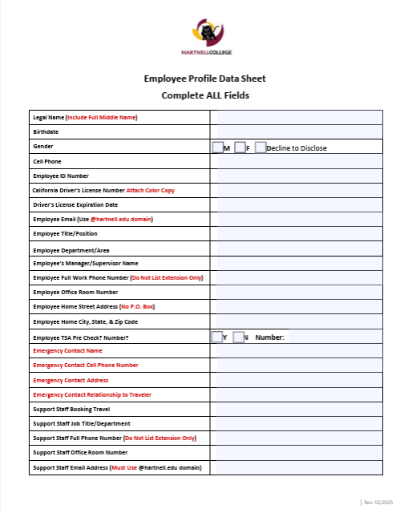
Concur Data Form – Must be Complete
Prior to traveling, request a Concur Data Form

Slide 4
Travel Training 2025
BUILDING A TRAVEL AUTHORIZATION PACKET
Include:
TA
Check/Credit Card Request Forms
Supporting Documentation/Estimates
Budget Report (for 55200 only)
Do Not Include:
Concur Data Form
Driving Credentials
Budget Transfer/s

Slide 5
TRAVEL AND CONFERENCE PER DIEMS
Travel expenses should fall within the dollar limits stated by the U.S. General Services Administration (GSA). These rates vary by location. Some fund sources (grants) apply additional restrictions.

Slide 6

Travel Authorization Form – GSA Per Diem Link
Submit Early!
Link to meal per diem rates by zip code.
Use hotel or venue zip code.
See following page.
Travel expenses should fall within the dollar limits stated by the U.S. General Services Administration (GSA). These rates vary by location. Some fund sources (grants) apply additional restrictions.

Slide 7
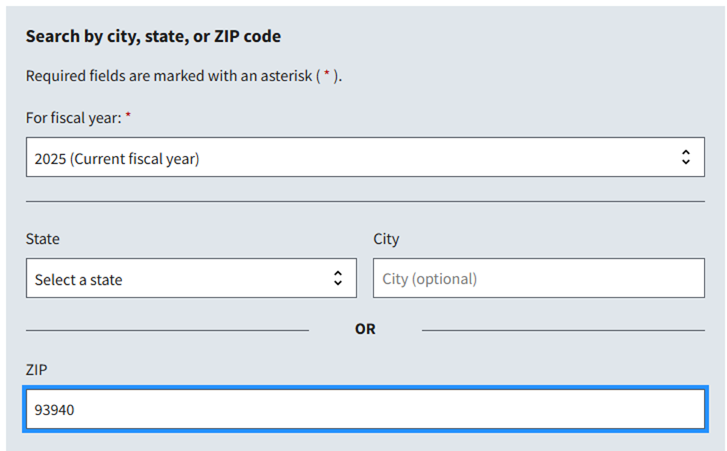
Locating Daily Meal Per Diem By Zip Code
The link at the top of the Travel Authorization form, gives you access the GSA website to locate your travelers daily meal per diem rate by zip code, as shown below:

Slide 8
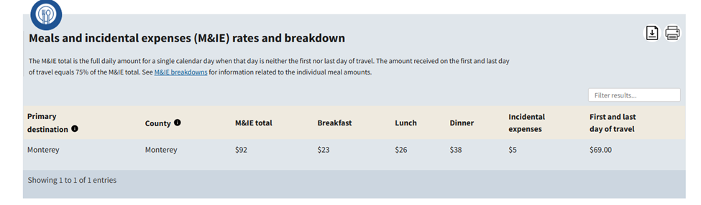
Determining Allowable Per Diem By Zip Code
The current daily meal per diem rate (M&IE) total in Monterey, CA (93940) is $92.00 per day, as shown below.
If your travel dates are 02/17-22/2025 = 6 days of travel. 2 days of travel and 4 days non-travel days.
Enter the allowable Meal Per Diem on the TA as 2@$69 and 4@$92

Slide 9
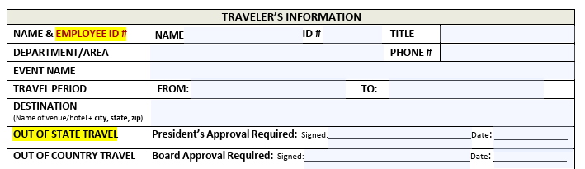
Travel Authorization-Event Info Entry
The TA will be returned if the Employee ID number is missing.
Avery Good-Teacher
Chemistry Instructor
Required
STEM
Full Phone Number
2025 ACCCA Winter Conference
President Signature Required for ALL Out Of State travel!
The day they leave
The day they return home
Hyatt - Monterey, 1 Old Golf Course Road, Monterey, CA 93940
Michael Gutierrez
Travel period should be the ENTIRE time they will be traveling for the event. If there are personal days before or after travel include only the days traveling to the event, attending the event, leaving the event. If they are traveling to the event the day before and returning the day after, those days are travel days.

Slide 10
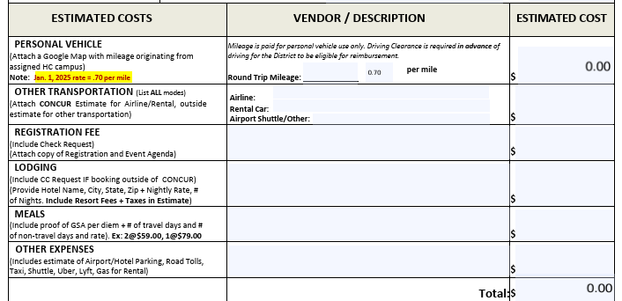
Estimates and Back-Up Documentation
Back-up documentation is REQUIRED for each area with an Estimated Cost.
If missing, the TA will be returned.
TA’s submitted on outdated forms will be returned.
TA will calculate number of
miles entered at the current years rate.
10
7
Include Google Map
United Airlines $851.50
Manually enter combined
total of all modes of transportation
Enterprise Car Rental $220.30
1239.30
Groome Transportation $167.50
2025 ACCCA Winter Conference Registration
1850.00
Enter nightly hotel rate by
number of days plus estimate of fees/taxes
Hyatt-Monterey 2 nights @ $225 +fees/taxes
400.00
2@92.00
184.00
Breakfast/Lunch/Dinner meal allowables apply to each meal. Do not list each allowable meal rate. Daily rate cannot be applied to one meal. Recommend all adult beverages go on separate tab.
Uber/Hotel Parking
300.00
Follow recommendations on following slide for attachments

Slide 11
Driving Clearance
Required for both Personal/Rental Vehicles
Apply for clearance a minimum of two weeks prior to the first date
of travel to allow time for the DMV to process;
Apply for clearance a minimum of two weeks prior to the first date of travel to allow time for the DMV to process
Credentials required are:
Color Copy of valid California driver’s license. Clearance cannot be granted on out of state licenses; and,
Liability Insurance:
A copy of the front and back of your current liability insurance card is required.
As the expiration date is reached, a new copy of your current liability coverage will be required to maintain your clearance.

Slide 12
Know What You Are Attaching
Please:
Be mindful of the number of miles entered. It is cheaper to fly to San Diego than drive there.
Do not submit double-sided copies.
Limit the event’s back-up documentation to 2-3 pertinent pages
Be mindful of the type of attachment used and how it will print. Packets will be returned if required documents are:
Oversized and cannot print on a single page
If the print is too small to read on a required document
Do not provide estimates for items in Other Expenses (New)
List the expense anticipated as Uber or Parking. Do not list Misc.
These expenses are now reimbursable expenses and itemized receipt will be require for reimbursement

Slide 13
Airfare
It is strongly recommended to DISCUSS SPECIFIC FLIGHTS DESIRED with the traveler. If the traveler does not reach out to you to do this, you MUST reach out to them.
Traveler should make the final choice of what flights work best for their needs.
All airfare is to be booked in Concur;
Book non-stop flights whenever possible
All airfare should be booked at least 30 days in advance;
Airfare should not be booked more than 90 days in advance, however if booking airfare greater than 90 days in advance:
Purchase Refundable Tickets
No Credit Card Request form is required;

Slide 14
Enterprise Car Rental
Having a conversation with your traveler is highly recommended to establish what they require in a rental car. Concur requires you to confirm the traveler’s desired pick-up and drop off dates/times before you book. The pick-up and drop off time are scheduled on the quarter hour.
The traveler needs to be informed of their responsibilities in car rental. Such as
Arriving late to pick up a vehicle can result in the car being rented to someone else and no car being available to them. The traveler must be on time to pick up their car.
The traveler needs to establish driving clearance at least two weeks prior to the date of travel;
The traveler will be the only driver allowed to drive;
No Credit Card Request form is required;
A full-size car is always recommended for safety;
An SUV may be rented when traveling into inclement weather. Please contact Business Services at Ext. 6800 for assistance.

Slide 15
GL Distribution
Must equal 100% of expenses. A copy of each GL must be attached as proof of funding.
Single GL
11-210-00-672010-55200
GL Distribution - Percentage Distribution: Must equal 100% of total submitted.
11-210-00-672010-55200 (90%)
11-210-00-672020-55200 (10%)
GL Distribution - Dollar Distribution: Must equal total submitted.
11-210-00-672010-55200 ($1000)
11-210-00-672020-55200 ($Balance)
When required, budget transfers should be submitted and completed prior to submitting a TA.

Slide 16
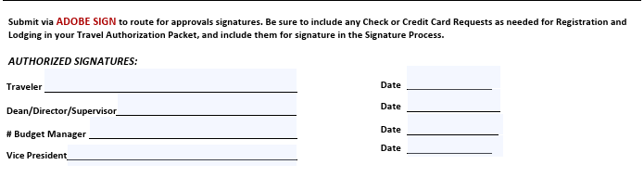
Completing the Travel Authorization
Know Who Must Sign.
Know Who Manages the Budget/s.
Submit ALL of your method of payment forms (Check Request/Credit Card Request) within the TA Packet.
No travel related documents pertaining to this event s/b sent outside of the packet.
Those authorizing (signing) the TA’s should only have to sign a travel packet containing all of the required forms, once.
Signature REQUIRED
Signature REQUIRED
Required Only If OTHER Than The Signer Above
Signature REQUIRED
Your TA Will Be Returned If Signed Incorrectly.
All TA’s must be submitted via Adobe Sign.

Slide 17
Outside Funding Documentation
Outside Funding:
When funding is offered from a Department/Area outside of the traveler’s own Department/Area, it is the responsibility of the funding department to provide proof of funding in a timely manner to the Department/Area booking the travel.
Travel is to be booked by the support staff within the traveler’s Department/Area and not the Department/Area funding the travel.

Slide 18
Group Travel
In some circumstances, group travel may be processed differently than individual travel and exceptions to individual travel policy procedures may be made. Should leadership choose to select and send a group of faculty/staff to an event as a group, they may also choose to have one person to organize the event, either by preparing all of the travel documents and/or making all of the arrangements for the group. Please notify Julia in Business Services when planning group travel.

Slide 19
Vans and One-Way Rentals
Please contact Julia In Business Services for:
Vans for groups may be rented. It is recommended to call the Enterprise office you intend to pick up from and inform them of your need for a van because vans are not always available on-site. However, they can requested prior to your dates of travel.
Cars will not be rented for all parties when a departmental group is attending the same conference/training.
One-way car rentals: May be an available option based on approval from the Enterprise office you are renting from.

Slide 20
Hotel LodgingPre-Booking
A Conversation with your traveler is highly recommended
Confirm if rooms are being offered at a special rate (block rooms) for attendees;
Confirm you have a signed Credit Card Request form within your signed TA packet;
If booking during an appointment in Business Services, bring this with you;
Sold-Out Block: Available rooms offered at the block rate provided by the conference, often sell out quickly. For safety, every effort should be made to acquire a room for the traveler where the event is being held at the block rate. Unfortunately, without the special pricing, some venues will be too expensive. In those cases, call the hotel where the event is being offered and ask which nearby hotel/s they recommend.

Slide 21
Lodging-Special Rates Available
If rooms at a special rate are being provided to attendees), you must book the room directly with the hotel. To book directly:
Contact Lucy Trafton (or Julia Silveira in her absence) for an appointment to use the Hartnell credit card;
Bring a copy of the signed Hartnell Credit Card Request form with you;
Call the hotel to make the reservation for the traveler,
make note of the confirmation number, you will need it later;
Get the name of the person you are speaking to, you will need it later;
If booking for more than 1 person, travel will need
Each person’s confirmation number;
Get the name of the person you spoke to;
Ask the hotel (exception: Hyatt) to email a Credit Card Authorization form/link directly to the travel email address; (Be sure to call the property and not the national reservation line.
If booking for more than 1 person, ask the hotel if you need individual Credit Card Authorizations for each guest, or if the group can go on 1 authorization;

Slide 22
Email the following to travel:
The name of the person you spoke to;
The confirmation number/s of the traveler. If booking for more than one traveler, be sure to provide travel with the confirmation number for each traveler;
Confirm that you requested the hotel to send their Credit Card Authorization form directly to the travel email account. If not received, you will need to call again;
If Hyatt Hotel, inform travel that you did not request a Credit Card Authorization form/link was requested as the reservation is with the Hyatt;
Travel will email confirmation of the Credit Card Authorization form when received;

Slide 23
Ask the hotel (exception: Hyatt) to email a Credit Card Authorization form/link directly to the travel email address; (Note: Be sure you are speaking to the property where the traveler will be staying and not to the national reservation number);
If booking for more than 1 person, ask the hotel if you need individual Credit Card Authorizations for each guest, or if all of those you are booking for can go on 1 authorization;

Slide 24
Travel Reimbursement, Mileage Reimbursement Related to Travel
Travel Reimbursement Claim Form

Slide 25
TRAVEL REIMBURSEMENT
Traveler will receive a “Travel Expense Claim Form.”
Attach original ITEMIZED receipts (no credit card summary slips) and obtain administrative signature(s) on the form.
Send completed “Travel Expense Claim Form” to the Business Office for payment processing.

Slide 26
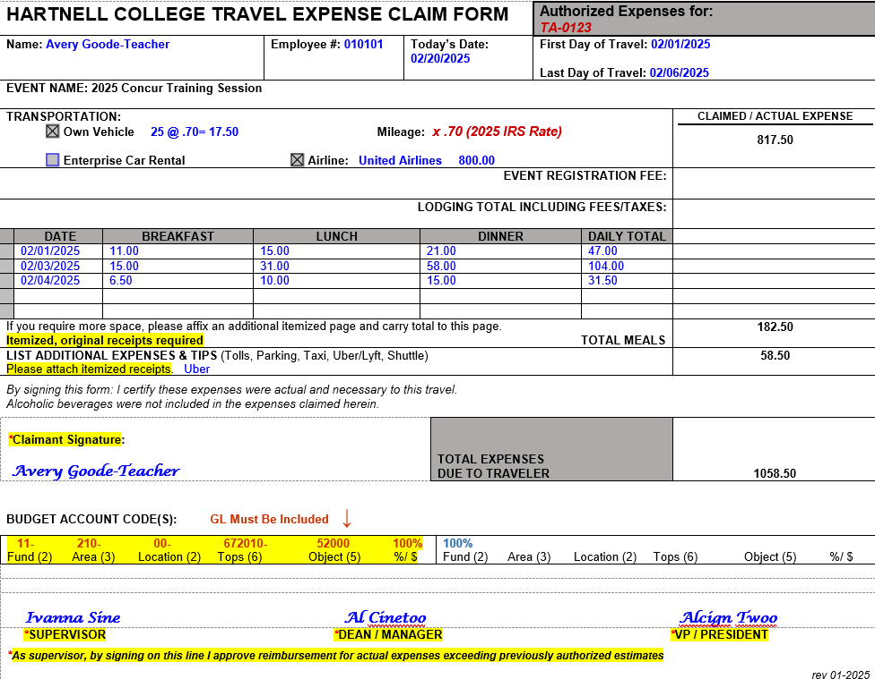
Travel Expense Claim Form
List Only What Needs to Be Reimbursed
Enter TA Number Here
Attach Itemized Receipts.
No Adult Beverages s/b listed
If GL has known Budget Manager and/or is outside budget, Budget Manager signature required also.
Traveler and Supervisor’s Signature Required.

Slide 27

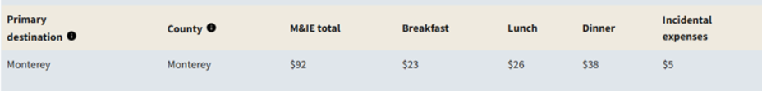
GSA Allowable Amount For Zip Code 93940
Breakfast cannot exceed $23.00
Lunch cannot exceed $26.00
Dinner cannot exceed $38.00

Slide 28
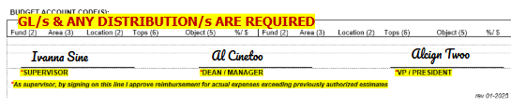
Travel Expense Claim Form Required Signatures
The traveler’s Supervisor/Dean/Director must sign. If they manage the funding budget they do not need to sign Budget Manager. If there is outside funding the funding Budget Manager must sign. VP signature required.

Slide 29
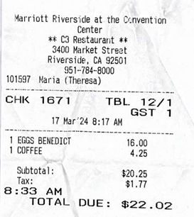
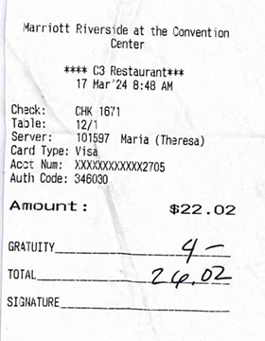

Receipt Examples
Itemized
Non-Itemized

Slide 30
GL Distribution for Reimbursement
The TA’s GL Distribution Also Applies to Travel Expense Claim Forms
Single GL
11-210-00-672010-55200
GL Distribution - Percentage Distribution
11-210-00-672010-55200 (90%)
11-210-00-672020-55200 (10%)
GL Distribution - Dollar Distribution
11-210-00-672010-55200 ($1000)
11-210-00-672020-55200 ($Balance)

Slide 31
TRAVEL AND MILEAGE REIMBURSEMENTS

Slide 32
Travel Expense Claim Form
List Only What Needs to Be Reimbursed
Enter TA Number Here
Attach Itemized Receipts.
No Adult Beverages s/b listed
If GL has known Budget Manager and/or is outside budget, Budget Manager signature required also.
Traveler and Supervisor’s Signature Required.

Slide 33
Receipt Examples
Itemized
Non-Itemized

Slide 34
MILEAGE REIMBURSEMENT
The College will reimburse employees for the use of their personal vehicle used for District business. California law requires that each person have automobile liability coverage on his or her personal automobiles. The school district will NOT provide insurance coverage to cover damage or loss to an employee’s car.
The Business Office will also need a DMV driving record on file for the employee before they are allowed to drive for district business. Contact Julia Silveira.
Mileage reimbursement is meant to cover only those miles incurred above and beyond the employee’s normal commute to his/her place of business.
Mileage Reimbursement Form

Slide 35
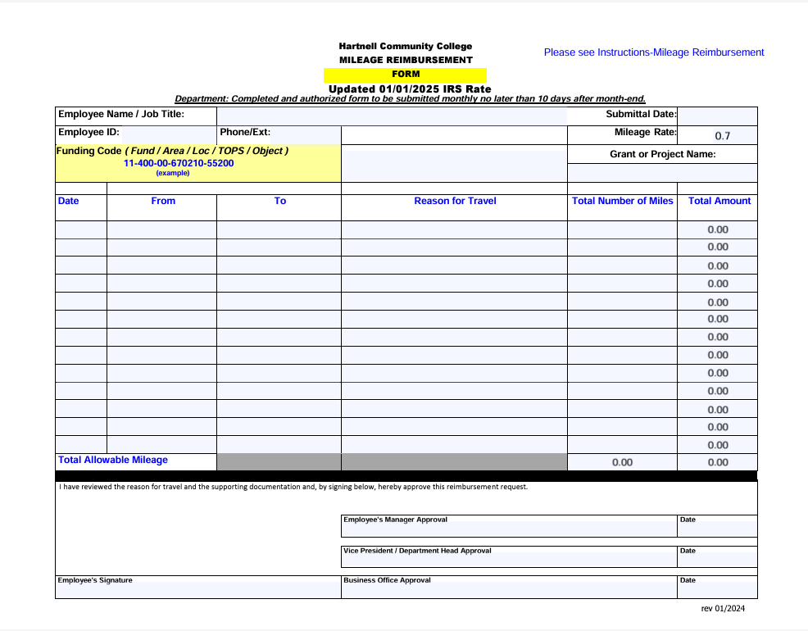

Slide 36
QUESTIONS?
THANK YOU!

Slide 37
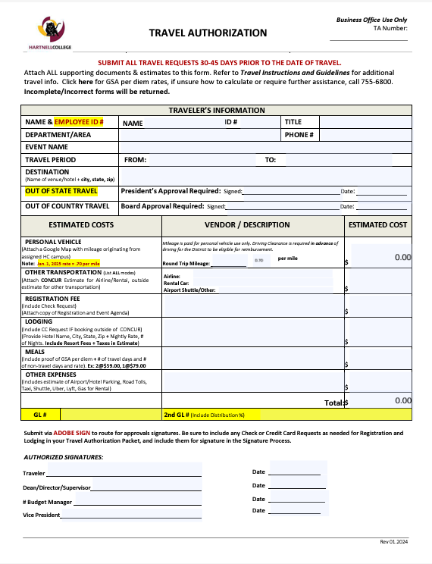
TRAVEL AUTHORIZATION FORM
A TA REQUIRES SUPPORTING DOCUMENTATION
TA Packets Will Be Returned when Missing REQUIRED Documentation
Name of EVENT You Are Traveling To (2025 ACCCA Annual Conference)
Event Venue (Hyatt Monterey, 1 Old Golf Course Road, Monterey, CA 93940)
President’s Signature REQUIRED For Out of State Travel
Mileage Begins/Ends at Your Assigned Campus
Printed Estimates MUST be Attached for EACH MODE of Transportation
Invoice or Registration Estimate MUST be Attached
Invoice or Estimate MUST be Attached
List Daily Per Diem Allowed
Other Expenses Anticipated MUST be Listed – May NOT Indicate Misc.
Other Expenses Anticipated MUST be Listed – May NOT Indicate Misc.
GL Number/s and REQUIRED - More Than One GL? Distribution/Percentage REQUIRED MUST Include Copy of Budget – Object Code 55200 Only
Traveler’s Signature - REQUIRED
Traveler’s Supervisor Signature - REQUIRED
Budget Manager Signature – Required if Budget is Not Managed by Travelers Supervisor
VP’s Signature - REQUIRED

Slide 38
Travel: Virtual Conference
No Travel Authorization is required; however, your supervisor may require prior approval to attend.
Upon approval, registration may be made by the departmental assistant, attendee, or the traveler.
When payment requires payment by credit card, prepare a Credit Card Request form. (Event registration that may be paid by check requires a Check Request form.
Event registration must be done outside of Concur.
Please refer to the Hartnell Travel Policy & Guidelines web page for full guidelines.

Slide 39
TRAVEL AUTHORIZATION
All conference and travel expenses should be pre-approved by appropriate administrators 45 days in advance of travel dates.
Use a Travel Authorization form to propose a travel/conference expenditure.
Please refer to Hartnell Travel Guidelines for full travel details
Out of state travel must be pre-approved by the President/Superintendent.

Slide 40
TRAVEL AND CONFERENCE PER DIEMS
All Hartnell travel expenses should fall within the dollar limits stated by the U.S. General Services Administration (GSA). These rates, often referred to as CONUS (Continental United States) rates vary by location. Some fund sources (grants) require that travel expenses not exceed those found in CONUS.
We recommend that you attach the per diem rates for the city of travel to your conference request in order for your Dean/Administrator to verify that the expenses in each area (hotel, meals, etc.) do not exceed the CONUS per diems.
http://www.gsa.gov

