Slide 1
Outside The Room Where It Happens
Developing a Meeting Culture Before, During, and After a Meeting

Slide 2
Webinar hosted by asccc
Available on the ASCCC website under Past Events
Nickawanna Shaw
Served as Academic Senate President at Citrus College
Katy Krolikowski
In her 2nd year as Academic Senate President at Contra Costa Community College
Watch the video recording

Slide 6
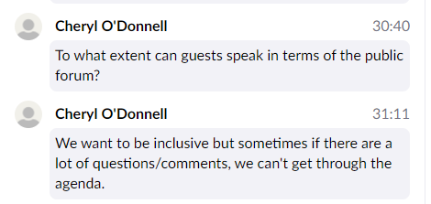
What are our ground rules?
Question I posed in chat:

Slide 7
The response
@Cheryl for guests it depends on your local ground rules. Roberts does not allow for guest speakers, only senators can engage in debate. This can be changes by 2/3 vote or by establishing your own ground rules.

Slide 8
Our constitution
Section 2. Meetings
Senate meetings are open to all members of the electorate, guests and the general public. Only members of the Senate possess a vote. Visitors, guests and faculty members may speak either at the time designated for public comments or at the time of discussion for an action item. The speaker must be recognized by the Senate President and a time limit may be placed prior to speaking.

Slide 9
Moving forward
Spring semester
Review and update the Constitution and Bylaws
Develop the ground rules for our meetings
Training for all senators by Kelly Locke

Slide 10
As we make changes . . . Things to consider

Slide 11
The culture we desire
A culture where we respect and honor decisions
A culture where we connect with people
A culture where we make others feel valuable and heard
A culture where when there is a disagreement, we focus on the idea(s) behind the disagreement, not the people themselves

Slide 12
As we are leading, we are creating leaders

