Slide 1
Saving Students $
Open Educational Resources/Low-Cost Resources
Notes:
NOTE:
To change the image on this slide, select the picture and delete it. Then click the Pictures icon in the placeholder to insert your own image.

Slide 2
An Open Educational Resource
Is no-cost and openly licensed, often using creative commons licensing;
Can be downloaded as a resource and shared;
Can be downloaded, edited, and reposted.

Slide 3
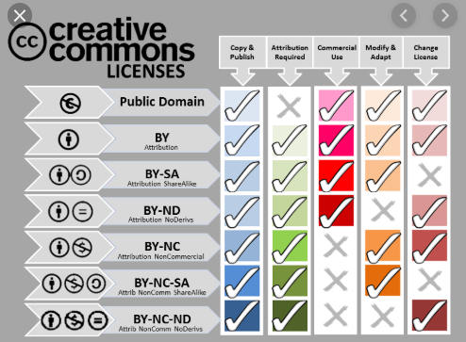
Some Versions of Creative Commons Licensing

Slide 4
Low-Cost Resources
Are defined in Academic Senate Resolution 19-3;
“Whereas a textbook that costs $40.00 or less is generally considered low-cost, and can be more affordable than traditional publisher options;”
“Resolved that courses utilizing textbooks that cost $40.00 or less shall be designated in the Hartnell College schedule as low-cost, so that students can identify classes with affordable textbook options thereby enhancing student preparation and success.”

Slide 5
An OER is Work That Gives Free and Perpetual Permission to Engage in the 5R Activities
Retain - the right to make, own, and control copies of the content (e.g., download, duplicate, store, and manage)
Reuse - the right to use the content in a wide range of ways (e.g., in a class, in a study group, on a website, in a video)
Revise - the right to adapt, adjust, modify, or alter the content itself (e.g., translate the content into another language)
Remix - the right to combine the original or revised content with other material to create something new (e.g., incorporate the content into a mashup)
Redistribute - the right to share copies of the original content, your revisions, or your remixes with others (e.g., give a copy of the content to a friend)

Slide 6
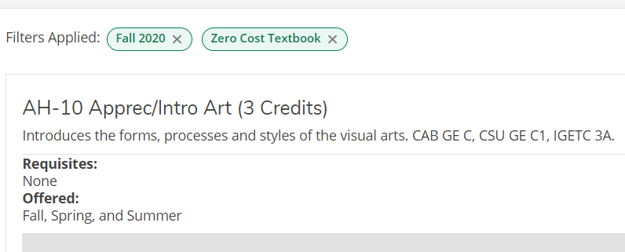
CA Ed Code 66406.9:
66406.9.
(a) Each campus of the California Community Colleges and the California State University shall, and each campus of the University of California is requested to, do both of the following:
(1) (A) Clearly highlight, by means that may include a symbol or logo in a conspicuous place on the online campus course schedule, the courses that exclusively use digital course materials that are free of charge to students and may have a low-cost option for print versions.

Slide 7
OER/Low-Cost Canvas Shell

Slide 8
Features OER and Low-Cost Repositories

Slide 9
Also Features OER/LC Courses, Webinars, and Sites

Slide 10
Survey Results and Other HC Adoptions are in Modules

Slide 11
Survey Results (Faculty, non-CTE)

Slide 12
Survey Results, Faculty (CTE)

Slide 13
Student Survey Results (Over 300 surveyed)

Slide 14
Does Adopting OER “Work?”
Effectiveness & Perceptions
A meta-analysis conducted by John Hilton III . Hilton's work synthesizes the results of 16 OER studies that examined the influence of OER on student outcomes, or student and faculty perceptions of OER. Key findings include:
Students generally achieve the same learning outcomes when OER are utilized and simultaneously save significant amounts of money
Both students and faculty are generally positive regarding OER

Slide 15
Why Use OER and Low-Cost Resources?
Textbook costs should not be a barrier to education. The price of college textbooks increased 88% from January 2006 to July 2016. If we take a longer look back, the increase is even more startling. Data from the Bureau of Labor Statistics show a 1,041% percent increase from January 1977 to June 2015, which is over three times the rate of inflation.
Students learn more when they have access to quality materials. The rapidly rising cost of textbooks in higher education has left many students without access to the materials they need to succeed. Studies show that 93% of students who use OER do as well or better than those using traditional materials, since they have easy access to the content starting day one of the course.
Openly licensed materials increase currency and relevancy. Imagine a science textbook that incorporates the latest results from a laboratory, or a math tutorial that incorporates local landmarks into word problems.

Slide 16
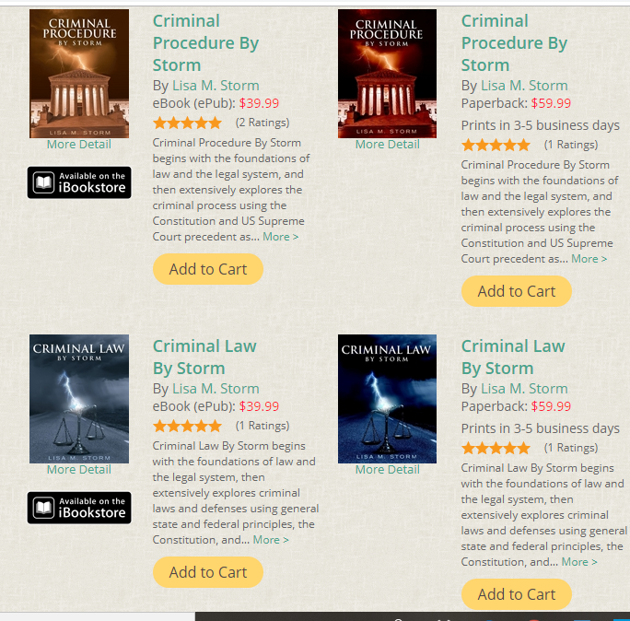

Slide 17
My Low-Cost Textbooks Were Originally Published by a Commercial Publisher
They are professionally copy-edited and peer-reviewed
After the price was raised to over $100 I requested a release
I spent some time updating the textbooks, then self-published with Lulu
The textbooks were written as ebooks and are completely interactive with over 1,000 links
The print versions are over 500 pages and cost $59.99

Slide 18
Criminal Law and Criminal Procedure are Utilized in All Four ADJ Courses That I Teach
Which costs the students $20 per course
ADJ 3, ADJ 4, ADJ 5, and ADJ 33
ADJ 3, 4, and 5 are major required courses and ADJ 33 is an elective
ADJ 4 and ADJ 33 are supported by OER to customize

Slide 19
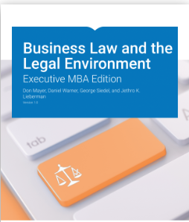
I Adopted an Open Textbook for BUS 18, Legal Environment of Business Which Makes This Course ZTC (Zero Textbook Cost)
I provide the textbook in an accessible word document
I send the textbook to students in an email the Friday before the class begins
The textbook chapters are uploaded next to every textbook reading assignment in Canvas

Slide 20
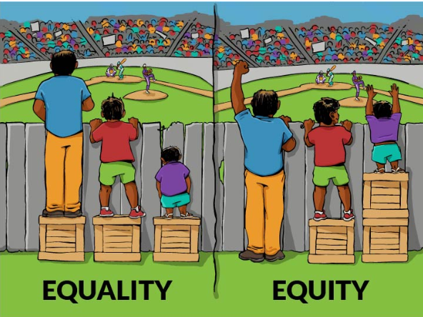
OER and Low-Cost Resources Support Equity for Students
Statistical analysis reveals that textbook prices are a significant educational barrier for all students, with a disproportionately negative effect among racial/ethnic minorities, low-income students, and first-generation college students.
It is our responsibility as faculty to remove any unnecessary financial barriers to academic success, and to ensure that our students’ learning potential is never limited by their purchasing power.

Slide 21
Here are Some Key Findings

Slide 22
I Have Been Approved to Teach Equity By OER/LC for Flex:

Slide 23
Saving Students $
Questions?
Notes:
NOTE:
To change the image on this slide, select the picture and delete it. Then click the Pictures icon in the placeholder to insert your own image.

