Slide 1
DSPS 2026-2027
Academic Senate 9/22

Slide 2

Learning Objectives
Gather Feedback on Accommodate
Identify Ideal Conditions for Use
Review AI Accommodations
Notes:
KO

Slide 3
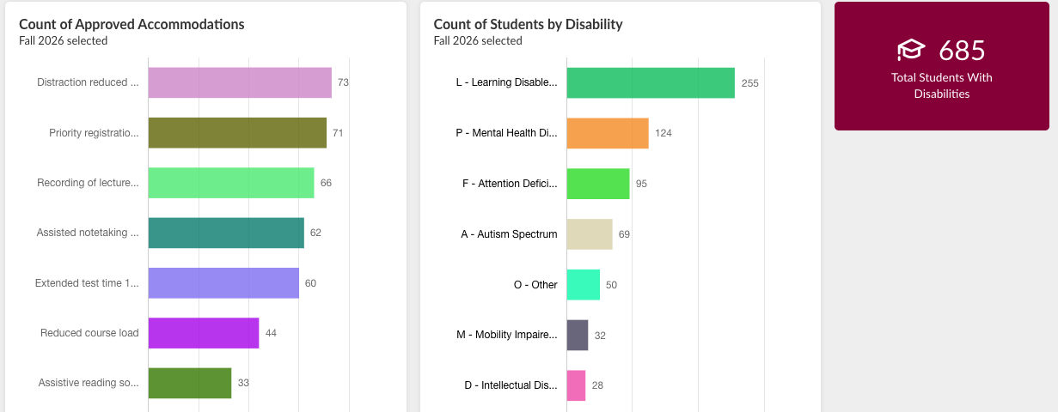
Totals as of 8/19
Notes:
KO

Slide 4
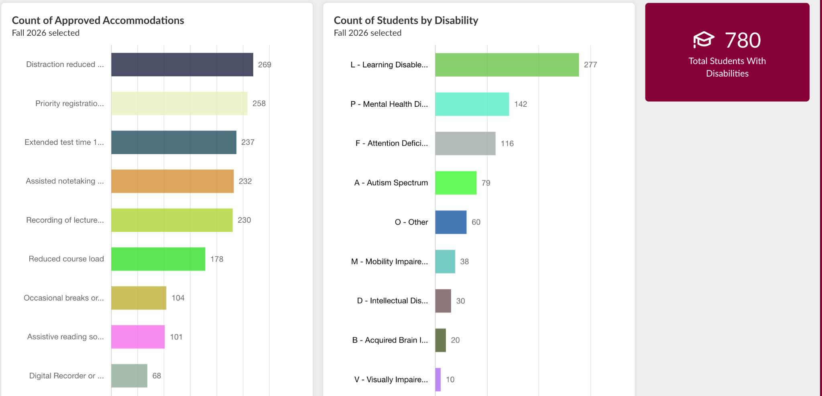
Totals as of 9/16
Notes:
KO

Slide 5

Accommodate: The Faculty Dashboard
Notes:
ER

Slide 6

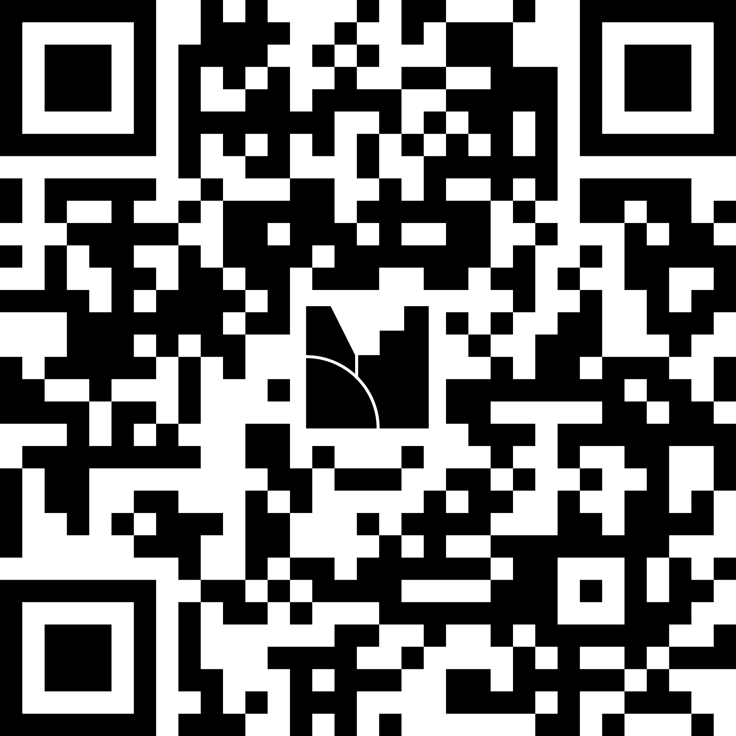
Progress Check

Slide 7
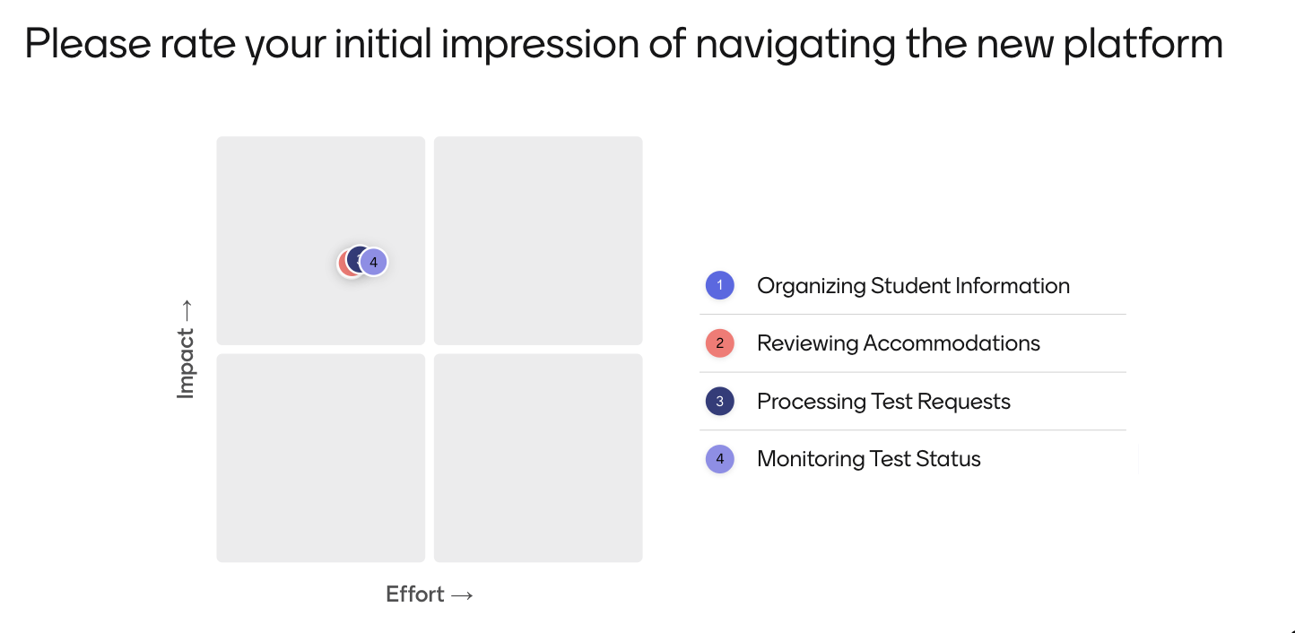
Initial Impressions
Notes:
ER

Slide 8
Ideal State

Slide 9
Questions - Innovations

Slide 10



DSPS Non Generative AI Suite of Tools
Notes:
KO

Slide 11
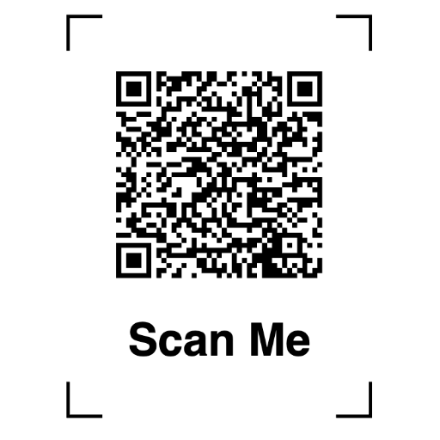
Exit Ticket: Feedback

