Slide 1
Ethnic Studies & Area F
Presented to the Hartnell College Board of Trustees by Hermelinda Rocha , Ethnic Studies Faculty & Gabriela Lopez, Articulation Officer/Counselor
October 19, 2021

Slide 2
Ethnic Studies Timeline
This Moment & Movement
1968 Ethnic Studies- Academic & Community Value
2017 AB 24 Seal of Civic Engagement Passed
2020 Racial Justice Movement/Black Lives Matter
Summer 2020 AB 1460 CSU “Ethnic Studies Requirement” Passed July 2021 CCC BOG “Title 5 Revision” ES Requirement Passed
2021 AB/SB 167 Native American, Vietnamese & Hmong Model Curriculum by 2025

Slide 3
Ethnic Studies Department
Since the early 80’s, Hartnell College has had an Ethnic Studies Department and currently offers 12 courses.
Since Fall of 2018, the college has offered a Social Justice Studies (SJS) degree for transfer. And currently offers three courses under the SJS designator.

Slide 4
Current Hartnell Degree Programs
Ethnic Studies/Social Justice Programs:
AA Chicanx Studies
AA-T Social Justice Studies for Transfer

Slide 5
Hartnell Ethnic Studies Faculty
Ethnic Studies/Social Justice Department Faculty
Hermelinda Rocha Tabera - Full Time Faculty
Alfredo Avila - Adjunct
Dr. Ana Gutierrez - Adjunct
Dr. Nereida Oliva - Adjunct
Luis Juarez- Xago - Adjunct
Phillip Tabera- Adjunct

Slide 6
Ethnic Studies
Hartnell | CSU | UC | High School
Current Requirement Ethnic Groups in the US; standards are set locally AP 4025 | Prior to FA 21, no ethnic studies requirement. | Currently none. | Varies by district. Currently Salinas Union High School district has adopted a requirement.
Title 5 changes approved this summer to require an ethnic studies course; awaiting implementation guidance including revised standards. May require HC to revise current AP. | Effective Fall 2021, per AB 1460: Required as part of CSU General Education Pattern also referred to as Area F. | Anticipated guidance and course criteria to be released in Spring 2022. | AB 101 (Medina) would require one-semester of ethnic studies as a graduation requirement commencing with the 2025-2026 school year. (Signed October 8, 2021)
Courses will continue to be reviewed using new Title 5 criteria, and approved locally. | Standards are set by legislation and Ethnic Studies Committee; Courses are reviewed & approved by CSUCO. | Standards will be approved by the IGETC Standards Sub-Committee of the UC Academic Council.Courses will be reviewed & approved by UC & CSU reviewers. | Course must meet model curriculum approved by State Board of Education; an existing ethnic studies course; or a locally developed course that is A-G approved.

Slide 7
Other things to consider
University of California is considering their own ES requirement for IGETC. This will be discussed this fall. Implementation is planned for Fall 2023.
Title 5 ES requirement has been approved and we are waiting guidance on implementation.
Goal will be to review all of the requirements and discuss the possible alignment of all three to streamline the process for our students.

Slide 8
AB 1460-CSU Ethnic Studies
Commencing with students graduating in the 2024–25 academic year, the California State University shall require, as an undergraduate graduation requirement, the completion of, at minimum, one three-unit course in ethnic studies.
It is the intent of the Legislature that students of the California State University acquire the knowledge and skills that will help them comprehend the diversity and social justice history of the United States and of the society in which they live to enable them to contribute to that society as responsible and constructive citizens.
Education Code Section 89032

Slide 9
AB 1460
In general, any student who begins work at either a CCC or CSU in fall 2021 and beyond will be required to complete the new general education requirements.
Students who began at a CCC or CSU prior to fall 2021, and maintained continuous enrollment, will not be held to the Ethnic Studies requirement due to their pre-2021 catalog rights.
CSUCO Implementation Guidance Memo dated 8/31/2021.

Slide 10
Core Competencies
Courses that are approved to meet this requirement shall meet at least 3 of the 5 following core competencies. Campuses may add additional competencies to those listed.
Analyze and articulate concepts such as race and racism, racialization, ethnicity, equity, ethno-centrism, eurocentrism, white supremacy, self-determination, liberation, decolonization, sovereignty, imperialism, settler colonialism, and anti-racism as analyzed in any one or more of the following: Native American Studies, African American Studies, Asian American Studies, and Latina and Latino American Studies.
Apply theory and knowledge produced by Native American, African American, Asian American, and/or Latina and Latino American communities to describe the critical events, histories, cultures, intellectual traditions, contributions, lived-experiences and social struggles of those groups with a particular emphasis on agency and group-affirmation.

Slide 11
Core Competencies
Critically analyze the intersection of race and racism as they relate to class, gender, sexuality, religion, spirituality, national origin, immigration status, ability, tribal citizenship, sovereignty, language, and/or age in Native American, African American, Asian American, and/or Latina and Latino American communities.
Critically review how struggle, resistance, racial and social justice, solidarity, and liberation, as experienced and enacted by Native Americans, African Americans, Asian Americans and/or Latina and Latino Americans are relevant to current and structural issues such as communal, national, international, and transnational politics as, for example, in immigration, reparations, settler-colonialism, multiculturalism, language policies.
Describe and actively engage with anti-racist and anti-colonial issues and the practices and movements in Native American, African American, Asian American and/or Latina and Latino communities and a just and equitable society.

Slide 12
Area F
Course must have ethnic studies prefix
Course may meet this requirement if cross-listed with an ethnic studies prefix
Course must have at least 3 of 5 ethnic studies core competencies.
Course has special focus on one or more historically defined racialized core groups: Native Americans, African Americans, Asian Americans, and Latina/o Americans
Focus is on ethnic studies foundations, concepts and theories

Slide 13
Ethnic Studies Courses
New Course
Existing Course being revised to meet Area F
ETH 21 Intro to African American Studies
ETH 1 Intro to Ethnic Studies
ETH 3 Intro to Chicanx Studies
Courses in Development
Approved for Area F
ETH 4 Chicano Culture
ETH 56 Ethnic Studies Cinema
ETH 13 Intro to Native American Studies
ETH 6 Intro to Asian American Studies

Slide 14
Implementation Timelines
Current and existing HC courses will be revised in Fall 2021
Submitted for review in December 2021
Decisions will be made available in late Spring 2022 and will be effective Fall 2022. Although, discussions indicate that approvals will be retroactive to Fall 2021.

Slide 15
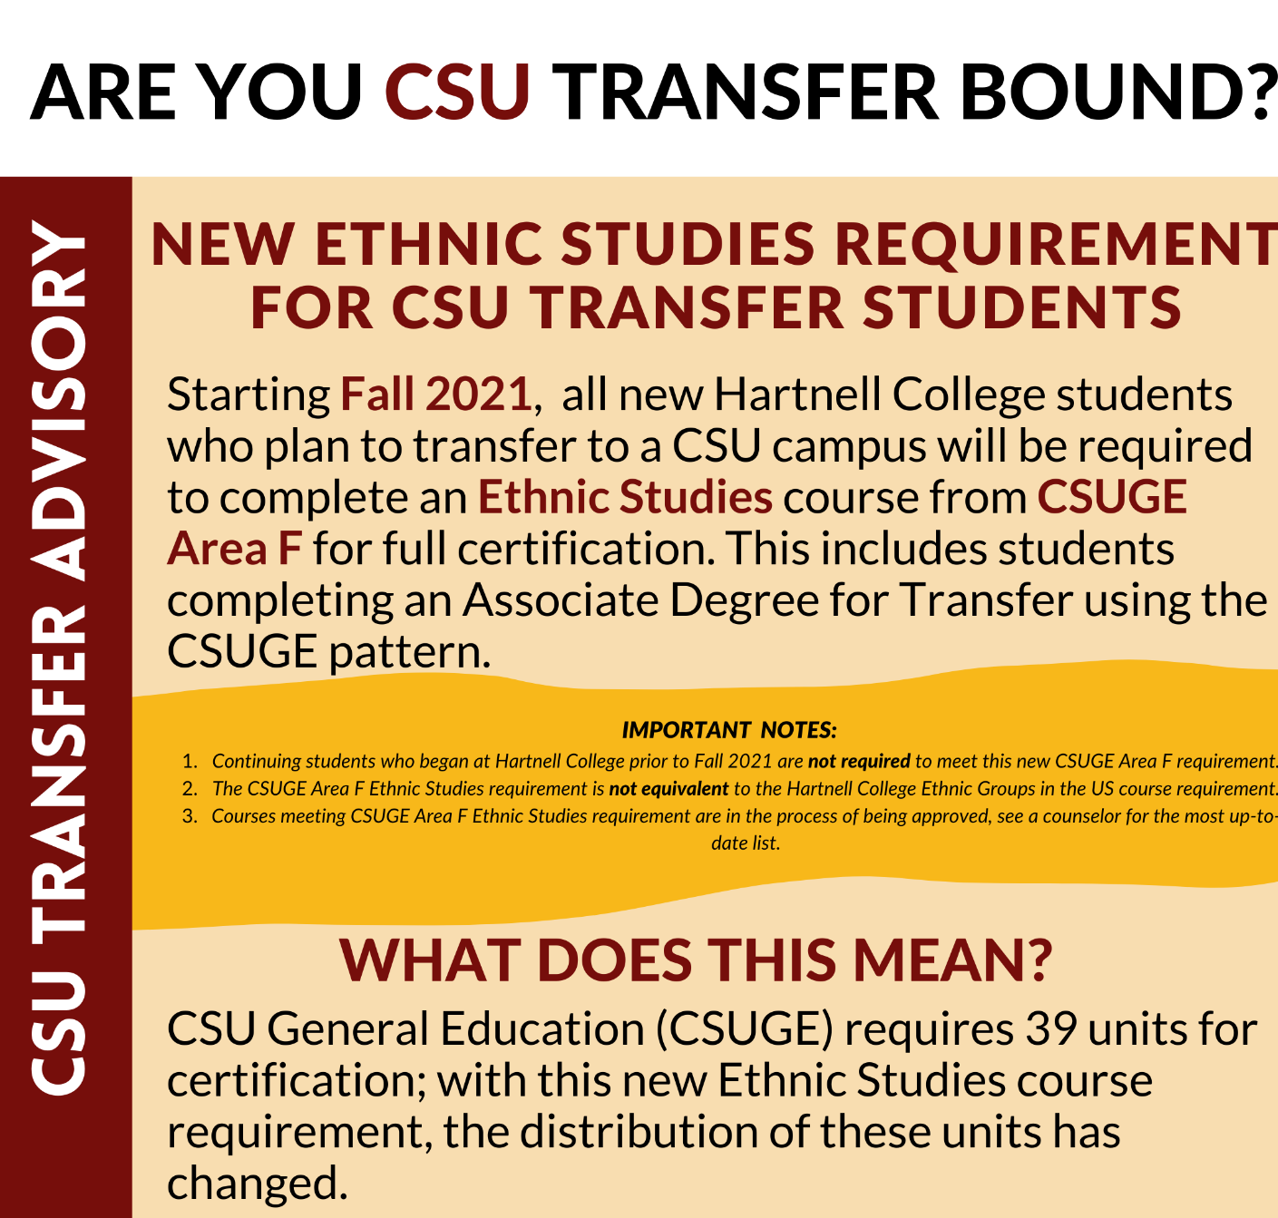
Communication to students
Infographics
Updated GE sheets
Program Maps
Catalog
Social Media

Slide 16
State-level Hartnell Faculty Participation
Hermelinda Rocha, Full Time Ethnic Studies Faculty was appointed to the statewide ASCCC Diversity & Equity Committee in August 2021. In addition, she serves on the Statewide Review Committee for Social Justice Curriculum.

Slide 17

Conference
“Liberation through Education”
Established 2019
Salinas Valley Ethnic Studies Collaborative
Mission: Through a critical and culturally responsive approach that values humanity, equity, and inclusion, we will cultivate a community of practice throughout systems of education and community partnerships in Monterey County centered on promoting and developing the academic, civic engagement, and advocacy that will transform and sustain our communities.
VISION
Develop and support homegrown scholar activists and community-centered professionals who will increase and revolitionalize educational social, political, economic, and health outcomes.

Slide 18
Salinas Valley Ethnic Studies Collaborative
2021- Salinas Valley Ethnic Studies conference
September 17 & 18
2020- Salinas Valley Ethnic studies Curriculum exchanges
2019 Xito- Xicanos Institute training for organizers and teachers: Planting the seeds
Members: Hermelinda Rocha, Phillip Tabera, Xago Luis Juarez, Laurencia Walker, Dr. Ana Gutierrez, Dr. Andrew Soto, Jason Agpaoa, Olivia Davalos

Slide 19
High School ES Requirement
Statewide Ethnic Studies requirement recently signed into law (AB 101), but locally Salinas Union High School District has already adopted an ES graduation requirement.
This is an opportunity for collaboration between Hartnell & local high school districts via concurrent/dual enrollment.

Slide 20
Opportunities
Examining local equivalency process for Ethnic Studies.
Hiring two additional FT Ethnic Studies faculty.
Identifying and recruiting potential local faculty.
Continuing to engage local educators through conference work to promote the and support the ES discipline.
Developing additional Ethnic Studies transfer degrees.

