Slide 1


Hartnell and the AI Overlords
Prof. Steve Lisowski, MSN, RN
Senator, Health Sciences,
Academic Senate, Hartnell College
AI Liaison,
Academic Senate, Hartnell College
Member, AI Council,
California Community Colleges Chancellor’s Office
Member, AI Caucus,
Academic Senate, California Community Colleges

Slide 2

CCCCO AI Micro Site Hub

Slide 3
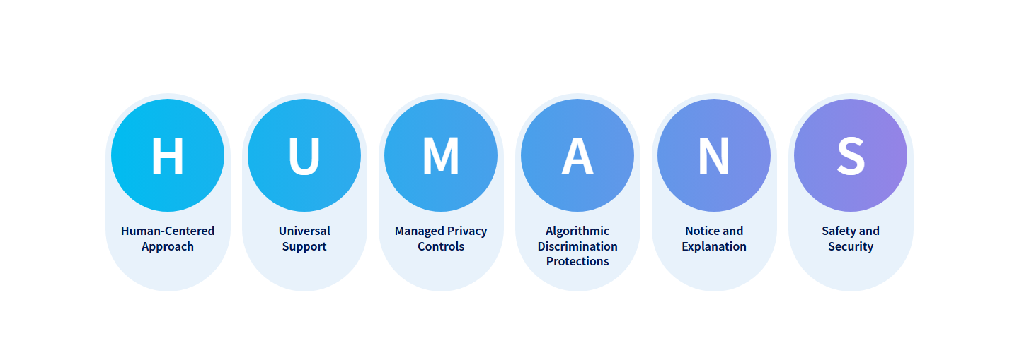
CCCCO AI Micro Site Hub

Slide 4
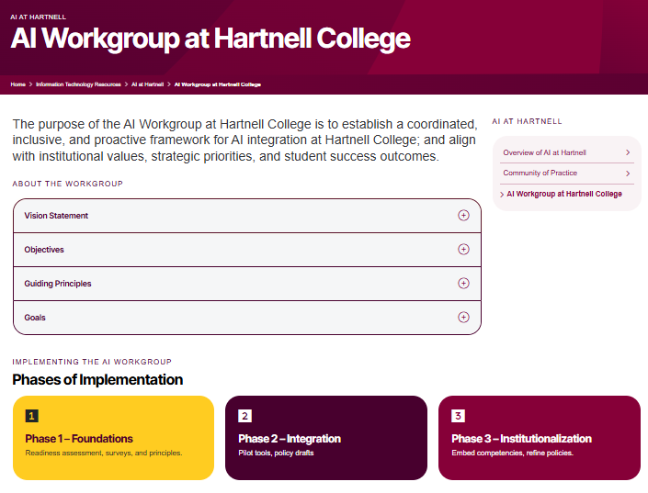
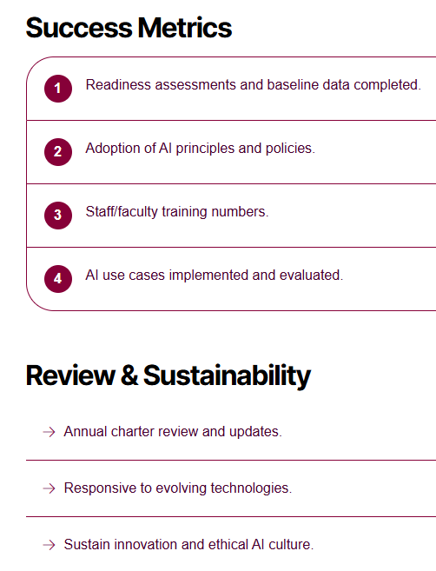

Slide 5
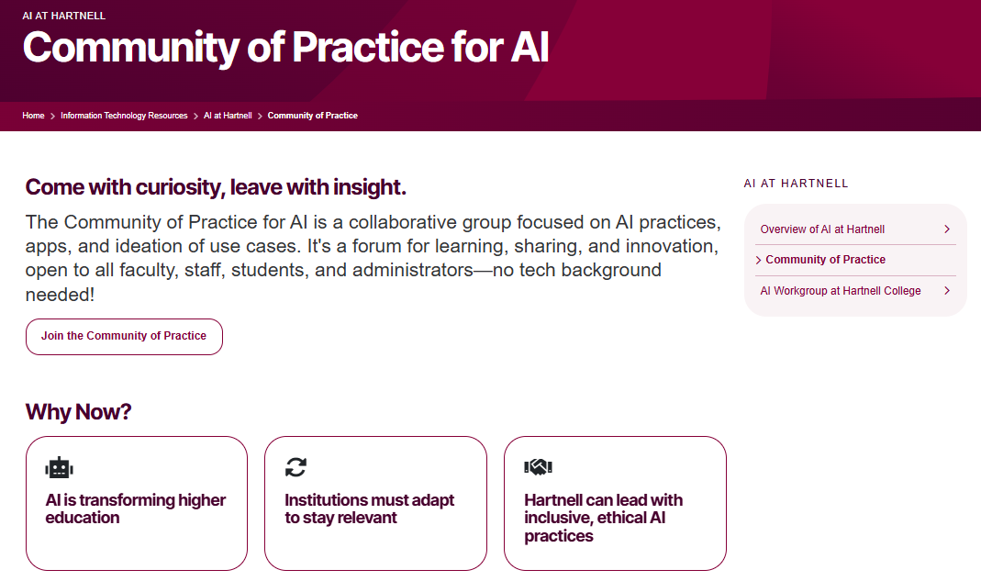

Slide 6
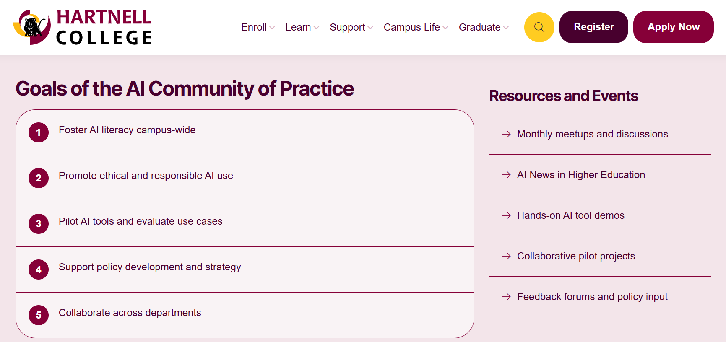

Slide 7
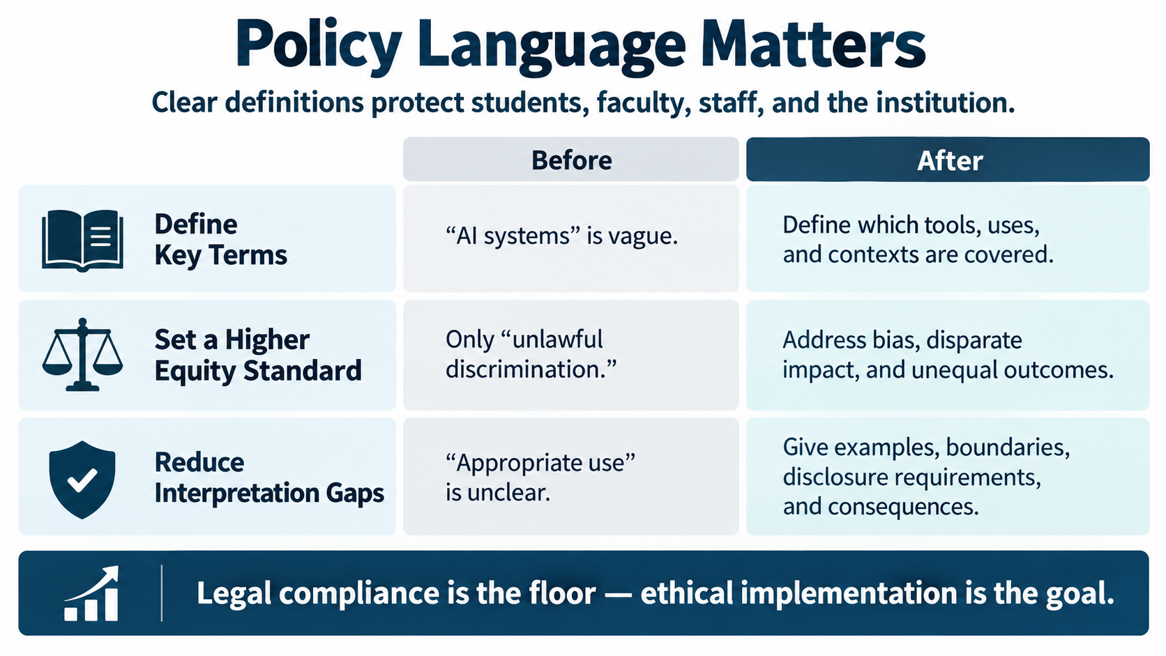

Slide 8
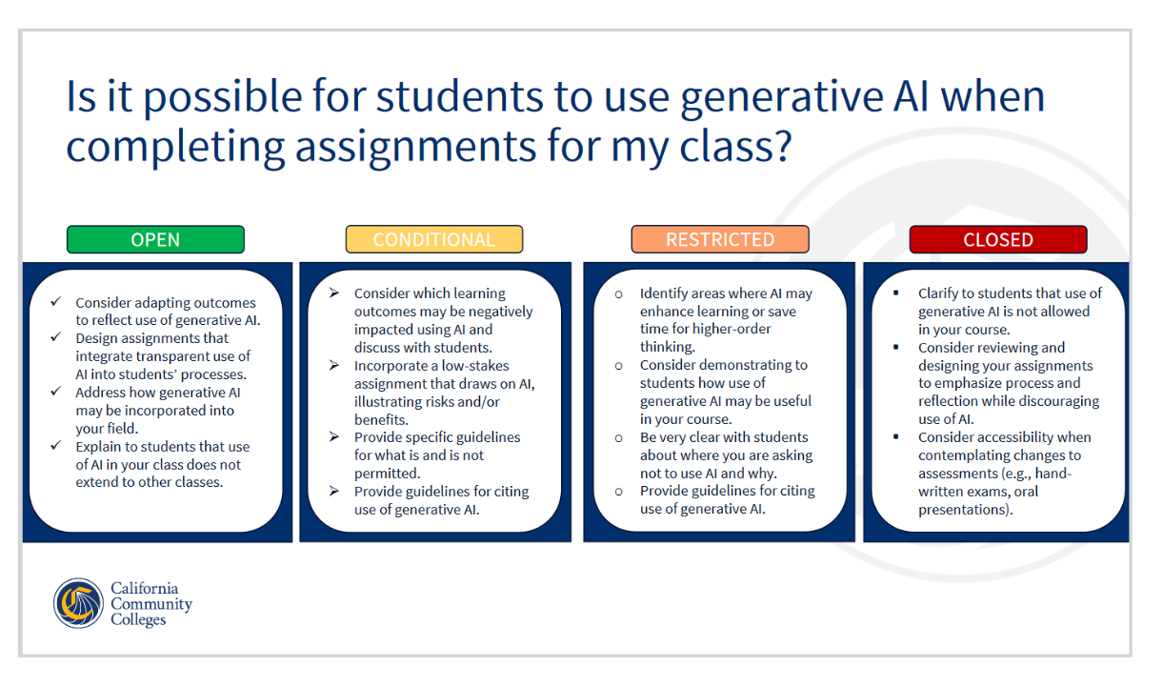

Slide 9
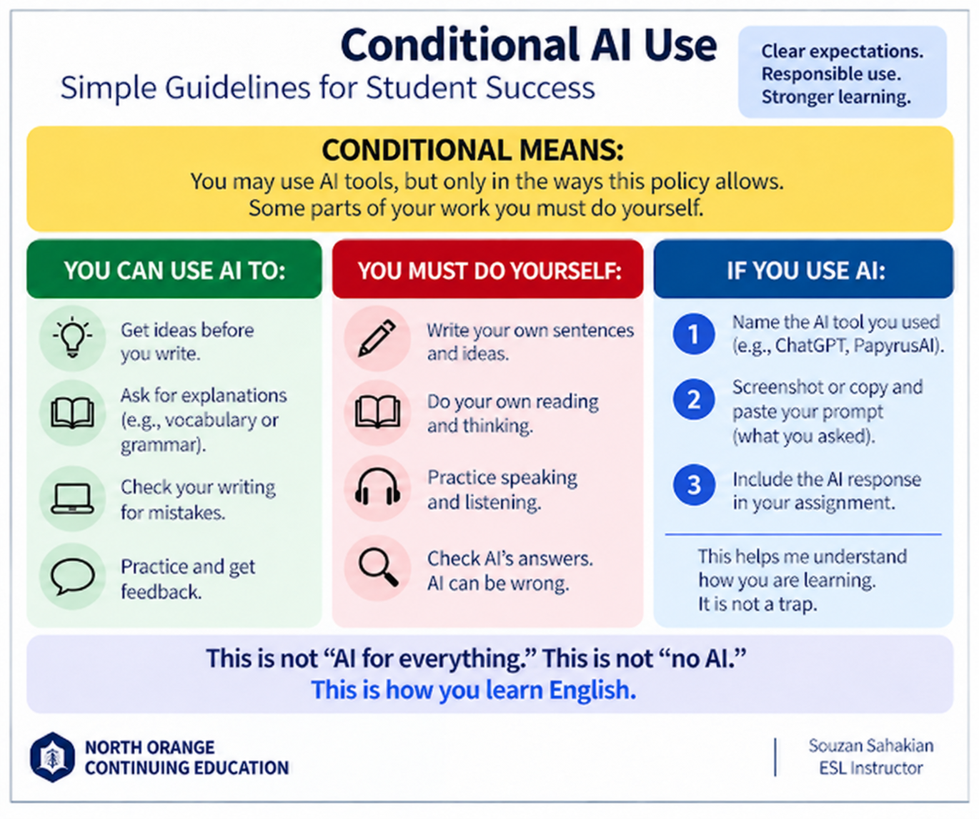

Slide 10
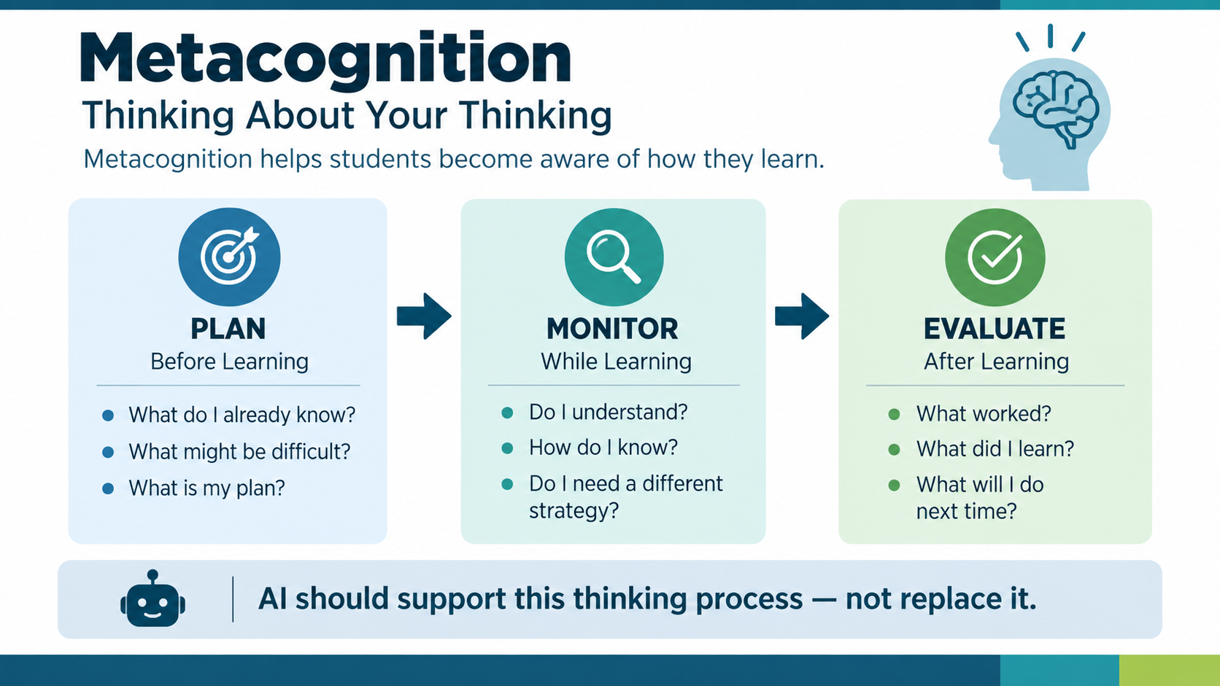

Slide 11
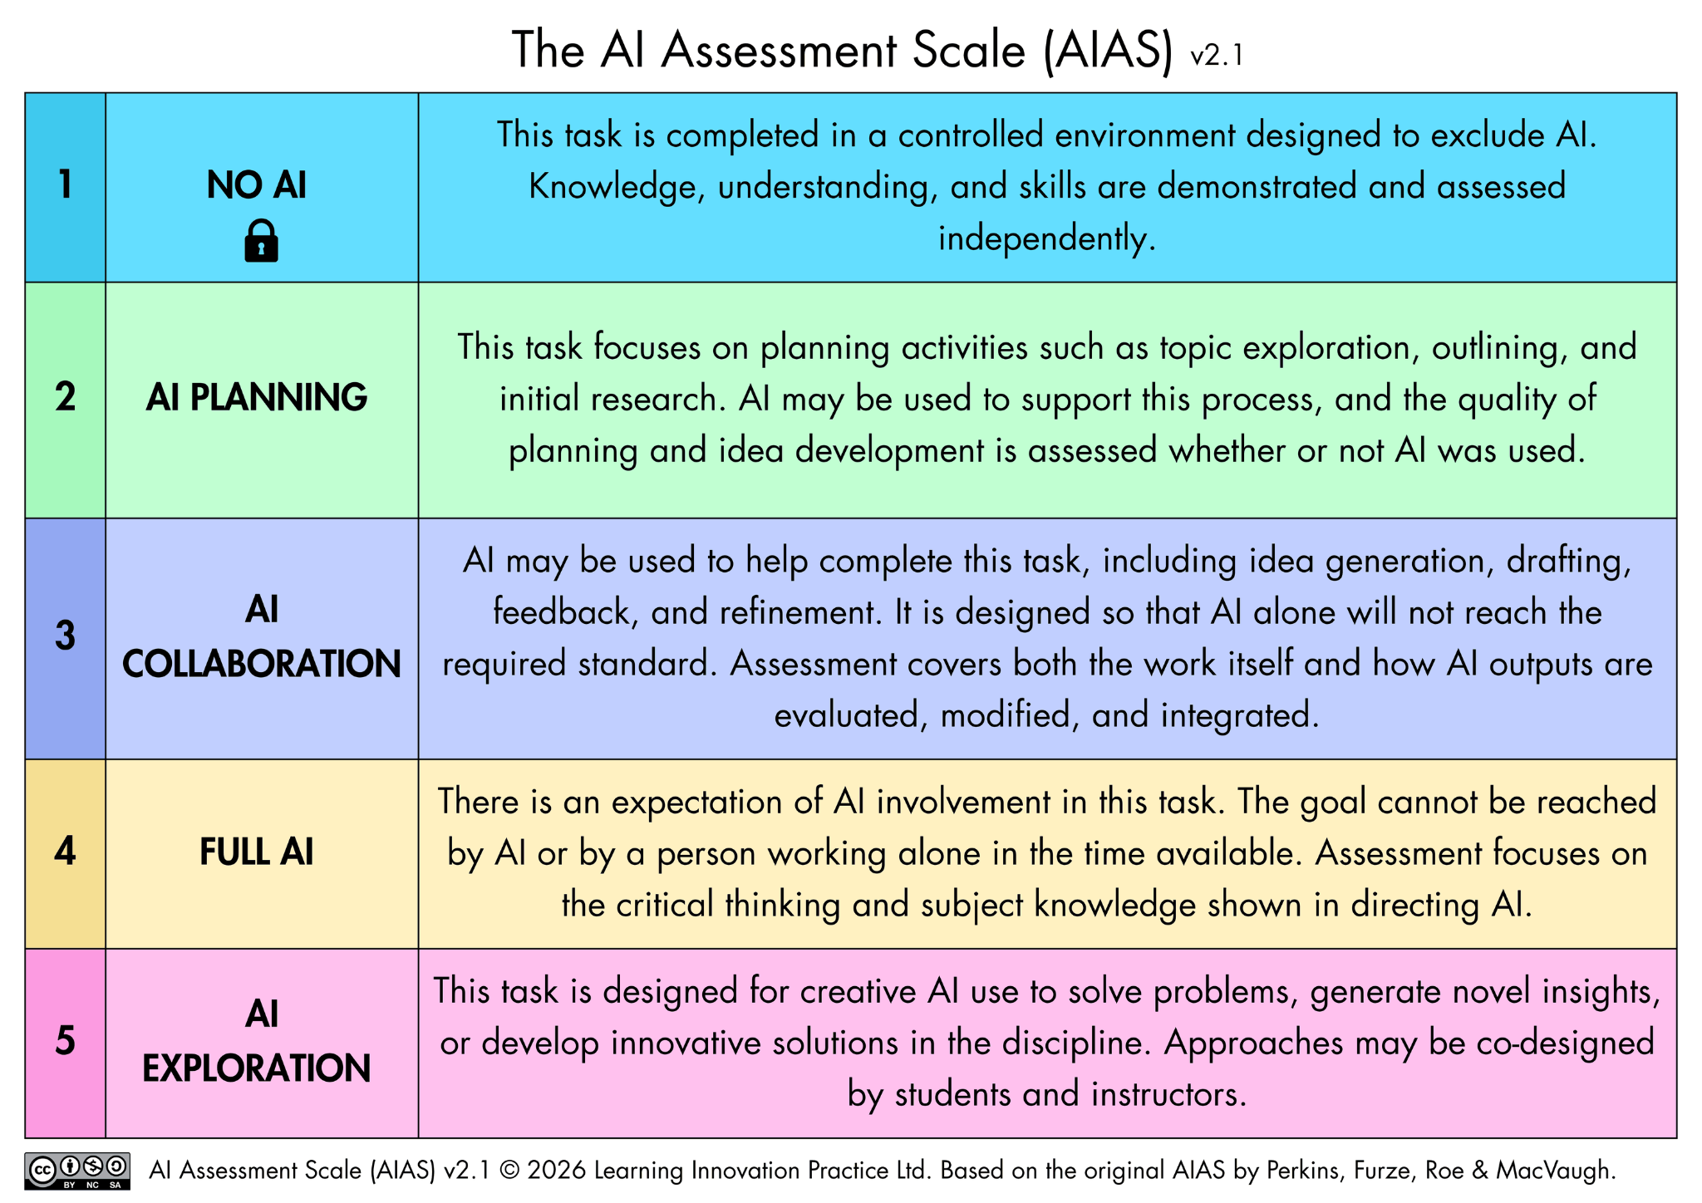
AI Assessment Scale [Learning with AI]
aiassessmentscale.com

Slide 12

Teaching Critical AI Literacy: Empowering Students
for a Digital Democracy
“with
civic engagement strategies includes creating
  digital media content as part of
  project-based learning (PBL),
  Universal Design for Learning (UDL), and
  culturally relevant and critical digital pedagogy.”
-Elemen (2024) Literacy Today Magazine, International Literacy Association
Critical AI literacy: the capacity to analyze, critique, and transform AI’s critical implications; disrupt inequities, consider multiple viewpoints, focus on the sociopolitical, and take action (Veldhius, et al., 2025)

Slide 13
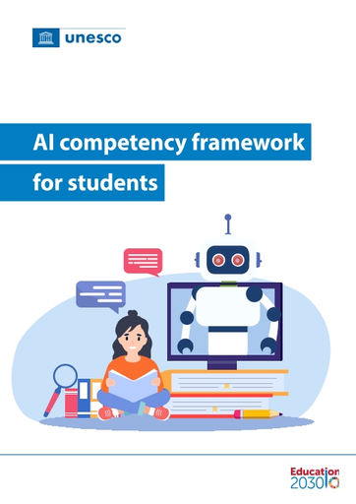
AI Competency Framework for Students
"students as AI co-creators and responsible citizens… emphasizes critical judgement of AI solutions" (p. 3)
Ethics of AI - Embodied Ethics: …potential impact of AI on human rights, social justice, inclusion, equity and climate change within their local context and with regard to their personal lives…
Do no harm
Proportionality
Non-discrimination
Human determination
Transparency: advocating for the rights of users to understand AI operations and decisions

Slide 14
Other Resources and Memos/Notes
AS Convening 4/25 on AI (Hartnell)
AI in Teaching and Learning Frameworks 8/26 (CCCO)
AI Literacy Memo 2/26 (CCCO)
Google Notebook (In progress)

Slide 15


Hartnell and the AI Overlords

