Slide 1
Matthew Trengove, PhD., Layheng Ting, PhD.
Results from:
Promoting Organizational Success Student Surveys (2020SP & 2021SP),
Student Services Survey, and
Stop-Out Student Survey
Institutional Research
March 17, 2021

Slide 2
Key Objectives & Findings of the Surveys
Key Objectives:
Determine whether students have adapted to online instruction and/or services
Support our students as they navigate these changes
Explore reasons that students stop-out (i.e., no classes for two primary semesters)
Present a fairly comprehensive profile of student experience over the past year.
General Findings:
Students have adapted to online format and overcome obstacles like internet reliability and/or computer access.
Students are satisfied with the support services provided by Hartnell, given increased satisfaction.
  Financial Support Services, Instructional Support, and Counseling Support are the top priorities among 2021SP respondents.
Among the biggest reasons for stopping-out was work commitments and/or transfer to another institution.

Slide 3
Survey Demographics
Promoting Organizational Success Student Surveys 2020SP & 2021SP:
  Students enrolled in 2020SP and/or 2021SP classes (excluding JPA)
    Response Rates (2020SP): 14.6% (n=1,276 respondents)
    Response Rates (2021SP): 12.3 % (n=942 respondents)
Hartnell Student Services Survey 2020FA(SS):
  Students enrolled in 2020FA and/or 2021SP (excluding JPA)
    Response Rates: 10.6% (n=1,086 respondents)
Stop-Out Student Survey Spring 2021(STOP):
  Students enrolled in '2019SU', '2019FA', '2019SP', who were NOT enrolled in '2020SU', '2020FA', '2020SP ‘ that are NOT Hartnell employees or those who’ve completed an Award/Certificate
    Response Rates: 4.3% (OR 191 respondents)
The responses were quite extensive, so this presentation targets a cross comparison of shared experiences and/or significant changes over time (e.g., 2020SP – 2021SP).
  We’re provided a flat file for those who want to dig into the data.
  Responses were anonymous so we can’t follow-up or disaggregate results

Slide 4
KEY FINDINGS
Responses on the switch to online-only classes were overwhelmingly positive:
77.0% said that it has been “easy” or “not bad” to adapt to online courses (POS21 Q1), a 2.1 % increase from 2020SP survey
76.1% respondents say the shift to online courses has not affected their communications and/or interactions with other students/classmates (POS21 Q5), a 0.5% increase from 2020SP survey.
73.1% of respondents say their communication with their instructors has gotten easier or been about the same over since the shift to online courses (POS21 Q6), with a 49.8 % increase in respondents who said their communication with their instructor had gotten easier (p<0.001, n=417)
A small percentage of 2021SP respondents (19.6%, n=144) had issues accessing course materials (POS21 Q13), essential services (9.4% , n=69,POS21 Q14) (p<0.05), and/or course assessments (18.2%, n=134, POS21 Q15). Independent T-test suggests that students had fewer issues accessing essential services this year, when compared with 2020SP respondents.
63% of the Student Services survey respondents prefer online services
41% of Stop Out survey respondents wanted to get an Associates
43% of Stop-Out survey respondents are working full-time
77% of Stop-Out survey respondents don't consult counselors before leaving

Slide 5
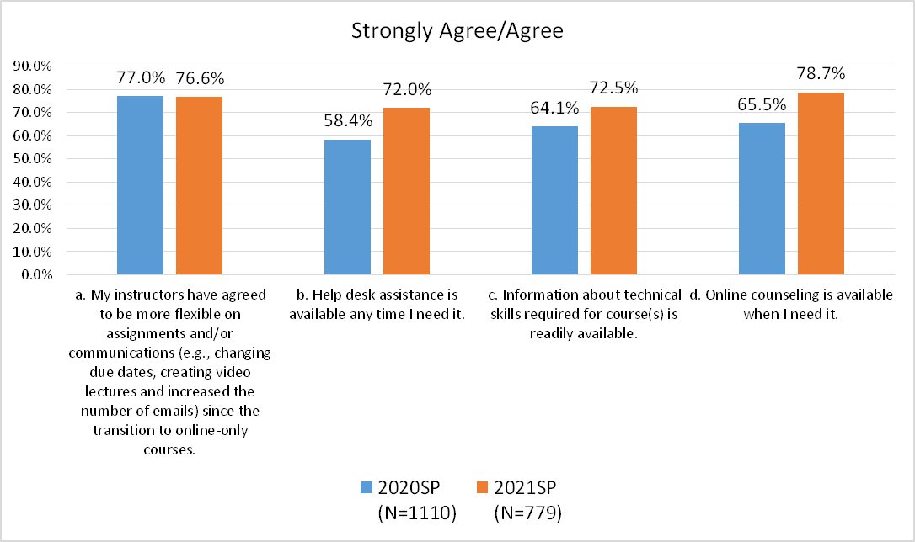
Q4. Please respond to each of the following statements (POS21)
Overall, respondents are satisfied with the support services provided by Hartnell, and the level of satisfaction has increased compared to previous year.

Slide 6
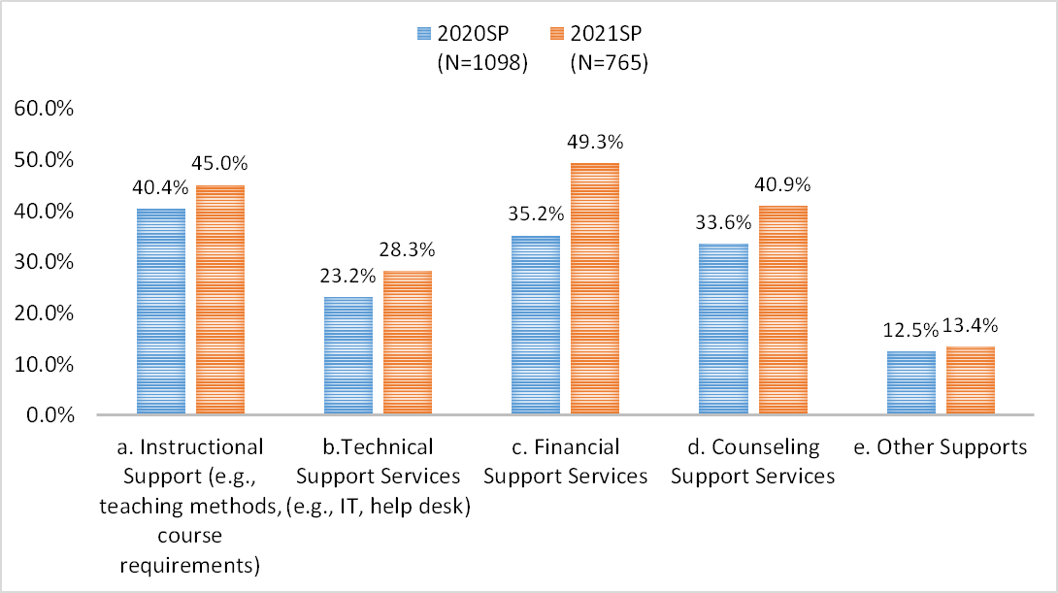
7. What kinds of supports/resources do you need to be successful, now that all courses are online-only? (POS)
Financial Support Services, Instructional Support, and Counseling Support are the most needed services among the 2021SP respondents

Slide 7
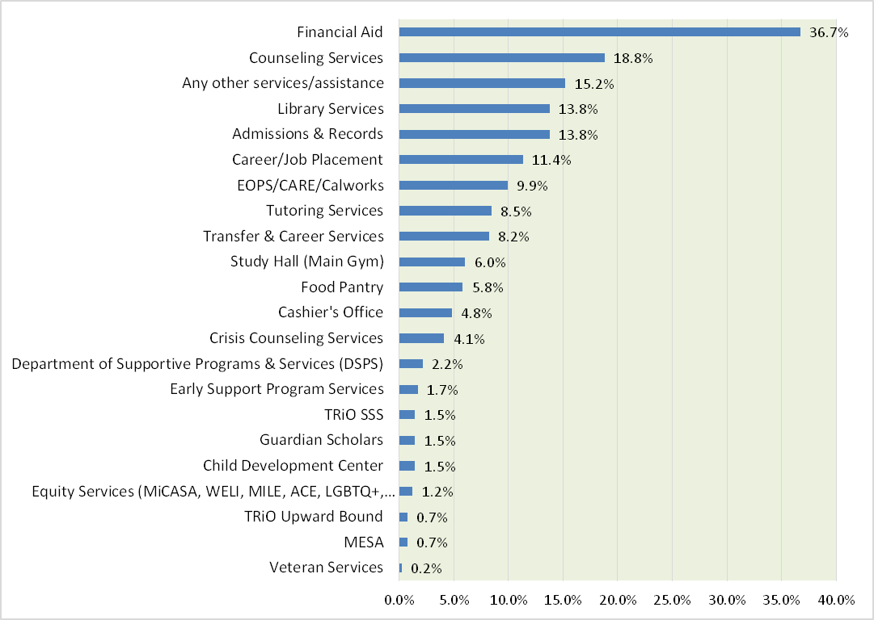
Q3. Are there any services that you need, but have been unable to receive, during the COVID-19 pandemic (select all that apply)? (SS)
N=414

Slide 8
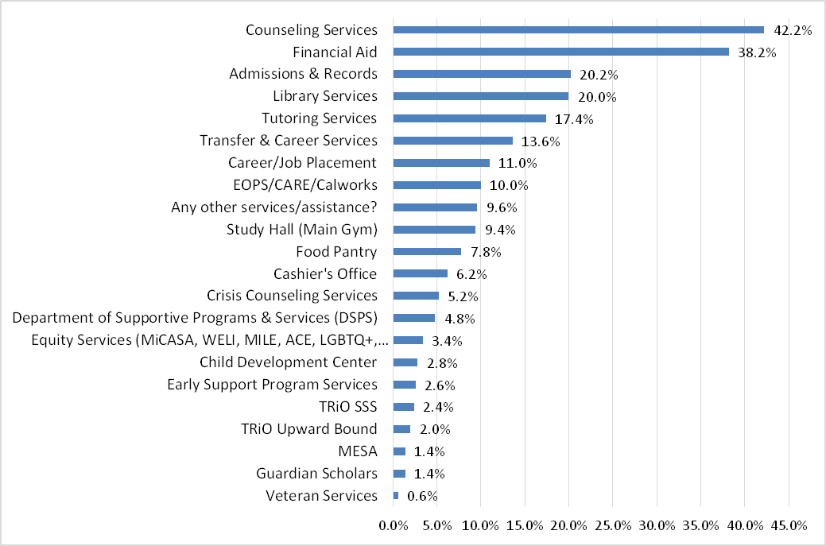
Q4. Are there ANY in-person appointment-only services that you'd like to receive during the COVID-19 pandemic (select all that apply)? (SS)
N=500

Slide 9
Student Services Received
A pre/post ‘Shelter in place’ comparison of service area statistics is difficult given the number of changes that have taken place over the past year (e.g., A&R offered in person and telephone appointments, so emails rare. Financial Aid services were on a “walk-in“ basis, and tutoring services were conducted in person).
A&R/Financial Aid Services
Students can now submit documents, and check financial aid status using their college-issued email address,
correspondence has increased to 18,000 emails, and/or 9,579 phone calls.
Implemented Cranium Café (2020FA only), which served about 600 students for both A&R and Financial Aid.
Implemented a Zoom virtual front desk which has served 1,091 (January - February) and 726 (February - March) students for Financial Aid and/or A&R purposes.
Tutoring Services
Launched canvas button, partnership with math faculty to host Academic Excellence Workshops and increased outreach to students Results of a 7 week comparison:
Fall 2020: August 24 - October 5 Spring 2021: January 25 - March 9
Students: 244, Visits: 973 Students: 364, Visits: 1334
Counseling Services
2019FA 2020FA
Students 16408 Visits 18,286 Students 10908 Visits 16,282
Library Services
2020SP (Jan/Feb) 2021SP (Jan/Feb)
Students 519 Students 319

Slide 10
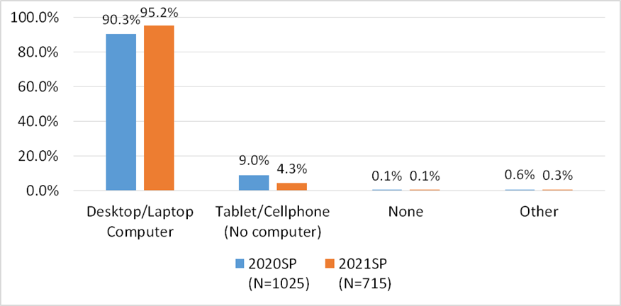
Q19. What kind of computer/technology is available from home (Select all that apply)? (POS)
A large majority of respondents (95.2%) have either a laptop or a desktop, 5.4% increase from last year.

Slide 11
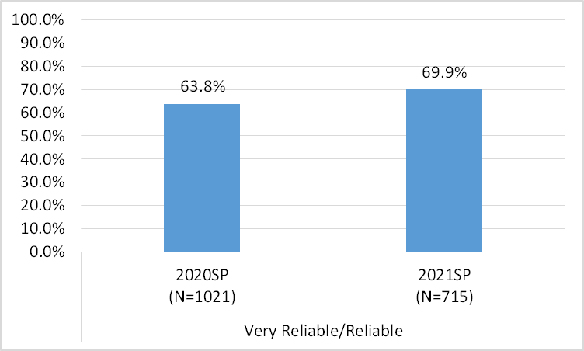
Q16. How reliable is your home internet now that all classes are online?(POS21)
A little over two-third of respondents indicated that their home internet is reliable. Home internet reliability has improved this year.

Slide 12
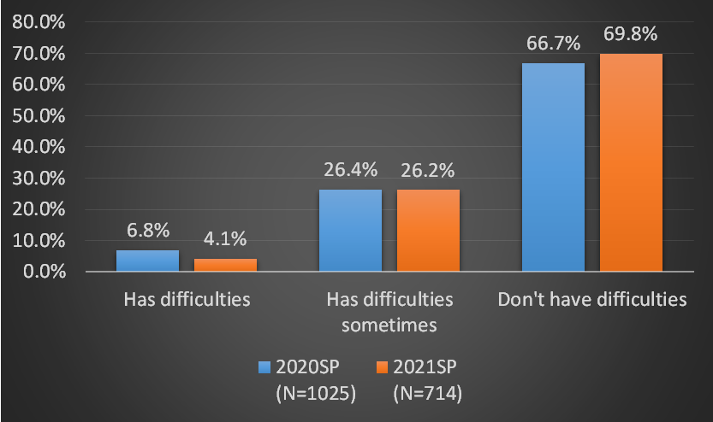
Q18. How often do you have technical difficulties with the Canvas learning management system?(POS)
A small percentage of respondents (4.1%, n=29) always or very often have technical difficulties with the Canvas learning management system, a 40.8% decrease from last year.

Slide 13
20.IS THERE ANYTHING ELSE YOU WOULD LIKE TO TELL US ABOUT THE CHALLENGES YOU HAVE FACED AS WE SWITCH TO ONLINE-ONLY COURSES? (POS)
 | Top 5 Challenges
 | 2020SP (N=265 or 20.8% of all Survey responses) | 2021SP (N=258 or 27.4% of all Survey responses)
Distraction and time management | 1 | 2
Lack of motivation/interest/adaptability | 2 | Not in top 5
Communication (student-student and student-faculty) | 3 | 1
Course instructional method fit | 4 | 5
More work/assignments | 5 | Not in top 5
Internet access | 5 | Not in top 5
Stress/Depression/Mental Health | Not in top 5 | 3
Access to course materials | Not in top 5 | 4

Slide 14
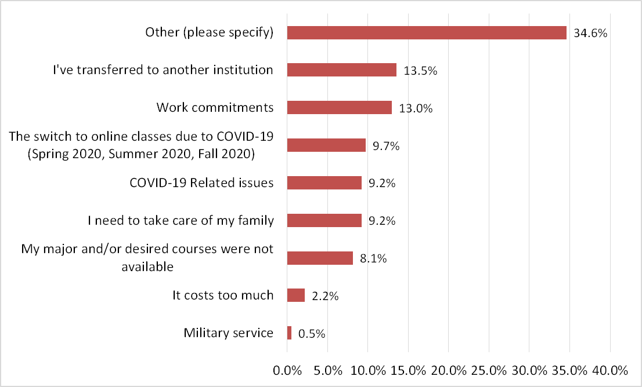

Q3.What is the biggest reason that you're NOT taking classes at Hartnell College anymore? (STOP)
Other (please specify) :
• Graduated/achieved plan (n=8)
• Attend another institution (n=6)
• Work commitment (n=6)
• Relocate (n=S)
• Lack of motivation/interest (n=4)
• Course/program not offered (n=3)
• Stress/depression/mental health (n=3)
• Still in high school (n=3)
• Unable to register (n=3)
• Harassment (n=3)
• Western Stage Theatre is closed. (n=3)
• Family obligations/issues (n=3)
• Have other priorities (n=2)
• Waiting to get to Nursing program (n=2)
• Waste of time (n=2)
• Unclear goal (n=l)
• COVID(n=l)
• Academic Probation (n=l )
• Poor education quality/inconsistent staff
Services (n=l)
N=185

Slide 15
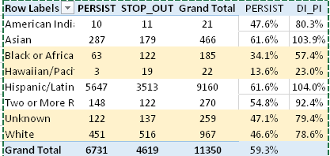
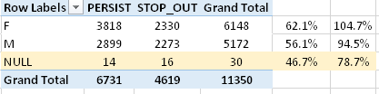
Disproportionate Impact
The persistence of African American, White and undeclared race/ethnicity students were disproportionately impacted (n=4,619). Persistence of Pacific Islanders and Undeclared gender were also disproportionately impacted

Slide 16
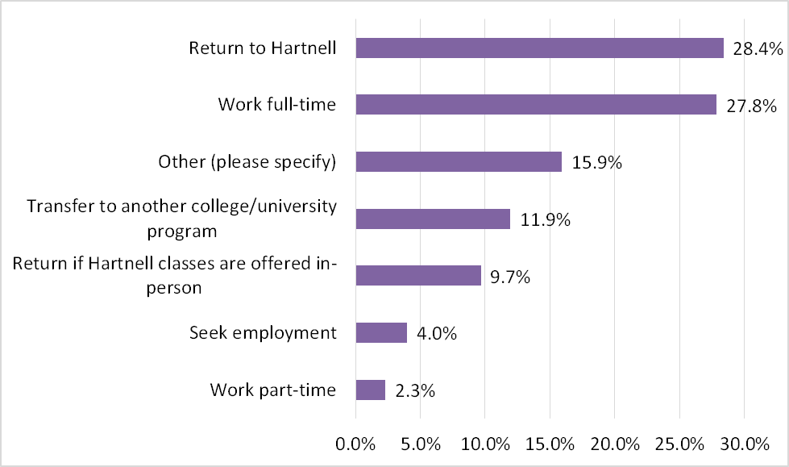
Q7.What are you future plans? (STOP)
N=176

