Slide 1
Matt Trengove
Preliminary results from the 2020SP Student Success Conference Feedback Survey
Institutional Research

Slide 2
Question 1

Slide 3
Question 2

Slide 4
Question 2: Comments
Positive
The speaker this year was wonderful
I always look forward to the keynote speaker!
I think the key note speak timeslot should be used strategically. I really enjoyed the key note speaker but since there was no direct connections made after the presentation the impacts of her presentation is reduced significantly. We are not advancing from these fundamental building blocks..
Keynote speaker with a topic that aligns with the main work that is in progress in the college. The keynote speaker in this student success conference aligned well with work done on parts of college redesign
We should have internal keynote speakers from Hartnell College
Neutral
If the keynote speaker leaves biases out of the conversation (see below).
depends on the fee charged by the speaker and whether the speaker speaks to the main theme of the conference. Not sure what the main theme of this conference was.
Depends on the speaker. If the topic is relevant to all, then have everyone there. If it really is a faculty-geared speaker, don't make the staff sit through that.
Cautionary
Can we bring in "team building" experts and be more interactive together?
Cancel the entire mess and let faculty meet and discuss items relevant to our students and disciplines
effective is setting an agenda/priority for all to work on.
I don't think we need a keynote speaker in most cases. They are very expensive and I would rather use the time to work on things like SLOs, PPA and other activities with my colleagues. Sometimes a keynote speaker can be inspiring, but it should really relate to the other things that we are doing at the college.
No, the keynotes set the direction of the conference. I hope that the faculty and administrators understood Dr. Laura Rendon's plea to validate the students so that the students feel more welcome and encouraged at Hartnell College, especially the first year students.
Time would be more productive in other sessions

Slide 5
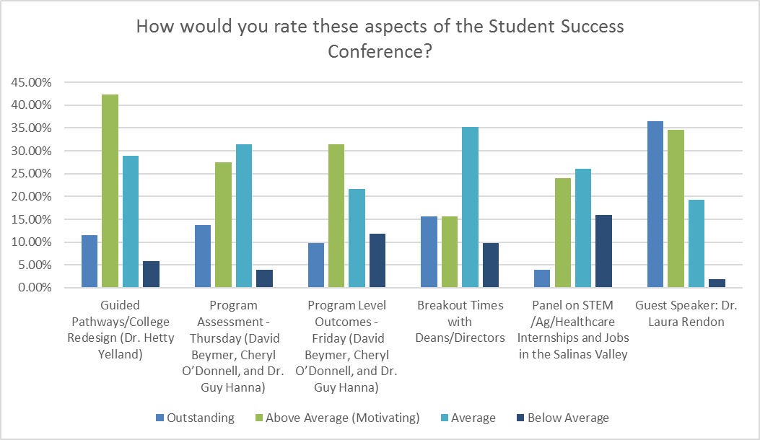
Question 3

Slide 6
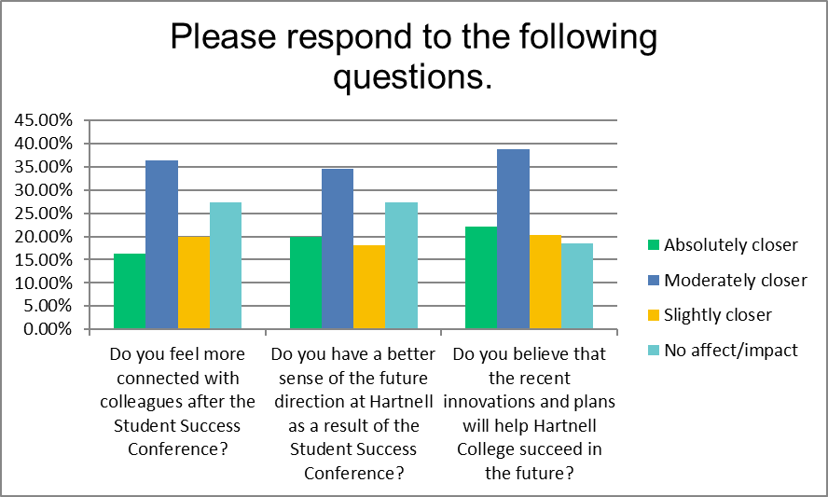
Question 4

Slide 7
Question 5
Do you have any comments, questions, suggestions or concerns about anything you heard/learned at the Student Success Conference, that you'd like to share?
Positive
A great opportunity for campus members to come together. An added benefit - to host when we can close offices to allow everyone to attend.
It was great that the president took the time to humanize hereself to the college community. It is inspiring to see her take the time to do that.
Thank you for allowing classified to attend. I found it beneficial and informative.
Please bring Dr. Laura Rendon, her motivational speech was outstanding!
Future Development
Most breakout sessions were exercises in collaboration only.Substantial information/content should be presented too.
Each breakout session was too long. Better to have shorter and more variety of workshops.
End the pointless meetings. We need to focus on relevant issues. In service is a total waste of time. Why does the college think bullshit meetings actually matter? Stop taking attendance and let faculty decide whether to attend. If these meetings were actually relevant we wouldn’t be forced to attend. Total bs.
No guest speaker. Were we required to buy/dispense her book as part of her speaking engagement? I hope not.
I didn't understand the panel on STEM and ag/healthcare. Most of us don't work in these areas. I could see where a panel like this could be useful to students, but I don't understand the relevance for faculty.
If these aren't going to be relevant, and they haven't for years, lets get rid of them and spend the time more productively. Also, sick of the doom and gloom speech by the president. It wasn't honest and what about something positive. Flex activities are not productive.

Slide 8
Question 5 (Cont.)
The student success conference is used for so many tasks other than increasing our knowledge of student success that it kind of gets lost. If the administration needs faculty to meet with their deans then that should be on a separate day. There should be a day for administrative tasks (Friday) and a day for student success (Thursday). There should be one day solely dedicated to student success advancement. The presentation should be screened for preparedness. Presenters need to provide quality presentations. This should not be a summary of tasks that we did in the last year, but to gather critiques, questions, and alternate perspectives. There needs to be a time where faculty, staff get to work with colleagues they do not see everyday. so many moving parts that it
There is always too much packed into these events and I feel not enough time and attention are paid to serious issues that impact students' and their success.
These types of events should include more interactive time shared between Student Affairs and Academic Affairs. Convocation seems to mostly herd staff and faculty between lecture halls--this seems like a missed opportunity to create collaboration and strengthen scalability of services that cannot be delivered without teamwork. More/new initiatives usually bring more work and little or no man-power to support it. We have got to work together to leverage our limited man-power to ensure we successfully meet our objectives as an institution. Communication is the famous "key" element in all successful relationships, we should strive to keep it as a priority between divisions' frontliners (i.e.,not just management).
They were some breakout sessions with the topics are based on deficit discourse and putting the blame on the students. Those should be unacceptable for an institution that is focused on student success and wants to be student-centric. Please no session that talks negatively about the students.
The main problem I have with most keynote speakers is the premise that Caucasian faculty are not capable of meeting the needs of the non-white students. I feel this is a huge disservice that fosters divisiveness between non-white and Caucasian faculty that trickles down to the student population. I loved how Rick Bennett explained Fiscal Reality. This is the first time a person explained it in an easy to understand way. I enjoyed the Program Assessment where we were divided and not with our discipline (although I wasn't a fan at the beginning). It was great to discuss the questions with others and get their feedback. Chef Ken et al, made delicious meals for us to eat. We really need to incorporate more breaks into the sessions - we don't have our students sitting for that long without them. I know it's difficult to round people back up, but it's not good for people's health to sit that long. The panel on STEM/Ag/Healthcare Internships was really difficult for me to engage in - mostly due to not being able to see the panel. They could have been on raised chairs in order to see them easier.

