Slide 1

Open Educational Resources and Low-cost resources at Hartnell College
Overview and Resolution 21-1
Notes:
NOTE:
To change the image on this slide, select the picture and delete it. Then click the Pictures icon in the placeholder to insert your own image.

Slide 2

An Open Educational Resource:
Is no-cost and openly licensed, often using creative commons licensing;
Can be downloaded as a resource and shared;
Can be downloaded, edited, and reposted.

Slide 3
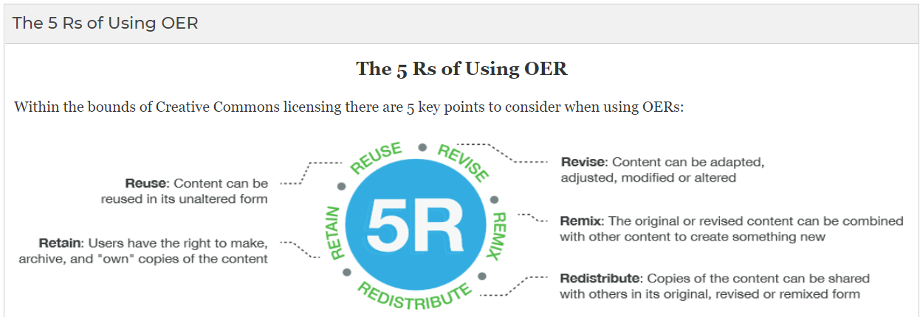
OER is subject to the 5 Rs:

Slide 4
Low-Cost textbooks:
Are textbooks that cost between 1 cent and $40;
Defined by the Academic Senate in Resolution 19-3.
Both our local Senate and the ASCCC call for identification of course sections that have adopted Low-Cost textbooks in the online course schedule.

Slide 5
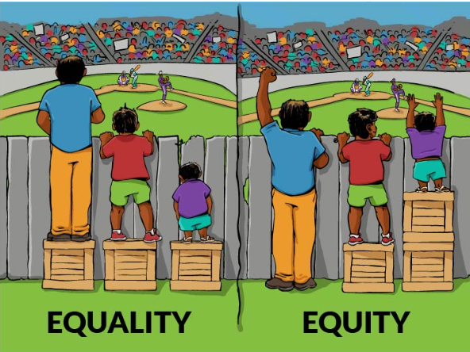
OER and Low-Cost resources support equity for students:
Statistical analysis reveals that textbook prices are a significant educational barrier for all students, with a disproportionately negative effect among racial/ethnic minorities, low-income students, and first-generation college students.
It is our responsibility as faculty to remove any unnecessary financial barriers to academic success, and to ensure that our students’ learning potential is never limited by their purchasing power.

Slide 6
Student survey results, 117 responses (2021):
38.8% of students pay $200 for textbooks each semester, and 78.4% also have to purchase a textbook supplement;
32.5% of students have dropped a class because they could not afford the textbook;
50.9% of students have avoided carrying a full load (12 units) because they could not afford the textbooks;
99.1% would choose a course that adopted a free or Low-Cost textbook over a course that did not;
77.8% of students say it is not easy to find courses that adopted free or Low-Cost textbooks in the online course schedule.

Slide 7
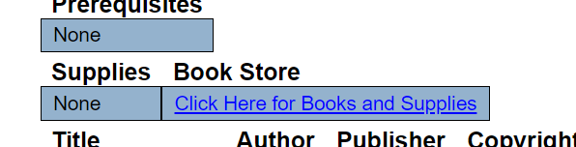

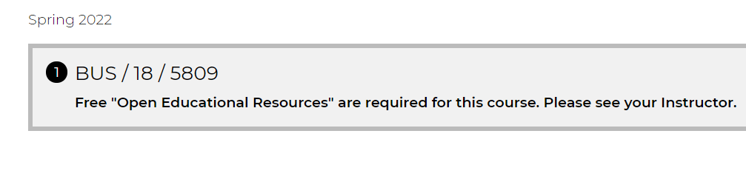
Current situation with PAWS and ZTC sections:
PAWS ZTC:

Slide 8
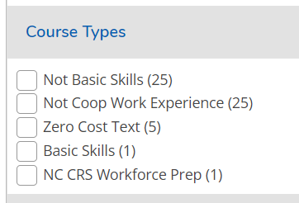

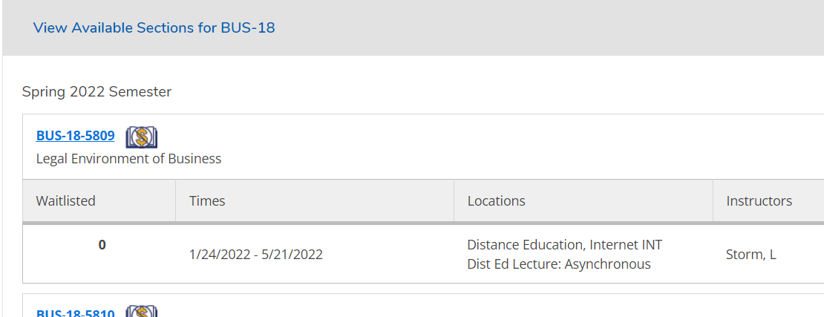
Current situation with PAWS self-service and ZTC sections:

Slide 9
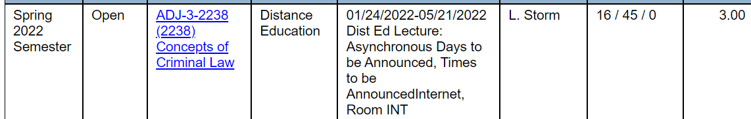
Current situation with PAWS and Low-Cost:

Slide 10

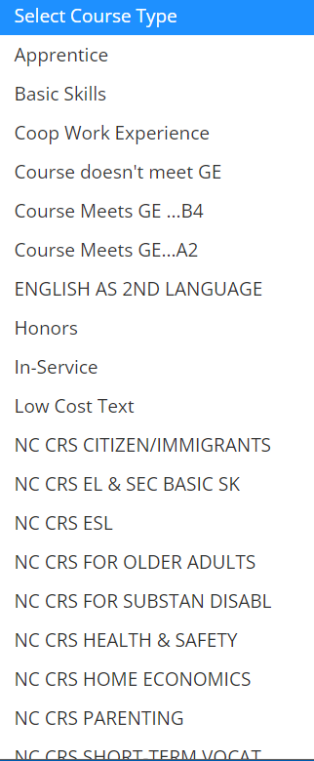
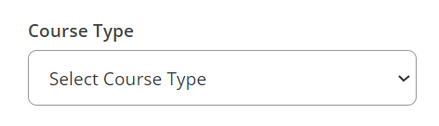
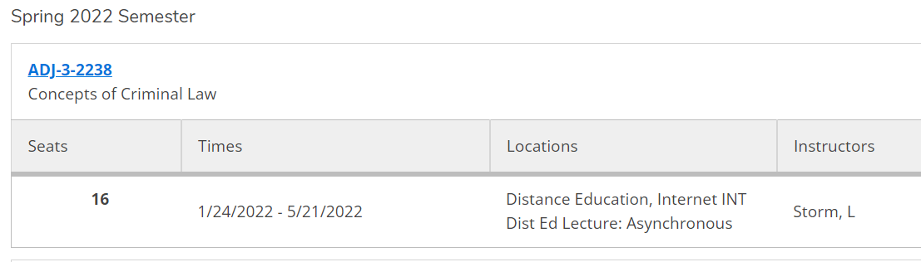
Current situation with PAWS self-service and Low-Cost:

Slide 11
Improvements requested from Dean/ITR:
Since PAWS self-service will be the new online schedule (PAWS is being discontinued), focus is on PAWS self-service;
Best solution: development of a second, Low-Cost logo;
Video posted on PAWS self-service log-in page about how to search for Low-Cost sections using advanced search;
New web-page devoted to affordable textbook options;
Banners advertising both ZTC and Low-Cost sections on the homepage.

Slide 12

Suggested improvements to planning process (Deans/ITR):
Add a line to the scheduling spreadsheet for textbook adoption, either ZTC or Low-Cost;
Allow faculty to “opt out” of designated ZTC or Low-Cost textbook adoption instead of having to “opt in” every semester;
Bookstore database created.

Slide 13
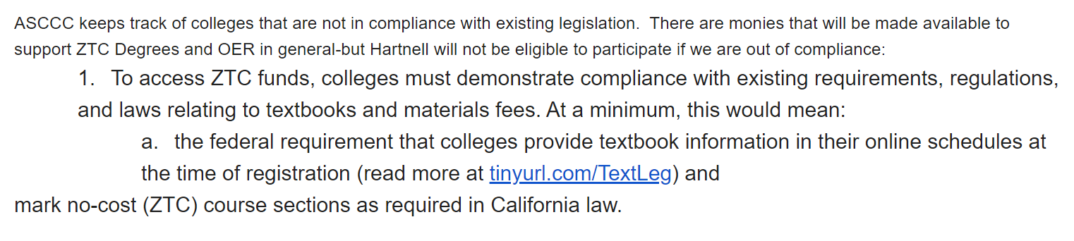

Governor Newsom has made $115 million available to support lowering textbook costs for students:

Slide 14

ASCCC recommends a local resolution supporting OER/LCT:
The ASCCC has recommended the below:
"In light of the funds ($115 million) dedicated to furthering the availability of zero textbook cost (ZTC) degrees in the California Community Colleges, faculty at the colleges may be wondering what they should do to prepare their college to access these funds. While the details of the initial disbursement have yet to be announced, there is reason to anticipate that formal support for ZTC will be needed and local senate sign-off will be required. Senates with an interest in getting ahead might want to move forward with a resolution in support of ZTC degrees and begin discussions regarding how to increase the availability of ZTC options at their college."

Slide 15
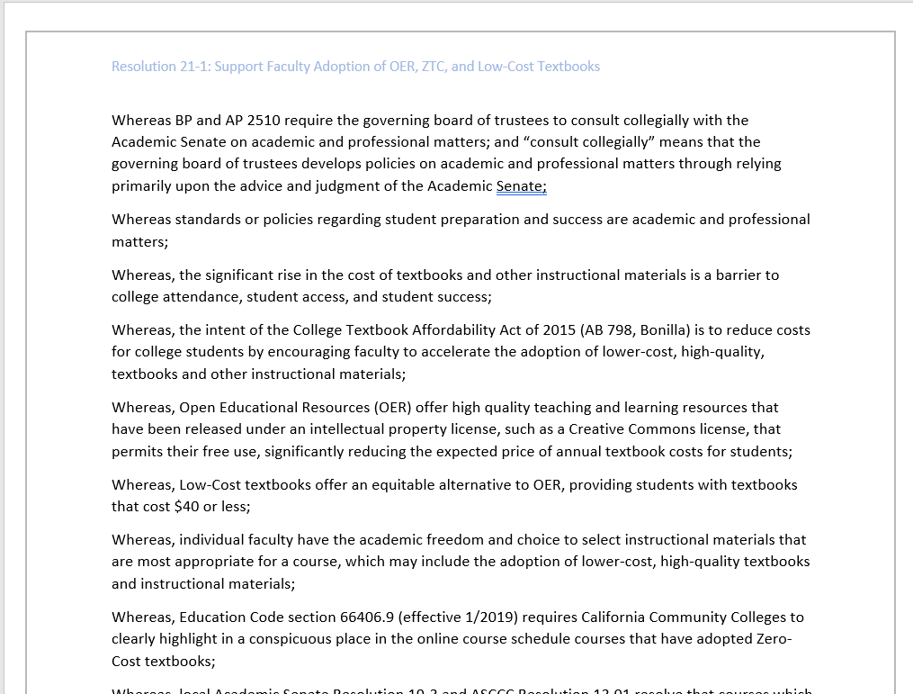
Resolution 21-3:
Ensures academic freedom in textbook adoption;
Supports faculty adoption of lower-cost textbooks and resources;
Insists on designation in the online schedule of Zero-Cost and Low-Cost adoptions;
Voices approbation of the development of both ZTC and Low-Cost Degrees and Certificates.

Slide 16
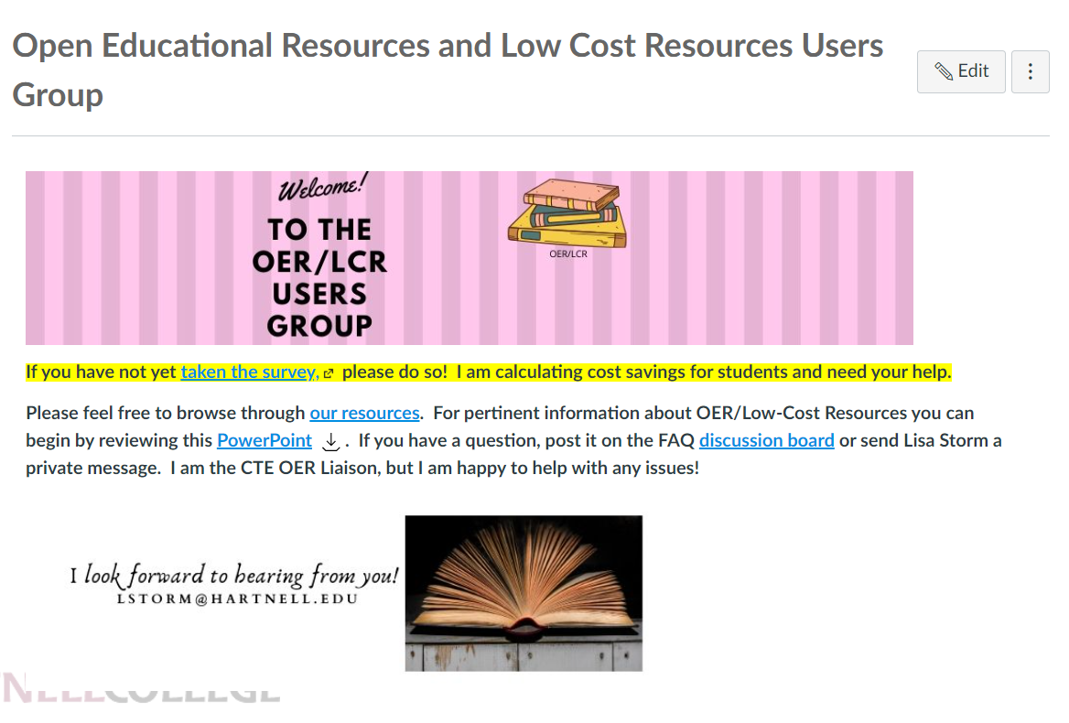
Questions?
Please join the Canvas OER/LCT shell if you want access to a variety of resources! Send me an email and I will give you the registration code.
Hopefully the class “OER and Equity” will be available for 12-hours of flex credit soon!

