Slide 1
Hartnell College Dual Enrollment
College and Career Access Pathway (CCAP)
Laurencia Walker
Director, College Readiness
April 2019

Slide 2
What is AB288?
  Definition: In California’s Education Code, the term “dual enrollment” is identified to define “special part-time” or “special full-time” students – that is, high school or other eligible special admit students enrolling in community college credit courses.
  Legal Standing: Assembly Bill 288 enacted January 1, 2016 and added to the California Education Code section 76004.
  Allows: Governing board of a community college district to enter into a College and Career Access Pathways (CCAP) partnership with the governing board of a school district.
  *AB30 is pending legislation will extend opportunities associated with AB288*

Slide 3
Dual Enrollment Progress
Semester | Location | Course Number | Enrollment Count | FTES | Retention Count (Completing with any Grades | Retention Rate | Class Grade Average (of Students Completing with any Grades | Success Count | Success Rate | Class Grade Average (of Students Successfully Completing)
Fall 2017 | GON | COU-1 | 27 | 2.7 | 22 | 81.5% | 2.8 | 19 | 70.4% | 3.2
 | GON | ENG-1A | 31 | 4.1 | 31 | 100.0% | 3.3 | 31 | 100.0% | 3.3
 | SOHS | COU-1 | 27 | 2.3 | 27 | 100.0% | 3.1 | 24 | 88.9% | 3.5
 | SOHS | ENG-101 | 32 | 3.7 | 32 | 100.0% | 3.7 | 31 | 96.9% | 3.7
 | SOHS | ADJ-1 | 29 | 3.7 | 29 | 100.0% | 3.3 | 29 | 100.0% | 3.3
Fall Total |  |  | 146 | 16.5 | 141 | 96.6% | 3.3 | 134 | 91.8% | 3.4
Spring 2018 | GON | COU-23 | 16 | 1.6 | 15 | 93.8% | 3.3 | 15 | 93.8% | 3.3
 | GON | ENG-1B | 31 | 3.1 | 31 | 100.0% | 3.0 | 29 | 93.5% | 3.2
 | KCHS | COU-1 | 38 | 3.7 | 36 | 94.7% | 3.1 | 31 | 81.6% | 3.5
 | NMC | COU-1 | 25 | 2.7 | 25 | 100.0% | 3.3 | 23 | 92.0% | 3.5
 | SOHS | ART-10 | 36 | 3.7 | 36 | 100.0% | 3.6 | 35 | 97.2% | 3.7
 | SOHS | ENG-1A | 40 | 4.8 | 40 | 100.0% | 3.8 | 39 | 97.5% | 3.8
 | SOHS | ADJ-4 | 29 | 3.7 | 29 | 100.0% | 3.1 | 28 | 96.6% | 3.2
Spring Total |  |  | 215 | 23.2 | 212 | 98.6% | 3.3 | 200 | 93.0% | 3.5
Key
GON= Gonzales High School AHS: Alisal High School
SOHS= Soledad High School EAHS: Everett Alvarez High School
KCHS= King City High School NMC= North Monterey County High School

Slide 4
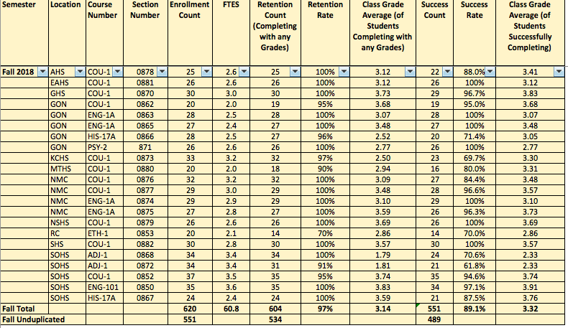
Hartnell Dual Enrollment and High School Districts:
Fall 2018
Enrollment= 620 (551 Unduplicated) Retention=97% Success Rate=89%

Slide 5
Hartnell Dual Enrollment and High School Districts
Spring 2019: 24 sections
Term | High School | Course Name
Spring 2019 | Gonzales | TAC-1
Spring 2019 | Gonzales | HIS-17B
Spring 2019 | Gonzales | ECE-6
Spring 2019 | Gonzales | ENG-1B
Spring 2019 | Gonzales | ENG-1B
Spring 2019 | Gonzales | COU-1
Spring 2019 | Alisal | COU-23
Spring 2019 | North Salinas | COU-23
Spring 2019 | Mount Toro | COU-1
Spring 2019 | Everett Alvarez | COU-23
Spring 2019 | Mission Trails ROP | EMT-53
Spring 2019 | Soledad | COU-1
Spring 2019 | Soledad | ADJ-2
Spring 2019 | Soledad | ADJ-2
Spring 2019 | Soledad | ENG-1A
Spring 2019 | Soledad | HIS-17A
Spring 2019 | Greenfield | COU-1
Spring 2019 | King City | COU-1
Spring 2019 | North Monterey County | ENG-1B
Spring 2019 | North Monterey County | ENG-1B
Spring 2019 | North Monterey County | COU-27
Spring 2019 | North Monterey County | COU-27
Spring 2019 | Rancho Cielo | ETHN 7
Spring 2019 | Rancho Cielo | EHTN 12

Slide 6
Next Steps for Dual Enrollment Partnership
Identify Dual Enrollment Pathways to map our 2019-2020 AY: Revisit data, review courses, analyze retention/success data, other opportunities
Identify faculty that are interested/meet Min. Quals. to teach in these pathways (Work with HR, Area Deans/Faculty Leads)
Identify a cross-section of internal (HC) champions of these student opportunities
Develop school-level implementation teams- Work with Districts/Schools to ID point people/support network (leverage support staff/programs)
Share Student Success Data for continuous improvement and development of best practices!

Slide 7
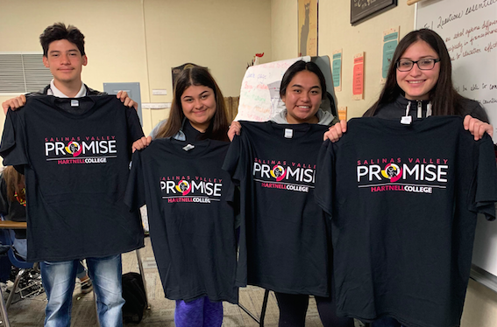
Opportunities to Collaborate for
Student Success (SVP, AB705, Guided Pathways)

Slide 8
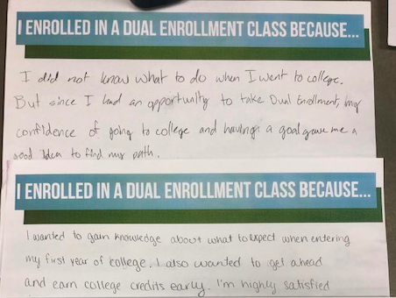
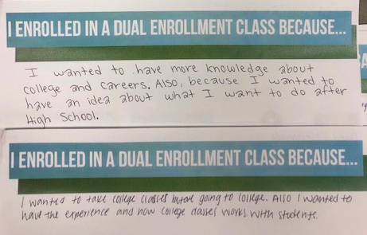
Student Voices

Slide 9
Hartnell College Dual Enrollment
THANK YOU for your
feedback, collaboration, and support!

