Slide 1
María Ceja, Ed.D.
Dean Student Affairs Enrollment Services
Add Authorization
Spring 2022
Bala Kappagantula
Director of Information and Technology Resources
9/14/2021

Slide 2
Transitioning the use of add codes
New Add Authorization
New faculty module in PAWS Self Serve in Spring 2022
Add codes will no longer be used to add students to courses
No more issuing multiple codes
The Add Authorization gives faculty more control to add students and the ability to rescind them

Slide 3
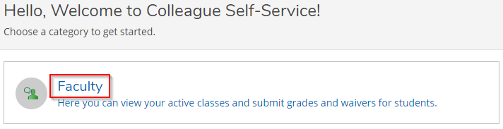
How to authorize an add
1. Login to PAWs Self-Service using
Hartnell ID and password
2. Select the Faculty module

Slide 4
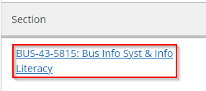
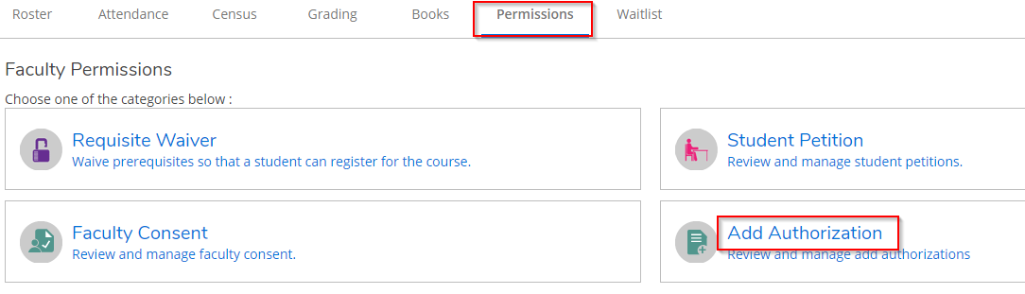
How to add a student Cont...
3. Select the Section to add students
4. Select the Permissions tab & select
Add Authorization

Slide 5
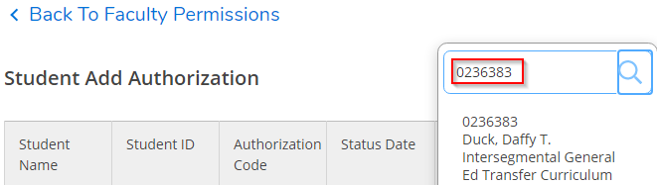
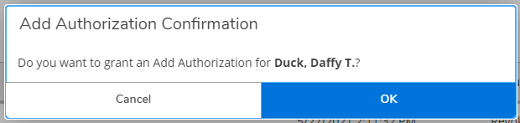
How to add a student Cont...
5. Search for a student & confirm their details in the dropdown before adding
6. Confirm the Add Authorization by selecting OK

Slide 6
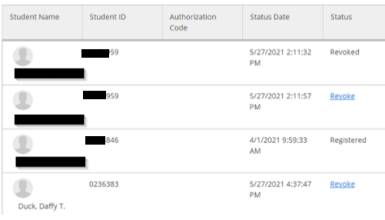
How to add a student Cont...
You’ve registered the student!

Slide 7
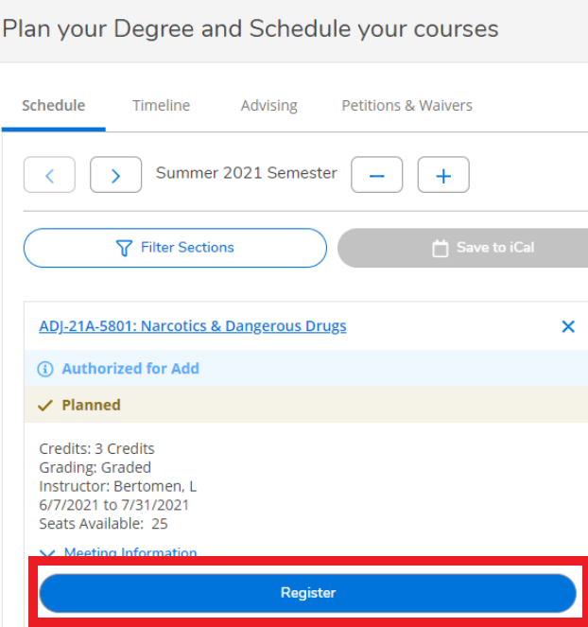
Let the student know they’ve been added
7. Email the students you’ve authorized to add the course and send them the
instructions on how to add the course.
NOTE: Student instructions are included in the presentation documents.

Slide 8
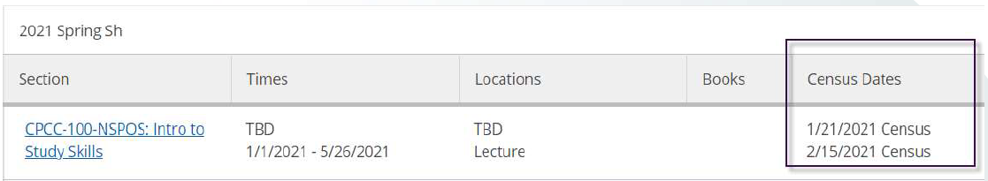
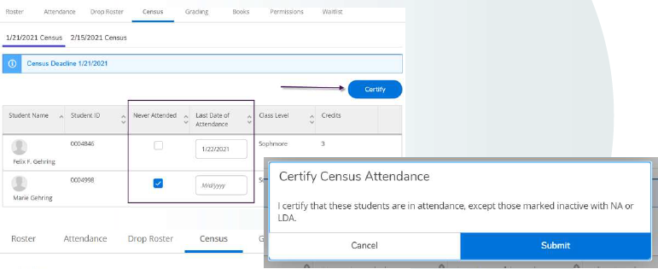
Upcoming Improvements - Census Rosters

Slide 9
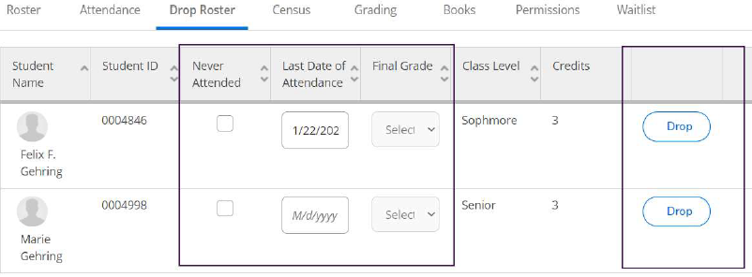
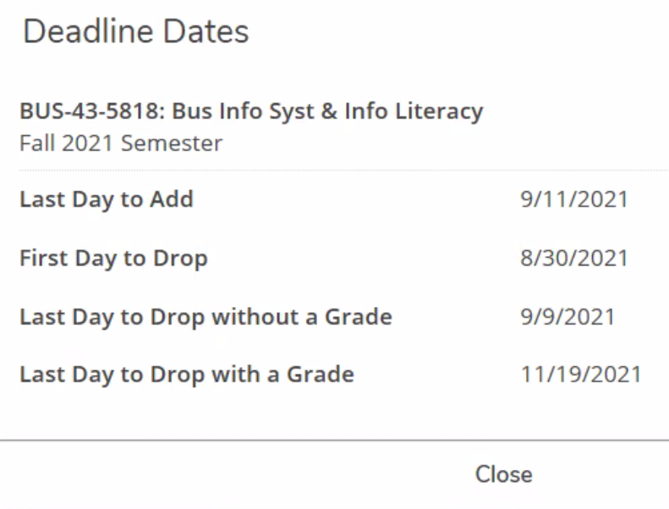
Drop Rosters

Slide 10
Interested in Piloting the Add Authorization?
Timeline
Fall 2021 - Pilot Add Authorization and Drop Rosters
Spring 2022 - Launch Add Authorization and Drop Rosters
Email Maria Ceja (maceja@Hartnell.edu) to be added to the pilot and have the opportunity to test the new functionality.

Slide 11
Thank you!

