Slide 1

New Tri-Leads: administrator, faculty, and staff
Plan team meetings
Facilitate team meetings
De-Brief team meetings
Responsible for…
  meeting monthly & other deadlines
  Role modeling collaboration, compromise, and inclusiveness
  Helping your team with issues & problems that come up
  Asking for help when you need it & seeking Hetty and Brian out when you have questions

Slide 2


Slide 3
Teams that need more members
Meta-Majors first Friday of the month from 1-2:30 p.m.
Create Institutionalized Facilitated Forums to Promote Employee Engagement 2nd Monday of the month from 3-4:30 p.m.

Slide 4
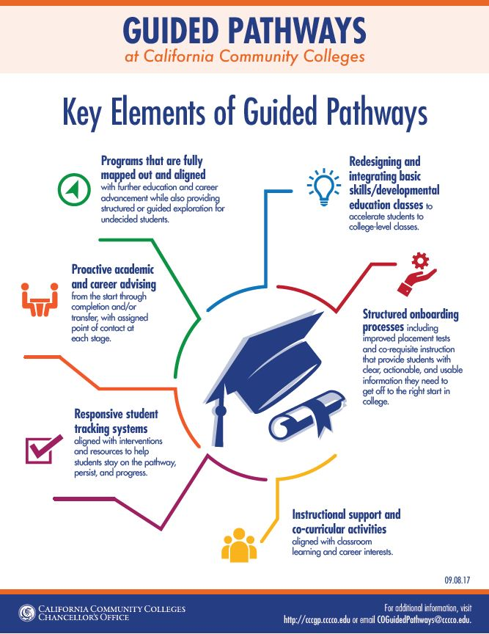


Slide 5
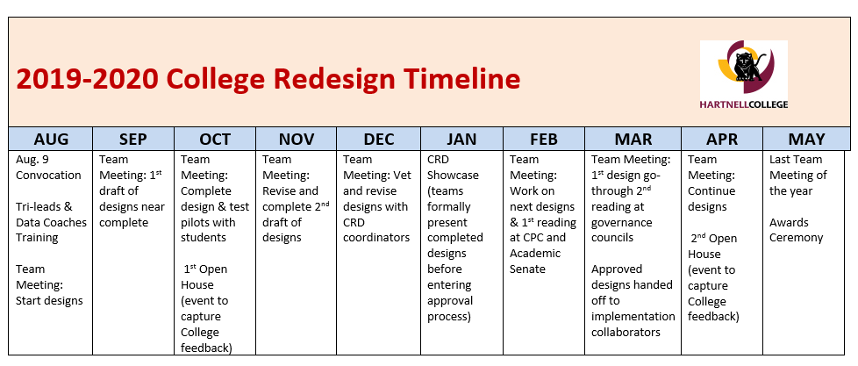
Things don’t just happen; you have to “Make it Happen”

Slide 6
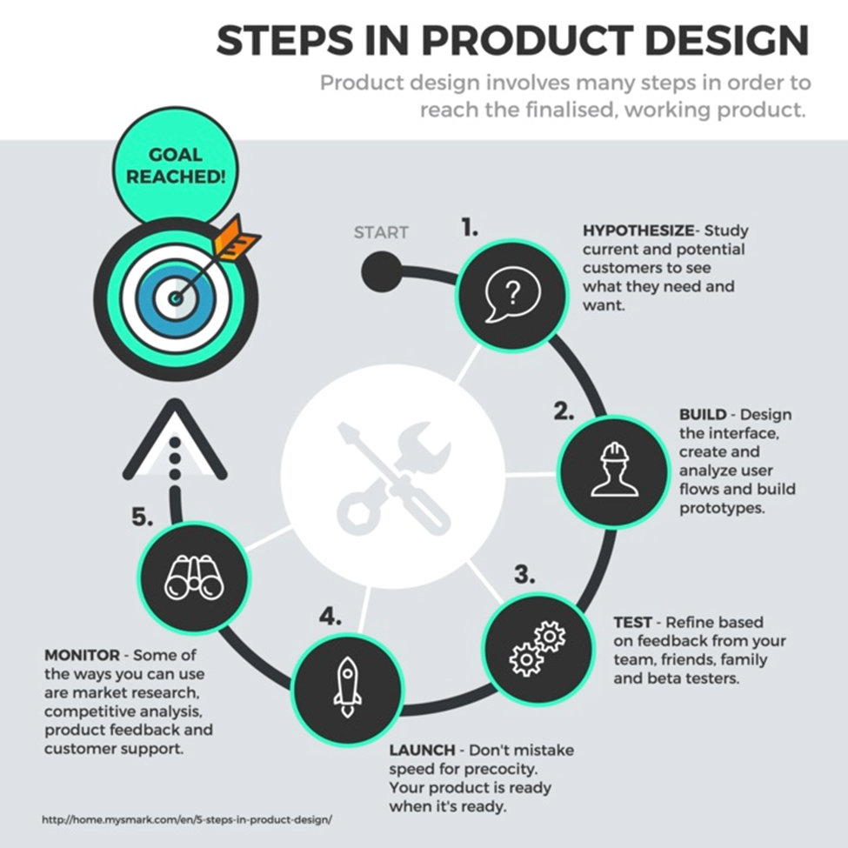
CRD Design Checklist
Design Blueprint:
A flow chart or other visual representation of the design
Why we are designing visuals?
To take the time to consider the best ways to approach the designs
So that the College and community can provide feedback to improve designs and avoid problems
To support a college culture of transparency, collaboration, and innovation
So that people will know what they are voting on during the approval process

