Slide 1

The Tenure Review Process
Tenure Review Committee
Dr. Sonja Lolland (VPAA)
Dr. Romero Jalomo (VPSA)
Lisa Storm (AS President)
Cheryl O’Donnell (AS Vice president)

Slide 2

Article 14
Governs the evaluation of probationary faculty
Purpose: the principal purpose of the probationary faculty evaluation process, is:
  to improve the educational programs of the District;
  to recognize and acknowledge good performance;
  to assure compliance with District policies and procedures;
  to enhance satisfactory performance and help probationary faculty members further their own growth;
  to identify weak performance and assist employees in achieving needed improvement;
  to document unsatisfactory performance, and
  to assist the Governing Board in determining continued employment by the District.

Slide 3

It is a 4 Year Process
Year 1 - The faculty member’s first year contract is based on initial hiring.
Year 2 – The Board of Trustees (BOT) will recommend a 2nd one-year contract based on the recommendation of the Tenure Review Committee and the college President.
Years 3 & 4 - At the end of year two, if all is satisfactory, the faculty member is offered a two-year contract. The faculty member is evaluated in each of the two years. However, there is no BOT decision in year three.
Year 4 – the faculty member is either granted tenure, or not offered a new contract.

Slide 4

Four Layers to the Decision
Layer one –
  The evaluatee’s immediate team. The team can be one or two faculty members of choice, and the evaluatee’s supervisor.
Layer two –
  The Tenure Review Committee (VP of Academic Affairs, VP of Student Affairs, Academic Senate President, and Academic VP – or designees).
Layer three –
  The college President.
Layer four –
  The Board of Trustees
    (must be made by March 15th).

Slide 5
Timeline
Evaluatee’s team named in spring (except in first year);
Early fall semester – evaluation team meets with evaluatee;
  Criteria of evaluation discussed, site visits scheduled;
October 15th
  reports by evaluatee submitted;
November 15th
  work site observations/student appraisals complete;
December 10th
  post-evaluation conference complete;
March 15th
  BOT decision is made.

Slide 6
The Evaluation Team
The appropriate administrator;
One or two faculty peer members, chosen by the evaluatee and approved by the Academic Senate;
Generally kept all four years, but can be changed “for good cause;”
One peer should be from the discipline or closely related discipline;
The Academic Senate may provide guidance if the evaluatee desires.

Slide 7
Evaluation Forms
Links to work site observation reports and student appraisals are found here.
  Distance Education looks at one learning unit.
Required Reports:
  Faculty Professional Growth Report
  College Related Activities Report
  Self Appraisal

Slide 8

Assessment Criteria
Core duties:
  teaching;
  student advising and assistance;
  accurate and timely record-keeping and submission of reports;
  collegial collaboration in meetings and activities;
  collegial collaboration in college-wide activities;
  development and assessment of student learning and program level outcomes.

Slide 9
Assessment Criteria II
Professional Competence:
  worksite observations are conducted to assess the professional competence of faculty members in all instructional and non-instructional settings;
  those competencies are listed in the worksite observation evaluation forms (see appendices, section C);
  written for particular roles, e.g., instructor (face-to-face and online), counselor, librarian, instructional specialist, coach, and athletic trainer.

Slide 10
Assessment Criteria III
Professional Conduct:
  willingness to assist students;
  meets obligations from state mandates and District policies;
  acknowledges and defends free inquiry;
  works cooperatively and professionally with others;
  shows consideration for constructive feedback;
  evidences a willingness to investigate new ideas, methods, and techniques;
  avails self to opportunities for professional growth;
  demonstrates personal integrity and ethics of the profession.

Slide 11
Assessment Criteria IV
Professional Growth:
  the comprehensive evaluation will also provide an opportunity for the evaluatee to:
    demonstrate his or her commitment to growing professionally,
    to improving teaching,
    to increasing proficiency in the discipline, and
    to being better prepared to support students and enhance their success.
    Examples of the activities that constitute professional growth are listed on the professional growth report form (see appendices, section C).

Slide 12
Assessment Criteria V
COLLEGE RELATED ACTIVITIES: looks at service to the college, the District, and its students outside of assigned instructional duties:
  service on department and college committees;
  service on Academic Senate committees;
  service on participatory governance councils and committees;
  participation in recruiting and outreach activities;
  participation on articulation committees;
  coordination, advisement, and supervision of Hartnell student organizations or student activities;
  participation in organized student success efforts.
  participation in community service or community projects
  that positively reflect on the district;

Slide 13
Assessment Criteria VI
Professional Goals:
  the comprehensive evaluation will also include an opportunity for the evaluatee to develop and assess one to three professional goals each evaluation cycle that will enhance the probationary faculty member’s ability to serve students and the campus-wide community.

Slide 14

INSTRUCTIONAL MATERIALS
Every syllabus for EVERY course taught during the evaluation semester should be provided.
Syllabi should include the following:
  Course content and objectives from the course outline of record
  Student Learning Outcomes
  Clear grading criteria
  Reference relevant college policies (safety, drop dates, etc).
Non-teaching roles – use materials that you have
generated to perform your job.

Slide 15

Instructional Materials
Provide samples of:
  study guides
  homework assignments
  quizzes
  examinations for all classes
  only course materials that you developed
  you may use items from your textbook publisher, but do not submit them as an example of your own work

Slide 16
Self Appraisal
Set 1-3 goals:
  make the goals SMART –
    Specific
    Measurable
    Action oriented
    Realistic
    Time frame
always one year until you are tenured,
then it is every three.
Notes:
Another example: Maybe you do not write test questions well, your students comment on that in the eval – that your tests are not fair.
So you write as goals. To attend a test writing workshop and have a peer meet with you and review your exams. The second goal is that the evaluations will show that students rate your tests as fair. (You can measure Spring with informal or formal evaluations.)

Slide 17
Out With The Old,
In With The New
The Tenure Review process is being streamlined and organized for efficiency!
  Reports have been created to allow for clear and consistent input of information
  The requirement of binders is being phased out
  Timelines and expectations are being presented in a clear and concise manner for each member of the evaluation team

Slide 18
Three Reports
Suggested Order of Completion
  Professional Growth Report
  College Related Activities Report
  Self-Appraisal Report
Avoid Redundancy
Notes:
Avoid redundancy

Slide 19
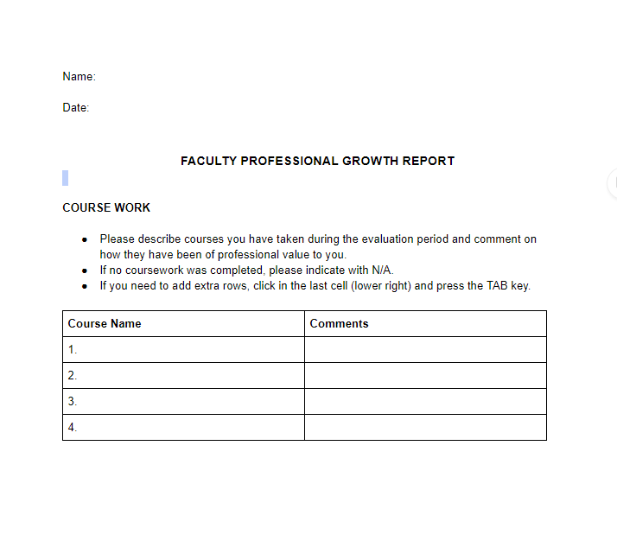
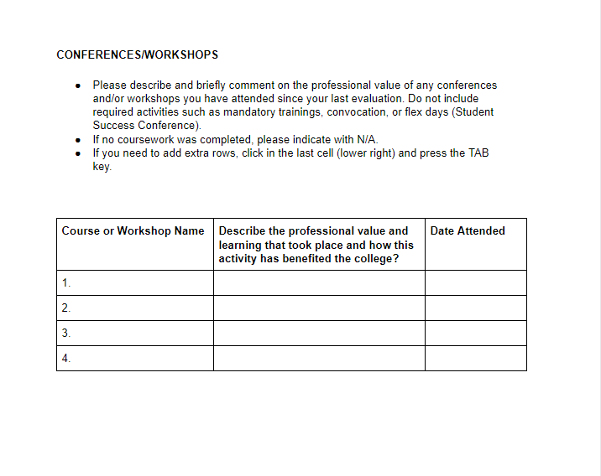
Faculty Professional Growth Report

Slide 20
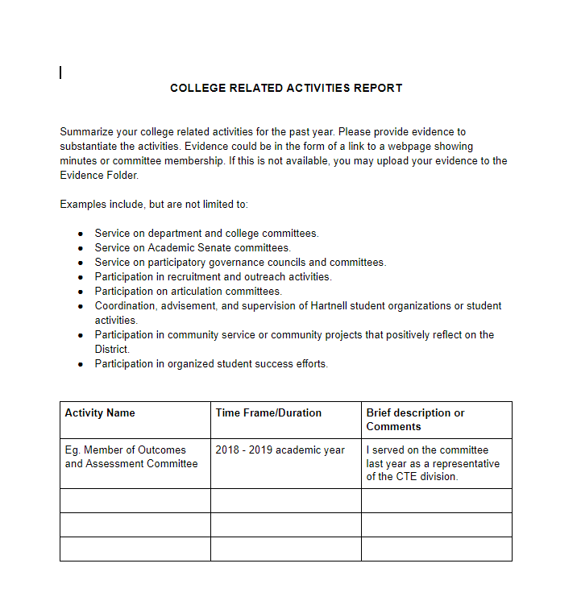
College Related Activities Report

Slide 21
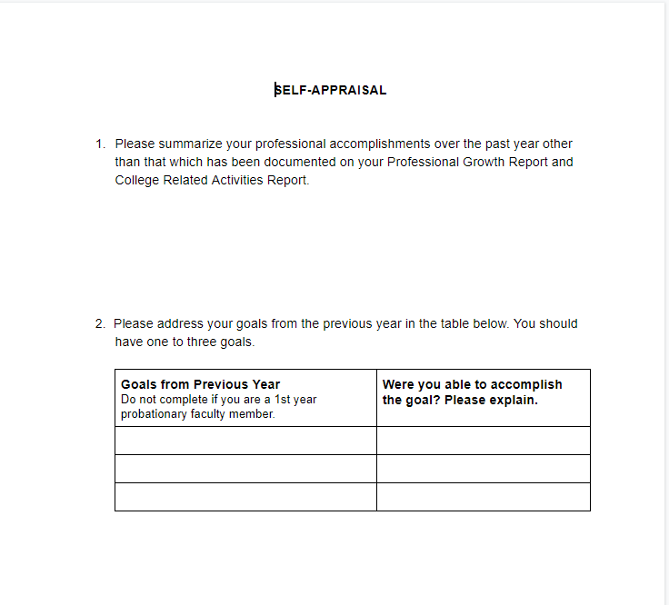
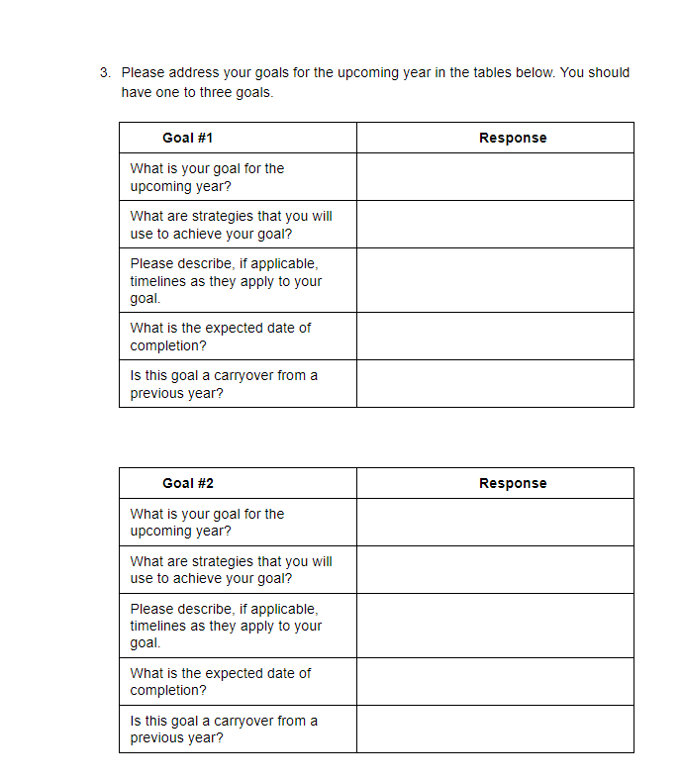
Self-Appraisal Report

Slide 22
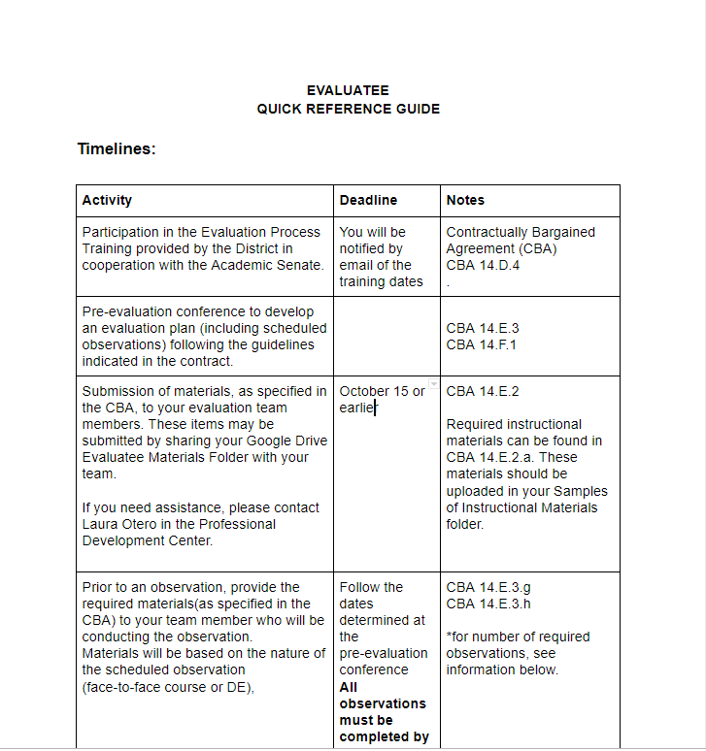
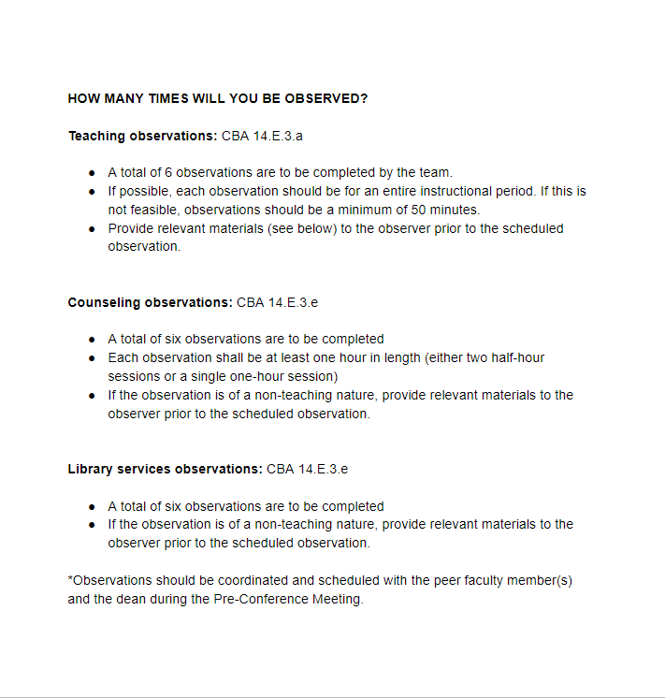
Quick Reference Guides

Slide 23
Requirements
1st Year Faculty
  Going digital is required
2nd, 3rd, and 4th Year Faculty
  Creating a binder is your choice!
Regardless of year in the process, submission of digital reports and materials will be required.
  Everyone will receive a USB drive!
  USB drive will be turned in by all.

Slide 24
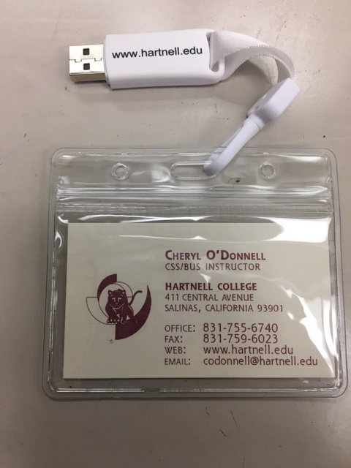
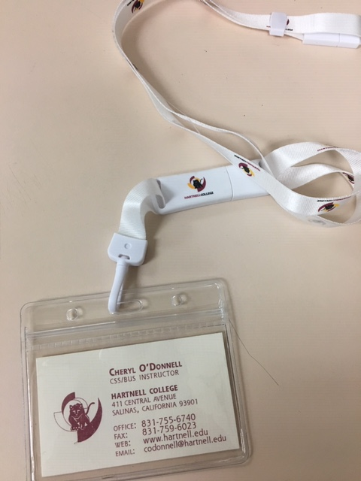
Moving Forward - Your New Binder

Slide 25
Questions?

Slide 26

We Are Here To Help!
Lisa Storm, Academic Senate President
  lstorm@hartnell.edu
Cheryl O’Donnell, Academic Senate First VP
  codonnell@hartnell.edu
Nancy Schur-Beymer, Academic Senate Secretary
  nschur@hartnell.edu

