Slide 1
Onboarding/Outreach Committee Co-Leads: Laura Zavala, HEP Director
Cesar Velazquez, Upward Bound Director
Guided Pathways: Onboarding Updates & Program Mapper
October 27, 2020
Onboarding Admin Oversight:
Carla Johnson, Dean of Student Affairs
Notes:
Today’s Presentation will include: Short Recap, Completed Projects and Project in Progress (total presentation time 15 mins)

Slide 2
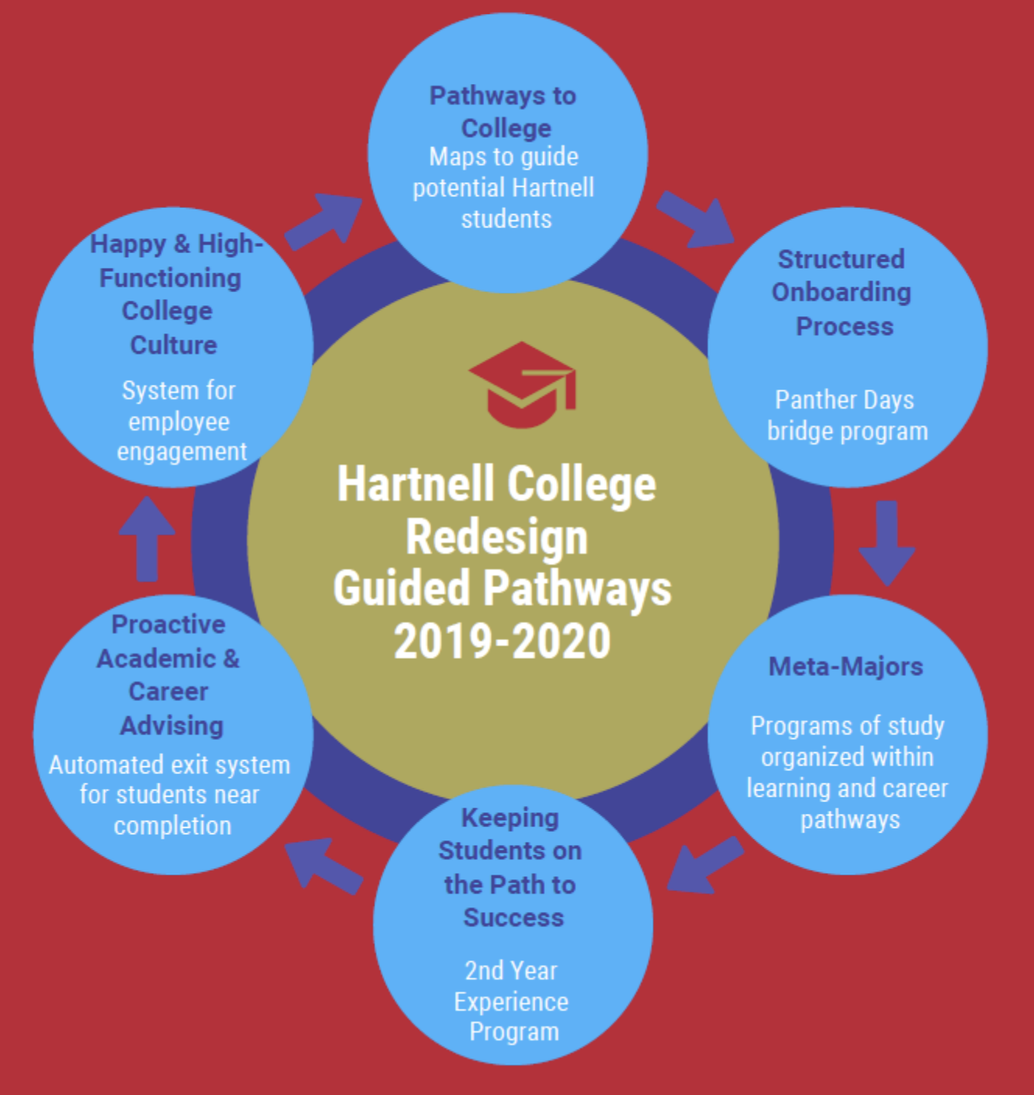
A Recap
2019 Pre-Enrolled, Meta Majors and
Pathways teams form as part of the
Guided Pathways Inquiry stage.
2020 Pre-Enrolled Team merges
with Onboarding/Outreach
Committee as part of
Implementation effort.
Meta-Majors and Program Mapper forms
10 Co-leads (two faculty per meta major), and falls
under the direction of SA and AA Vice Presidents.
Membership in Onboarding Committee includes those part of Pre-Enrolled team as well as current programs with outreach/onboarding components. AB705 Co-Leads are also working towards these onboarding efforts.

Slide 3
Onboarding Implementation:
Completed Projects Overview
New Online Orientation (English and Spanish) launched in February 2020
Steps to Success YouTube videos (English and Spanish) and Social Media
Placement Tool (English, Math, Counseling, ESL) - (AB705 work that falls under Onboarding)
Web Update: revamped Counseling web pages, HC website can be translated into other languages, Virtual Front Desk, and a Chatbot (AI)
Student Planner Self-Serve (the NEW PAWS)

Slide 4

Online Orientation
Mandatory Orientation for all NEW students available through PAWS.
Accessible through any mobile device
ADA Compliant
All areas locked and accessed upon completion.
Quizzes to assess for understanding
Videos, accordion files, bookmarks are interactive to engage different learning styles.
In English and Spanish
Records completion into Colleague within minutes allowing for immediate registration
Over 8000 students have completed the Orientation since Feb. 2020.
0 student complaints since February 2020
Notes:
This Orientation, unlike previous one, allows us to easily make edits to text or load videos at any time. Currently working to replace the President’s Welcome video. All student talent are ACTUAL Hartnell students.

Slide 5
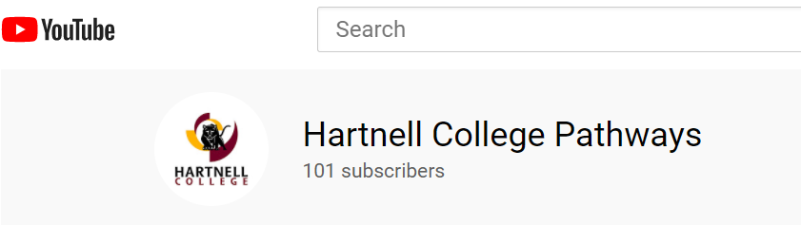
Steps to Success as Videos & Social Media
College Pathways team of five work with over 20 local high schools (and programs) to facilitate 5 of the 7 Steps to Success starting Oct.
Visit the Panther Prep Pledge website or the Enroll Now link to view the Steps to Success Videos.
College Pathways Team on Social Media:
Instagram: hc_pathways_team
Twitter: @HC_PathwaysTeam
TikTok: @hartnellcollegepathways
Youtube: Hartnell College Pathways
Videos are available in English and Spanish
This year we had very positive responses from students and education partners about the videos.
Due to COVID: Panther Prep became Panther Pledge. Over 1400 students completed the Steps to Success in 2020 (the biggest group ever). Over 1200 students enrolled this 2020 semester and about 70% did so full-time.

Slide 6
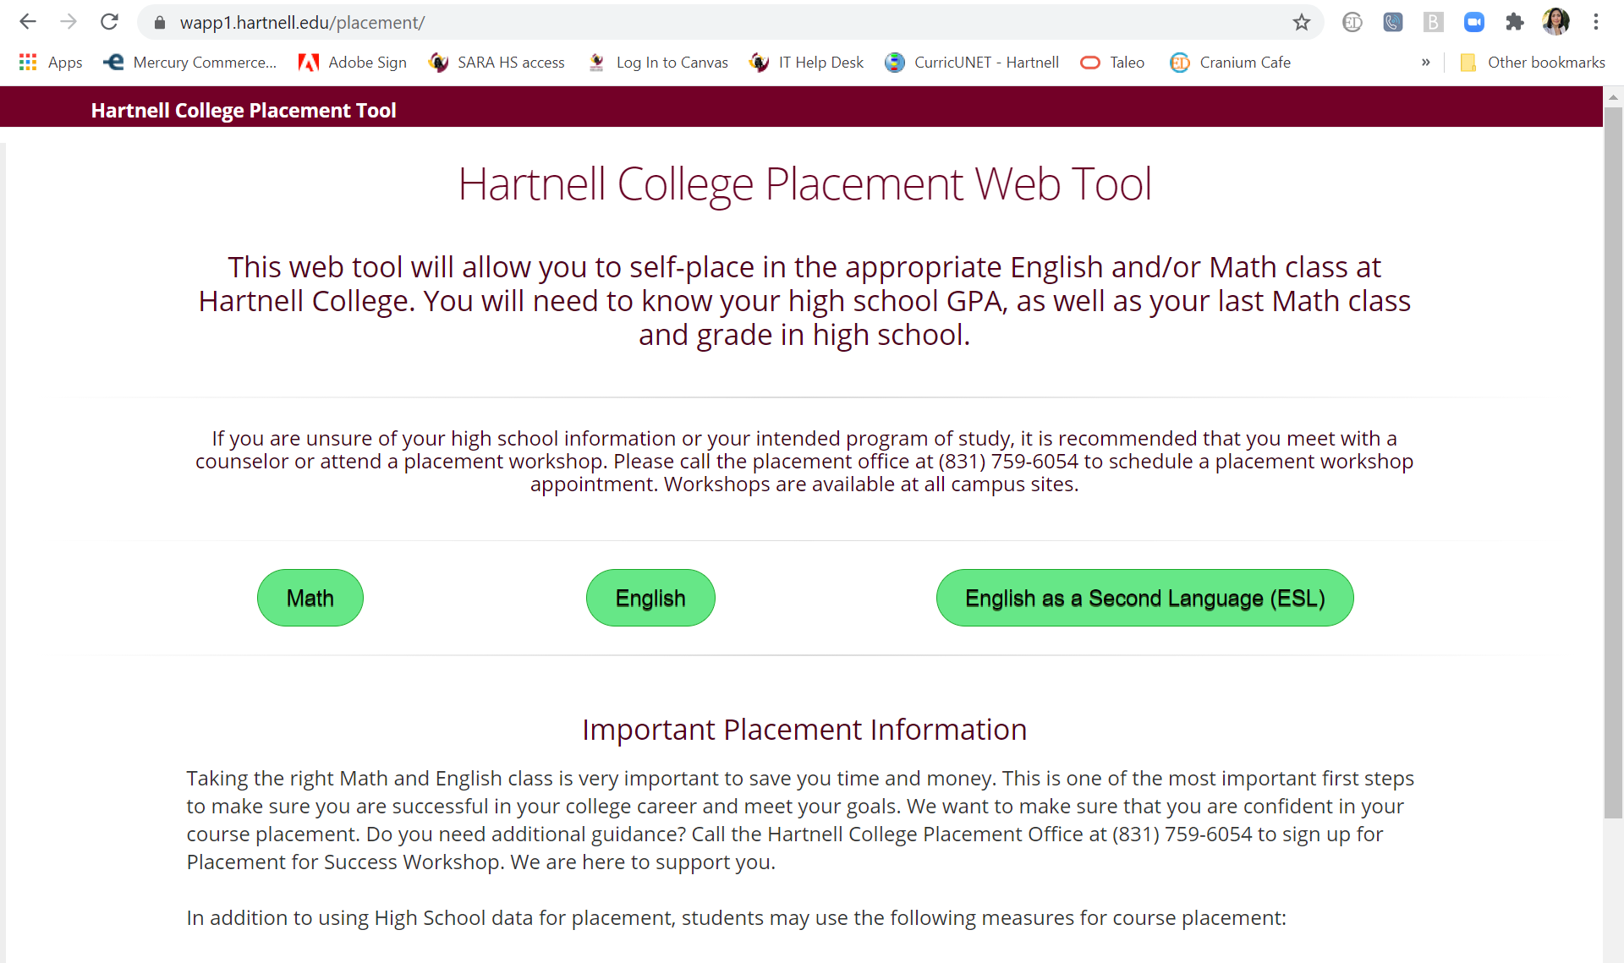
Placement Tool
Placement Tool was developed in-house in response to legislation AB705 to eliminate assessment for placement and utilize self-guided placement.
For Math, English and ESL Placement
Requests: highest level of course completed, grade received in course and overall GPA
Placement Tool itself does not seem to have any significant impact on success
Data taken from AB705 Leads presentation - will be presenting success data at College Transitions and Curriculum Institute, Nov. 20th
]
“AB705 changes allowed 823 more students to pass Math 13 in 2019-20 than in 2017-18”
“Under the new AB705 placement rules, 400 more students passed transfer level English in 2019-20 than in 2017-18”
ESL just starting to gather data

Slide 7
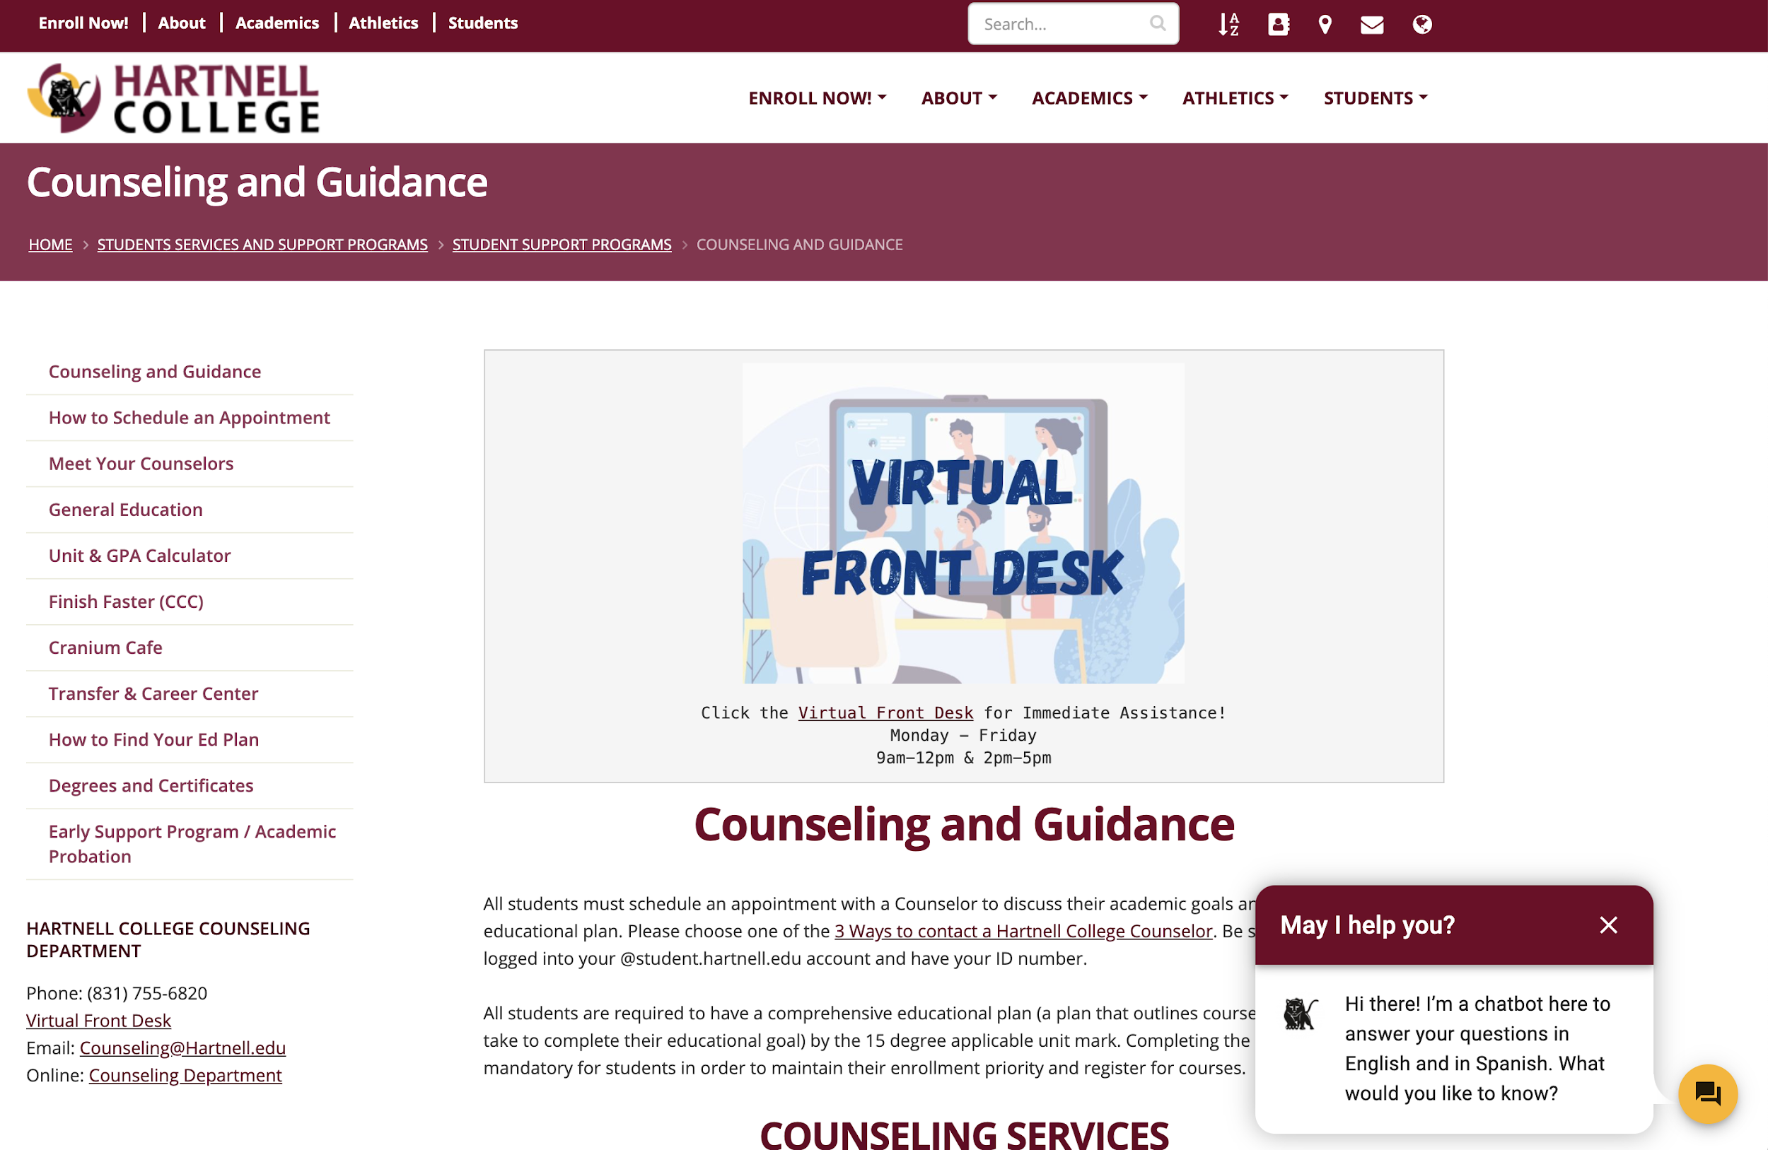
Web Updates and Chatbot
Counseling web page now includes list of degrees and certificates search by program
Online Appointments by Counselor (with Counselor Bio)
Express Appointments online
Chatbot is an AI interactive platform that helps answer student questions. Available on counseling, A&R and Financial Aid pages
Financial aid questions and looking for an Ed Plan are the two top search queries
Language translation icon in all pages
*survey data compiled and analyzed by Hartnell Office of College Readiness. Questions? Please contact lwalker@hartnell.edu

Slide 8
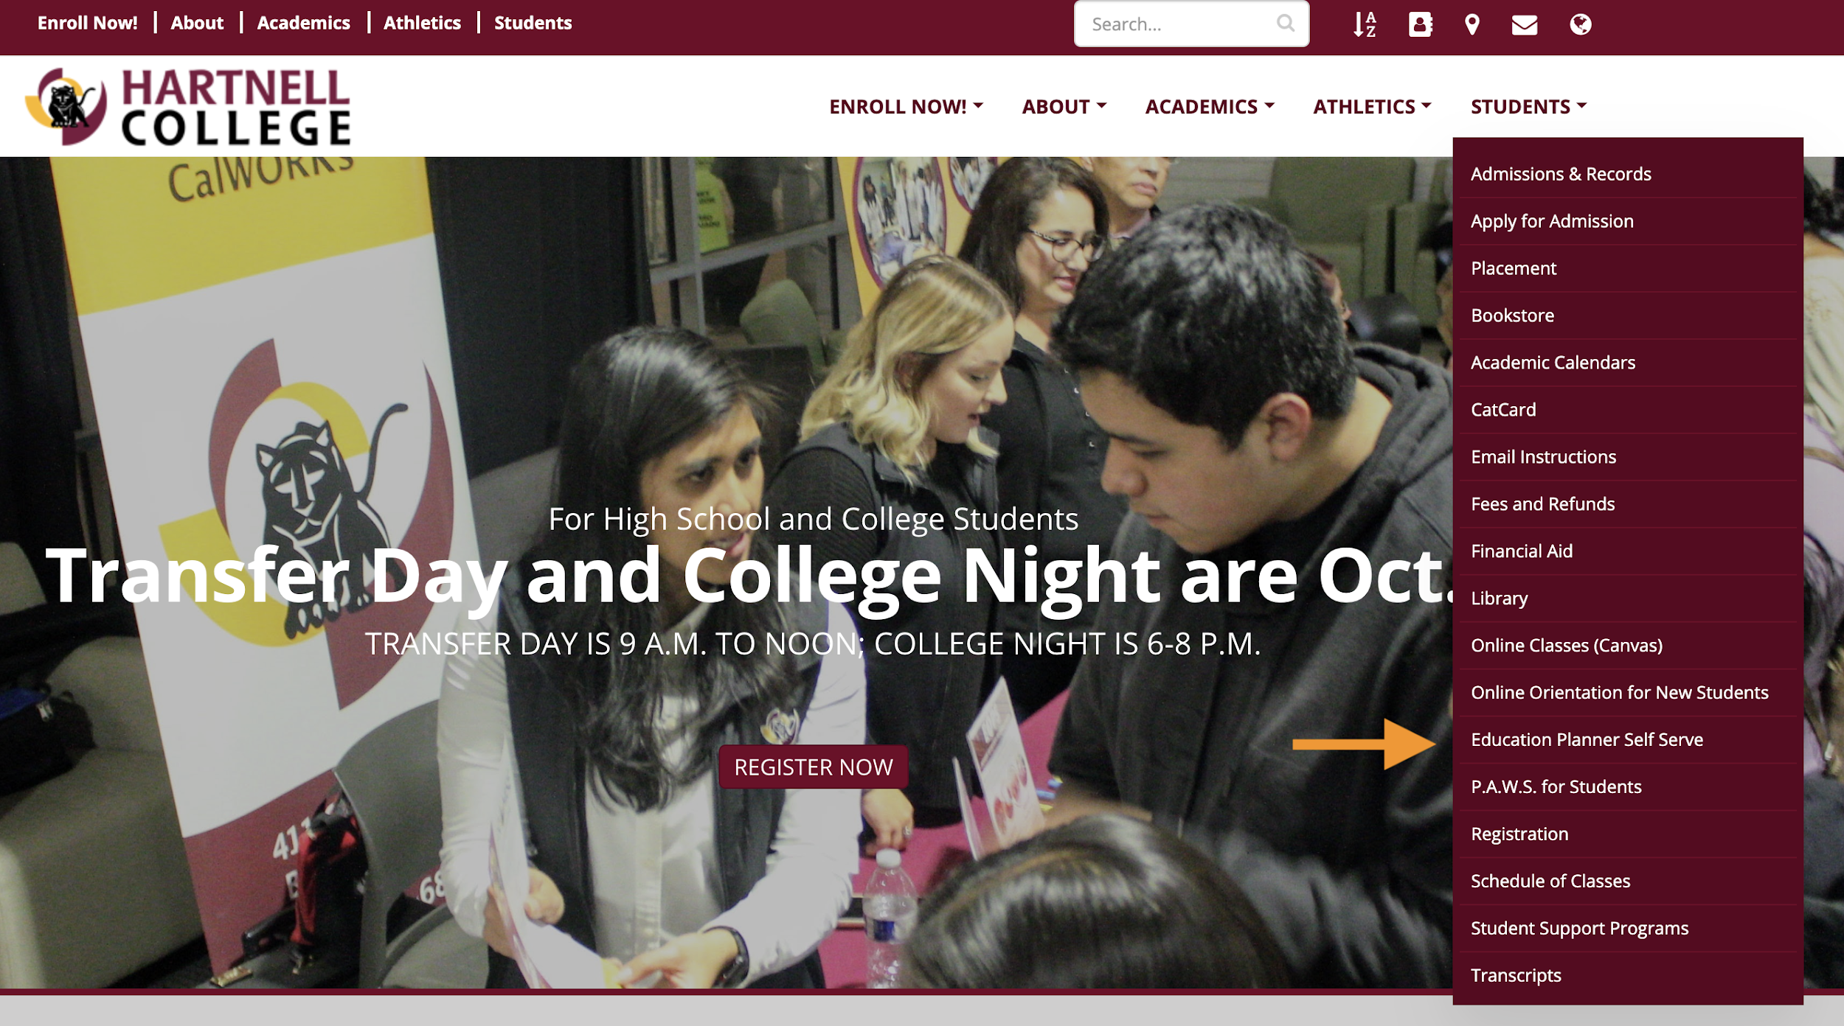
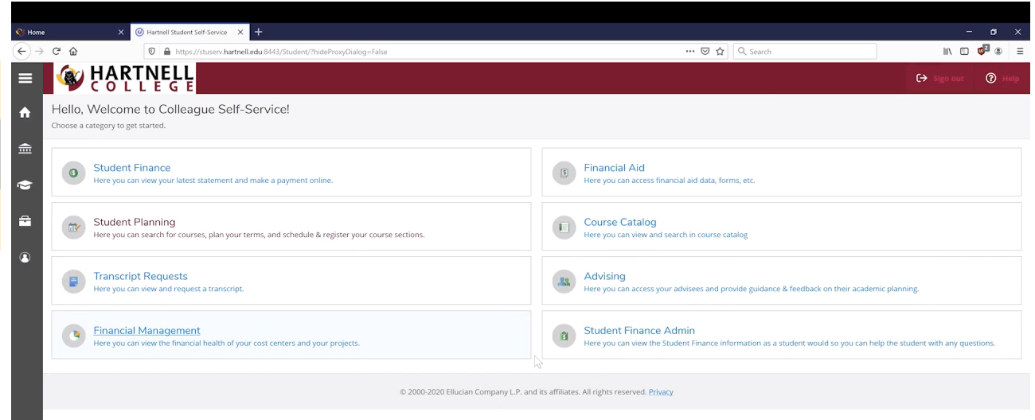
Self-Serve Portal (Student Planner to be new PAWS)
Student Planner was released for student use in FA2019.
Students can access their Educational Plans, even make suggested changes for counselor review.
Students can make a payment to their account and account will clear automatically.
Students can search the catalog and available courses using better filters.
Since FA19 there have been 17,000 new users.
“Student Planning and Degrees” is the #3 most viewed pages.
During Panther Prep about 1500 new students accessed the Student Planner.

Slide 9
Implementation Projects in Progress
Welcome Center is on hold due to COVID, but we have identified a Welcome Spot (current campus safety kiosk on roundabout)
Working with Marketing to redesign a Prospective Student landing page on our website (with onboarding resources and links- Virtual Welcome Center)
Working with Marketing to create a College Viewbook
Student Ambassador program
Redesigning Steps to Success (current steps and steps for non-traditional students)

Slide 10
Welcome center
Pre-enrolled team identified as a main project to provide prospective students with a one stop, welcoming location
Team identified possible locations at each campus
Request made to Campus Safety for a shared location
Team identified: staffing, technology, and other resources needed
Team focused on virtual and physical Welcome Centers additional elements
Landing pages of website
Viewbook to promote instructional and non-instructional programs
Student Ambassadors to assist students

Slide 11
Implementation Projects in Progress
Redesigning Steps to Success
Focus on the process and barriers
Process: evaluate roadblocks to onboarding, analyze potential resources to those roadblocks
Current focus: Adult Ed/ESL/Non-traditional students
Future projects: focus on other student populations: high school students, dual enrollment/concurrent enrollment etc.

Slide 12
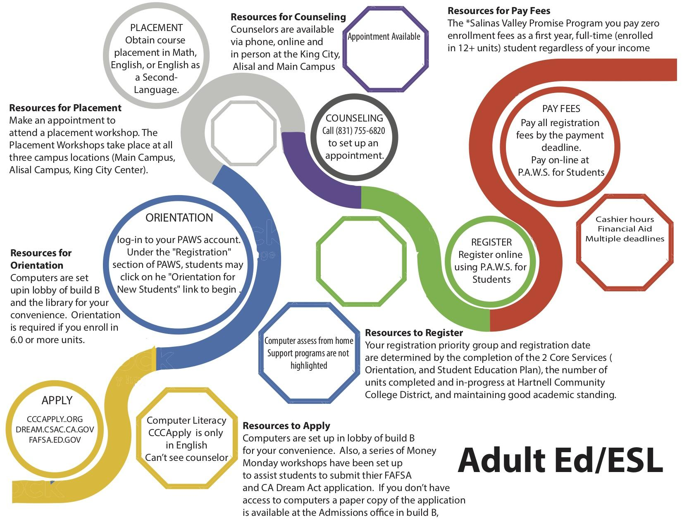
Steps to Success: roadblocks for nontraditional students
Non-traditional Students (those not coming directly from H.S.

Slide 13
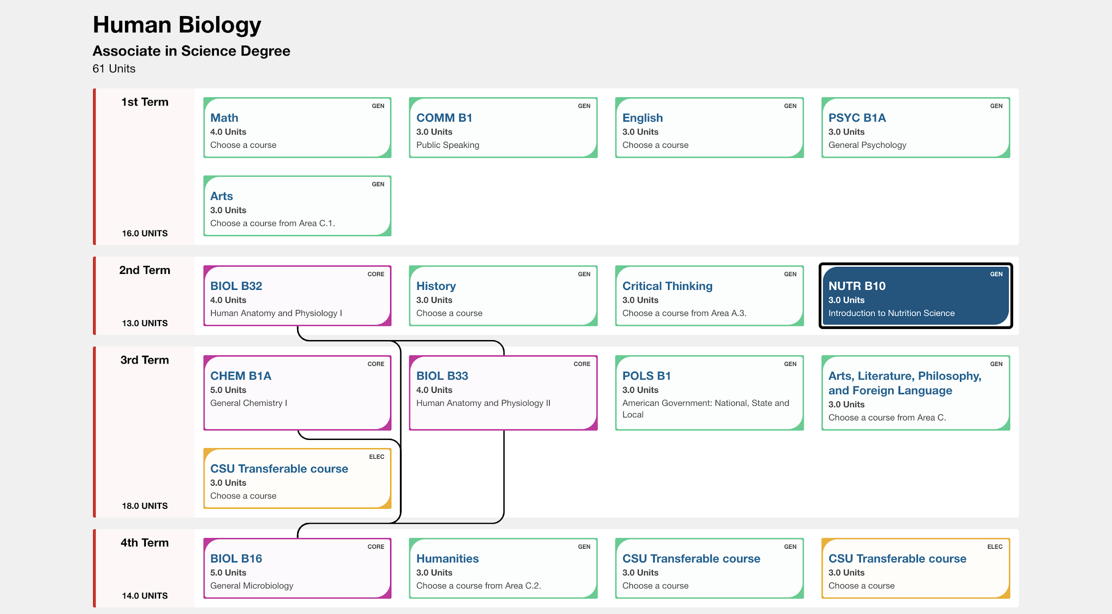
The Program Mapper Tool: Sample
Bakersfield College: https://programmap.bakersfieldcollege.edu/academics

Slide 14
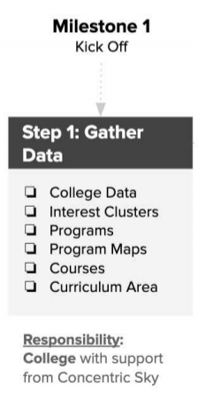
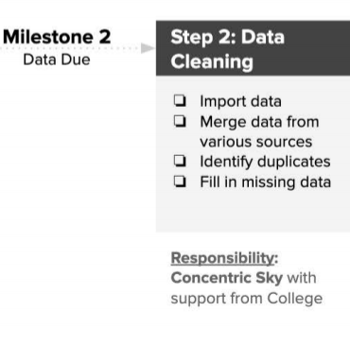
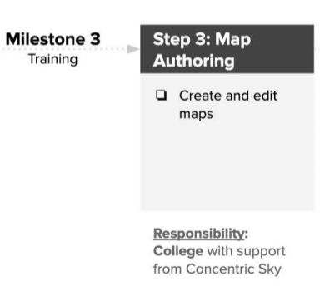
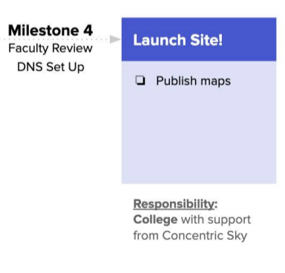
Program Mapper Leads & Timeline
Faculty Co-Leads:
Concentric Sky Timeline:
STEM : Chris Moss and Brooksley Foley
Arts & Languages: Dr. Hetty Yeland & Nayeli Figueroa
Business Ag and Industries: Mark Dehart & Violeta Wenger
Health Sciences: Mary Davis & Dr. Liz Estrella
Social Sciences: Tina Esparza- Luna & Joel Torres

Slide 15
Faculty Leads / Q & A

