Slide 1
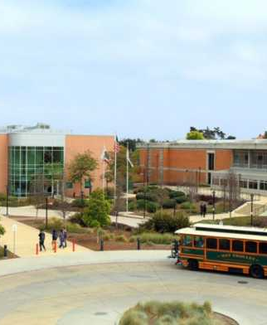
Dr. Brian Lofman
Dr. Jason Hough
Code of Communication Conduct
03/09/21

Slide 2
rationale
In our ISER response to Standard I of the ACCJC accreditation assessment, “Mission, Academic Quality and Institutional Effectiveness, and Integrity”, it includes:
The institution demonstrates integrity in all policies, actions, and communication.
In our college’s list of values, it includes “Ethics and Integrity”:
  We commit to respect, civility, honesty, responsibility, and transparency in all actions and communications.
The 2019-2024 Strategic Plan includes strategies necessary to improve communication.

Slide 3
Rationale (cont’d)
Hartnell College requested a Partnership Resource Team (PRT) through the Chancellor’s Office’s Institutional Effectiveness Partnership Initiative (IEPI).
The College was notified the request was approved and developed an Innovation & Effectiveness (I&E) implementation Plan.
A key aspect of the plan focuses on “employee engagement”, including improving communication between employee stakeholders.
Various conflictual communication issues have occurred at the college the past year, involving various stakeholders across campus.

Slide 4
The approach
Dr. Lofman and Dr. Hough collaborated to determine top priorities.
  How do we define engagement and responsiveness?
  Who are the key stakeholders for this endeavor?
  What types of communication standards should be recommended?
The Communication Studies literature was reviewed for recommended standards.
  Intrapersonal Communication
  Interpersonal Communication
  Organizational Communication

Slide 5
The approach (cont’d)
Existing APs and BPs were reviewed to avoid ignorance of existing institutional standards.
  AP 3720
  AP 3900
  BP 4030
Sister institutions were reviewed for best practices and possible templates.
  City College of San Francisco
  Grossmont College
  Las Positas College
  Modesto Junior College

Slide 6
The proposal
In reviewing the literature, standards, and existing practices, it was determined communication standards should be handled as values versus dictates.
Communication standards should focus on positive behaviors.
Communication standards should be simple to learn and universal in application.

Slide 7
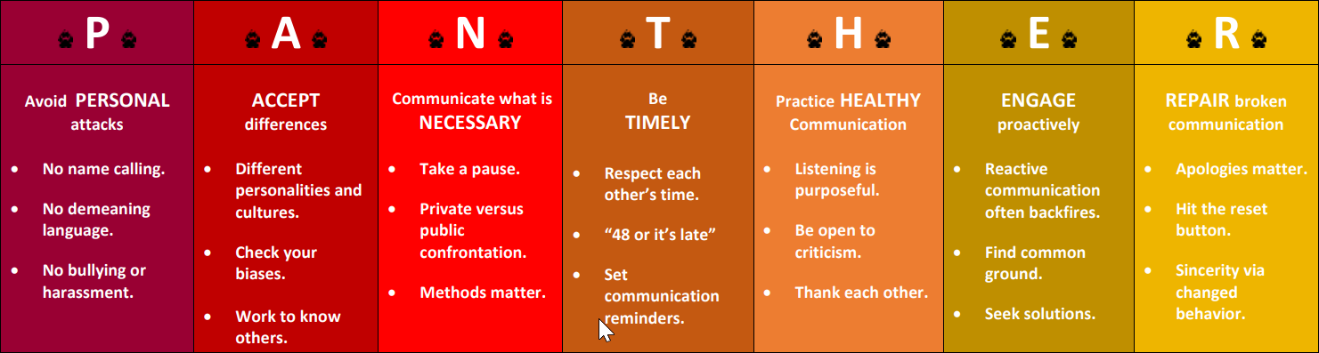
THE PROPOSAL (CONT’D)

Slide 8
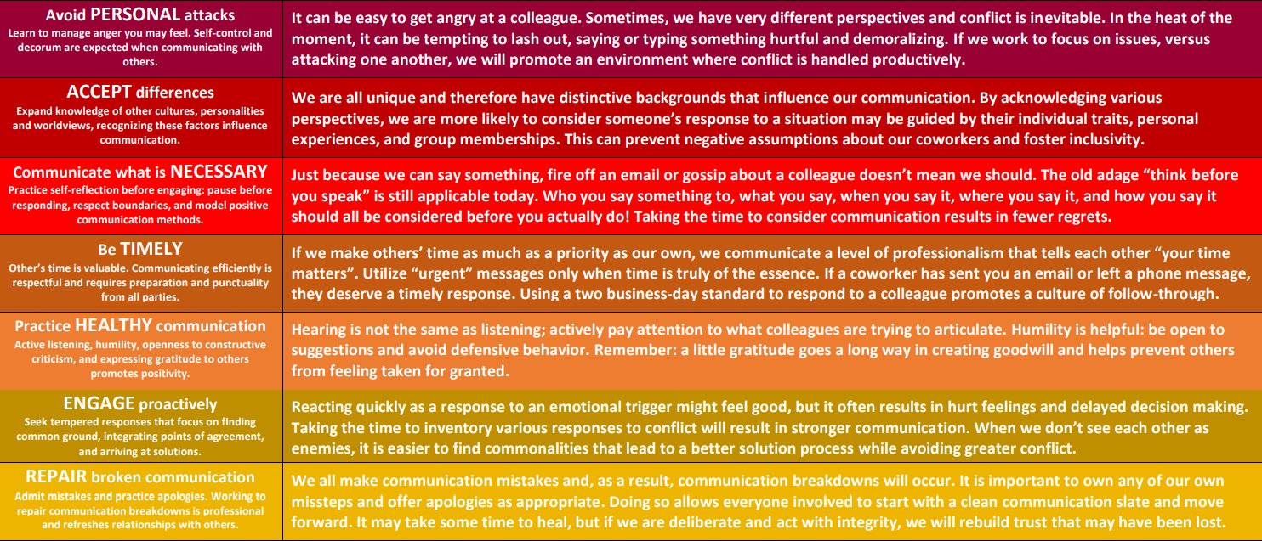
THE PROPOSAL (CONT’D)

Slide 9
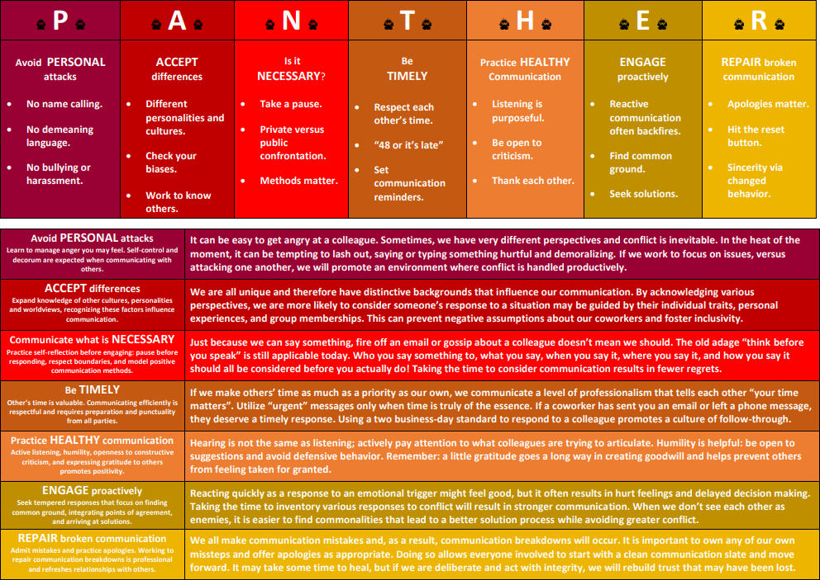
THE CAMPAIGN

Slide 10
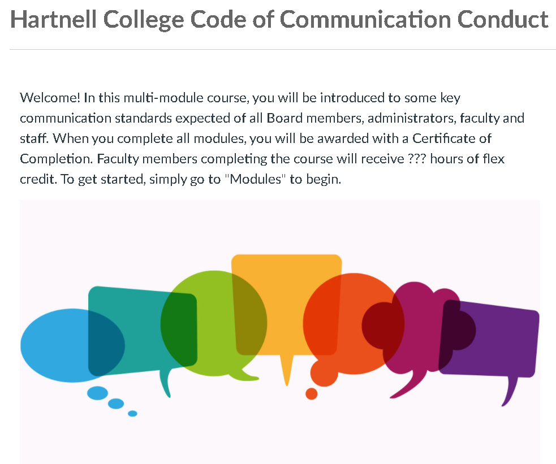
THE CAMPAIGN (CONT’D)
A course shell has been set up in Canvas that can provide training on the seven different areas.

Slide 11
The TIMELINE
The Code of Communication Conduct is currently being presented to key stakeholder groups and committees:
Presidential Cabinet
College Planning Council
Academic Affairs Council
Academic Senate
California Schools Employee Association
Student Senate

Slide 12
The timeline (cont’d)
A pilot of the training will begin in March/April to include the following:
10 administrators/Board members
10 faculty members (full and part-time)
10 classified staff
10 non-classified staff
10 students

Slide 13
The timeline (cont’d)
Pilot and rollout:
Feedback from constituents received by 03/17
All training modules completed and live by 03/28
Pilot modules open to trial participants on 03/29
Participants to complete modules by 04/11
Data analyzed and summarized by 04/18
Presentations of trial data 04/19-04/29
Planning for campus wide rollout May-July
Training available for all stakeholders fall 2021

Slide 14

Questions?

