Slide 1
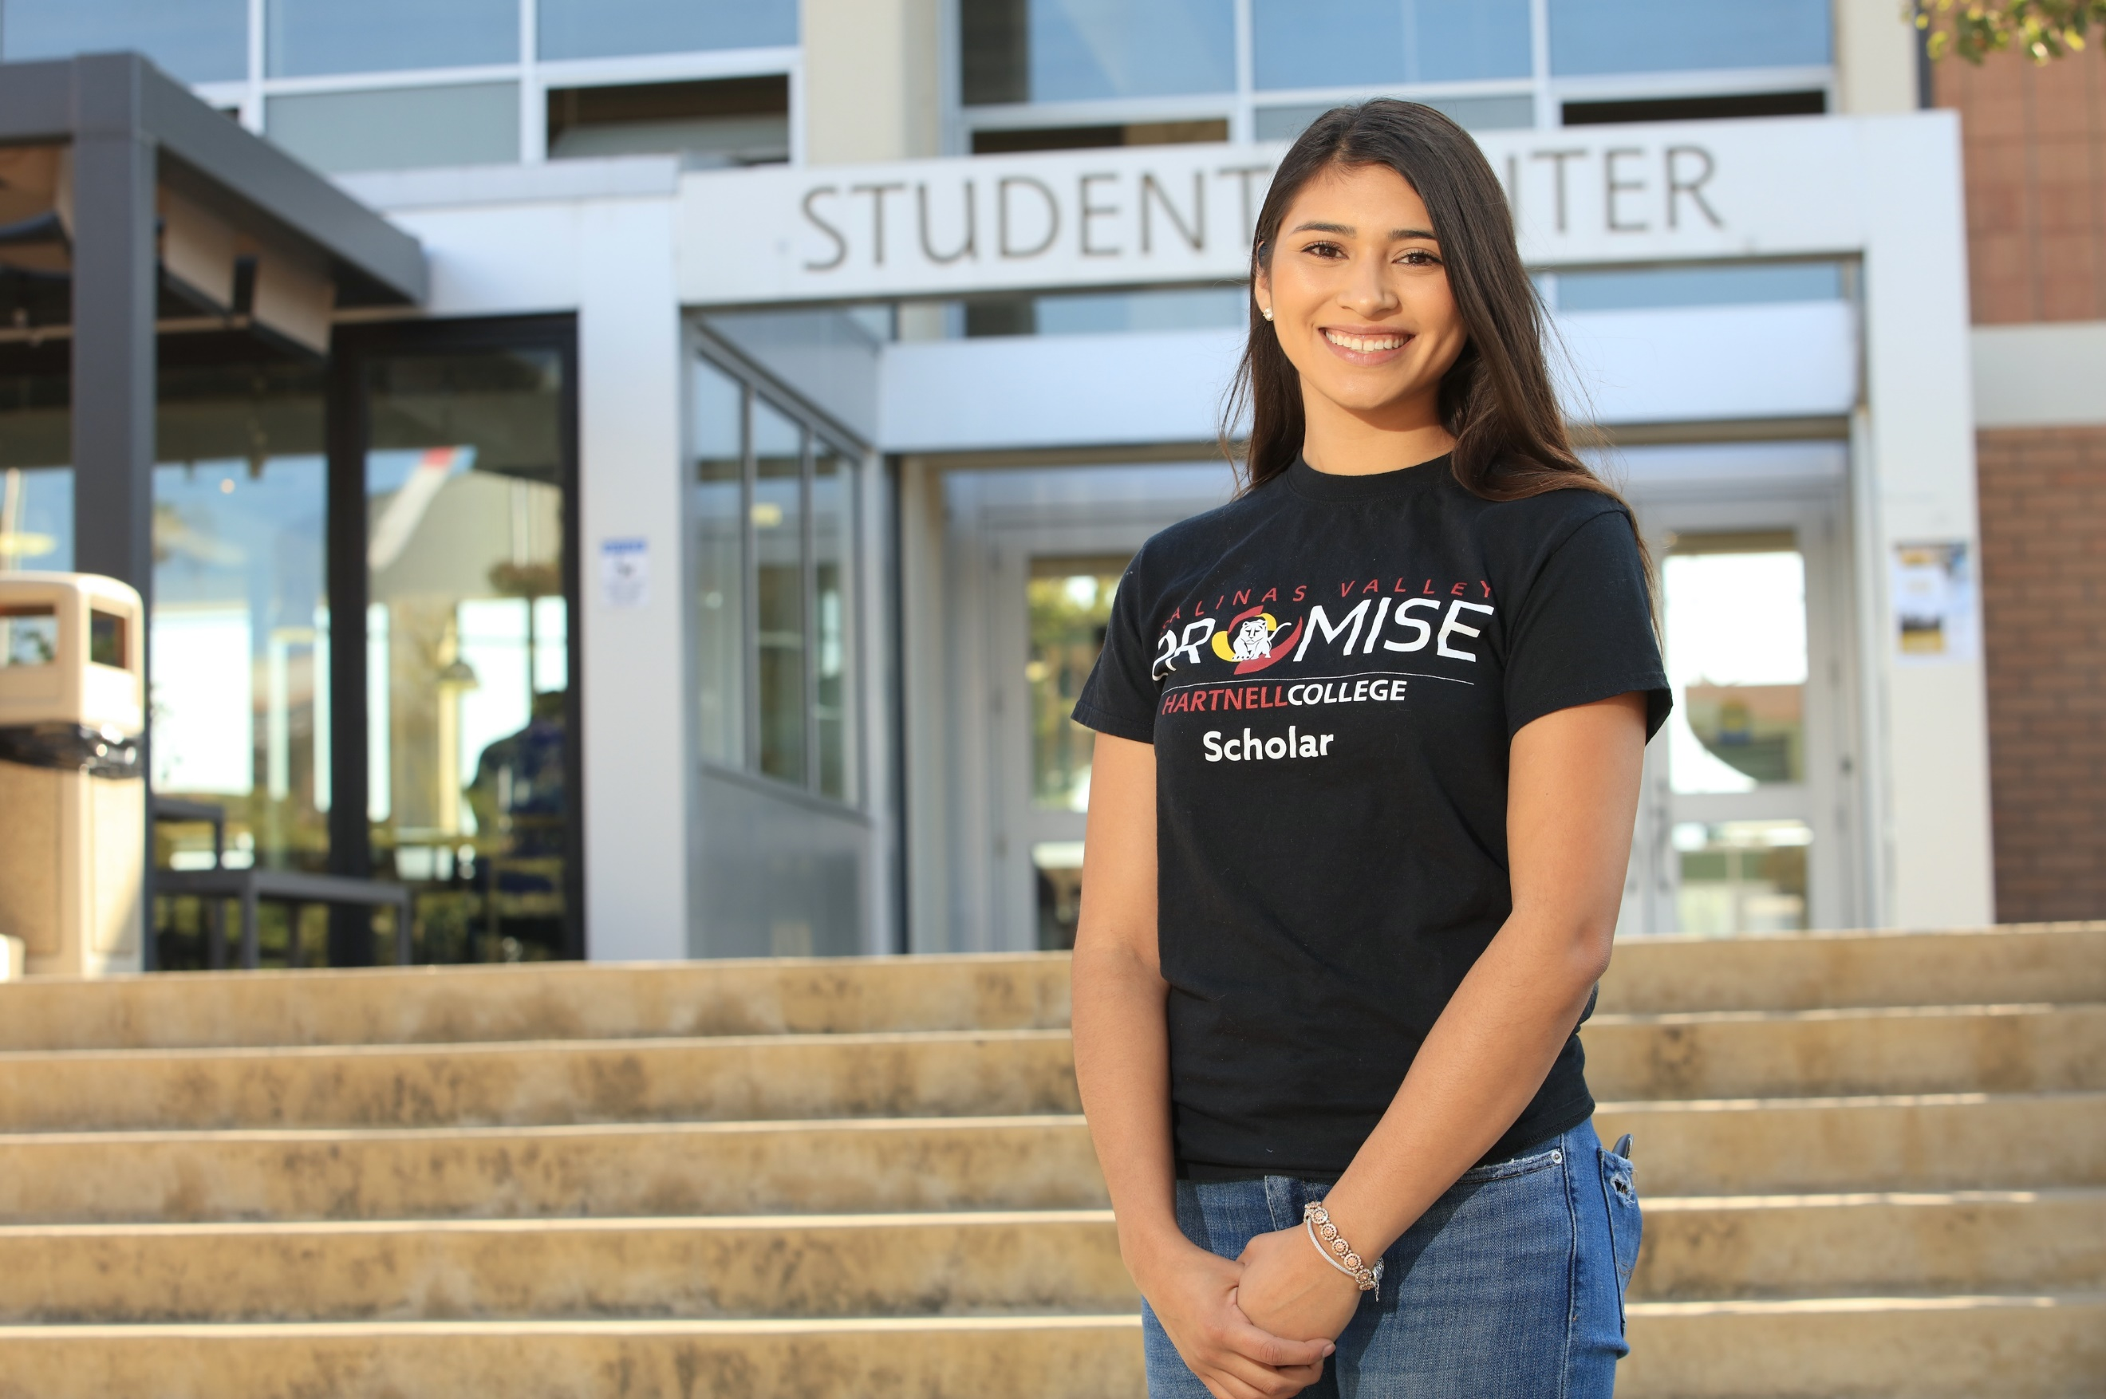
President’s Task Force Race, Equity, and Social Justice
Academic Senate meeting 4/13
Lisa Storm
Senorina Vasquez
Jackie Cruz

Slide 2
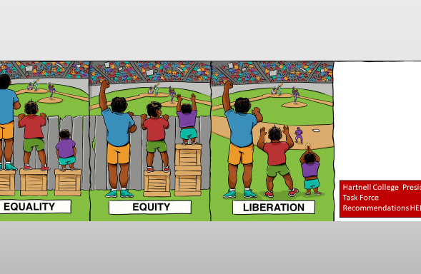
Defining Our Why?
Student & community centered
Responsive to l ocal, state, and national context and mandates
Data informed- confronting our brutal truths
Teaching & learning
Transformative leadership for cultural change
“Being Community Responsive, Is Being Culturally Responsive”
Quote by Dr. Jeff Duncan Andrade

Slide 3
Equity & Racial Justice- Beyond “Inclusivity”
Student Demographics | Percentage
First-Generation | 37%
Female | 45%
Male | 55%
American-Indian | 1%
Asian | 5%
Black | 2%
Latinx | 62%
Two or more races | 2%
Unknown | 6%
White | 22%
Hiring
Professional Development
Program & Curriculum Design
Board Policies & Administrative Procedures
Marketing & Communications
Students’ experiences throughout the College
Facilities
Antiracism is the intentional implementation of beliefs, laws, policies, procedures, curriculum, or other actions that identify and oppose personal and institutional racism- Dr. Angelica Garcia
Notes:
Antiracism is the intentional implementation of beliefs, laws, policies, procedures, curriculum, or other actions that identify and oppose personal and institutional racism.

Slide 4
Hartnell College’s Equity Commitment
We commit to provide a student-centered design of the college experience to ensure that every student receives what they need in a tailored pathway to successfully achieve their varied educational, career and personal goals. We will promote an anti-racism and anti-sexism agenda. We will raise awareness to the historical context of inequity and promote evaluation as well as reform of policies and practices that produce structural inequity. We pledge to work to correct other forms of systemic oppression against students based on race/ethnicity, gender identity and expression, sexuality, national origin, citizenship status, class, socioeconomic status, ability, language, religion, age, physical appearance, intersections of these identities, and others not yet identified ~ The Student Success and Equity and Committee
Recommended for adoption Institution wide
Recommended for Board Resolution
“Being Community Responsive, Is Being Culturally Responsive”
Quote by Dr. Jeff Duncan Andrade

Slide 5
Approach
Timeline of PTF Recommendation and Next Steps (Process)
OUR APPROACH:
1. TRI-CROSSWALK​ RESPONSE
CCCCO Call to Action​
President’s Task Force Framework​
Hartnell's Student Equity Committee (Nov. 2020)
2. DEVELOP AND LAUNCH ACTION TEAMS ( Jan. 2021)
3. EACH TEAM HAS BEEN DOING RESEARCH ON CURRENT CAMPUS EFFORTS AND WILL MAKE FIRST LEVEL RECOMMENDATIONS ON INSTITUTIONAL WIDE ACTION PLANS AND TIMELINES FOR IMPLEMENTATION (February - April 30)
4. COURAGEOUS CONVERSATIONS CAMPUS WIDE TO SHARE RECOMMENDATIONS AND GATHER INPUT (May- September 2021)
5. FINAL RECOMMENDATIONS WITH INPUT FROM CAMPUS WIDE COURAGEOUS CONVERSATIONS GOES TO PRESIDENT, TRUSTEES, CPC, COUNCILS AND ACADEMIC SENATE AND COMMITTEES
6. IMPLEMENTATION BEGINS
7. ASSESSMENT, DISSAGREGATED DATA AND METRICS REVIEWED AND REPORTED TO THE COLLEGE, CHANCELLOR’S OFFICE AND COMMUNITY AT LARGE ANNUALLY
TASK FORCE MEETS TWICE A YEAR FOR CONTINUED ADVOCACY OF IMPLEMENTATION
“Being Community Responsive, Is Being Culturally Responsive”
Quote by Dr. Jeff Duncan Andrade

Slide 6
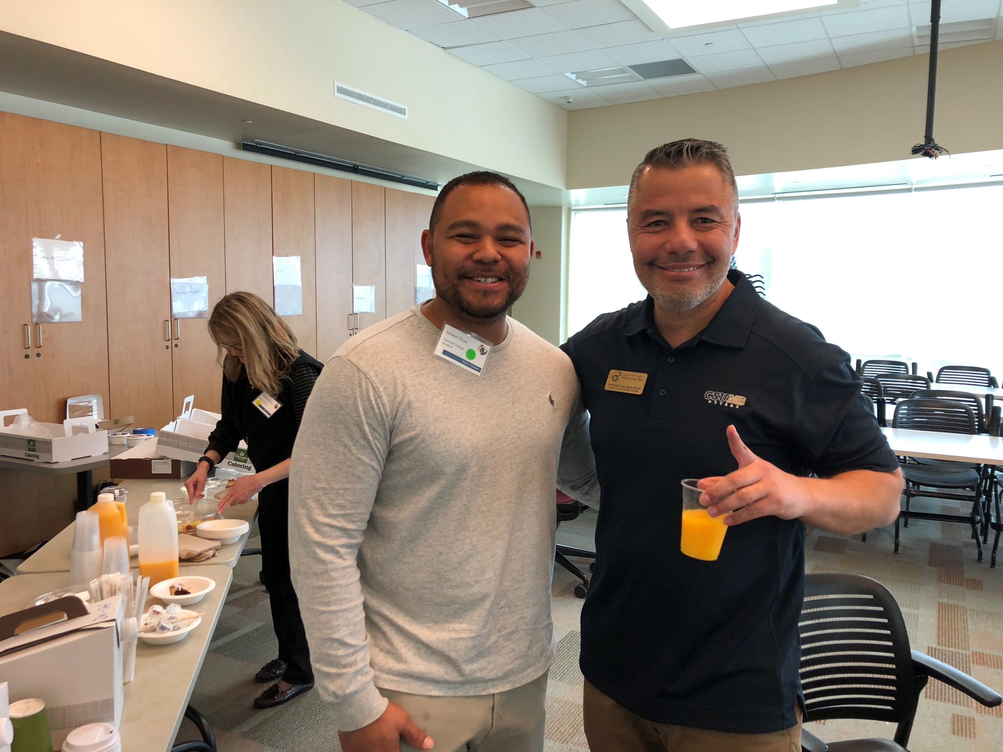
Action Teams
Group A​
Curriculum Review​
Lisa Storm ​
Nina Vazquez​
Jackie Cruz​
Hermelinda Rocha-Tabera
​
Courageous Conversations​
Marnie Glazier​
3 Student Representatives
​
Institutional Audits​
Laurencia Walker ​
Erica Rowe​
Guy Hanna ​
Bronwyn Moreno ​
Jay Singh ​
Moises Almendariz ​
Group B​
Student Equity Plan​
Jay Singh ​
Jackie Cruz​
Guy Hanna
​
Professional Development​
Moises Almendariz ​
Erica Rowe ​
Lisa Storm ​
Laurencia Walker ​
Nina Vazquez ​
​
Student Engagement​
Bronwyn Moreno ​
Shawn Pullum ​
Marnie Glazier
Group C​
Data Team – ​
Coordination with SSEC​
Guy Hanna​
Shawn Pullum​
Nina Vazquez​
​
Technical Updates - from CCCCO ​
Inventory/Research + Gap Analysis + Recommendations

Slide 7

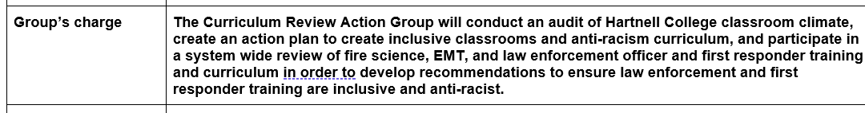
Curriculum Action Group
Recommendations will go to the College President
Charged with classroom climate audit and first responder curriculum review

Slide 8
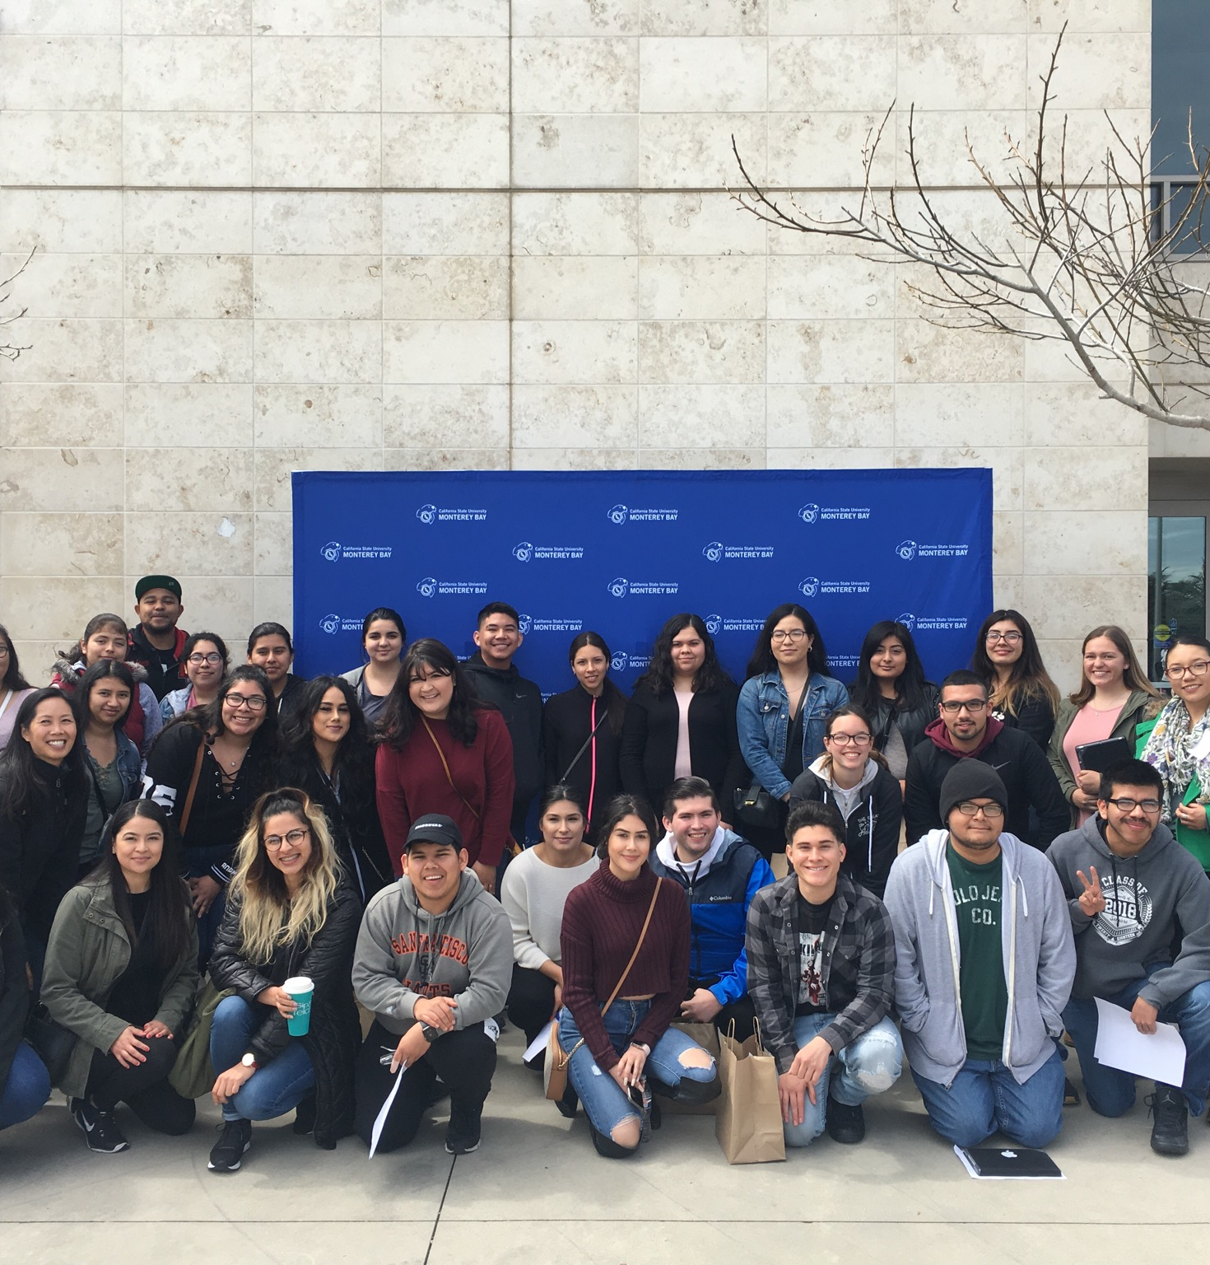
Equity Rubrics
#1: SSEC Equity Rubric #2: CC Equity Lens #3: Peralta Equity Rubric
We are recommending:
Systemic use of the SSEC equity rubric and CC equity lens
Cataloging online courses that conform to the Peralta Equity Rubric and Online Education Initiative Rubric
Highlighting equity-minded coursework in the online course schedule (Self-Serve)

Slide 9

We recommend: inform and promote new ethnic studies courses to students
Promote expansion of courses to fulfill the CSU requirement at the CC level, therefore supporting Hartnell students at a foundational level and completing a transferable course at a lower cost

Slide 10

We recommend enhanced education for law enforcement officers and first responders
On the horizon: AB 89 and SB 387

Slide 11

JAJ and JFS Coursework Review Per the Joint Powers Authority
We recommend being an active partner, using our funding leverage to have courageous conversations and dialogue with the JPA consortium regarding review and revision of these courses per the call to action by Chancellor Oakley.

Slide 12

Preliminary Overarching Recommendations :
Be Explicit, Be Intentional, Be Responsive to the Community
Add Equity to the following :
Strategic Plan
Mission Statement
Vision Statement
Values Statements

Slide 13

Large image
Thank you! Please let us know if you have any questions

