Slide 1
Brian Lofman, PhD.,
Matthew Trengove, PhD.
Results from Student Pandemic Surveys:
Promoting Organizational Success Student Surveys (2020SP & 2021SP)
Student Services Survey
Stop-Out Student Survey
ASHC Return to Campus Survey
Institutional Planning Research & Effectiveness (IPRE)
April 20, 2021

Slide 2
Key Objectives
Conducted multiple surveys over the past year:
  Determine whether students have adapted to online instruction and/or services over the past year
  Support our students as they navigate this transition
  Explore reasons that students stop-out (i.e., no classes for two primary semesters)
  Evaluate student perceptions/attitudes on a return to in-person learning

Slide 3
General Findings
Result is a comprehensive profile of student experience, perceptions and attitudes.
  Students have adapted to online format and overcome many significant obstacles like internet reliability and/or computer access.
  Students are satisfied with support services, report increased use, access and satisfaction.
  The most common reasons for stopping-out were work commitments and/or transfer to another institution.
  Students are reluctant to return to campus, citing health concerns and convenience of online classes.

Slide 4
Survey Demographics
Promoting Organizational Success Student Surveys:
Response Rates (2020SP): 14.6% (n=1,276 respondents)
Response Rates (2021SP): 12.3 % (n=942 respondents)
Hartnell Student Services Survey 2020FA (SS):
Response Rates: 10.6% (n=1,086 respondents)
Stop-Out Student Survey Spring 2021 (STOP):
Students enrolled in '2019SU', '2019FA', '2019SP', who were NOT enrolled in '2020SU', '2020FA', '2020SP ‘:
Response Rates: 4.3% (OR 191 respondents)
Return to Campus survey Spring 2021 (ASHC):
Response Rates: 9.5% (OR 744 respondents)
Notes:
The responses were quite extensive, so this presentation targets a cross comparison of shared experiences and/or significant changes over time (e.g., 2020SP – 2021SP).
Responses were anonymous so we can’t follow-up or disaggregate results
We’re provided a flat file for those who want to dig into the data.

Slide 5
Promoting Organizational Success (POS)
(2020SP & 2021SP)
&
Student Services Survey (SS)
Determine whether students have adapted to online instruction and/or services over the past year
  Compare shared experiences and/or significant changes over time
    We’re provided a flat file for those who want to dig into the data.
    Responses were anonymous so we can’t follow-up or disaggregate results

Slide 6
Online environment (POS, Q1, Q5 & Q6)

Slide 7
Assessing Essential Services/Materials (POS, Q13, Q14 & Q15)
Independent T-Tests indicate that students have had significantly fewer issues accessing essential services this year, when compared with 2020SP respondents.

Slide 8
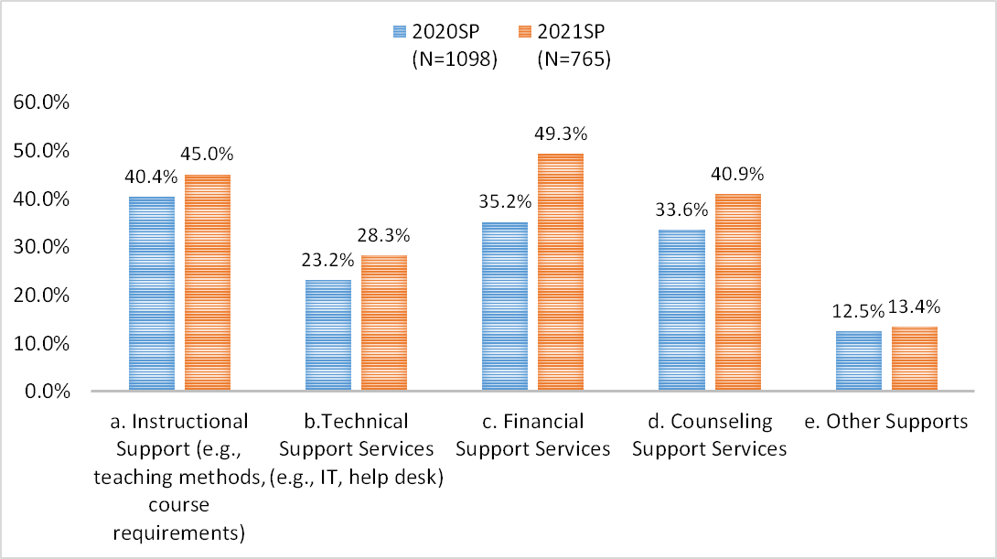
What do you need to be successful (POS, Q7)?
Financial Support Services, Instructional Support, and Counseling Support are the most needed services among the 2021SP respondents

Slide 9
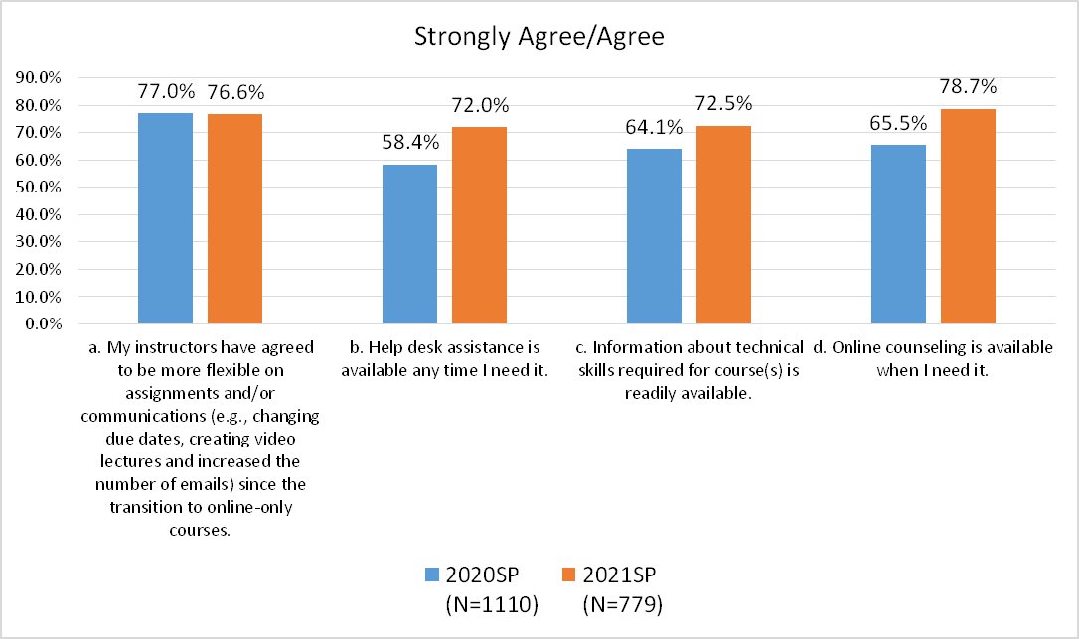
Respond to each of the following statements (POS, Q4)
Overall, respondents are satisfied with the support services provided by Hartnell, and the level of satisfaction has increased compared to previous year.

Slide 10
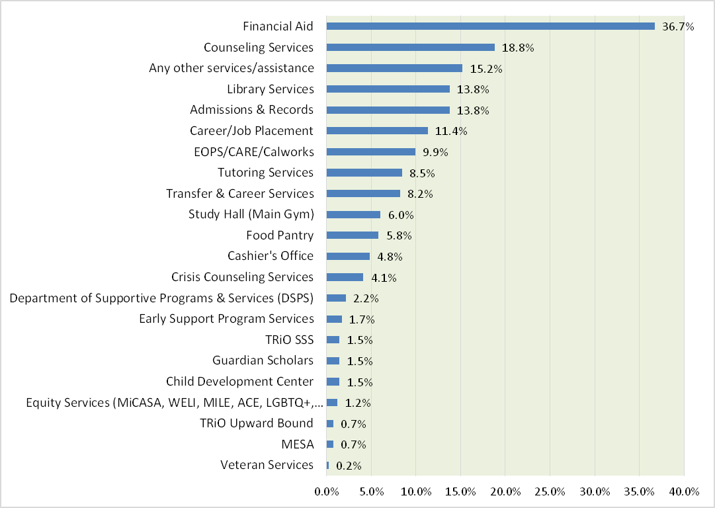
Are there any services that you need, but have been unable to receive (SS, Q3)?
N=414

Slide 11
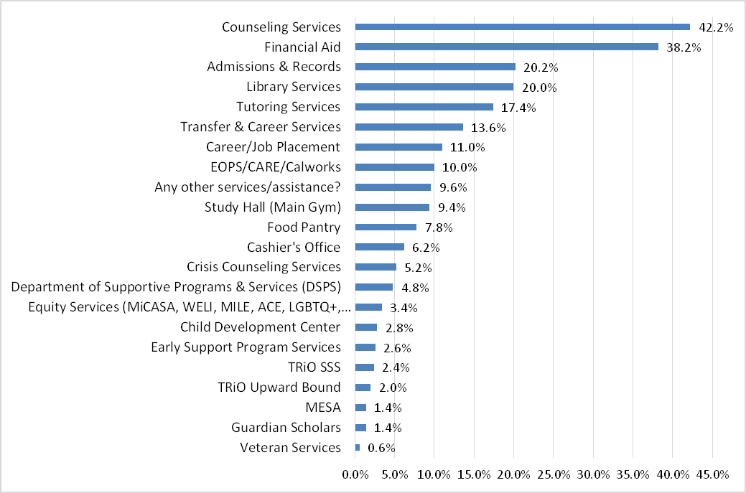
Are there ANY in-person appointment-only services that you'd like to receive (SS, Q4)?
N=500
Notes:
63% of the Student Services survey respondents prefer online services
A&R
Implemented Cranium Café (2020FA only), which served about 600 students for both A&R and Financial Aid.
Implemented a Zoom virtual front desk which has served 1,091 (January - February) and 726 (February - March) students for Financial Aid and/or A&R purposes.
Tutoring Services: Launched canvas button, partnership with math faculty to host Academic Excellence Workshops and increased outreach to students Results of a 7 week comparison
Fall 2020: August 24 - October 5 Spring 2021: January 25 - March 9
Students: 244, Visits: 973 Students: 364, Visits: 1334
Counseling Services
2019FA 2020FA
Students 16408 Visits 18,286 Students 10908 Visits 16,282

Slide 12
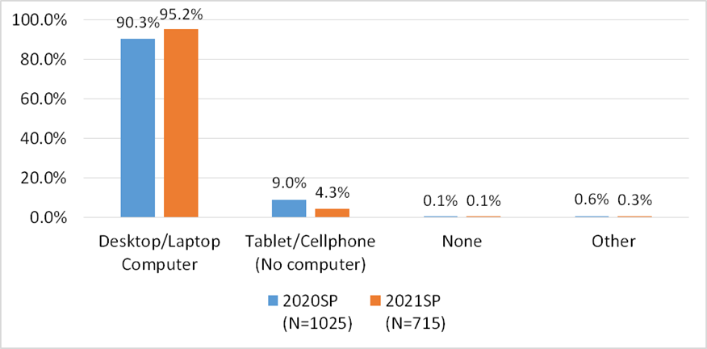
What kind of computer/technology is available from home (POS, Q19)?
A large majority of respondents (95.2%) have either a laptop or a desktop, 5.4% increase from last year.

Slide 13
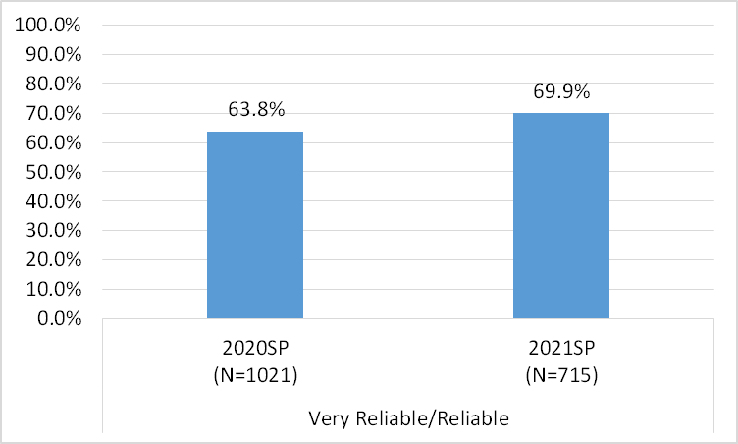
How reliable is your home internet now that all classes are online (POS, Q16)?
A little over two-third of respondents indicated that their home internet is reliable. Home internet reliability has improved this year.

Slide 14
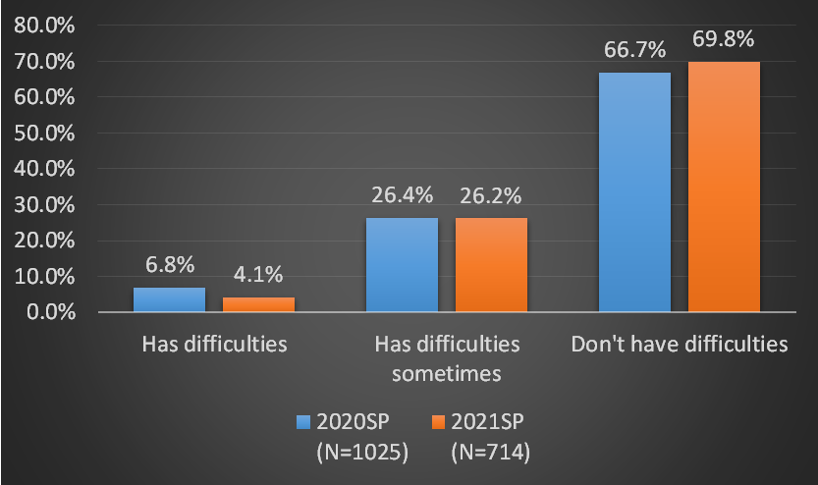
How often do you have technical difficulties with the Canvas learning management system (POS, Q18)?
A small percentage of respondents (4.1%, n=29) always or very often have technical difficulties with the Canvas learning management system, a 40.8% decrease from last year.

Slide 15
Challenges students have faced (POS, Q20)
 | Top 5 Challenges
 | 2020SP (N=265 or 20.8% of all Survey responses) | 2021SP (N=258 or 27.4% of all Survey responses)
Distraction and time management | 1 | 2
Lack of motivation/interest/adaptability | 2 | Not in top 5
Communication (student-student and student-faculty) | 3 | 1
Course instructional method fit | 4 | 5
More work/assignments | 5 | Not in top 5
Internet access | 5 | Not in top 5
Stress/Depression/Mental Health | Not in top 5 | 3
Access to course materials | Not in top 5 | 4

Slide 16
Stop-Out Student Survey
(2021SP)
Explore reasons that students stop-out (i.e., no classes for two primary semesters)
  41% of Stop Out survey respondents wanted to get an Associates
  43% of Stop-Out survey respondents are working full-time
  77% of Stop-Out survey respondents don't consult counselors before leaving

Slide 17
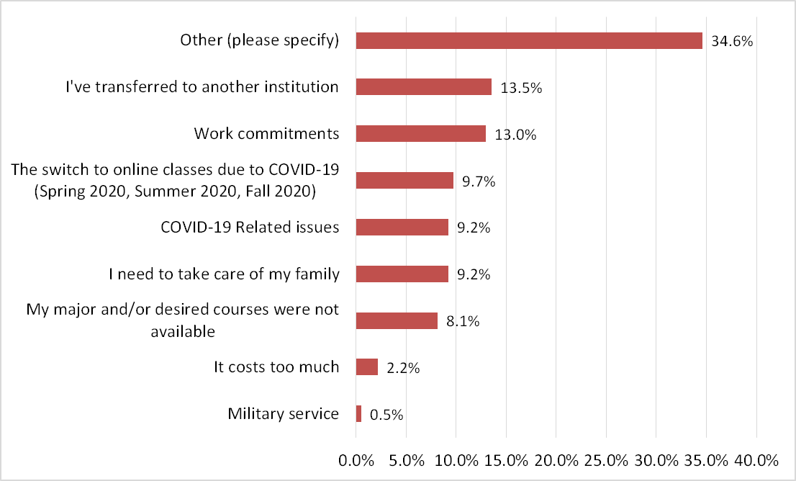

Biggest reason that you're NOT taking classes at Hartnell College (STOP, Q3)
Other (please specify) :
• Graduated/achieved plan (n=8)
• Attend another institution (n=6)
• Work commitment (n=6)
• Relocate (n=S)
• Lack of motivation/interest (n=4)
• Course/program not offered (n=3)
• Stress/depression/mental health (n=3)
• Still in high school (n=3)
• Unable to register (n=3)
• Harassment (n=3)
• Western Stage Theatre is closed. (n=3)
• Family obligations/issues (n=3)
• Have other priorities (n=2)
• Waiting to get to Nursing program (n=2)
• Waste of time (n=2)
• Unclear goal (n=l)
• COVID(n=l)
• Academic Probation (n=l )
• Poor education quality/inconsistent staff
Services (n=l)
N=185

Slide 18
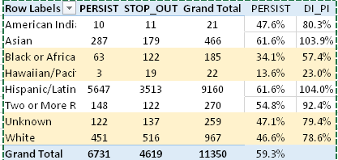
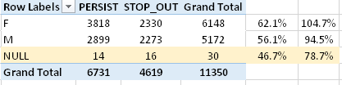
Disproportionate Impact Stop-Out
The persistence of African American students may have been disproportionately impacted based on Proportionality Index method (Above 80% = No disproportionate impact)
White and undeclared race/ethnicity students were also disproportionately impacted but close to the margin
Persistence of Pacific Islanders and Undeclared gender may be disproportionately impacted, but subject to small sample (subject to error)

Slide 19
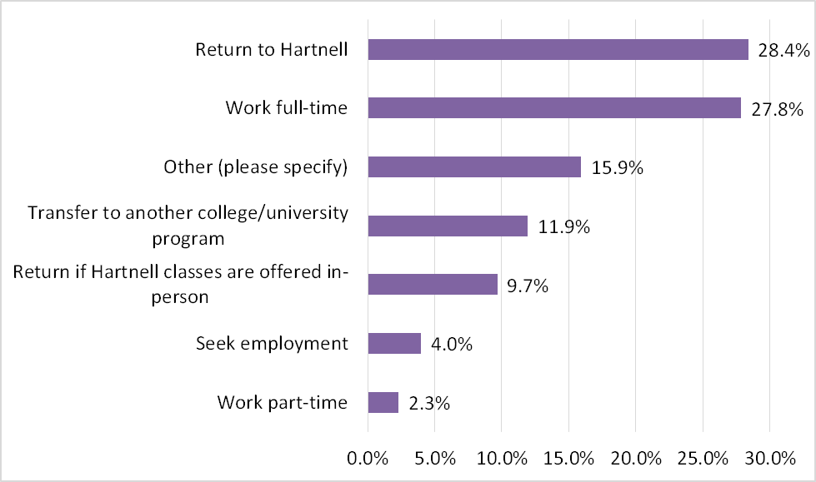
What are you future plans (STOP, Q7)?
N=176

Slide 20
Return to Campus Survey (2021SP)
Evaluate student perceptions/attitudes on a return to in-person learning

Slide 21
Return to Campus Survey (ASHC Q1)
Yes 283
No 347
Maybe 113
Safety Concerns 54 (47.79%)
Online Convenience 17 (15.04%)
Prefer Hybrid 16 ( 14.16%)
Depends on Course 16 (14.16%)
Transportation 3 (2.65%)
Kids 2.65% 3 (2.65%)
N/A 2.65% 3 (2.65%)
Notes:
46.7% (n=347) said they did NOT want to return to in person learning (ASHC, Q1)
15.2% (n=113) said they may return depending on health/safety issues (e.g., illness, class size, maintain safety protocols) being the biggest concerns.

Slide 22
In-person lessons following safety protocols (ASHC, Q2)
Notes:
43.9% prefer a hybrid format moving forward (ASHC, Q2).
32% prefer continuing with a fully online course format.

Slide 23
Return to Campus (ASHC, Q3)
57% (n=424) were slightly/very uncomfortable returning to campus in 2021FA, with biggest concern (87%) being personal/family health
Notes:
Aligns with 57% who were slightly/very uncomfortable returning to campus in 2021FA (ASHC, Q3) biggest concern (87%) was personal/family health

Slide 24
PPE Utilization (ASHC, Q5)

Slide 25
Vaccination (ASHC, Q6)
77.3% said that they have already or would receive a COVID vaccination
68.1% said that it’s extremely important (mandatory) or very important to vaccinate all students, faculty, staff and administrators before resuming in person learning (ASHC, Q7).
Notes:
68% said that it’s extremely/very important to vaccinate staff, faculty, administrators and students before resuming in-person learning
30% of respondents have already received a COVID vaccination, another 46.9% are willing/willing with some hesitation to receive vaccination

Slide 26

Thanks for your attention

