Slide 1
Matt Trengove
Results from the 2021SP Promoting Organizational Success (HR Survey)
Institutional Research
(233 Respondents)

Slide 2
Survey Demographics
233 Respondents
220 were working remotely
  There was a good distribution of stakeholders FT-Faculty (n=76), CSEA (n=56), PT-Faculty (n=34) & Administrators (n=29)
72% were working remotely 5 days a week
  Intermittent remote workers consisted of CSEA (n=19) PT-Faculty (n=16) and FT-Faculty (n=11)

Slide 3
Q9: Advantages from working remotely
60% (n=123) survey respondents favor remote work experience
Benefits Include:
Increased Flexibility, and Productivity (n=57) (e.g., Closer to family, no commute, fewer distractions)
Avoid COVID (n=11)
However,
Responses differ by position with 50% split among faculty who cite student development
75% CSEA & Admin favor remote work experience
Potential Issues include:
Concerns with student development (n=20)
Fewer collegial/social experiences (n=8)
Small children (n=2)
Health weight gain/Overwork (n=2)
Technical Issues (n=2)
Notes:
This question provides a good summary of the responses on remote work experience.
The numbers cited relate to this specific question, but were common throughout the survey.

Slide 4
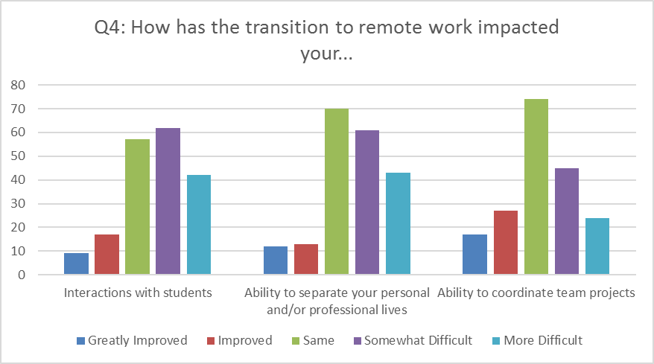
Question 4: Impacts of remote work
Largest impact of the transition has been ‘interactions with students’ and their ability to separate personal & professional lives, based on statements that they’re working longer, are more productive and concerned with student development.
65% of responses report as Same or Somewhat difficult.

Slide 5
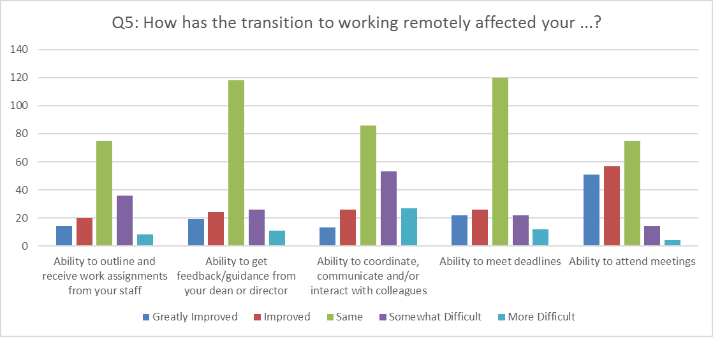
Question 5: Productivity/Interactions
Many favorable comments, like increased productivity and/or flexibility (no commute, ability attend more meetings, and coordinated schedules across campus(es).
Respondents miss collegial interactions, so timely email responses are now more important.
There is a 50/50 split among faculty, who are generally concerned with student development

Slide 6
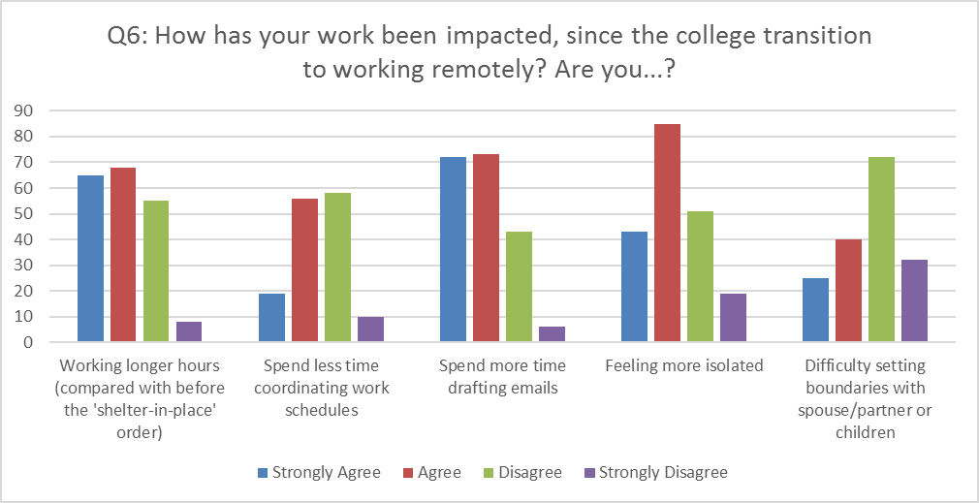
Q6: Work-life balance
Even though 68% of survey respondents say they’re working longer and 64% feel more isolated, the majority 66% say that remote work is a viable long-term option for their position. Note: Varies by position (re: Q10).
Difficulty setting boundaries applies to those with small children.

Slide 7
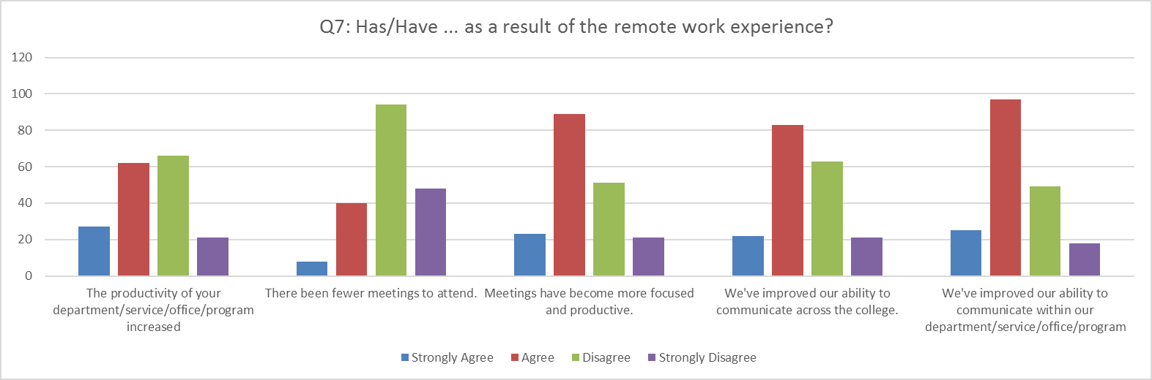
Q7: Productivity measures
Response to remote meetings are favorable (includes counselors & multi-campus positions):
55% say it’s easier to communicate across campus
61% say meetings are more focused
65% say communication has improved in their office

Slide 8
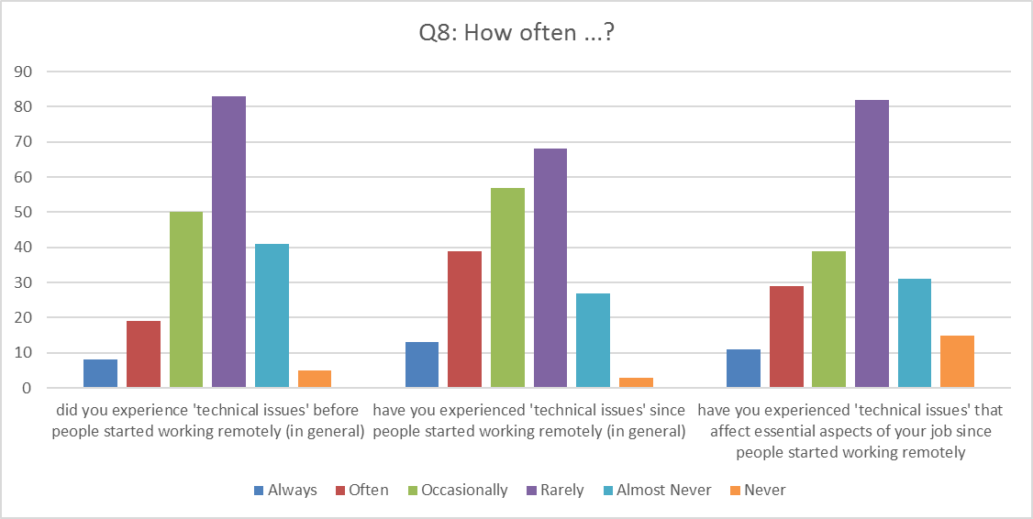
Q8: Technical Issues: Good News
Technical issues have largely focused on internet connections (n=53)
Most of the Hardware issues (n=20) have focused on chromebooks, hotspots and/or need for dual-monitors
Occasionally = every other week, Rarely = once a month, almost never = once a year

Slide 9
Q10: Technology needs
71% (n=149) said they had the equipment and/or technology to be successful working remotely
33% (n=18) cited dual monitors/laptop
28% (n=15) cited office equipment, chairs desk, printers
19% (n=10) cited internet access
21% (n=11) cited special needs (software, kiln)
66% felt that working remotely was a viable long-term option for their positions, again split among faculty
72.4% % Administrator
65.5% Classified CSEA Staff
72.7% Confidential Staff
52.6% % Full-Time Faculty
44.1% %% Part-Time Faculty

