Slide 1
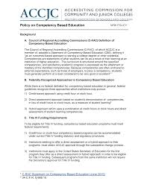
Clint Cowden
Direct Assessment Competency-Based Education Collaborative
Dean | Academic Affairs
2/9/21

Slide 2
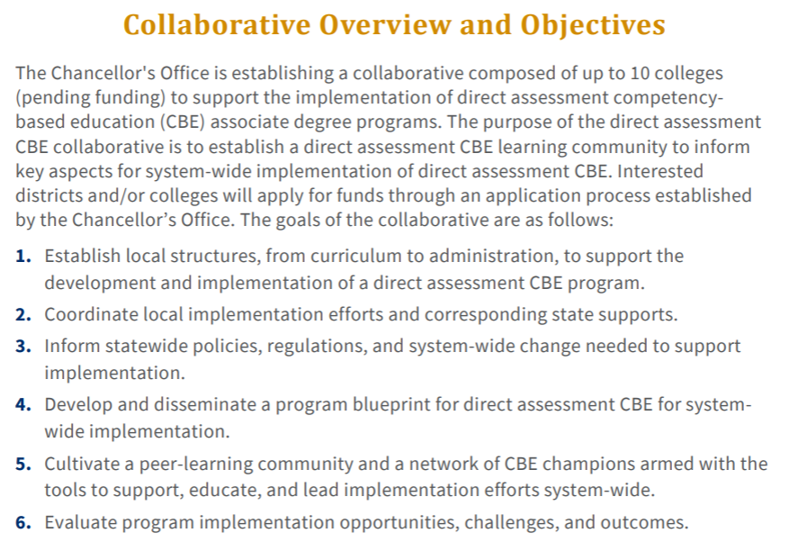
Collaborative Overview and Objectives

Slide 3
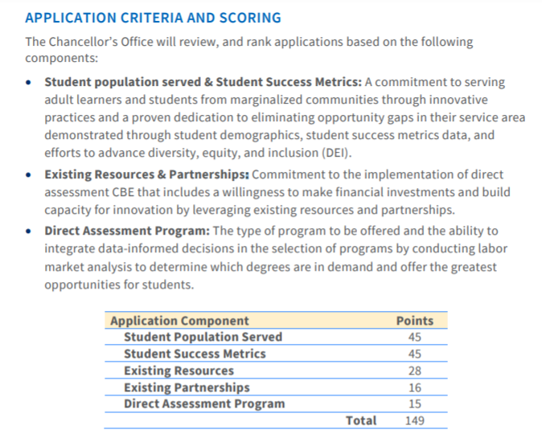

Slide 4
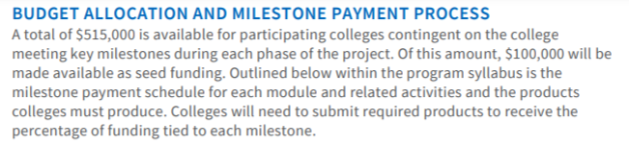
BUDGET ALLOCATION AND MILESTONE PAYMENT PROCESS

Slide 5
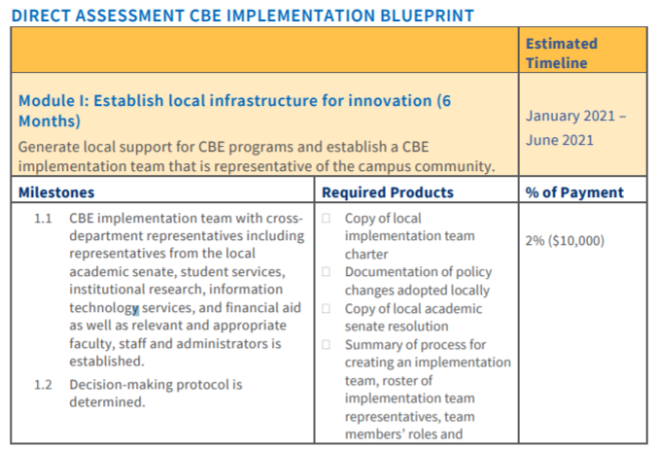
First Steps

Slide 6
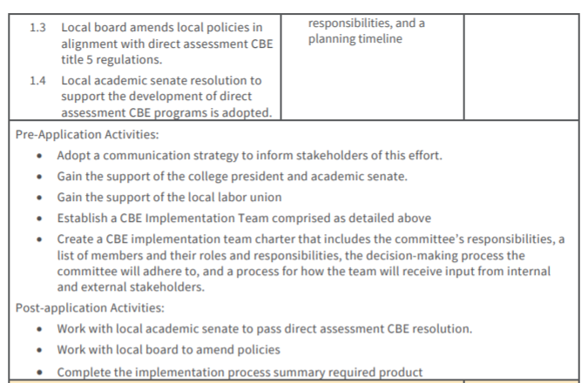
First Steps

Slide 7
The Ask
Gather a group of interested participants
  Member from each Metamajor Area
  Student Services
  Institutional research
  IT
  Financial aid
  HCFA
Complete the application by Feb 5th

Slide 8
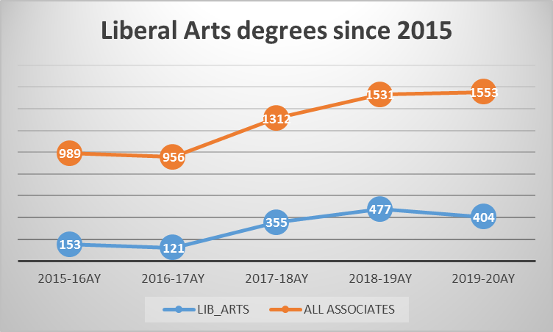

Slide 9
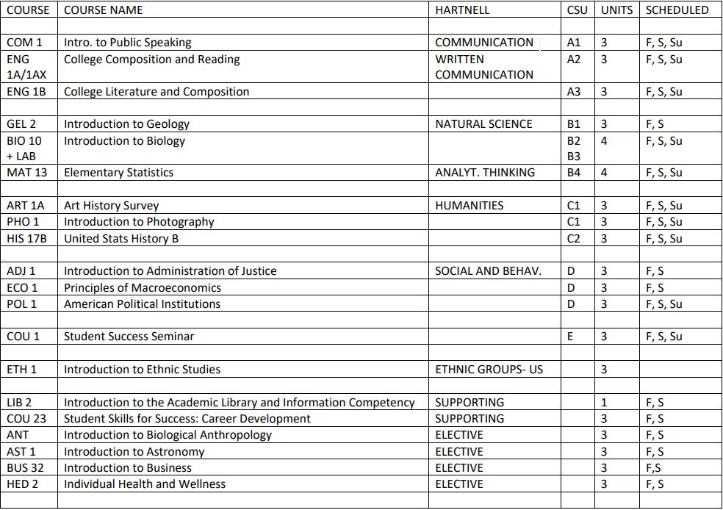
POSSIBLE 2 YEAR, FULLY ONLINE ASSOCIATES IN LIBERAL ARTS, cbe

Slide 10
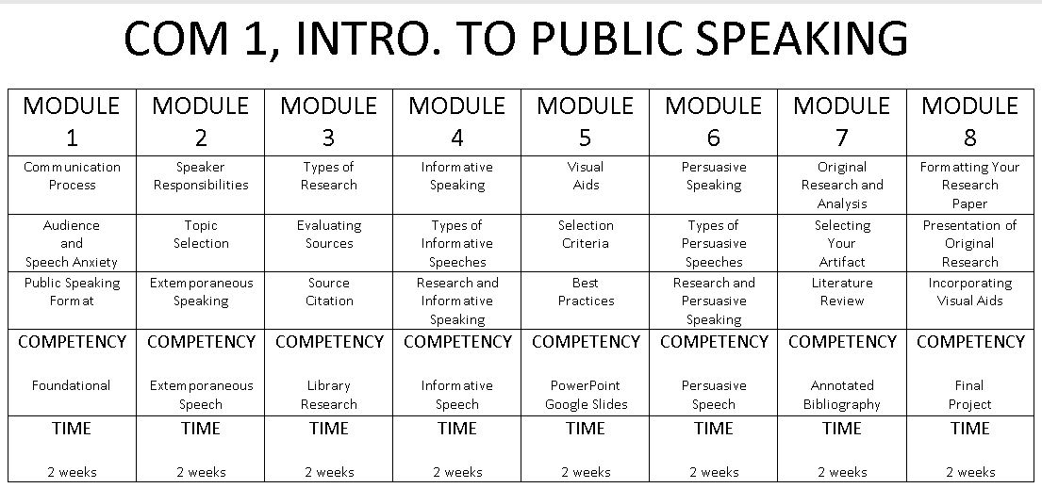
CBE SAMPLE COURSE

Slide 11
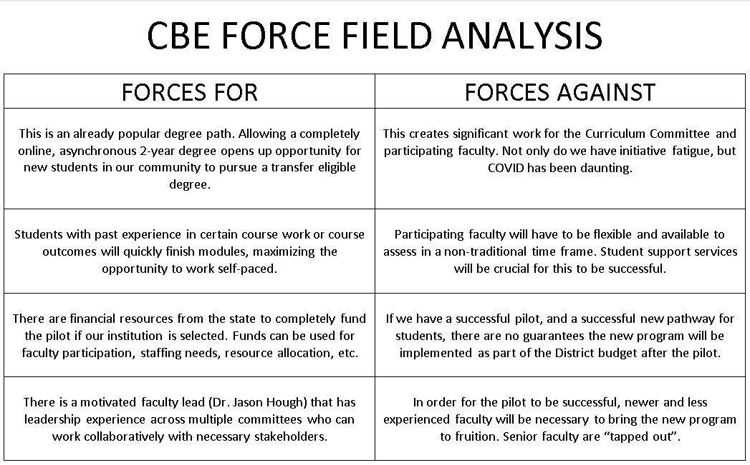

Slide 12

Questions

Slide 13
Links
ACCJC
  Policy on Competency Based Education
Grant
  Direct Assessment Competency-Based Education Collaborative
DQP
  National Institute for Learning Outcomes Assessment
CBE Grant Open Question Hour
  Zoom Link (1/15/31 @ 11 AM)

