Slide 1


Augustine Nevarez
Director of Student Affairs – Student Life
Basic Needs Center
Bronwyn Moreno
Director of Student Affairs – Equity Programs

Slide 2
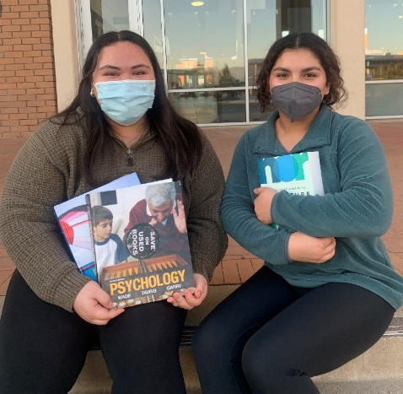
Purpose of the Basic Needs Program
The Basic Needs for Postsecondary
Students Program provides grants to eligible institutions of higher education (IHEs) to support programs that address the basic needs of students and to report on practices that improve outcomes for students.

Slide 3
Grant Competition
Approximately $5,000,000 allotted in FY 2021.
First time BN competition was funded
Competition opened in Nov. 2021.
37 applications received.
$4,950,000 was used to award grants to 6 2-year public institutions.
Cut-off score was 103.33 out of 105 possible points.

Slide 4
2021 Grantees
Grantee | State
Montgomery College | MD
McLennan Community College | TX
Rio Hondo College | CA
Hartnell College | CA
Los Angeles City College | CA
Passaic County Community College | NJ

Slide 5
CCCCO Basic Needs centers
Assembly Bill 132 provides $100 million in one-time
funding to help California community colleges provide comprehensive basic needs services to reduce equity and achievement gaps among traditionally underrepresented student populations across California.
Hartnell College Allocation: $243,064

Slide 6
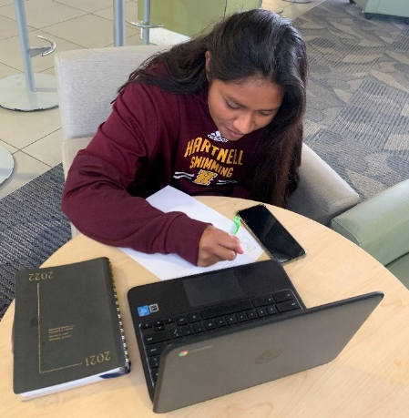
Current Plan
Develop a small workgroup to plan BNC
implementation
Develop a staffing plan
Find an appropriate tracking software
Work with facilities to find an appropriate location for the center
Sustainability/institutionalization plan
Notes:
(not just expressed once to push buttons)
thoughts such as, “Women should be barefoot and pregnant,” “Gays are an
abomination to God and should be punished,” “Muslims are all terrorists and
should be wiped off the earth.”
to staff, faculty or students, such as “I am going to
kick your ass” or “If you say that again, I will end you.”
such as sitting with arms
crossed, glaring or staring at staff, and refusing to speak or respond to questions
or directives.
such as cutting or burning, including during a meeting or
class, or exposing previously unexposed self-injuries.
Overuse of an office or staff function or time; especially when already instructed
not to overuse the staff or office

Slide 7
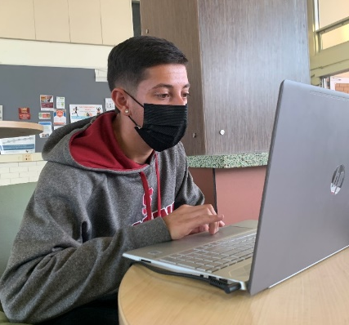
The Roles of the Project Staff
Project Director oversees the project and staff to ensure successful implementation of activities
Ensures project stays within budget and stays compliant at all times
Ensures evaluation methods are sound and produce results
Actively works to institutionalize components of the project
Case Manager works with students to assess and develop a plan the
Peer Mentor/Ambassador will support project
Notes:
while talking and/or repeated asking of irrelevant, off-topic
questions.
● Interruptions in conversation, frequent unnecessary use of the restroom or smoke
breaks that have a student up and down in class, etc.

Slide 8

Preventing Disruptive Behavior
Notes:
The statement needs to be non-authoritarian but very clear regarding your attendance policy, lateness to class policy, respecting everyone’s opinions in class and respecting one another, cell phone policy, no-talking while someone else is talking, etc

