Slide 1
CB Codes and Curriculum
Kelly Locke
Presented to Curriculum Committee August 30, 2019

Slide 2
What are CB codes?
CB stands for “course basic”
Used for CCCCO to count things (and fund things)
Codes go from 00 to 26
CB 12, and 14-20 have been deleted
CB 25 and CB 26 are new

Slide 3
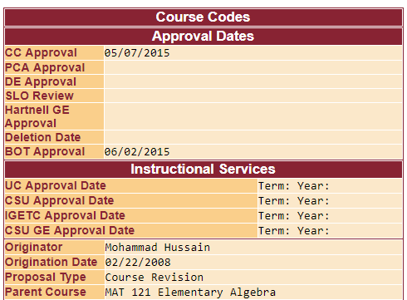
Curricunet Codes/Dates Page

Slide 4
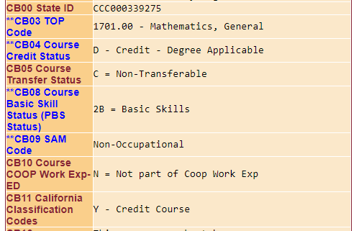

Slide 5
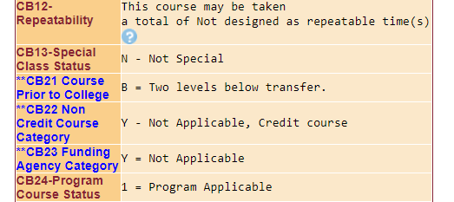

Slide 6
What are the codes?
CB 00 is course control number
CB 01 is what we call the course designator and number
CB 02 is the course title
CB 03 is the TOP code More info coming!
CB 04 is credit status (degree applicable or not or noncredit)

Slide 7
What are the Codes?
CB 05 is transfer status (to UC and CSU, CSU only, or not transferable)
CB 06 is maximum units
CB 07 is minimum units
CB 08 is basic skills status—basic skills or not
CB 09 is SAM code. It indicates the degree to which a course is occupational and assists in identifying sequences in occupational programs

Slide 8
What are the Codes?
CB 10 is work experience status. Is this a cooperative work experience class or not?
CB 11 is classification as credit or designates type of noncredit
CB 12 repeatability HAS BEEN DELETED
CB 13 indicates special status for students with disabilities
CB 14, 15 (CAN) HAS BEEN DELETED

Slide 9
What are the Codes?
CB 16, 17, 18, 19, 20 HAVE BEEN DELETED
had to do with cross-listing
CB 21 indicates how many levels below transfer a math or English or ESL course is. (More info later!)
CB 22 is noncredit category (more detailed than CB 11)

Slide 10
What are the Codes?
CB 23 indicates if the course was funded through EdNet funding for workforce development.
CB 24 indicates whether a course is part of a program (degree or certificate)—either as a required course or one of the restricted electives

Slide 11
Two New Codes
CB 25 will identify GE requirement or local competency: CSU GE Breadth/IGETC—B4/2A (math/QR) and A2, A3/1A (English Comp/Critical Thinking), local GE/competency
CB26 will identify support course created for AB 705 compliance. This is a binary code: support course or not a support course

Slide 12
All Based in Curriculum
Content determines TOP code (CB 03), basic skills or not (CB 08), how far below transfer (CB 21), where in the occupational sequence (SAM code—CB 09), special status for students who are disabled (CB 13)
Other codes are direct parts of outline—course number (CB 01), title (CB 02), units (CB 06, 07), credit or noncredit (CB 11)

Slide 13
All should be proposed by faculty in the discipline and approved by the Curriculum Committee.

Slide 14
Implications
Codes are used by CCCCO to identify things they want to count.
  Types of CTE courses
  Transfer level math/English courses (new funding formula)
  Units for apportionment
  Courses in a program vs “stand alone” courses
  Courses that DSPS students take where repeating is allowed

Slide 15
Implications
Funding
  State funding
  Perkins funding
Recognition
Data collection and reporting
  e.g. Scorecard, Basic Skills Student Tracker
  For example…

Slide 16
SAM Codes
Student Accountability Model (SAM) codes help identify pathways within CTE programs
  introductory vs capstone
Determine Perkins and Strong Workforce funding
CTE Outcomes Survey and LaunchBoard.

Slide 17
SAM Codes
Affect calculations about students who took intro courses and skills-builders
(A) Apprenticeship (offered to apprentices only)
(B) Advanced Occupational
A “B” course is offered in one specific occupational area only and clearly labels its taker as a major in this area. The course may be a “capstone course” that is taken as the last requirement for a career technical education program.

Slide 18
SAM Codes
(C) Clearly Occupational (but not advanced)
  Courses will generally be taken by students in the middle stages of their programs and should be of difficulty level sufficient to detract “drop-ins.”
(D) Possibly Occupational
    Taken by students in the beginning stages of their occupational programs. Also used for service (or survey) courses for other occupational programs.

Slide 19
SAM codes
(E) Non-Occupational
  These courses are non-occupational.
How is this related to Perkins funding?
  Students successfully completing 12 units in Career Technical Education in a two-digit TOP of which one course was a Sam A-C is considered a “concentrator.”
  The number of concentrators is a key comparison in Perkins accountability reporting. The number of CTE concentrators who complete, persist, and leave are reported as ratios.

Slide 20
Our 2019-20 Goal
To review and verify existing coding of all our courses (bulk action—802 active courses)
  Some codes will be easy to verify, others will require discussion with discipline faculty
  Similar to the “placing courses in disciplines” verification we started last year
Establish system
  CC to assist faculty to correctly code courses as they come through Curriculum Committee

