Slide 1
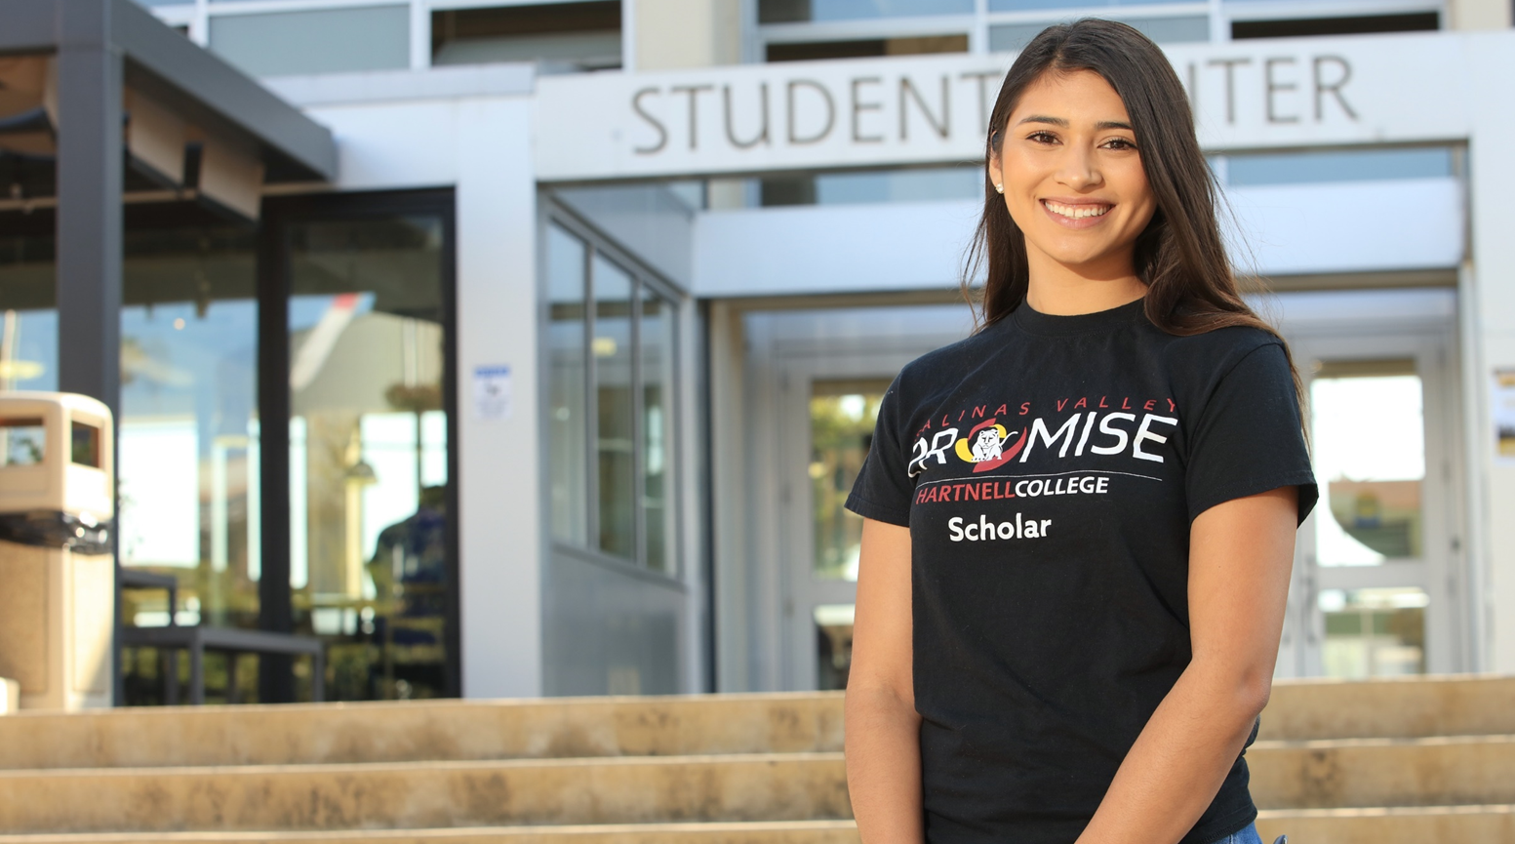
President’s Task Force Race, Equity, Social Justice
Jackie Cruz, Vice President of Advancement and Development
November 23, 2021

Slide 2
Defining Our Why?
Student & community centered
Responsive to local, state, and national context and mandates
Data informed- confronting our brutal truths
Teaching & learning
Transformative leadership for cultural change
“Being Community Responsive, Is Being Culturally Responsive”
Quote by Dr. Jeff Duncan Andrade

Slide 3
Hartnell College’s Equity Commitment
We commit to provide a student-centered design of the college experience to ensure that every student receives what they need in a tailored pathway to successfully achieve their varied educational, career and personal goals. We will promote an anti-racism and anti-sexism agenda. We will raise awareness to the historical context of inequity and promote evaluation as well as reform of policies and practices that produce structural inequity. We pledge to work to correct other forms of systemic oppression against students based on race/ethnicity, gender identity and expression, sexuality, national origin, citizenship status, class, socioeconomic status, ability, language, religion, age, physical appearance, intersections of these identities, and others not yet identified
~ The Student Success and Equity and Committee
Recommended for adoption institution wide
Recommended for Board Resolution
“Being Community Responsive, Is Being Culturally Responsive”
Quote by Dr. Jeff Duncan Andrade

Slide 4
Equity & Racial Justice- Beyond “Inclusivity”
Hiring
Professional Development
Program & Curriculum Design
Board Policies & Administrative Procedures
Marketing & Communications
Students’ experiences throughout the College
Facilities
Student Demographics | Percentage
First-Generation | 37%
Female | 45%
Male | 55%
American-Indian | 1%
Asian | 5%
Black | 2%
Latinx | 62%
Two or more races | 2%
Unknown | 6%
White | 22%
Antiracism is the intentional implementation of beliefs, laws, policies, procedures, curriculum, or other actions that identify and oppose personal and institutional racism- Dr. Angelica Garcia

Slide 5
Approach Timeline of PTF Recommendation and Next Steps (Process)
OUR APPROACH:
1. TRI-CROSSWALK​ RESPONSE
CCCCO Call to Action​
President’s Task Force Framework​
Hartnell's Student Equity Committee (Nov. 2020)
2. DEVELOP AND LAUNCH ACTION TEAMS ( Jan. 2021)
3. EACH TEAM HAS BEEN DOING RESEARCH ON CURRENT CAMPUS EFFORTS AND WILL MAKE FIRST LEVEL RECOMMENDATIONS ON INSTITUTIONAL WIDE ACTION PLANS AND TIMELINES FOR IMPLEMENTATION (February – August 2021)
4. COURAGEOUS CONVERSATIONS CAMPUS WIDE TO SHARE RECOMMENDATIONS AND GATHER INPUT (August- December 2021)
5. RECOMMENDATIONS WITH INPUT FROM CAMPUS WIDE COURAGEOUS CONVERSATIONS GOES TO PRESIDENT, TRUSTEES, CPC, COUNCILS AND ACADEMIC SENATE AND COMMITTEES
6. IMPLEMENTATION BEGINS
7. ASSESSMENT, DISSAGREGATED DATA AND METRICS REVIEWED AND REPORTED TO THE COLLEGE, CHANCELLOR’S OFFICE AND COMMUNITY AT LARGE ANNUALLY
TASK FORCE MEETS TWICE A YEAR FOR CONTINUED ADVOCACY OF IMPLEMENTATION
“Being Community Responsive, Is Being Culturally Responsive”
Quote by Dr. Jeff Duncan Andrade

Slide 6
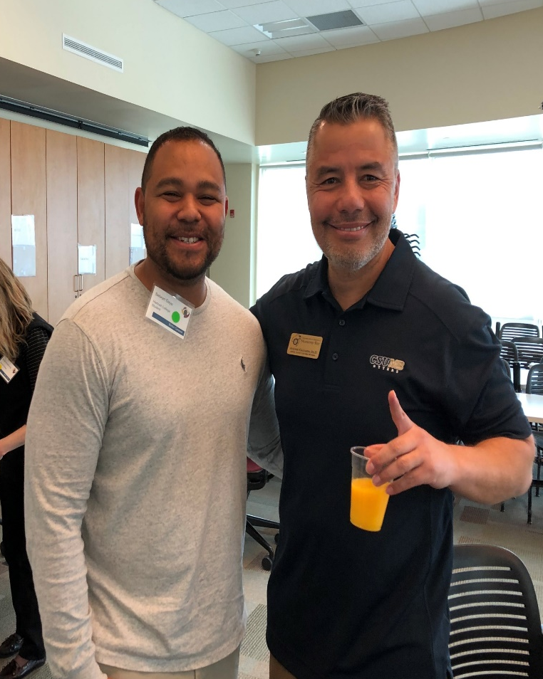
Action Teams
Group A​
Curriculum Review​
Lisa Storm ​
Nina Vazquez​
Jackie Cruz​
Hermelinda Rocha-Tabera
​
Courageous Conversations​
Marnie Glazier​
3 Students
David Orta, Daniel Orta, Guadalupe Altamirano
​
Institutional Audits​
Laurencia Walker ​
Erica Rowe​
Guy Hanna ​
Bronwyn Moreno ​
Jay Singh ​
Moises Almendariz ​
Group B​
Student Equity Plan​
Jay Singh ​
Jackie Cruz​
Guy Hanna
​
Professional Development​
Moises Almendariz ​
Erica Rowe ​
Lisa Storm ​
Laurencia Walker ​
Nina Vazquez ​
​
Student Engagement​
Bronwyn Moreno ​
Shawn Pullum ​
Marnie Glazier
Group C​
Data Team – ​
Coordination with SSEC​
Guy Hanna​
Shawn Pullum​
Nina Vazquez​
​
Technical Updates - from CCCCO ​-
Website Presence
Communication
Need to identify help in this area
Inventory/Research + Gap Analysis + Recommendations

Slide 7
Action Teams
Task Force Member | Title | Role and/or Stakeholder Representative
Bronwyn Moreno | Director of Student Affairs (Equity Programs) | Classified manager
Carla Gonzalez | Academic Support Specialist | Classified staff
Daniel Orta | Associated Students Hartnell College - Senator Evenings/Weekends/Online | Student
Erica Rowe | Analyst (Human Resources and EEO) | Classified staff
Guadalupe Rodriguez | Associated Students Hartnell College - Senator At-large | Student
Guy Hanna | Outcome and Assessment Specialist | Classified staff
Jackie Cruz | Vice President of Advancement and Development and ED for Hartnell College Foundation | Institutional Advancement, Foundation, President’s Cabinet
Jay Singh | Director of Student Academic Support Systems | Classified manager
Laurencia Walker | Director of College Readiness | Classified manager
Lisa Storm | Instructor (Administration of Justice) | Full time instructor, former Academic Senate President
Luis xago Juarez | Instructor (Theatre Arts & Cinema and Ethnic Studies) | Part time instructor
Marnie Glazier | Instructor (Theater Arts & Cinema and Communication Studies) | Full time instructor
Moises Almendariz | Director of HSI Initiatives | Classified manager
Senorina Vazquez | Instructor (Mathematics) | Full time instructor
Shawn Pullum | Software Support Specialist | Classified staff

Slide 8
Action Groups
Action Groups | Action Group Charges
Curriculum Review Lisa Storm Senorina Vazquez Shawn Pullum Jackie Cruz Advisor- Hermelinda Rocha Tabera | The Curriculum Review Action Group will conduct an audit of Hartnell College classroom climate, create an action plan to create inclusive classrooms and anti-racism curriculum, and participate in a system wide review of fire science, EMT, and law enforcement officer and first responder training and curriculum in order to develop recommendations to ensure law enforcement and first responder trainings are inclusive and anti-racist.
Courageous Conversations Carla Gonzalez Luis xago Juarez Marnie Glazier Guadalupe Rodriguez Daniel Orta David Orta | The Courageous Conversations Action Group is tasked with creating an action plan and recommendations on how to ensure culturally affirming spaces for students and foster dialogue to further understanding and anti-racist action.
Institutional Audits Laurencia Walker Erica Rowe Guy Hanna Bronwyn Moreno Jay Singh Moises Almendariz | The Institutional Audits Action Group will undertake an equity index by surveying the college to determine the status of all Hartnell College equity efforts for the purpose of understanding where the college currently stands, and for prioritizing specific action steps that need to be implemented.

Slide 9
Action Groups
Action Groups | Action Group Charges
Student Engagement Bronwyn Moreno Luis Xago Juarez Shawn Pullum Marnie Glazier Guadalupe Rodriguez Daniel Orta David Orta | The Student Engagement Action Group will develop a recommended plan to engage students in the equity work of Hartnell College.
Professional Development Moises Almendariz Erica Rowe Lisa Storm Laurencia Walker Senorina Vazquez | The Professional Development Action Group, working with the Professional Development Committee, will develop a recommended plan for anti-racist professional development for Hartnell staff, faculty, administration and students.
Student Engagement Bronwyn Moreno Luis xago Juarez Shawn Pullum Marnie Glazier Guadalupe Rodriguez Daniel Orta David Orta | The Student Engagement Action Group will develop a recommended plan to engage students in the equity work of Hartnell College.

Slide 10
Recognition of Key Advisors
President- Angelica Garcia, Berkeley City College- Organizational and Operational Framework
Lauren Padilla Valverde, The California Endowment, Racial Equity Program Manager
President- Foothill College, Dr. Nguyen – Organizational and Fiscal
Faculty- Hermelinda Rocha Tabera - Ethnic Study requirements and new legislation
Faculty- Kelly Locke- Cultural Audit
Faculty- Cheryl O’ Donnell – Academic Senate President- Outcome and Assessment
Faculty- David Beamer- PPA team and Outcome Learning and Assesment
Community- Judy Sulsona, Consultant and Foundation President

Slide 11
Overarching Recommendations
Recommendation 1. Review and revise the primary guiding documents of Hartnell College, the Mission and Vision Statements, and the current strategic plan to be inclusive, anti-racist, and culturally affirming and sustaining.
Responsible Parties: College Planning Council with the support of the President’s Task Force
Proposed Implementation Timeline: Fall 2021
Resources Needed: Primarily part of existing job duties, compensation for faculty for time worked outside of regular contract hours, approval of managers for classified staff and compensation for students
Notes:
The Student Engagement Action Group developed a plan to provide support and create the capacity for students to take active leadership roles, ensure ongoing racial equity and social justice-focused conversations and actions within the larger campus community. The Student Engagement Action Group made recommendations for creating the foundation that will allow for realization of the Courageous Conversations Action Group recommendation, which is to embrace the community engagement spectrum. The complete recommendations from this action group can be found in the Full Recommendations section of this document.

Slide 12
Four Overarching Recommendations : Be Explicit, Be Intentional, Be Responsive to the Community Integrate Equity in to the following :
Strategic Plan
Mission Statement
Vision Statement
Value Statements

Slide 13
Overarching Recommendations
Recommendation 1. Review and revise the primary guiding documents of Hartnell College, the Mission and Vision Statements, and the current strategic plan to be inclusive, anti-racist, and culturally affirming and sustaining.
Responsible Parties: College Planning Council with the support of the President’s Task Force
Proposed Implementation Timeline: Fall 2021
Resources Needed: Primarily part of existing job duties, compensation for faculty for time worked outside of regular contract hours, approval of managers for classified staff and compensation for students
Recommendation 2. Complete an annual review of student outcomes data and integrate the findings into all aspects of college planning including the budgeting and resource allocation process. Create a Data Response Team to determine what data and metrics are needed, to be revised annually and to take action based on the annual review, including the development of Board Policies and Administrative Procedures. Doing so would also ensure that all stakeholders have access to the proper tools and queries to access timely reports.
Responsible Parties: Student Success Equity Committee, Program Planning and Assessment, Cabinet, College Planning Council, Data Response Team
Proposed Implementation Timeline: happening now – finalized Fall 2021
Resources Needed: Primarily part of existing job duties, compensation for faculty for time worked outside of regular contract hours, approval of managers for classified staff and compensation for students
Notes:
The Student Engagement Action Group developed a plan to provide support and create the capacity for students to take active leadership roles, ensure ongoing racial equity and social justice-focused conversations and actions within the larger campus community. The Student Engagement Action Group made recommendations for creating the foundation that will allow for realization of the Courageous Conversations Action Group recommendation, which is to embrace the community engagement spectrum. The complete recommendations from this action group can be found in the Full Recommendations section of this document.

Slide 14
Overarching Recommendations
Recommendation 3. Create an inclusive, anti-racist, and culturally affirming and sustaining hiring process from job descriptions, equivalencies, training of hiring committees and recruitment of faculty and staff.
Responsible Parties: Cabinet, Academic Senate, with Human Resources as a lead, EEO/Diversity Committee, (may consider an outside consultant for support)
Proposed Implementation Timeline: Fall 2021
Resources Needed: Primarily part of existing job duties, compensation for faculty for time worked outside of regular contract hours, approval of managers for classified staff and compensation for students
Recommendation 4. Create an Equity Office and administrative position, with resources and support, to serve as a resource for all Hartnell faculty, staff, administration and students. This office will be responsible for fostering relationships and collaboration across the campus and community to implement inclusive, anti-racist, culturally affirming and sustaining policies and practices, as well as implementing Recommendations 1-3 listed above
Responsible Parties: Program Planning and Assessment, President's Task Force, Cabinet, Academic Senate, Human Resources
Proposed Implementation Timeline: Fall 2021 or Spring 2022 depending on Program Planning and Assessment cycle
Resources Needed: Funding for a position and programmatic support
Notes:
The Student Engagement Action Group developed a plan to provide support and create the capacity for students to take active leadership roles, ensure ongoing racial equity and social justice-focused conversations and actions within the larger campus community. The Student Engagement Action Group made recommendations for creating the foundation that will allow for realization of the Courageous Conversations Action Group recommendation, which is to embrace the community engagement spectrum. The complete recommendations from this action group can be found in the Full Recommendations section of this document.

Slide 15
Curriculum Review Summary of Recommendations
(Recommendations 5, 7) Review of current curriculum including implementation of the systemic use of the Equity Rubric for Student Success and identification of courses that meet Online Education Initiative, Peralta Equity Rubric and the Student Success & Equity Rubric, support ongoing work for the development of guidelines for equitable curriculum
(Recommendation 6) Work with local law enforcement and first responder employers to promote continued coursework, certificates and degrees for existing and aspiring law enforcement and first responders, and engage the South Bay Regional Public Safety Training Consortium to review JAJ (Administration of Justice) and JFS (JPA Fire Science) curriculum
(Recommendations 8, 9) Development of new curriculum including new Ethnic Studies courses and a new Ethnic Studies faculty position
(Recommendations 10, 11) Support for faculty to review curriculum, create new curriculum and become trained in how to implement a cultural curricular audit
Notes:
The Curriculum Review Action Group addressed challenges to specific discipline areas, such as public safety training of which Hartnell is one of many colleges in a consortium, as well as curriculum overall across the college. The complete recommendations from this action group can be found in the Full Recommendations section of this document. Recommendations cover four areas:

Slide 16
Institutional Audits Summary of Recommendations
(Recommendations 12, 13) A review and audit of processes and program, student and service area outcomes
(Recommendations 14, 15) A campus climate audit including a review of past campus climate surveys, evaluation of the systemic integration of future climate surveys, and review of student conduct hearing outcomes as it relates to the student code of conduct to identify patterns of bias
(Recommendations 16, 17) A review of Hartnell College communications and contracts
(Recommendations 18, 19) Catalogue all the college committees or groups currently working on equity-related issues, coordinate the Chancellor’s Call to Action, the Hartnell Framework for Racial Equity and Social Justice and the initial response that was developed under the direction of Vice President of Student Services, Dr. Romero Jalomo
Notes:
The Institutional Audits Action Group provided recommendations for how to undertake a campus wide audit of institutional policies and practices, and documentation of efforts already underway. Three documents that have been completed and that can also serve as resources for implementation of recommendations include a list of all campus committees and groups working on issues of equity, a Hartnell College Institutional Self-Assessment for Equity, and a Tri-Crosswalk of the Chancellor’s Call to Action, the Hartnell College Framework on Racial Equity and Social Justice and the tool developed over summer 2020 under the direction of the Vice President of Student Services. The complete recommendations from this action group can be found in the Full Recommendations section of this document. The recommendations can be summarized as looking for evidence of inclusive, anti-racist, and culturally affirming and sustaining practices or bias and disproportionate impact in the following areas:

Slide 17
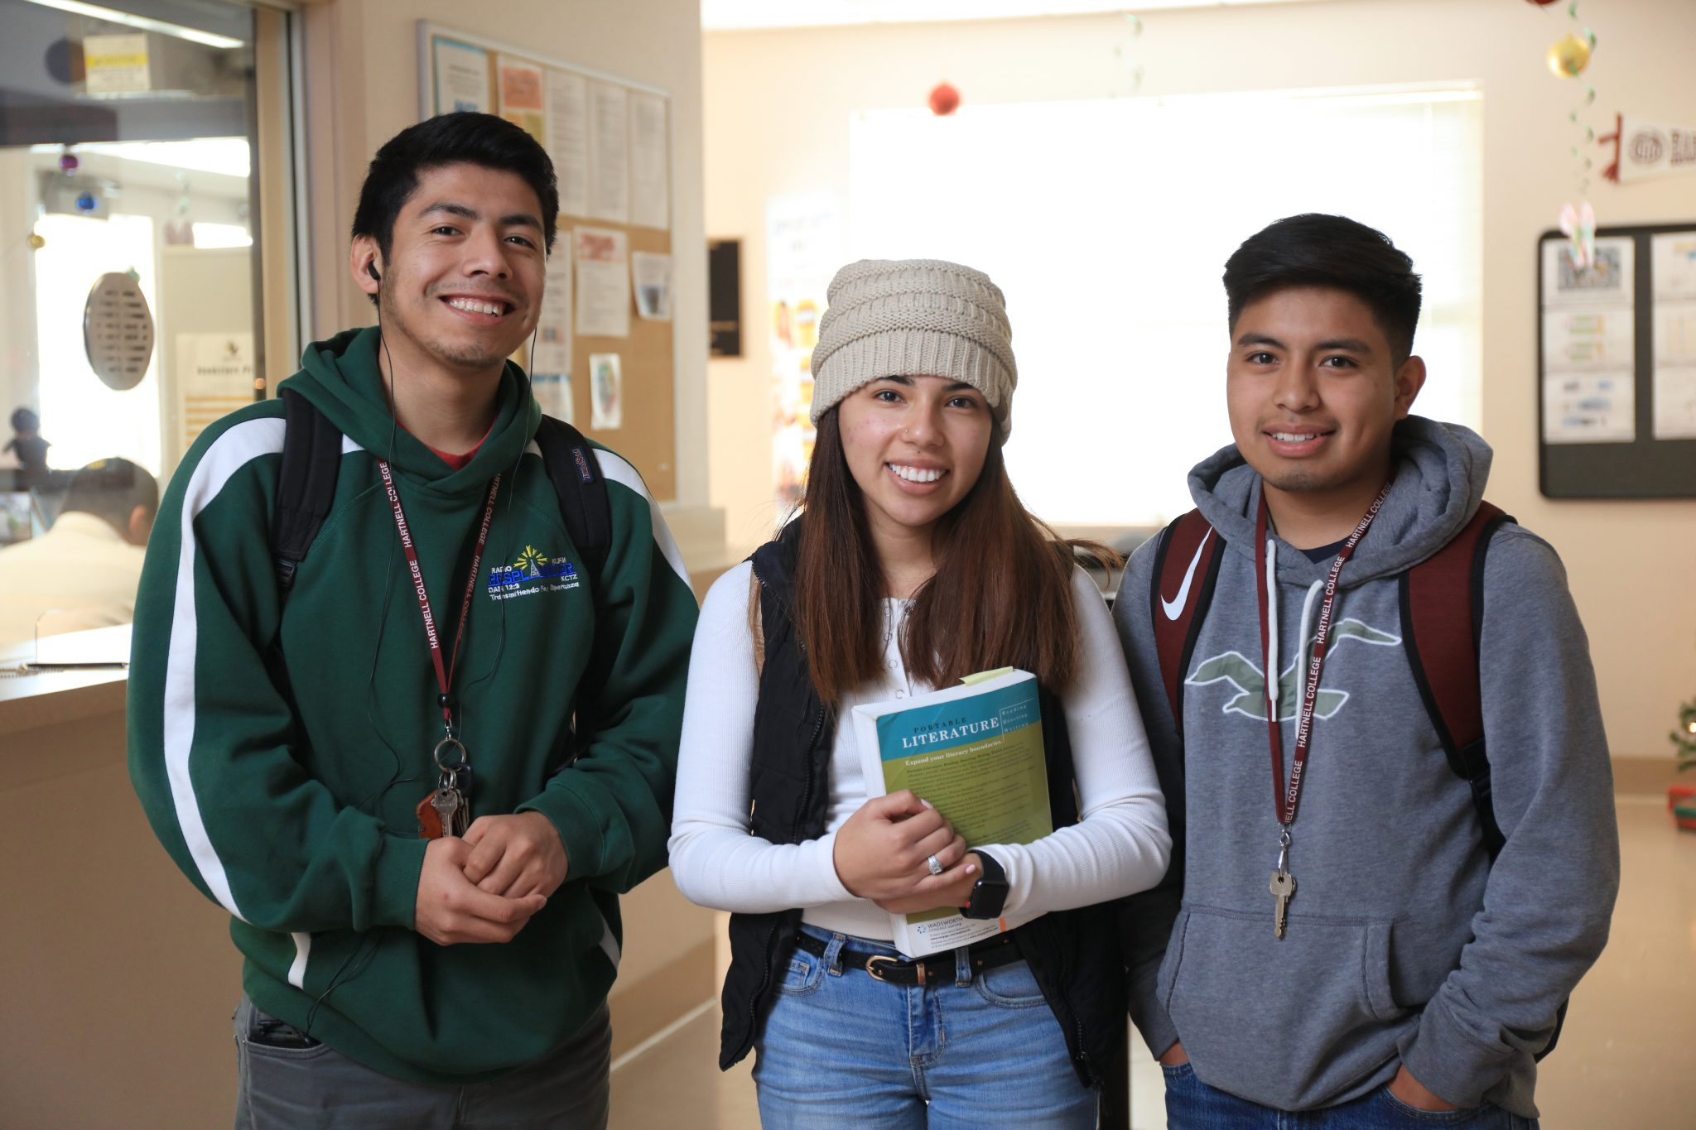
Student Equity Plan Summary of Recommendations
(Recommendation 20) Review current SEP utilizing the findings of CUE, and incorporating those findings into future SEPs, to be reviewed annually with annual updates to the board
(Recommendations 21, 22) To better support African American, African Heritage and Black student success, create an advisory group and begin an inquiry process focused on success strategies, and provide institutional support for Umoja
Notes:
The Student Equity Plan Action Group was tasked with responding to the CCCCO specific call to review and implement, with haste, campus Student Equity Plans (SEP). The action group incorporated the use of findings from the Student Equity Plan Review: A Focus on Racial Equity by the Center for Urban Education (CUE) into their recommendations. The complete recommendations from this action group can be found in the Full Recommendations section of this document. Recommendations are summarized as:

Slide 18
Professional Development Summary of Recommendations
(Recommendation 23) Review and analyze the current process for approving professional development requests, whose requests are being approved and the kind of professional development that is approved
(Recommendation 24) Create communities of practice as means to foster community and collegiality around anti-racist and equity efforts
(Recommendation 25) Redesign professional development at Hartnell College around cohesive themes focused on equity, so that events, trainings and opportunities develop a common nomenclature and foster deeper understanding for the college as a whole
Notes:
The Professional Development Action Group took inspiration from the unified approach to professional development at some other colleges, including Compton College. The action group made recommendations to support the Professional Development Committee in planning inclusive, anti-racist, and culturally affirming and sustaining professional development for Hartnell students, staff, faculty and administration. The complete recommendations from this action group can be found in the Full Recommendations section of this document. Recommendations can be summarized as:

Slide 19
Courageous Conversations Summary of Recommendations
(Recommendation 26) Adopt the four-stage community engagement framework to ensure culturally affirming spaces for students and foster dialogue to further understanding and anti-racist action
Notes:
The Courageous Conversations Action Group created a four-stage framework to support moving the campus along the community engagement spectrum. This spectrum moves from informing, consulting, involving and finally to deferring to the community as a means for implementing institutional change. The framework document provides a narrative rationale for each of the stages and multiple approaches within each stage. The full text can be found in the Full Recommendations section of this document.

Slide 20
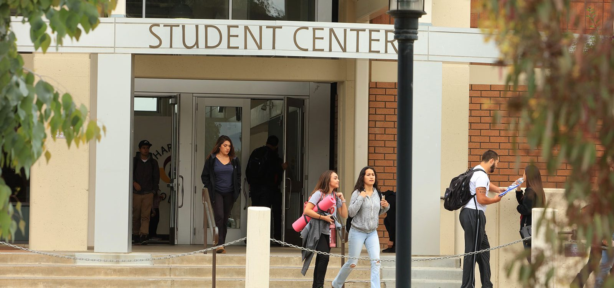
Student Engagement Summary of Recommendations
(Recommendations 27, 28, 29) Build the capacity of students to shape their college experience and opportunities through student-centered shared governance and college committees, a Cultural Diversity Festival, and an expansion of the Equity and Excellence Student Fellowship Program to create a district-wide racial equity and social justice focused student fellowship program and opportunities to create inclusive, community building activities and events.
(Recommendations 30, 31) Create a Basic Needs Coordinator position, a student advisory group and a Basic Needs Center to assess and meet the food and housing needs of students.
Notes:
The Student Engagement Action Group developed a plan to provide support and create the capacity for students to take active leadership roles, ensure ongoing racial equity and social justice-focused conversations and actions within the larger campus community. The Student Engagement Action Group made recommendations for creating the foundation that will allow for realization of the Courageous Conversations Action Group recommendation, which is to embrace the community engagement spectrum. The complete recommendations from this action group can be found in the Full Recommendations section of this document.

Slide 21
Input
Questions and Thank you!

Slide 22
Thank you!
Please let us know if you have any questions

