Slide 1
Counseling CRD Coordinator, Norma Cuevas
Instructional CRD Coordinator, Hetty Yelland
Administrator CRD Coordinator, Brian Lofman
CRD Designs 2020
Facilitation (Employee) Team
Pre-Enrolled Students Team
Entering Students Team – Meta-Majors
Entering Students Team – Panther Days
Continuing Students Team
Completing Students Team

Slide 2
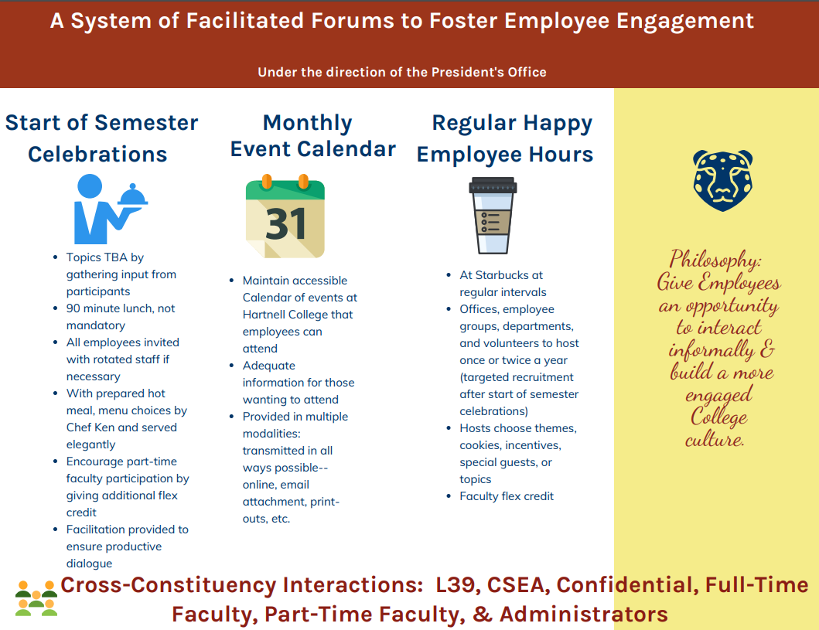

Slide 3

FACILITATED FORUMS FOR EMPLOYEE ENGAGEMENT
Description
Description
Methodology
Justification
Facilitated forums include several innovations that would work together to generate more informal interactions and build a more engaged employee culture at Hartnell College for faculty, staff, and administrators. A particular concern is to ensure that constituent groups have opportunities to interact with each other. These three innovations include: 1) Start of the Semester Celebrations (at flex days), 2) Monthly Event Calendars, and 3) a Regular Happy Employee Hours.
The innovations build on the foundation of pre-existing events and activities at the institution. The President's Annual Holiday Lunch, the website calendar, and the recent opening of Starbucks all played a role in the development of this design.
Because we have become particularly focused on conducting the transactional business of the College, we have not been emphasizing the importance of building community and maintaining relationships. The idea to design a more conducive environment where all constituent groups are collaborating toward achieving institutional goals. As Dr. Patricia Hsieh has stated, “we can create a workplace that we are proud of and that helps our students succeed.”
Funding

Slide 4
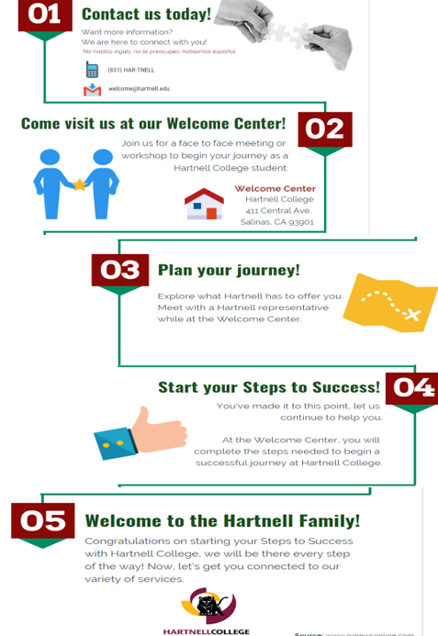


Slide 5
Welcome Center & Pre-Enrolled Student Map
Description
Methodology
Description
Justification
This design is a roadmap for enrollment into the College. It includes: promotion of Welcome Center, promotion various programs and services offered at the College, promotion of face to face enrollment, and assistance with the Steps to Success. It is designed for the following populations: Adult, ESL, GED, Adult School, non-traditional, re-entry, and formerly incarcerated prospective students.
This design serves to promote the college while providing information and services for enrollment. The team took a holistic approach to assist and guide pre-enrolled students prior to applying to the College. The map will be provided in multiple languages and District wide. The Welcome Center will focus on providing excellent customer service to all visitors; a designated web page will provide an online element to the Welcome Center.
Qualitative information indicates that Adult populations are getting lost in the entry process and not completing their application. Given the length of time that adult students have been away from the educational system, they may lack confidence in applying and require more information before making what they perceive is a substantial commitment.
Regular student team members and the Associated Students of Hartnell College provided valuable feedback that informed the work and final product.
High school students are currently provided adequate entry pathways with successful Hartnell programs, such as Panther Prep and dual enrollment. Adult students, however, are not provided similar services. Complicating matters is that the College does not currently provide a Welcome Center. Providing these additional services and a Welcome Center will diminish existing barriers that adult students experience.
Funding

Slide 6

BUSINESS, AGRICULTURE & INDUSTRIES
SOCIAL SCIENCES
Administration of Justice
Advanced Automotive Technology
Advanced Diesel Technology
Agriculture Business
Agriculture Plant Science
Agriculture (Food Safety, Production)
Business Administration
Business Office Technology (Bookkeeping,
Business Information Worker & Information Processing)
Construction Management & Architecture
Manufacturing Technology
Welding
Addiction Studies
Chicanx Studies
Early Childhood Education
Economics
Elementary Teacher Education
History
Political Science
Psychology
Social Justice
Sociology
HARTNELL
META-MAJORS
STEM
ARTS & LANGUAGES
Astronomy
Biology
Chemistry
Computer Science
Computer Science & Information Systems
(Mobile Development, Network and Security, & Web Development)
Engineering
Geology
Mathematics
Physics
Communication Studies
Digital Arts
English
English as a Second Language
Music
Photography
Spanish
Studio Arts
Theater Arts & Cinema
HEALTH SCIENCES
EXPLORATORY*
Kinesiology
Public Health Science
Registered Nursing
Respiratory Care Practitioner
Vocational Nursing
General Studies
Liberal Arts
* Exploratory is not a meta-major. We will encourage students to move towards a program with dedicated faculty from within a specific meta-major. See a counselor for more information.
Are you unsure where to start? We have resources to answer your questions. Contact us to schedule an appointment.
HARTNELL COUNSELING DEPARTMENT
(831)755-6820
www.hartnell.edu

Slide 7
Meta-Majors
Description
Methodology
Justification
Description
Hartnell College Meta-Majors are a group of academic majors with overlapping courses. The creation of Meta-Majors is intended to provide clear direction to students based on their career and academic interests and to develop clear career or transfer pathways. Efforts are placed on supporting student's goals including but not limited to graduation, careers, transfer, and advanced degrees.
A designated web page with links to career exploration information and salary and job market indicators will accompany the rollout of meta-majors.
Most students are taking far too many earned units past the number required to complete their degree. They frequently do not select their program in which to major early in their studies at the College; when they do, they often rely on word of mouth information or make the decision based on limited information.
This design is aimed at providing more comprehensive information to students when they first enter the College, including how Meta-Majors are linked to careers. It also allows students to make an early informed choice of Meta-Major that will assist them in choosing from a long list of programs offered by the College.
The Entering Students Team followed the guidelines set forth in the State Academic Senate’s webinar “Meta-What?” and started the process with agreeing upon guiding principles that would inform and act as a rubric for the work. Surveys immediately following presentations about Meta-Majors and the guiding principles were emailed out to students, staff, faculty, and administrators. The guiding principles were then revised based on the approximate 130 survey responses.
To group Hartnell College majors into Meta-Majors, data from the RP Group was extracted from the CA Community College Chancellors office and analyzed to identify course overlap between majors to identify major clusters. These clusters were then checked to make sure that they followed the agreed upon guiding principles.
Regular student team members and the Associated Students of Hartnell College provided valuable feedback that informed the work and final product.
Funding

Slide 8
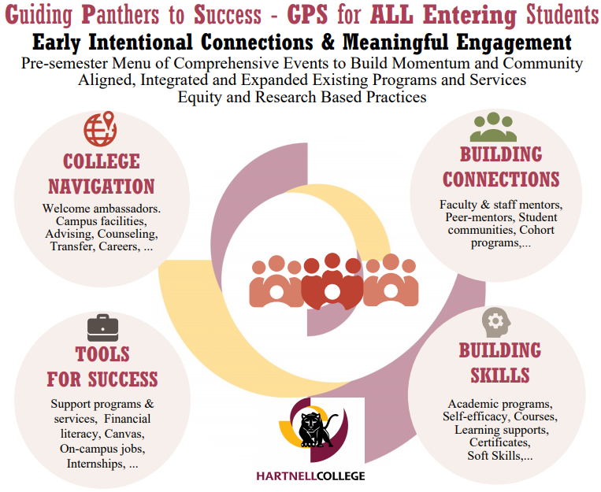

Slide 9
GPS (Guided Panthers to Success)
Description
Methodology
Justification
Description
Guiding Panthers to Success (GPS) will create an intentional system to connect students to caring staff and faculty, peers, resources, and information, prior to the start of the semester. The system must create bridges for early engagement for all students, regardless of demographics and enrollment status. The system will be a large scale collaborative effort to leverage existing activities and develop new approaches for underserved and disproportionately impacted students. The system will embody core elements that have been identified as best practices, and branch out accordingly to ensure that every student will have awareness of and access to the people and resources they need in order to achieve their educational goals at Hartnell College.
The GPS System will be accompanied by a designated web page that provides information about summer bridge and related student resource events.
40+ students, faculty, staff, and administrators participated in a year of inquiry to identify best practices for serving entering students. After conducting analysis and summarizing reports from relevant surveys including qualitative and quantitative research on factors impacting Hartnell student success and completion such as HERI(n=576), CCSSE (n=855), SENSE (n=422), Student Satisfaction (n=1126), and RP Group-Student Perspectives (38), faculty stakeholders from the Student Perspectives group led 12 student focus groups (n=10 to 35 each) in spring 2019 to identify unmet student needs. A pilot was conducted in Summer 2019 to measure the success of aligning current summer offerings and incorporating core pieces across all programs. 621 students participated in the pilot. In addition, 360 student participants in the collaborative pilot completed a questionnaire to survey their experience and identify which elements were most impactful.
According to the 2017 Survey of Entering Student Engagement (SENSE), Hartnell students are below the national average in the areas of Early Connections and Academic and Social Support Networks. Intentional connections to other students, faculty, staff, and student support programs and services, are critical to student success, leading to improved outcomes as measured by Hartnell College Strategic Priorities.
Funding

Slide 10
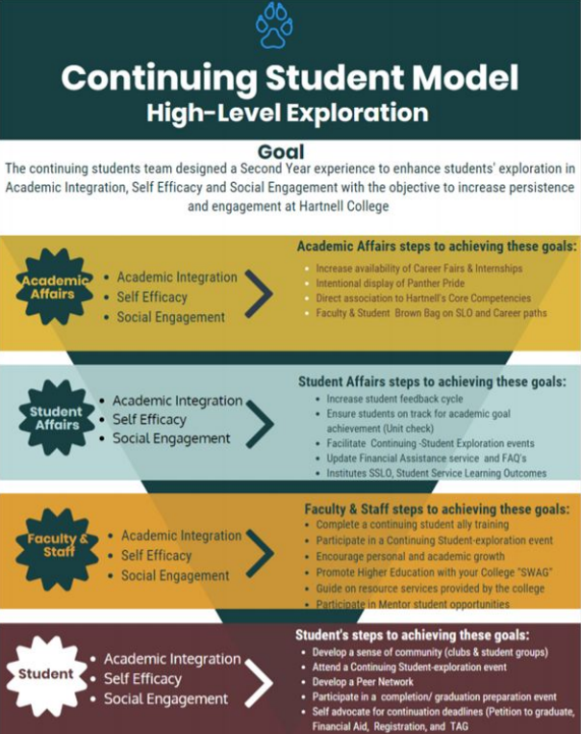

Slide 11
Continuing Students Experience
Description
Methodology
Justification
Description
As part of Student Support (Re)defined, the RP Group reviewed leading studies on effective support practices and interviewed both practitioners and researchers to identify “six success factors” that contribute to students’ achievement. The RP Group’s Six Success Factors (Directed, Focused, Nurtured, Engaged, Connected and Valued) were used in the context of Academic Integration, Self Efficacy, and Social Engagement to identify essential elements necessary for assisting continuing students to achieve a high level of engagement and success at Hartnell College
A student survey regarding registration barriers at the College was also conducted. Twenty-nine continuing students randomly chosen from the survey pool participated in a led focus group to determine their perceptions and needs as they relate to Academic Integration, Self Efficacy and Social Engagement.
Continuing students are defined in the following unit categories:
• Momentum students: 36-45 units
• Transfer explorers: 12-30 units
Within a Continuing Student Experience model, different divisions and stakeholders throughout the College will adopt similar best practices necessary for assisting continuing students persist and succeed. These essential practices are:
• Academic Integration : Students have opportunities to connect what they are learning to curriculum in multiple classes, community, and career
• Self Efficacy: An Individual’s belief in his or her capacity to execute behaviors and to produce certain results
• Social Engagement: A student’s involvement with Hartnell
The Continuing Student Experience will be accompanied by a designated web page that provides information for continuing students.
As a College we have focused on access, and not focused on students as they continue toward their educational goals.
Students need reinforcement of guiding steps to ensure that they are on their pathway, but continuing students also need assistance building academic and soft skills that empower them to overcome obstacles and to achieve their educational and career goals.
Funding

Slide 12
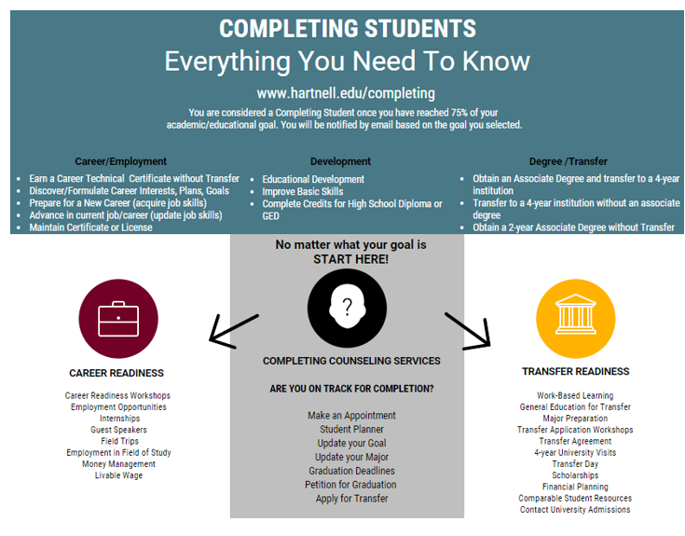

Slide 13
Completing Students Exit System
Description
When considering how we could define a completing student it was critically important to take into consideration that our students come to Hartnell with varied educational goals. Students may choose from eleven (11) different goals in the CCC Apply application process. We have distinguished three (3) categories of goals based on the eleven choices: Career/Employment, Development, and Degree/Transfer. The main foci for most completing students are transfer readiness and career placement.
Justification
Description
Methodology
This design centers on a system that will identify students who are nearing completion, and notify them to ensure they are on track and prepared for graduation, transfer, and/or employment. A student is considered nearing completion once they have reached 75% of their academic/educational goal.
Additionally, the proposed system of coordinated resources will operationalize support strategies including completion and transfer workshops, emotional supports, drop-in counseling, financial literacy, etc.
Notifications and information will be duplicated across as many platforms as possible such as email, postcard, Ellucian go, Canvas, social media, and/or text messages.
Students would not be required to complete all steps, but the website can show requirements and recommendations.
As a College we have focused on access, and not focused on students as they complete their goals and leave Hartnell.
Students need reinforcement of guiding steps to ensure that they are on their pathway and what their next steps leading to completion will be.
Many of our students need to be better prepared for employment or transfer readiness.
Funding

