Slide 1
Follett Access
TRANSFORMING THE WAY COURSE MATERIALS ARE DELIVERED

Slide 2

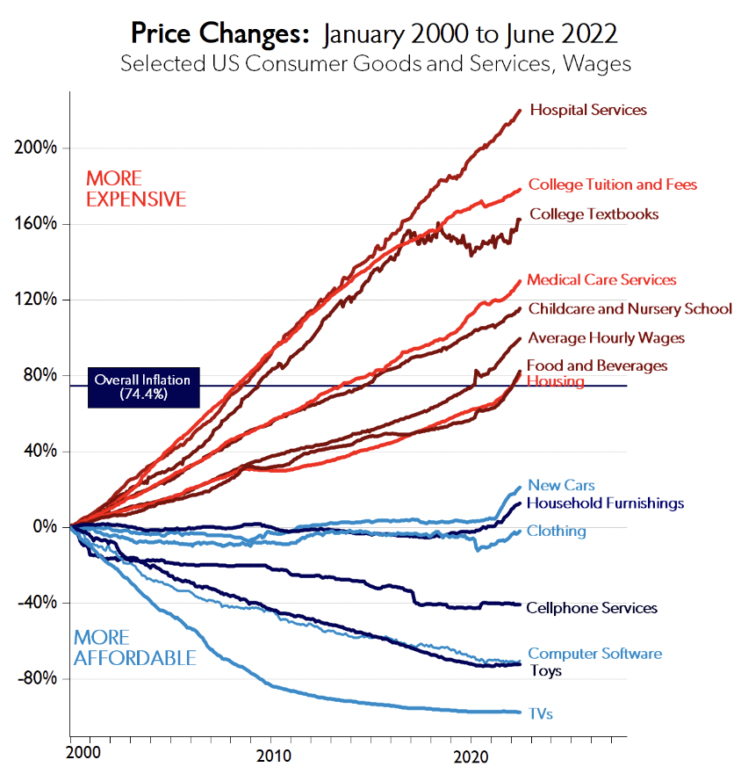
Price Changes– Consumer Goods

Slide 3

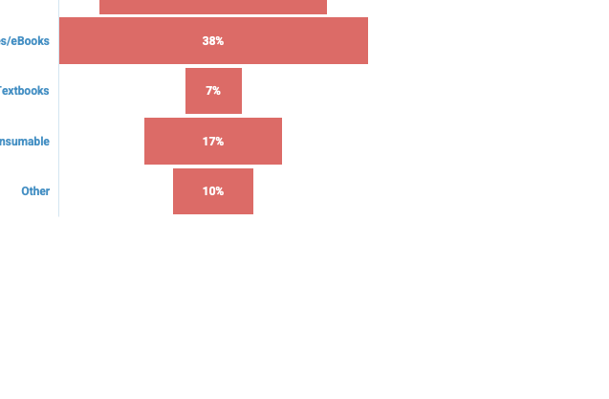
Digital
Is highly used on your campus
Faculty
Trying to save students money by adopting older editions
51%
Students bought from the bookstore last year

Slide 4





STUDENTS ARE NOT COMING TO CLASS PREPARED
96%
OF STUDENTS KNOW WHAT TEXTBOOKS ARE REQUIRED BEFORE THE FIRST DAY OF CLASS(1)
60%
WAIT UNTIL CLASS STARTS BEFORE BUYING OR RENTING COURSE MATERIALS(1)
65%
DID NOT PURCHASE A COLLEGE TEXTBOOK DUE TO COST
95%
*(OF THE 65%)
KNEW THEY WOULD SUFFER
ACADEMICALLY
FROM NOT PURCHASING

Slide 5

SOLUTIONS
COURSE MATERIALS FOR ALL

Slide 6

Follett Access
Campus Wide
All Required Books for All Students
Flat Fee for All Materials
Opt-Out Available at Each Term
Digital First, Physical if Digital Unavailable
Academic Freedom

Slide 7

FREEDOM TO CHOOSE FOR FACULTY
Academic freedom to choose the materials that best fits the class curriculum
Ensures everyone will have the same edition
Supports higher academic performance for all students with a leveled playing field
Follett manages accessing materials in the LMS or on campus
Follett works with 6000+ publishers
“
Follett ACCESS has solved so many problems for us by simplifying and streamlining the process of students accessing their required course materials.
”
— Shearen Fredere, Associate Professor and Chair of Mathematics
Department, Southeastern University
Notes:
Expanded bullets:
• Academic freedom to choose the content provider,
edition and medium that best fits the class curriculum
• Know that everyone in class will have the same
edition on day one
• Let Follett troubleshoot and provide instructions
for accessing materials
• Support higher academic performance for all
with a leveled playing field
Supplemental quotes/testimonials:
“Overall, I believe the Follett Access (IncludED) program is a step in the right direction for providing the appropriate materials to our students so they can learn content as it was intended to be learned.”
- Faculty Member at Jefferson Community College
“Follett Access is an excellent concept, saves money for students in the long run, eliminates complaints about the price of textbooks, and ensures they have all materials for each course.”
St. Thomas University faculty response in a survey conducted by St. Thomas University about the Follett Access program, August 2017.
“It’s a GREAT competitive advantage for students to have ALL their materials on the first day of class.”
- Faculty Member at St. Thomas University
“Follett understood our challenge and helped us establish and implement a program that made it easier for our faculty to teach and our students to learn.”
- Jean Wisuri
Director, Distance Education, Cincinnati State Technical and Community College
“The ability of students to obtain course materials at the beginning of the academic semester has been shown to aid students in the successful completion of their courses. The UF All Access Program is an essential component that aids students in having resources from the first day of class.”
- Brian Harfe, Ph.D.
Associate Dean, College of Liberal Arts and Sciences
Assistant Provost, Teaching and Technology
Professor, College of Medicine

Slide 8
SAMPLE Campus Wide Program Pricing
COURSE MATERIALS FOR ALL STUDENTS
1
ALL STUDENTS
$25.00
PER CREDIT HOUR
2
DIGITAL FIRST
3
PRICE DOESN’T INCLUDE COMMISSIONS
STUDENTS TAKING 12 CREDIT HOURS CHARGED $300.00
COST OF ATTENDANCE REPORTS $938/YR FOR BOOKS
4
NEED HARTNELL DATA FOR REAL PRICING

Slide 9
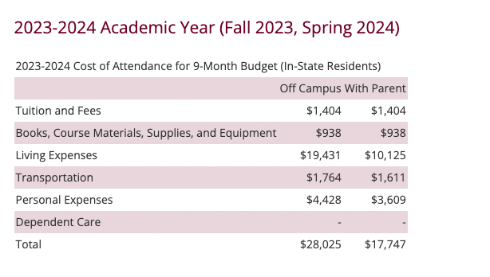
Proposed Program
BOOKS AND
COURSE MATERIALS
$938

Slide 10






Students were surveyed
Why are you most satisfied with the Follett Access Program?
76%
70%
63%
47%
33%
71%
Had materials first day of class
Convenience of not having to shop for materials
Knowing I’d have all the materials and correct editions
Materials cost less
Materials were better incorporated into course
Preferred the digital format of materials
Follett Higher Education Course Materials Student Survey © 2022

Slide 11




A Trusted Blockchain Platform allowing Students, Colleges and Employers to Share Credentials, Scholarships and Job Opportunities
Green Light & Campus Wide Access
Share records, credentials and recommendations with anyone, anytime.
Explore educational and scholarship opportunities.
Students
Educational Institutions
Employers
Push out scholarship opportunities and connect with interested students earlier in the recruiting process.
Invite employers to join network to connect with job ready students.
Advertise internships and job openings.
Find quality candidates with the skills you are looking for.
5 Feeder Schools

Slide 12

Follett Access
Course by Course
Course Level Program
20-60% Off
Digital Materials
Opt-Out
Academic Freedom

Slide 13
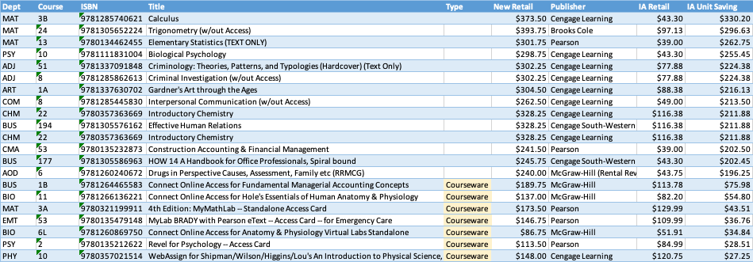
Real Courses – Real Savings
Fall 2023 Total Savings: $427,000
Notes:
Negotiated pricing-

Slide 14


Slide 15
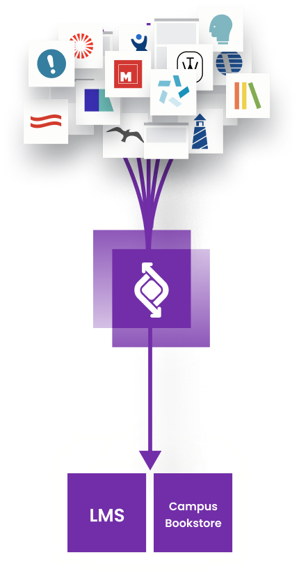
ONE CLICK ACCESS = CONVENIENCE
A CAMPUS-BASED SOLUTION
Students Access Course Materials on Day One Effortlessly
Follett’s “Digital-First” Access Programs provide students with access to course materials inside the LMS.
One location for course materials
One login for all students
Grade sync
This technology enhances:
  Success – Improved learning outcomes
  Privacy – Student data is protected
  Affordability – Access programs affect affordability

Slide 16
Thank You

