Slide 1
ZTC Update, College Council ‘24
From your Academic Senate Open Educational Resources Coordinator, Lisa Storm

Slide 2
Topics to be covered
Definitions
Current status of OER, ZTC, and LCT at Hartnell College
Improvements to date
Chancellor’s Office grant
Questions? Feel free to ask questions during the presentation too

Slide 3
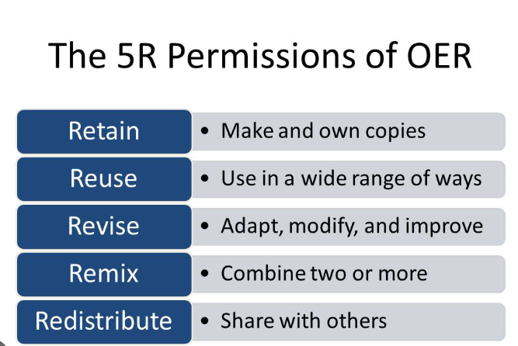
Open Educational Resources (OER)definition
Teaching, learning, and research resources in any medium
Openly licensed, generally with Creative Commons licensing
Includes: textbooks, full courses, course materials, and videos
OER is subject to the 5 Rs:

Slide 4
Benefits of OER adoption
Lowers cost of instruction for students and thereby removes unnecessary financial barriers to student success
Enhances enrollment and retention
Supports student persistence and success by ensuring every student in the section receives instructional materials on time
Allows financial aid to go further
Reduces stress for vulnerable student populations, promoting equity
Resources are customizable, allowing for continuous updating and refining
Could allow for infusion of IDEA, for example

Slide 5
Zero Textbook Cost (ZTC) definition
A course section that does not include an instructional materials cost for the student
Could be achieved via OER adoption, lack of a required textbook, free college library subscriptions, or if the institution otherwise absorbs the cost of instructional materials for students
Requires an analysis of “what is an instructional material?”
ZTC sections must be disclosed in the online course schedule by law, so it is essential for the institution to determine which sections are truly ZTC (CA Ed Code s. 66406.9)
A recent Chancellor’s Office grant for ZTC pathways to credentials also mandates this analysis

Slide 6
Examples of instructional materials that could destroy ZTC status if the student must purchase them
Software subscriptions
Required printing of OER materials (exa: the instructor wants all illustrations or photographs viewed in print format only)
Lab manuals
Workbooks

Slide 7
Examples of course supplies that are not considered instructional materials and thus will not destroy ZTC status if students have to purchase them
Optional course supplies
Optional printing of OER textbooks
Calculators
Lab supplies such as beakers and chemicals (sometimes students may be required to purchase these items in online labs)
Lab safety equipment such as goggles, lab coats
Art supplies
Library subscriptions that are free and no textbook required are also examples of ZTC

Slide 8
OER vs. ZTC comparison
OER:
Instructional materials are openly licensed and subject to the 5 Rs
Instructional materials can be updated and diversified
Students can access instructional materials immediately
ZTC:
Instructional materials may be copyrighted and the costs covered by the institution
Instructional materials may be locked in by copyright
Students may still have to wait for the bookstore to have instructional materials available
Notes:
ZTC may be equal to OER in value if materials are literature and cannot be put in the public domain

Slide 9
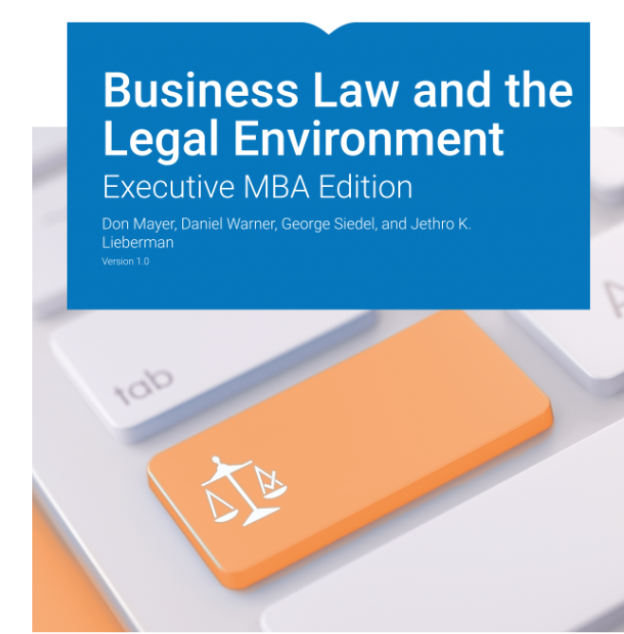

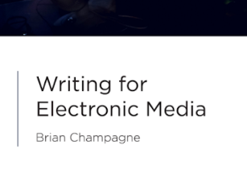

Examples of Hartnell College OER
BUS 18
MAT 13
BUS 43
TAC 58

Slide 10
Academic freedom
Faculty have the academic freedom to adopt instructional materials that support course learning outcomes
This freedom is buttressed by:
BP 4030 (Academic Freedom)
BP 4042 (Open Educational Resources and Low-Cost Textbooks)
New: HCFA contract language on academic freedom
Title 5§ 59404. District Policies and Regulations for Instructional Materials. (a) The governing board of a community college district which requires that students provide instructional materials for a course shall adopt policies or regulations, consistent with the provisions of this subchapter, which specify the conditions under which such materials will be required. These policies and regulations shall direct instructors to take reasonable steps to minimize the cost and ensure the necessity of instructional materials.

Slide 11
Low-Cost Textbook (LCT) definition
At Hartnell College, an LCT is any textbook that costs $40 or less. Academic Senate Resolution 19-3 resolves that LCTs should be designated in the online course schedule.
The state student senate has defined LCTs as $30 or less
Benefits of LCT adoption are removal of unnecessary financial burdens to student success, promotion of equity, enhancement of enrollment, retention, persistence, and student success, student financial aid goes further, may cost less than printing OER, and accessibility
The Low-Cost Textbook model is also self-sustaining and does not rely on rounds of grant funding, so there is incentive to create and update
Some disciplines (exa: ENG, CSS) have no choice but to rely on LCT to promote equity because there is skimpy OER available

Slide 12
Inclusive Access (IA)definition
Automatic billing: instructional materials’ cost is included in tuition
Also called First Day, Equitable Access, Complete, Auto Access (there are other branding titles too)
Materials are digital, and often the student does not retain the materials after the course has concluded
Students are forced to accept cost and all publisher policies including terms of service, privacy policy, and data collection practices
Allows publisher to collect valuable infrastructure data from the institutions and to levy textbook costs onto every single student

Slide 13
Department of Education IA response
In preparation for the U.S. Dept. of Education’s negotiated rulemaking beginning Monday, Jan. 8th, to review the current education code on Cash Management, which allows for institutions to charge student accounts for course materials as part of tuition and fees (also known as Inclusive Access, Equitable Access, First Day, Complete, AutoAccess, etc.), the Dept. release proposed language which essentially eliminates the ability for institutions to continue to run these programs as is. Instead, the proposed language would only allow for a similar program when institutions demonstrate a health or safety reason for including books and supplies in tuition and fees or if the institution is the only option for students to access the supplies or course materials.

Slide 14
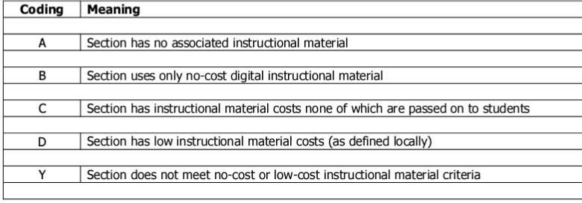
XB12 Instructional-Material-Cost data element
Coding at the section level to track each institution’s progress on reducing textbook costs for students
ASCCC resolution wants section B to differentiate between OER and other no-cost digital instructional materials
Implemented summer 2022
Not sure how Hartnell is capturing this data

Slide 15
Current status of OER, LCT, ZTC
We do not participate in IA at Hartnell College, although Follett recently presented on IA to the AVP and Dean of Equity
Online course schedule (PAWS self-service) is in strict compliance with federal and state legislation, but out of compliance with ASCCC and local resolutions (LCT not marked in online course schedule, bookstore link used to show textbook information)
Data collection on ZTC needs improvement
We have been awarded Chancellor’s Office grants to develop ZTC pathways to credentials in the amount of $425,000
New legislation and ASCCC resolutions call for more online course schedule disclosure obligations

Slide 16



PAWS self-service
If a student clicks on a course and one of the sections is ZTC, this is what the student sees:
This is what students see when they click on the ZTC course section:
If the student clicks a third time, this is what the student sees:
Notes:
This is too many clicks! Students won’t do it. There are no directions or explanations.

Slide 17
Bookstore issues
Many ZTC sections do not have the correct information displayed. Either the “books” link leads to a blank page, or a resource with an affiliated cost. None of the ZTC course sections have the proper message for spring 24.
Hartnell College should not rely on a 3rd party for-profit vendor to display valuable and legislatively mandated course instructional materials cost information. See: ASCCC Resolution 13.06, spring 2022
Bookstore will not share its adoption list with scheduling
Bookstore does not sell many books that are not supported by vouchers-I have been informed that almost 100% of the bookstore revenue is from textbook vouchers

Slide 18
New legislation: AB 607
Purpose: close price transparency gaps regarding course materials, allows students to make informed decisions
Donahue Higher Education Act (2010) already requires disclosure of ISBN, price, for all required/recommended college textbooks and supplemental materials
Effect: adds calculators, remote attendance platforms, and software subscriptions to textbooks as far as online course schedule cost disclosure obligations
Applies to CCCs and CSUs (UCs are “requested”)
Different dates for implementation
ASCCC Fall ‘23 Plenary Resolution 6.01: adds homework systems, art supplies, uniforms, and safety equipment to disclosure obligations
Remote attendance platforms, software subscriptions, and homework systems will destroy ZTC status if they cost the student

Slide 19
PAWS self-service issues
Bookstore link used to display textbook cost
No logo for Low-Cost textbooks, although an additional logo is possible
Students must perform a complicated search to seek out ZTC and LCT course sections. As the Academic Senate OER Coordinator, I created a search video for this purpose but now it has been deleted. A professional video should be made and posted in multiple locations including PAWS self-service. In the alternative, a better way to show students ZTC/LCT course sections should be devised.
Data collection for ZTC is insufficient as 30% of course sections are not marked in PAWS self-service (scheduling survey). For this purpose, I created a ZTC list but it should be posted on PAWS self-service (I have requested this posting).

Slide 20
OER/ZTC/LCT improvements to date
ZTC Chancellor’s Office grants applied for and received ($425,000)
OER and Low-cost Canvas shell created to help faculty
BP 4042 (OER and LCT) drafted and approved by the Board of Trustees
Academic freedom language for HCFA contract (partial) drafted and ratified
ZTC sections of Student Equity Plan/Guided Pathways drafted
Affordable Textbook Options webpage developed and published
Senate Resolutions drafted and approved
Student and faculty surveys administered
List of course sections that are ZTC/LCT created and posted
Student newsletter drafted, sent to students, and posted

Slide 21
Academic Senate Resolutions
19-3: Defines Low-Cost textbooks as $40 or less; calls for identification of Low-Cost textbooks in the online course schedule
21-4: Supports the development of affordable textbook options, and pathways to ZTC/Low-Cost Degrees and Certificates
22-4: Authorizes Academic Senate OER Coordinator to work on the CCCCO ZTC grant funding

Slide 22
Student survey (752 responses, fall 2023)
25.5% of students pay $200 for textbooks each semester, and 21% pay more than $300
32.5% of students have avoided carrying a full load (12 units) because they could not afford the textbooks
94% would choose a course that adopted a free or Low-Cost textbook over a course that did not
54% of students say it is not easy to find courses that adopted free or Low-Cost textbooks in the online course schedule

Slide 23
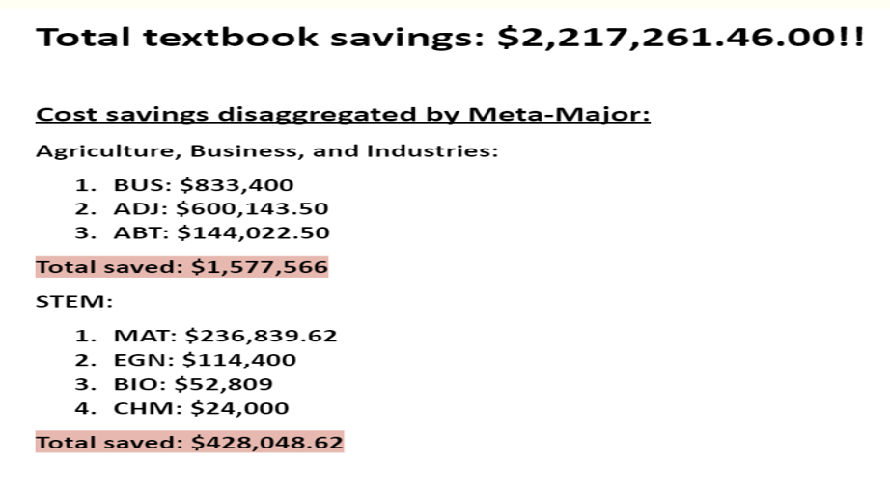
Faculty survey (spring 2023)

Slide 24
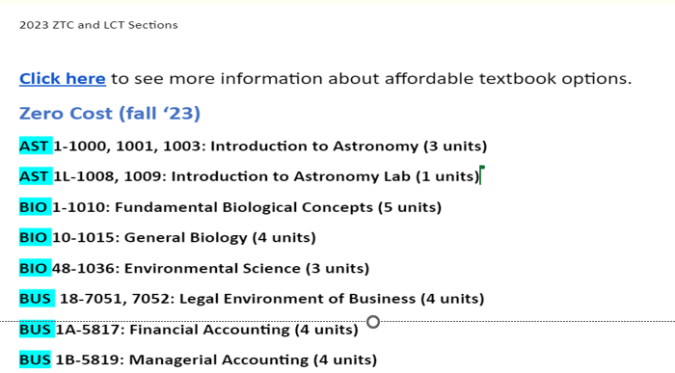
Identification of ZTC/LCT sections
List created using the search function of PAWS self-service and faculty reporting
List is posted on the Affordable Textbook Options page

Slide 25
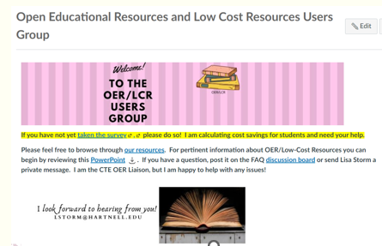
Canvas shell for faculty
Resources for faculty including OER and Low-Cost repositories, resolutions, surveys and survey results, available webinars and listservs
Hands-on help anytime it is needed
Announcements to update faculty on OER and Low-Cost issues

Slide 26
Suggested OER/ZTC/LCT improvements
Designate ZTC/LCT when scheduling, instead of via a separate survey
Share bookstore’s adoption list
Improve online course schedule by making it searchable for ZTC/LCT, highlighting LCT with a separate logo, getting rid of bookstore link to pricing
Advertise and promote ZTC and LCT, especially during registration
Provide faculty incentives to adopt OER and LCT

Slide 27
Chancellor’s Office Grants
Implementation and acceleration grants applied for and received in the total amount of $425,000
Implementation grant: $20,000 for planning and $180,000 to develop ZTC pathways to the COM ADT and a noncredit Workforce and Academic Readiness Certificate
Acceleration grant: $200,000 to develop ZTC pathway to the First Line Supervisor Certificate
Acceleration grant: an initial $25,000 to work in a cohort with one or more CCC on a ZTC pathway to the ADJ AS-T and ADJ Certificate, with IDEA infused in the OER

Slide 28
Grant progress
COM ADT: completed, may require tweaking
WARC Noncredit CT: draft narratives in progress (new program)
First Line Supervisor: two courses needed to reach ZTC status (BUS 42, BUS 194)
ADJ AS-T/CT: waiting for instruction from Chancellor’s Office about working in a cohort
Applications for funding: developed and awaiting approval
Compensation available: $10,000 to create and adopt OER for 5 years, $7,500 to update and adopt OER for 5 years, $5,000 to revise course to adopt OER for five years, $2,500 to continue with OER for 5 years
Work must be completed in the future; no compensation for past work
CCCCO preference is for nonduplication, disciplines with the highest textbook costs, general education courses

Slide 29
Questions?

