Slide 1
Graciano Mendoza
Vice President of Administrative Services
David Techaira
Executive Director of Fiscal and Auxiliary Services
October 3, 2025
Overview of
California Community College
Funding Trends

Slide 2
STATE “BIG THREE” REVENUE SOURCES
Personal Income Tax
Corporation Tax
Sales Tax

Slide 3
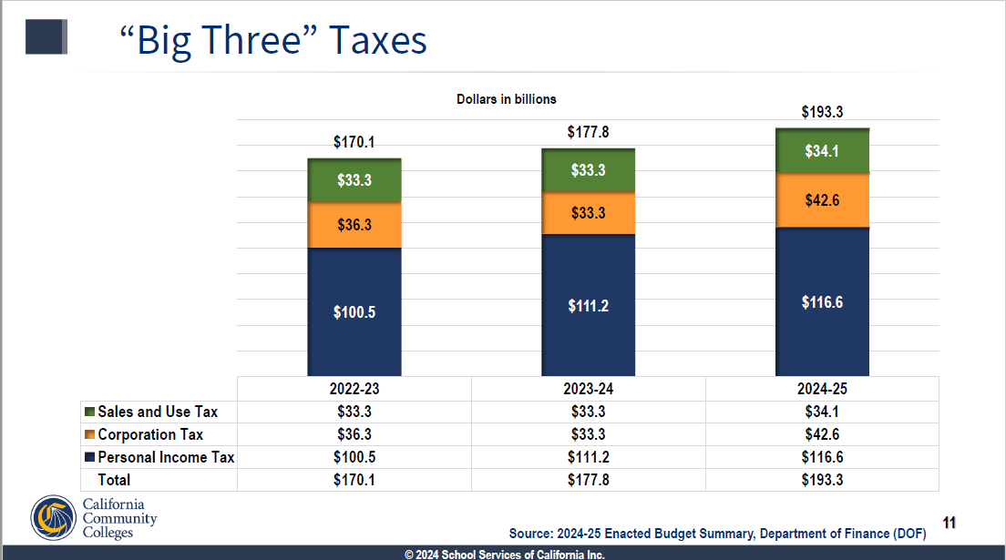

Slide 4
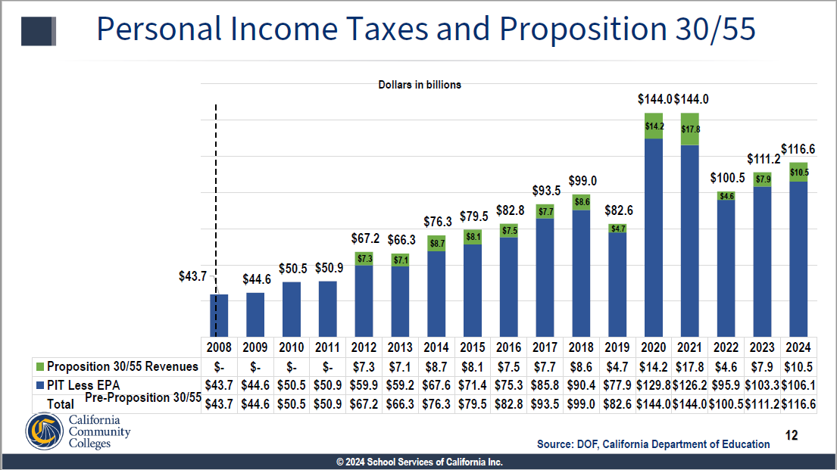

Slide 5
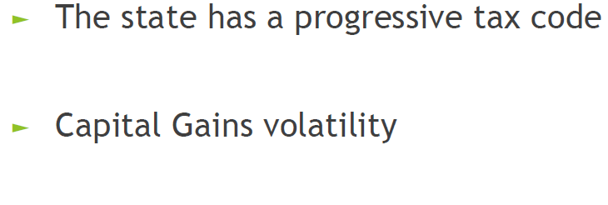
FUNDING VOLITILITY

Slide 6
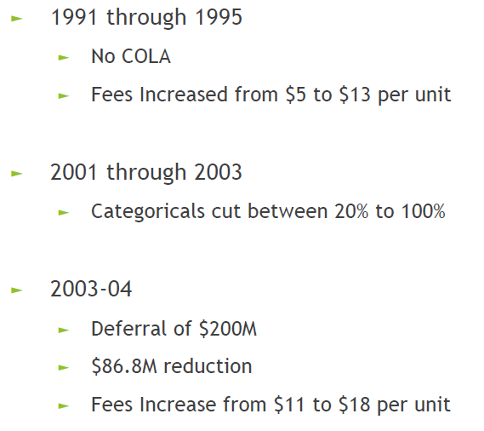
RECENT ECONOMIC DOWNTURNS

Slide 7
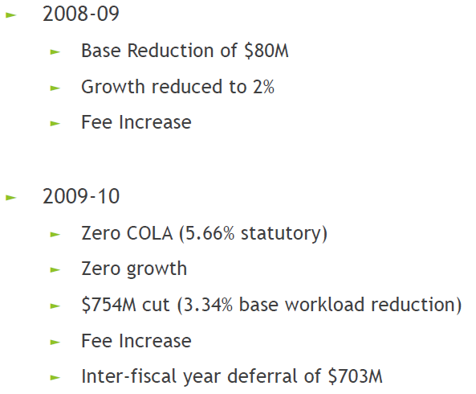
RECENT ECONOMIC DOWNTURNS

Slide 8
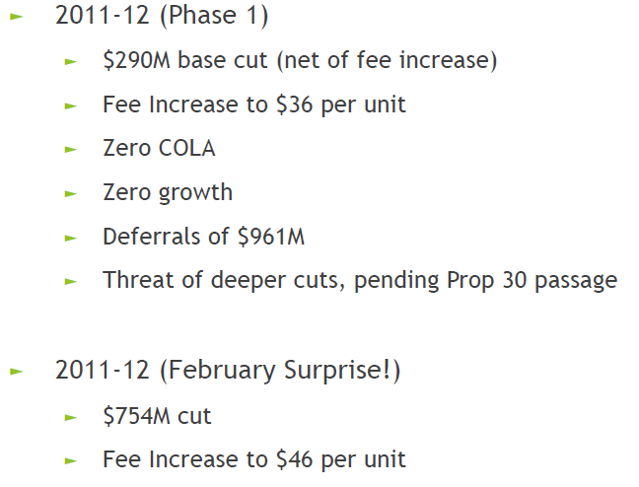
RECENT ECONOMIC DOWNTURNS

Slide 9
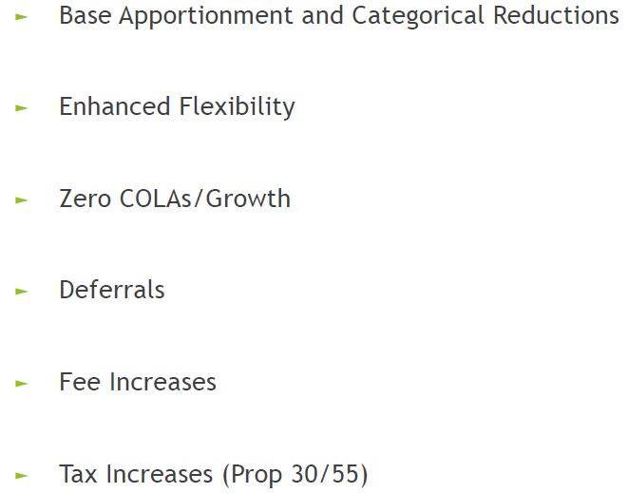
LAWMAKERS RESPONSE

Slide 10
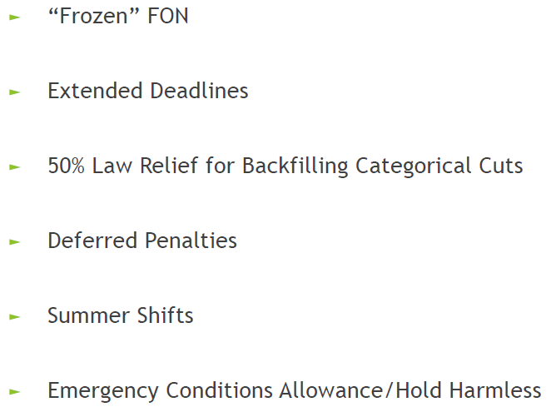
CALIFORNIA COMMUNITY COLLEGES CHANCELLOR’S OFFICE RESPONSE

Slide 11
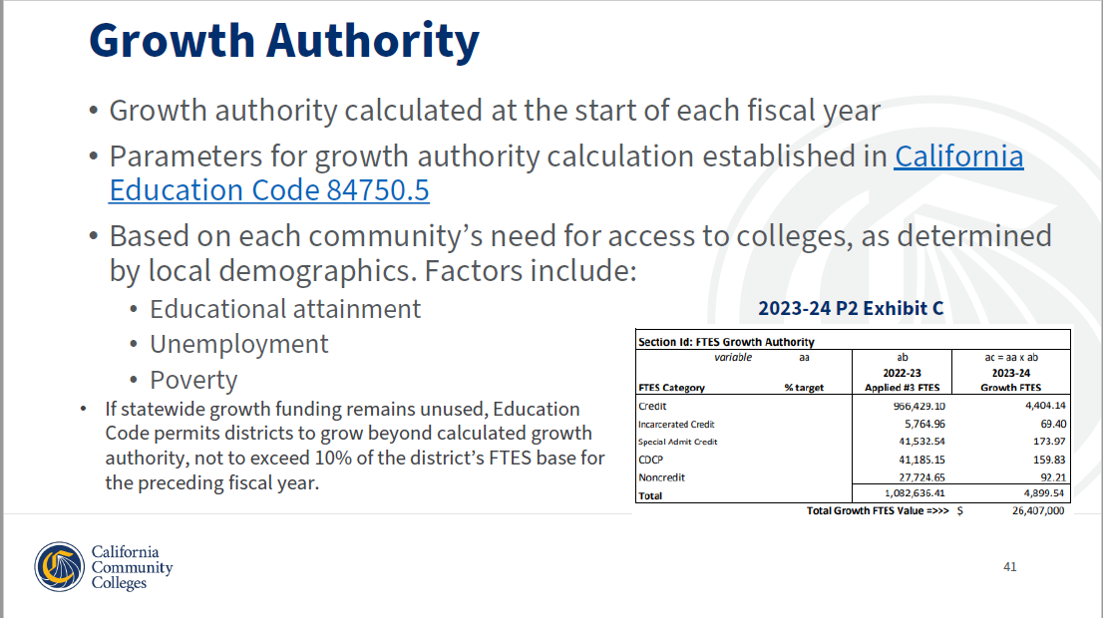

Slide 12
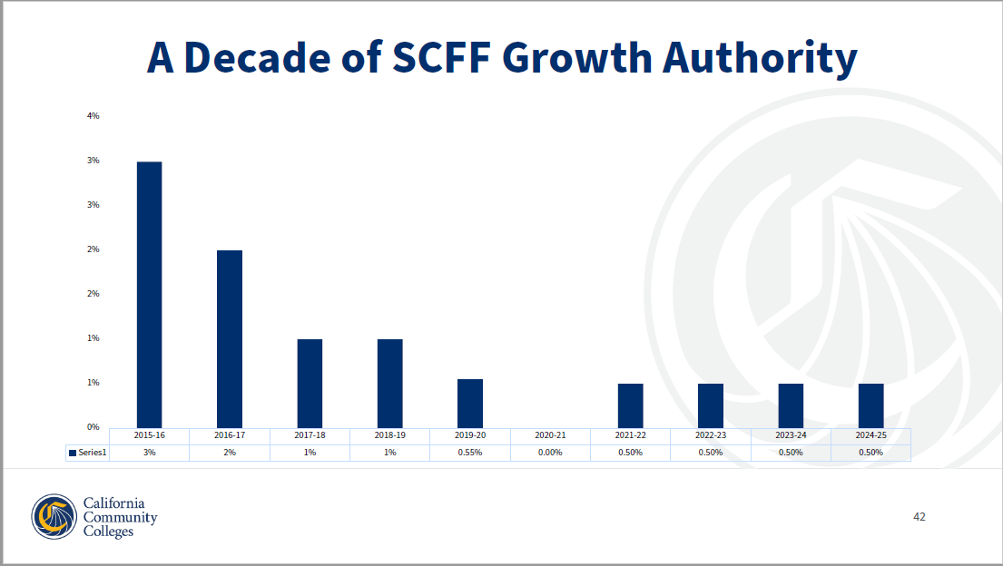

Slide 13
END

