Slide 1
Graciano Mendoza
David Techaira
Fiscal Fundamentals
Administrative Services
October 3, 2025

Slide 2
AGENDA
1) Regulatory and Compliance Requirements
2) Overview of Funding Sources
3) Questions

Slide 3
1. Regulatory and Compliance Requirements

Slide 4
REGULATORY AND COMPLIANCE REQUIREMENTS
Generally Accepted Accounting Principals
Governmental Accounting Standards Board (Statements, Interpretations and Technical Bulletins)
Generally Accepted Auditing Standards
AICPA Practice Bulletins, Issue Papers
Federal Accounting Standards Advisory Board Statements, Interpretations, Technical Bulletins and Concept Statements
Education Department General Administrative Regulations (EDGAR)
State Chancellor’s Budget and Accounting Manual (BAM)

Slide 5
OVERSIGHT
Annual Independent Audit (Contracted District Audit Manual)
General Obligation Bond Audit Requirement
Citizens Bond Oversight Committee
State Audits
Federal Audits
IRS Audits
Accreditation Review

Slide 6
2) Overview of Funding Sources

Slide 7
FUND TYPES
General Funds: Primary Operating Fund
Special Revenue: Used to account for the proceeds of specific revenue sources whose expenditures are legally restricted.
Capital Projects: Used to account for financial resources to be used in acquisition or construction of major capital facilities and other capital outlay projects.
Enterprise: Used to Account for an operation when it is intended to operate as a business.
Internal Service: Used to account for the financing of goods or services provided by one department or organizational unit to other units on a cost-reimbursement basis.
Trust & Agency: Used to account for assets held by the district in a trustee or agency capacity.

Slide 8
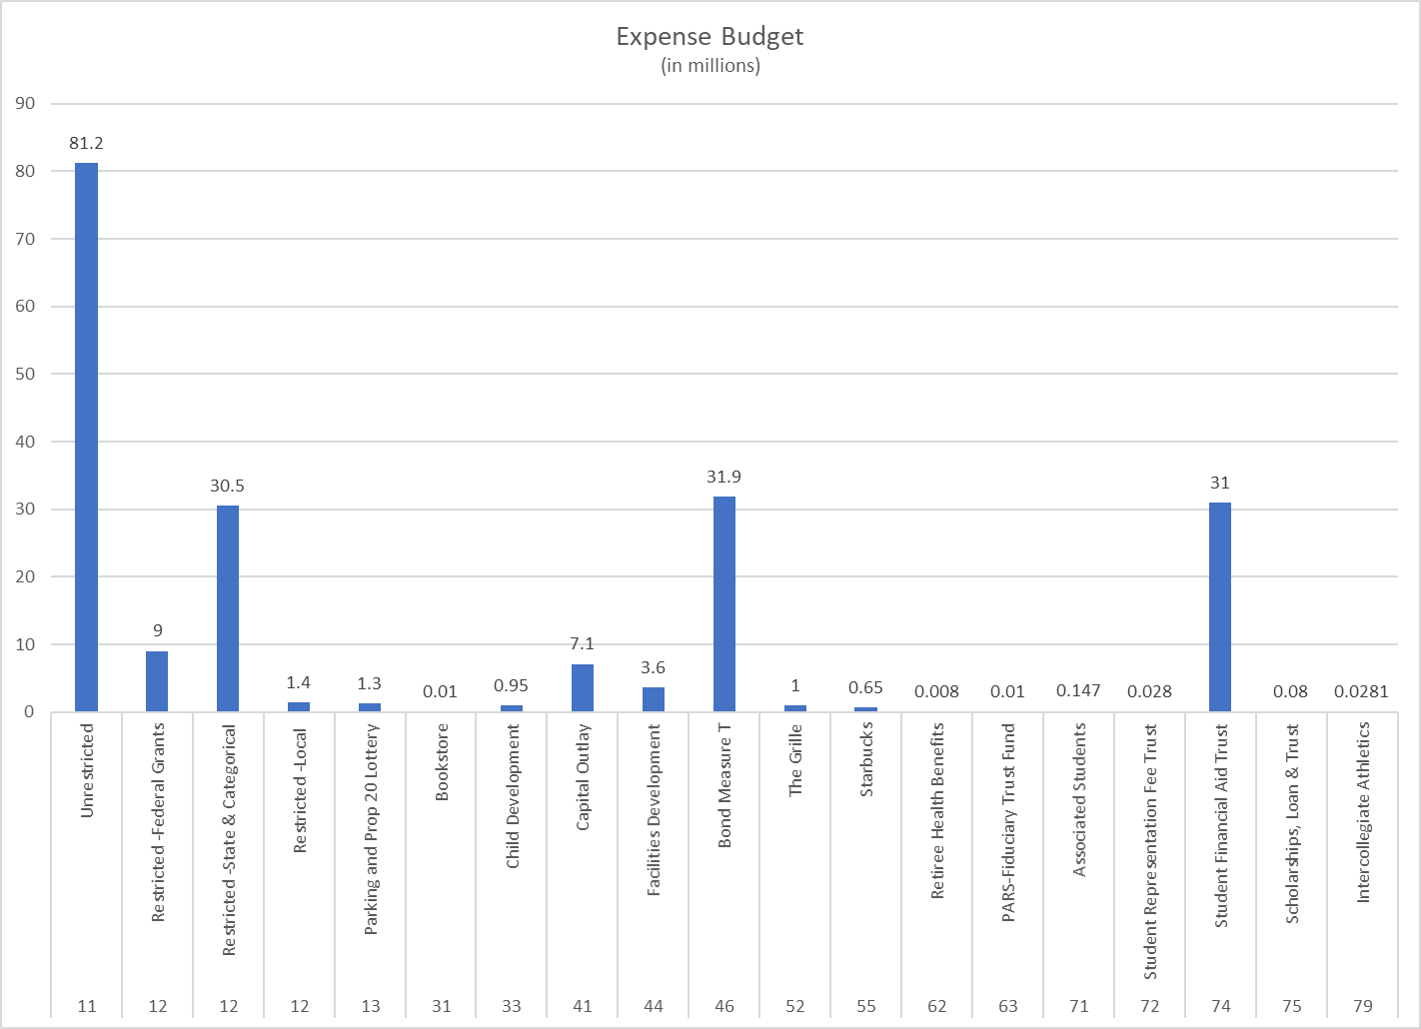
FY 2025-26
Expenditure Budgets for All Funding Sources

Slide 9
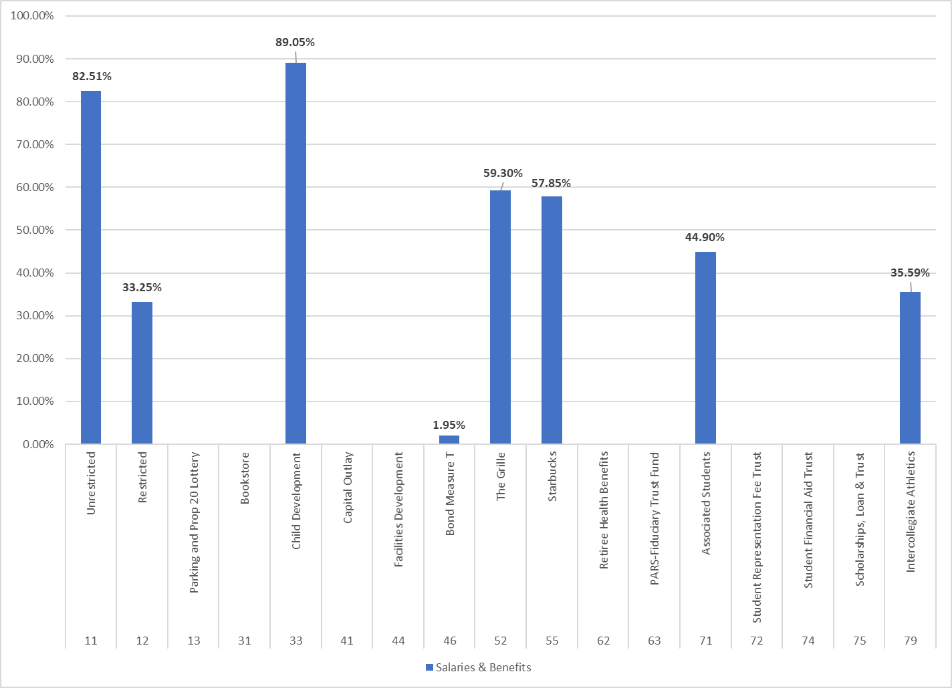
FY 2025-26
Salaries and Benefits as a % of Total Expense Budget

Slide 10
3) Questions

