Slide 1
Graciano Mendoza Vice President of Administrative Services
75/25 Ratio
And
Full-Time Faculty Obligation (FON)

Slide 2
AGENDA
Background
Calculations
Planning Considerations
Consequences of non-compliance

Slide 3
1) Background

Slide 4
ASSEMBLY BILL 1725 –PASSED 1988
Passed by the CA legislature and signed by the Governor as an omnibus bill.
Intended to reform the CA community colleges by aligning their practices and criteria to other segments of higher education.
AB 1725 included a requirement to increase the ratio of full-time to part-time faculty in community colleges to 75 percent of instruction.

Slide 5
ASSEMBLY BILL 1725
Recognized a severe hiring crisis looming with 55 percent of full-time faculty expected to retire by 2003. Following critical factors were identified:
The maintenance of a fully staffed, full-time faculty is an essential element of a coherent program.
If the community colleges are to respond creatively to the challenges of the coming decades, they must have a strong and stable core of full-time faculty with long-term commitments to their colleges and time to participate in non-teaching faculty activities.
However, in many areas the employment of part-time temporary faculty is both appropriate and necessary, especially in vocational programs where part-time faculty members may be practicing professionals in the field.
There is widespread concern about the current tendency to fill “retiring full-time positions with multiple part-time positions, and that there is a financial incentive to do so.

Slide 6
PROBLEMS and IMPEDIMENTS in REACHING 75/25 Goal
The State Chancellor’s Office Workgroup in 2003 identified the following issues as problems or impediments for districts in reaching the 75/25 goal, they continue to exist today:
Funding inadequacy
Funding reductions
Rapid enrollment growth
Enrollment decline or instability
Retirement incentive impact
Nature of the institution
Institutional priorities and choices

Slide 7
FACULTY OBLIGATION NUMBER
The implementation of AB1725 was accompanied by program improvement funding that was specifically targeted at making progress toward the 75/25 goal. This funding stream was discontinued after only two years, and there has been no dedicated funding mechanism since that time to support progress toward the 75/25 goal.
The AB1725 legislation created a “Faculty Obligation Number” (the FON) for each District as a mechanism to improve the full=time vs. part-time ratio. Each year the FON is adjusted based upon the percentage change in funded credit FTES provided that the Board of Governors determines that adequate funds had been provided to support an increase in the obligation.

Slide 8
FON -DETERMINATION
Title 5 Regulations define the mechanism for counting the number of Full Time Faculty
53302. Full Time Faculty
For purposes of this Chapter the term “full-time faculty” means any faculty member as defined in Section 53402© , who is a regular or contract employee of the district pursuant to Sections 87601, 87605, 87608, 87608.5 or 87609 of the Education Code.
Regular (Tenured) and Contract (Tenure Track) are counted from Employee lists provided by District Human Resources and adjusted for the percentage of 100percent worked. Thus a Faculty member on a 75 percent contract counts as a ¾ of an FTE. Faculty on leave or release/reassignment are counted as if present and their replacements are excluded from counting.

Slide 9
History
Pursuant to Education Code Section 87482.6 and CCR Title 5 Section 51025, the FON is the number of full-time faculty a district is required to employ each Fall as adjusted by:
the lower of the projected fundable growth at the time of the budget enactment (at Advance)
OR
the actual percentage change in funded credit FTES from the prior year (at P2).

Slide 10
History
AB1725 (passed in 1988) established a goal to reach 75% of instructional hours to be taught by full-time faculty.
Funding was initially appropriated in reaching this goal.
Baseline FON Compliance Established (based on local FON in 1988-1989)
FON increased proportionately with funded credit FTES
Board of Governors take action (in November) to determine if there are adequate funds in the current year to increase FON for the following year Fall.

Slide 11
2. CALCULATING THE FON

Slide 12
FON CALCULATION
Calculation is based upon credit funded FTES
From Apportionment Exhibit C
Remember the 3-year credit FTES average
Special Admit and Incarcerated FTES added in
Compliance FON = lower of Advance FON or P2 FON
If the Apportionment has a Deficit factor, FON is adjusted accordingly
Deficit factor not known until apportionment released

Slide 13
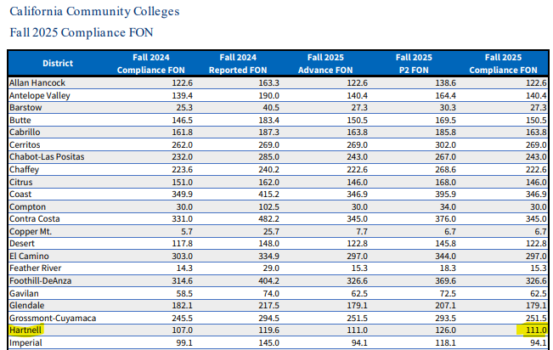
FALL 2025 COMPLIANCE FON

Slide 14
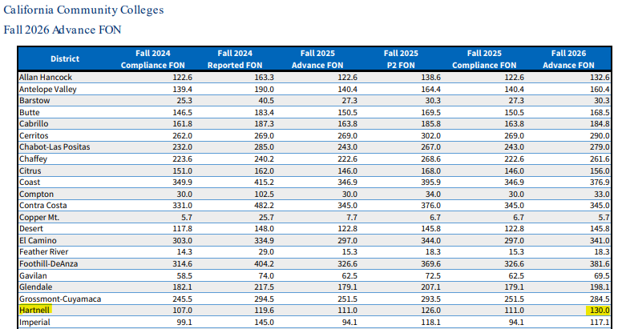
FALL 2026 ADVANCE FON

Slide 15
3. PLANNING CONSIDERATIONS

Slide 16
ANNUAL TIMELINES
September or Before: Advance FON provided for next Fall
November: BOG determines adequacy of funding for current fiscal year; effects next Fall’s FON
November 1: Districts submit current Fall numbers
January: Penalties determined for past Fall FON
June/July: P2 FON and Compliance FON provided for next Fall
Notes:
Wrenna

Slide 17
ADEQUATE vs. INEDQUATE FUNDS (Determined by BOG in November)
Adequate means COLA, Growth, or funds for other core programs exist in budget
Districts are expected to hit their FON
Inadequate funds
Options available:
Prior year FON or
Current year FON (if lower than prior year) or
Maintaining, at a minimum, the full-time equivalent faculty (FTEF) percentage attained in the prior fall term.
Notes:
Wrenna

Slide 18
PLANNING
It’s ALL an Estimate
Advance – Estimate based on Budget Act
Prior year funded credit FTES plus full restoration and full growth funds
P-2 – Based on funded credit FTES at P-2
Compliance = lesser of two “estimates”

Slide 19
PLANNING
Retirement notices received within 45 days of Spring term end count in subsequent Fall FON
However – if received more than 45 days of Spring term end, they do not count in Fall FON

Slide 20
THINGS to KEEP in MIND
Full-time Faculty help with meeting 50% Law
Instructional Service Agreements (ISAs)
If they generate growth in credit FTES, then FON will also grow
The FON is the floor, not the ceiling, a mechanism to maintain status quo at best

Slide 21
WHAT COUNTS? (Title 5, Sections 53308, 53309, 59204)
Type of Faculty | FON (FT Faculty only) | 50% Law (FT and PT Faculty)
Instructional Faculty | Yes | Yes
Non-Instructional Faculty | Yes | No
Non-credit Instructional Faculty | No | Yes
Non-credit Counselors | Yes | No
Tenure Track Grant Funded Faculty | Yes | No
Non-tenure track Grant Funded Faculty | No | No
FTF Overload | No | Yes
Faculty Reassigned Time | Yes | No
Sabbatical/Unpaid Leave | Yes | No
Late Retirements (within 45 days) | Yes | N/A
Funded by Parcel Tax | No | Maybe
Notes:
A-M

Slide 22
4. CONSEQUENCES OF NOT MEETING THE FON REQUIREMENT

Slide 23
CONSEQUENCES of NOT MEETING FON
Penalty = Apportionment reduction
Number of Faculty positions to be filled in achieving FON multiplied by Average replacement cost of a Full-Time Faculty
No Waiver
Title 5 section 51025 (e) does not provide authority to waive the penalty for noncompliance
Deferral of Penalty
Funds from Penalty
Distributed systemwide (one-time) to fund diversity in hiring (E.C.S. 87107) = EEO funds
Notes:
Wrenna

Slide 24
Thank you!

