Slide 1
Graciano Mendoza
Vice President of Administrative Services
FIFTY PERCENT LAW

Slide 2
AGENDA
Fifty Percent Law Defined
Regulatory and Legal Sources
Hartnell College Calculations
Consequences of Non-Compliance and Filing for Exemption

Slide 3
1) Fifty Percent Law Defined

Slide 4
ED CODE 84362(D)
Law dates back to 1959
    “There shall be expended during each fiscal year for payment of salaries of classroom instructors by a community college district, 50 percent of the district’s current expense of education.”

Slide 5
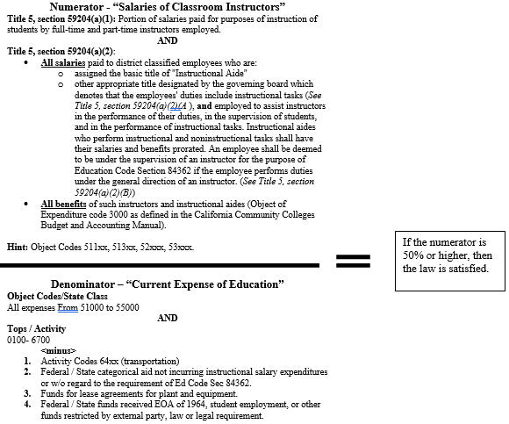
50PERCENT LAW CALCULATION
Ed Code Sec. 84362; Title 5, Sec. 59204 (a) and (b)

Slide 6
BACKGROUND
Salaries of Classroom Instructors (referred to as “the numerator”) are described in the California Community Colleges Budget and Accounting Manual as “Expenditures for the full or prorated portions of salaries of all employees in contract or regular faculty positions”.
Current Expense of Education (referred to as “the denominator”) generally includes the unrestricted general fund expenditures of a community college district. Excluded from the current expense of education are expenditures for student transportation, food services, community services, lease agreements for plant and equipment, and other costs specified in law and regulations. Amounts expended from State Lottery proceeds are excluded except for expenditure for instructional salaries.

Slide 7
2) Regulatory and Legal Sources

Slide 8
REGULATORY AND LEGAL SOURCES
Compliance
Contract District Audit Manual (CDAM) Section 421 requires the external auditors to audit the 50 Percent Law calculation. Steps include:
  Determining whether local match for categorical programs (i.e. DSPS, EOPS, College Work Study, VTEA, and WIA) are included in the current expense of education.
Loss in Revenue
Failure to comply results in reduction in apportionment the third year after non- compliance

Slide 9
REFERENCES
Education Code (EC) Sections
  84362 and 84363
California Code of Regulations Sections
  59204 - 59214
Contracted District Audit Manual (CDAM)

Slide 10
3) Example of Calculations

Slide 11
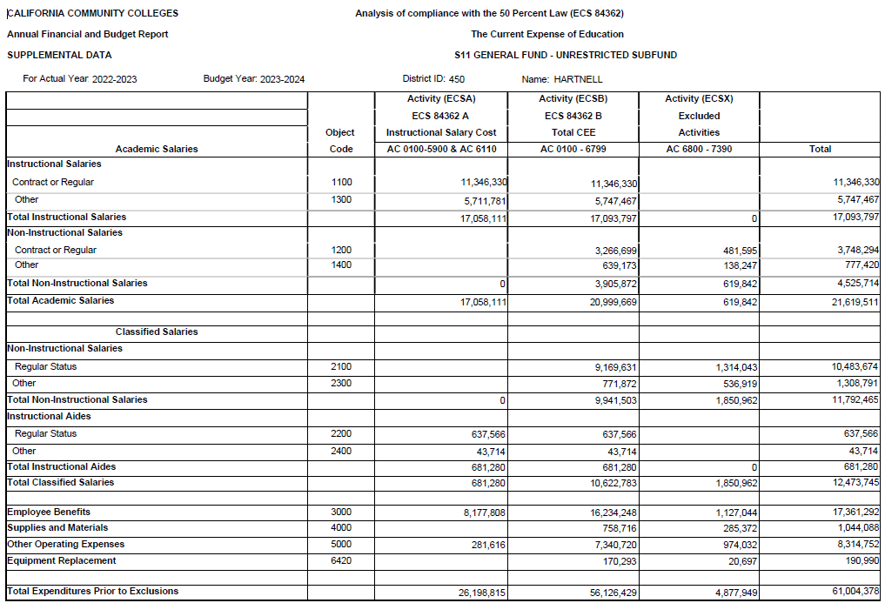
CURRENT EXPENSES AND EXCLUSIONS
Total equals UGF actual 1000-5000 expenditures

Slide 12
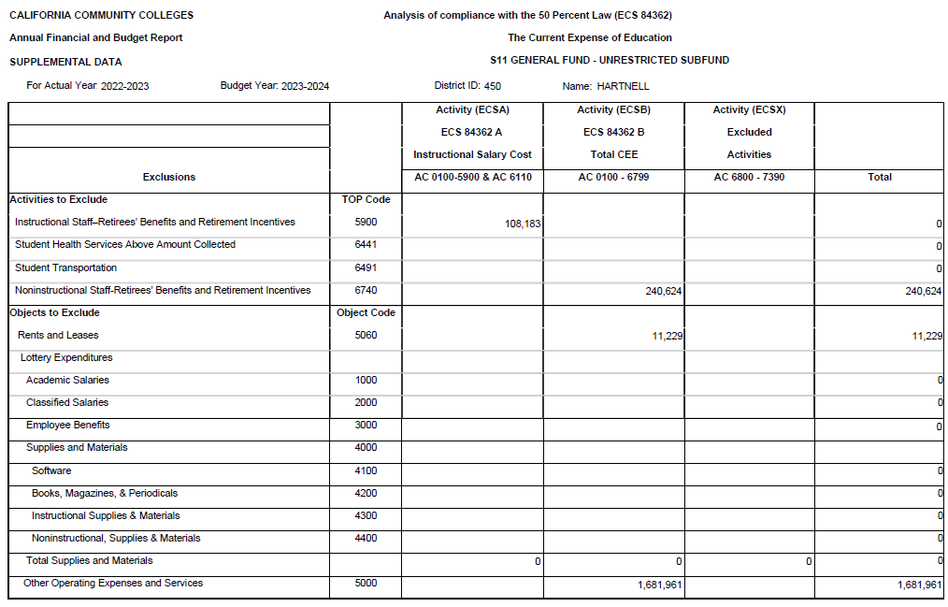
FY 2022-23 EXPENSES AND EXCLUSIONS

Slide 13
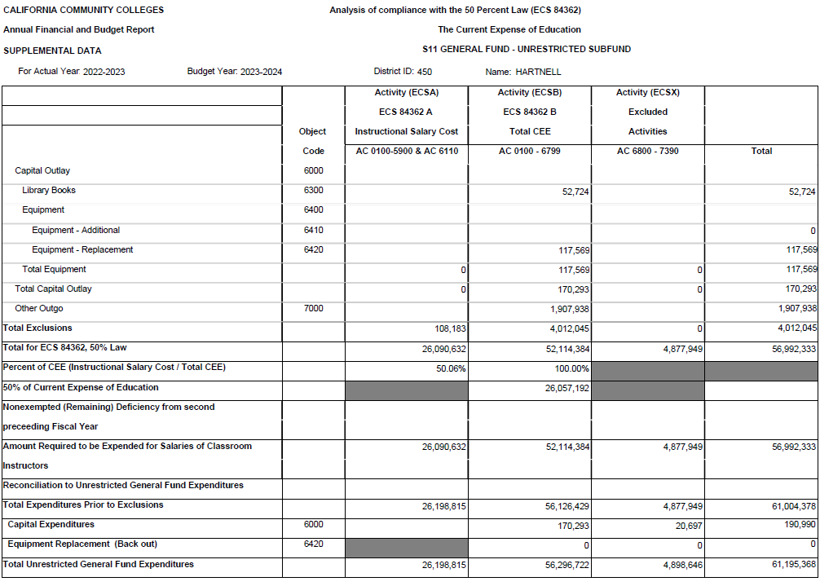
FY2022-23
EXPENSES AND EXCLUSIONS

Slide 14
4) Consequences of Non-Compliance and Filing for Exemption

Slide 15
BACKGROUND
The responsibility for administering the Fifty Percent Law resides with the Chancellor and the Board of Governors.
Every year, exemption application forms and applicable due dates are distributed to all districts, and the annual financial and budget reports of all districts are monitored for compliance with Ed Code section 84362.

Slide 16
BASIS FOR EXEMPTION
If compliance would have resulted in serious financial hardship
If salaries of classroom instructors are higher than the average of comparable districts
Districts may choose either one or both of the categories listed above

Slide 17
SERIOUS FINANCIAL HARDSHIP:
FOUR CRITERIA
Conformance with the 50 percent requirement would have resulted in the district’s inability to discharge financial liabilities. Consideration must be given to the following factors:
Whether the district’s general fund ending balance is less than three percent: and whether the district’s credit base FTES is less than 3,001.
The first year of infusion of new moneys would have resulted in the district’s inability to comply with the requirements of the Fifty Percent Law. The percentage is recalculated without including these new moneys in order to determine if the district would have been in compliance.
Unanticipated, unbudgeted and necessary expenditures resulted in the district’s inability to comply with the Fifty Percent Law. Such as, litigation, arbitration, costs of energy, insurance and security are among the items to be considered.
Districts with unexempted deficiency from a prior cycle may expend funds for other than salaries of classroom instructors, but count the expenditures as instructional after reaching an agreement with faculty representatives that these expenditures, as itemized in title 5, section 59213(f), are necessary.

Slide 18
FAILURE TO COMPLY
(TITLE 5, SECTION 59214)
    The nonexempted amount shall be reduced by any amount by which the district has exceeded fifty percent (50) of the current expense of education in the two years immediately following the year for which exemption has been sought.
    Within two years following the year for which exemption is being sought: an amount equal to the nonexempt amount or the amount by which the district failed to comply with Education Code section 84362, whichever is less, shall be deducted from apportionments made to the district on a one-time basis during the third year following the year of the deficiency.

Slide 19
FILING FOR EXEMPTION
Filing an exemption – Title 5, Sections 59206-59214:
  Two Step Application Process:
    1st Step: Exemption application (CCFS-350a) due September 15
    2nd Step: Findings of the Local Governing Board Regarding the 50 Percent Law (CCFS-350b) due December 1
Notes:
Wrenna

Slide 20
FILING FOR EXEMPTION
  Process leading up to 2nd filing due December 1:
    30 days prior to public hearing – share application with faculty exclusive representative union and Academic Senate
      They have 2 weeks to file an objection with Chancellor’s Office and request a hearing
    Hold a public hearing to determine basis for application
      Serious Hardship
      Payment to faculty results in salary schedule in excess of the salary schedule paid by other districts of comparable type and functioning under comparable conditions
      Public hearing must be noticed 30 days prior to hearing
      Document comments received during public hearing, etc.
Notes:
Wrenna

Slide 21
FILING FOR EXEMPTION
  Chancellor’s Office makes recommendation to the Board of Governors (BOG) no later than March 1 one of three things:
    The BOG deny the application
    The BOG grant the application
    The BOG grant the application in part
  If denied, the District must develop a plan of how to rectify deficiency
Notes:
Wrenna

Slide 22
FILING FOR EXEMPTION
  The plan may include:
    Salary increases for instructors (either on- or off-salary schedule)
    Additional instructors
    Additional instructional aides within the definition in section 59204
    Conversion of part-time instructors to full-time
    Reassignment of qualified personnel from other activities
    Other items such as instructional materials or additional counselors or librarians
      Must garner the mutual agreement of the exclusive representative of the district's academic employees or, if none exists, the district or college academic senate
Notes:
Wrenna

Slide 23
SOURCES
“Everything you want and need to know about the Fifty Percent Law and FON” ACBO Conference, May 17, 2021. Presented by Wrenna Finche, Fred Williams and Ann-Marie Gabel
“Coast Community College District Fifty Percent Law”, ACBO Conference March 17, 2010
Califorina State Chancellor’s Office website: Fifty Percent Law | California Community Colleges Chancellor's Office (cccco.edu)

Slide 24
Thank you!

