Slide 1
Graciano Mendoza
Vice President of Administrative Services
March 1, 2024
FINANCIAL OVERVIEW

Slide 2
AGENDA
Budget Update: On-Going General Unrestricted Fund
Future Fiscal Considerations
Resource Requests -Funding Summary

Slide 3
1) ONGOING REVENUE

Slide 4
SUMMARY OF ANTICIPATED INCREASES TO
ON-GOING REVENUE
FY 22-23 => 6.56 Percent Funded COLA => $6M
FY 23-24 => 8.22 Percent Funded COLA => $6.2M
FY 24-25 => 0.76* Percent Estimated COLA => $451K
FY 25-26 => TBD
FY 26-27 => TBD
FY 27-28 => TBD
* As of December, 2023, the ACBO Board informed that the current estimated State Funded COLA for FY 2023-24 is 1 percent. In early Spring 2024, the estimated State Funded COLA was reduced to .76%. (Awaiting further updates in Spring 2024.)

Slide 5
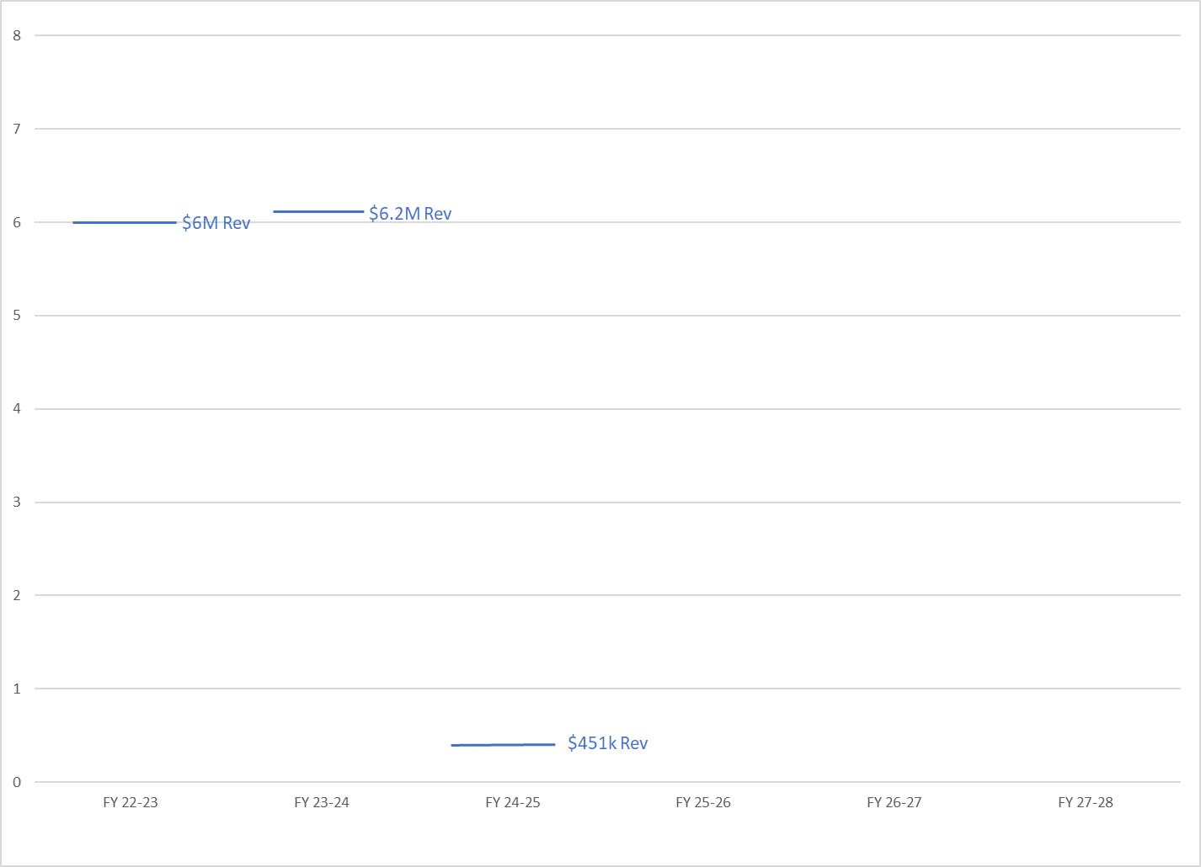
ESTIMATED NEW ADDITIONAL REVENUE

Slide 6
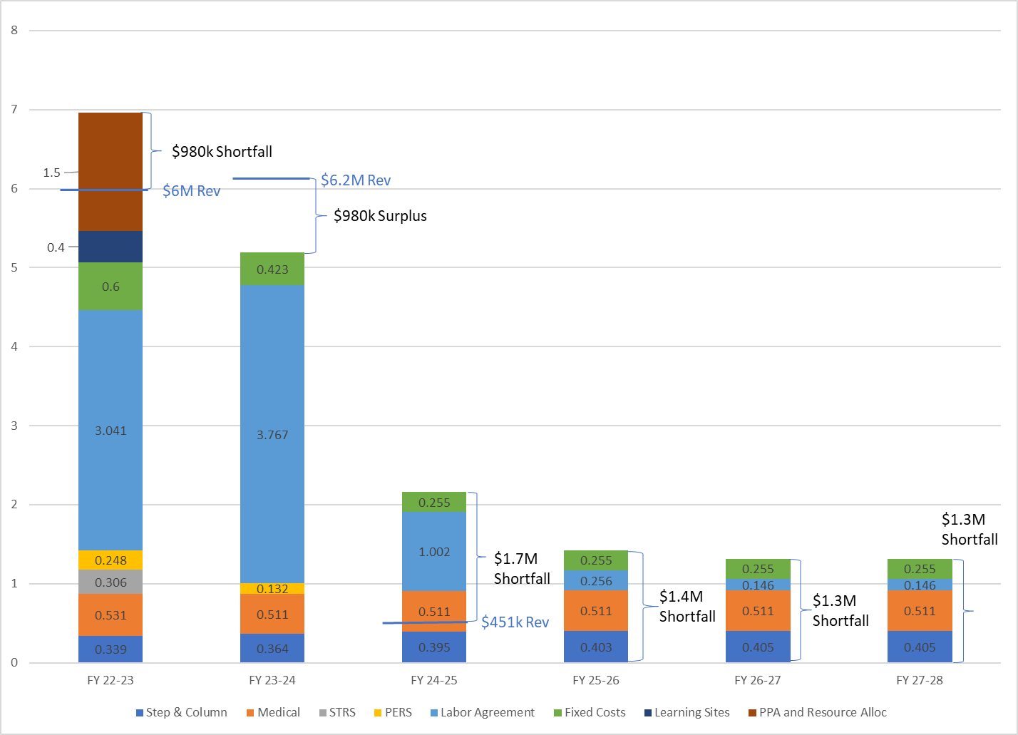
Multi-Year Projections for
FY 2022-23 thru
FY 2027-28
(Reflecting Recent Agreement with Bargaining Groups)

Slide 8
2) FUTUE CONSIDERATIONS

Slide 9
FUTURE CONSIDERATIONS
Escalating Operating Expenses Requiring New/Additional Funding to Cover Existing Commitments.
District Commitment to Forgo New Operational Funding Augmentations through FY 27-28.
End of “Hold Harmless” Emphasizing Importance of Growing Enrollment through Enrollment Management Efforts.
Local Impact from California’s Declining State Economy.
Other?

Slide 10
FY 2023-24 Resource Requests
3) Funding Summary

Slide 11
FY 2023-24 Resource Requests Summary

Slide 12
Overview
No “on-going” requests will be funded at this time.
Approximately $1.5M of one-time requests are tentatively approved based on the following:
  Confirmation of funding availability.
  Confirmation that items are still needed.
  Note: Funding cannot be used for a different purpose other than what is identified and listed on schedule.

Slide 13
Summary of One-Time Requests

Slide 15
END

