Slide 1
FY 2026-27
Tentative Budget and
Multi-Year
Projections
FY 2025-26 thru FY 2029-30
June 5, 2026
Graciano Mendoza
Vice President Administrative Services
David Techaira
Executive Director of Fiscal and Auxiliary Services

Slide 2
AGENDA
Economic Overview
May Revise
Tentative Budget Summary
Multi-Year Projections
Considerations, Recommendations and Reminders

Slide 3
1. Economic Overview

Slide 4
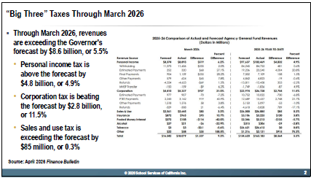
“BIG THREE” TAXES THROUGH MARCH 2026

Slide 5
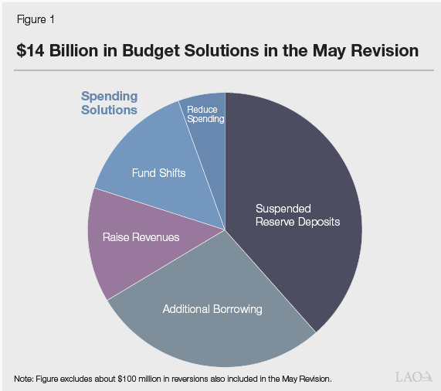
STATE BUDGET SOLUTIONS

Slide 6
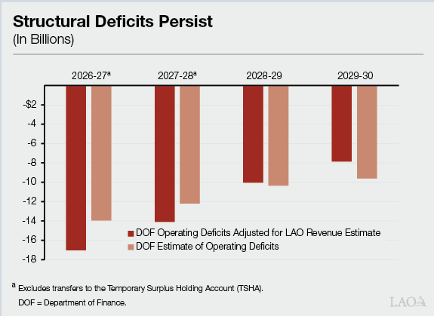
STATE ECONOMIC PROJECTIONS

Slide 7
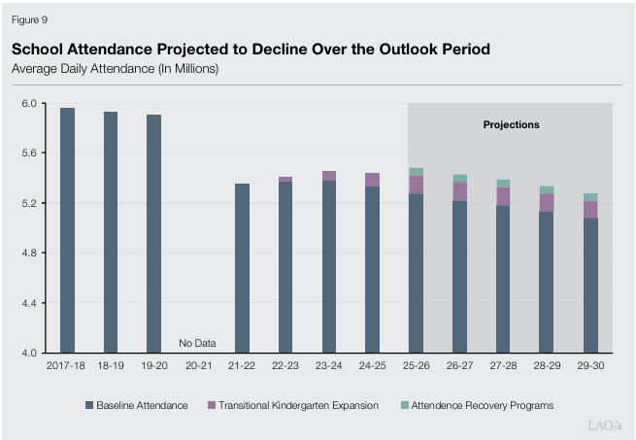
PROJECTED SCHOOL ATTENDANCE

Slide 8
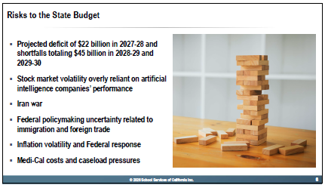
ECONOMIC RISKS

Slide 9
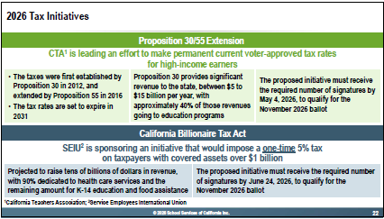
2026 TAX INITIATIVES

Slide 10
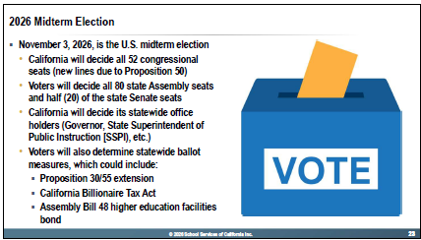
2026 MIDTERM ELECTION

Slide 11
2. May Revise

Slide 12
May Revise: Statewide Budget Outlook
California continues to face a constrained fiscal environment due to economic uncertainty, lower capital gains revenue, and volatility tied to financial markets and tariffs.
The Governor’s May Revision generally maintains core support for California Community Colleges.
The May Revision proposes a total SCFF COLA of 4.31%, consisting of:
      2.87% statutory COLA
      1.4% discretionary COLA tied to AB 65 implementation.
Community colleges continue to benefit from stability protections and funding floor provisions under SCFF.
The May Revision includes continued investments in systemwide priorities such as student support, transfer reform implementation, and workforce development.

Slide 13
May Revise: Implications for Hartnell
No proposed reductions to base apportionment funding.
Proposed SCFF COLA of 4.31% is assumed in the tentative budget revenue projections.
The District anticipates implementation of AB 65 paid pregnancy disability leave provisions, aligning with assumptions tied to the discretionary COLA augmentation.
2024-25 SCFF/TCR funding protections continue to provide stability while enrollment recovery and FTES growth trends are monitored.
State budget adoption remains pending and assumptions may be revised upon enactment of the final State Budget Act.

Slide 14
3. Tentative Budget Overview

Slide 15
Tentative Budget Summary
The Unrestricted General Fund Budget is balanced at $85.8 M.
Revenue projections include proposed 4.31% SCFF COLA.
Estimated year-end Fund Balance (Reserve) is 24% or $20.8 M.
Budget Assumptions include:
  Step and column increases.
  COLA pass-through assumptions for employee groups
  STRS rate of 19.10% and PERS rate of 26.40% (down from 26.81% in 2025-26).
  Health and welfare benefits cost increases of 10.2%.
The tentative budget maintains required reserve levels while funding known operational obligations and negotiated commitments.
All District funds are projected to maintain positive ending balances at fiscal year-end

Slide 16
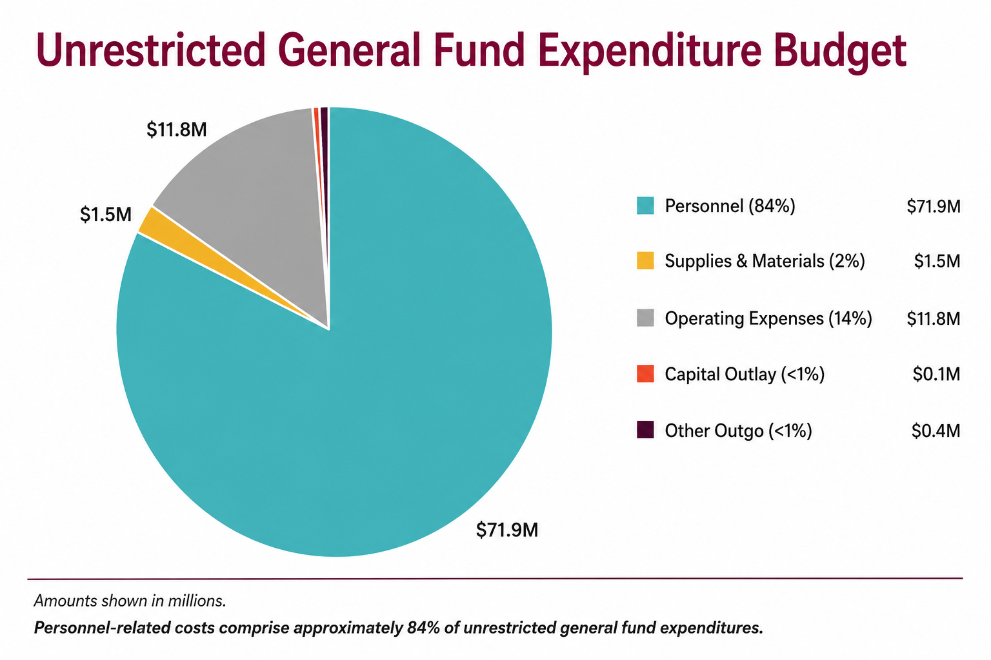

Slide 17
4. Multi-Year Projections

Slide 18
ENROLLMENT TRENDS (FTES)

Slide 19
REVENUE ASSUMPTIONS
FY 26-27 thru FY 29-30
Projections for Funded COLA => 4.31%, 3.06%, 3.34% and 3.14%
Projections for Funded Growth => 1.0%, 0.50%, 0.50%, and 0.50%
Projections for Supplemental and Student Success Factors => 6.86%, 5.86%, 4.86% and 3.86%

Slide 20
MULTI-YEAR PROJECTIONS

Slide 21
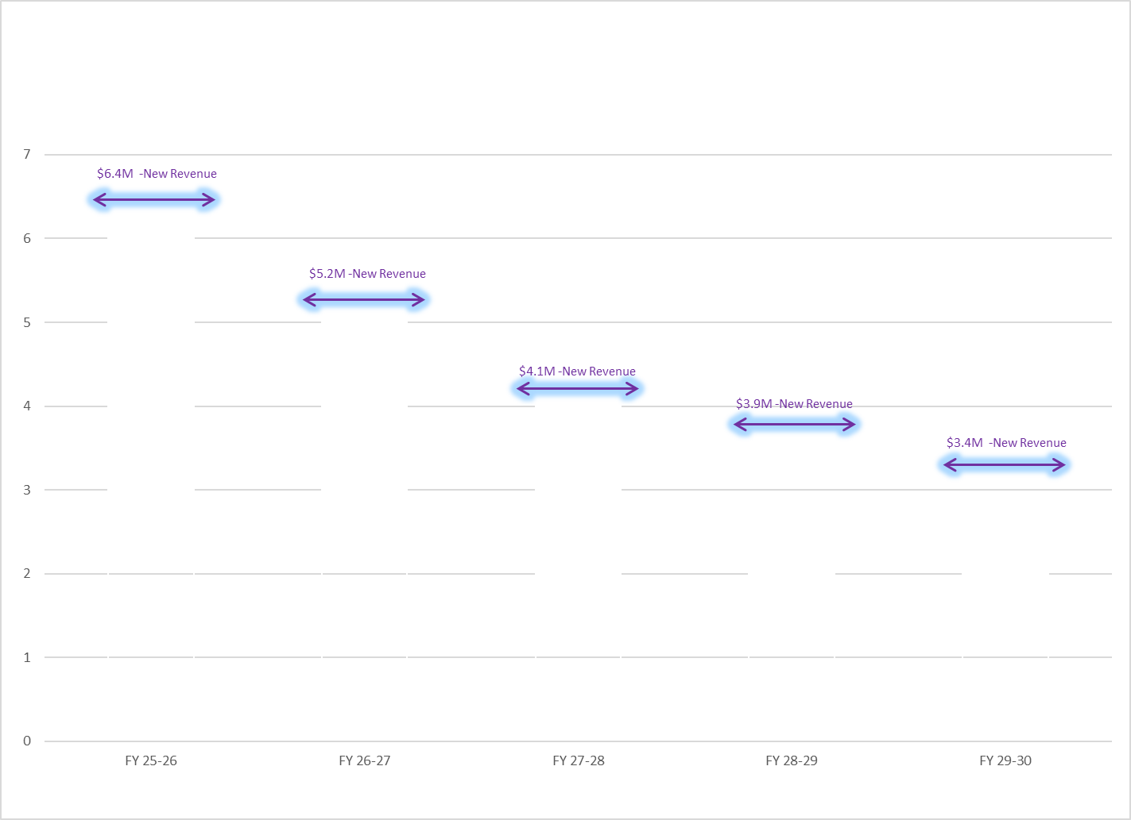
MULTI-YEAR PROJECTIONS

Slide 22
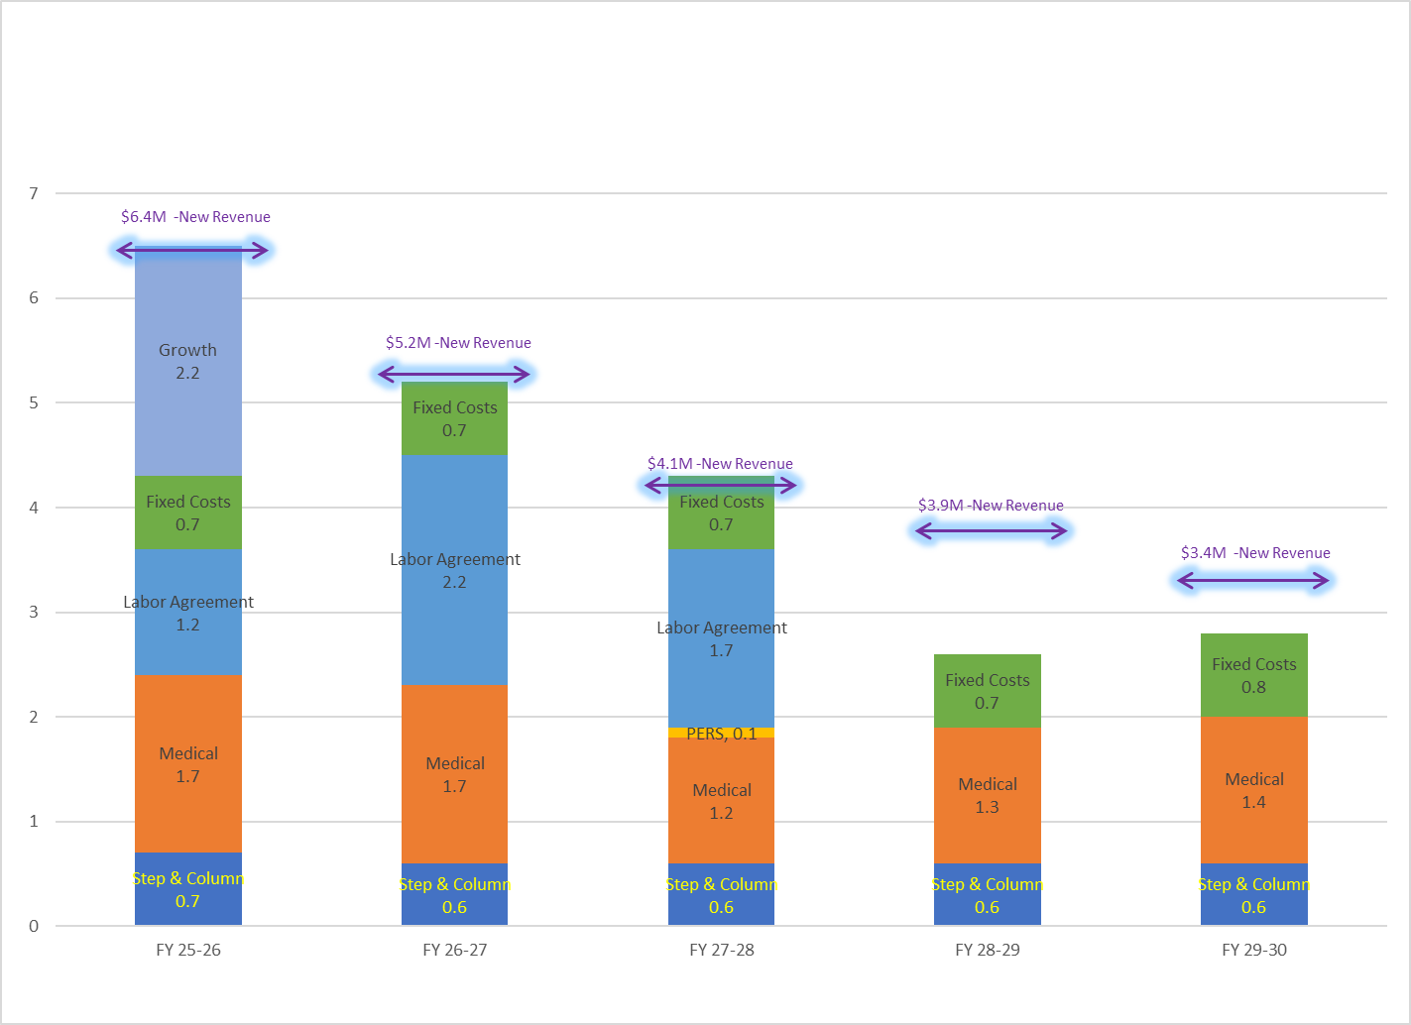
MULTI-YEAR PROJECTIONS

Slide 23
5. Considerations, Recommendations and Reminders

Slide 24
FUTURE CONSIDERATIONS
Vulnerable to National and State Economic Fluctuations
Unknown Effects from Federal Changes to Education
Enrollment and FTES targets must be monitored closely as funding continues to be enrollment-driven
Maintain structural balance in consideration of flat or slightly declining revenues.
Prepare contingency plans for potential mid-year reductions from Federal Government.
Monitor final budget passage by legislature and Governor.

Slide 25
RECOMMENDATIONS and REMINDERS
Recommendations:
Approve the proposed 2026-27 tentative budget by July 1st.
Reminders:
Approval of the tentative budget provides authorization to expend District funds at the start of the fiscal year.
The Tentative Budget includes projected revenues and expenditures based on the Governor’s May Revision and adjustments for District operations.
Adoption of the Final Budget is required by September 15th.

Slide 26
QUESTIONS?

