Slide 1
FY 2025-26
Tentative Budget and
Multi-Year
Projections
FY 2024-25 thru FY 2028-29
June 2, 2025
Graciano Mendoza
Vice President Administrative Services
David Techaira
Executive Director of Fiscal and Auxiliary Services

Slide 2
AGENDA
Economic Overview
May Revise
Tentative Budget Summary
Multi-Year Projections
Considerations, Recommendations and Reminders

Slide 3
1) Economic Overview

Slide 4
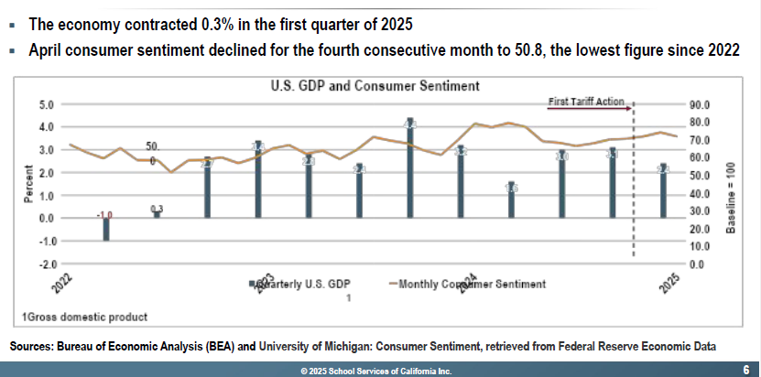
U.S. GROSS DOMESTIC PRODUCT AND CONSUMER CONFIDENCE

Slide 5
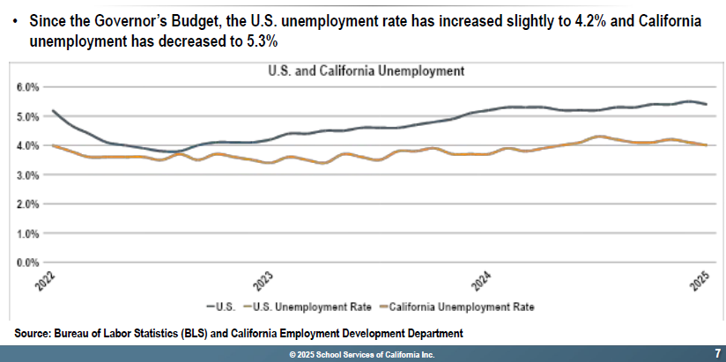
U.S. AND CALIFORNIA UNEMPLOYMENT RATE

Slide 6
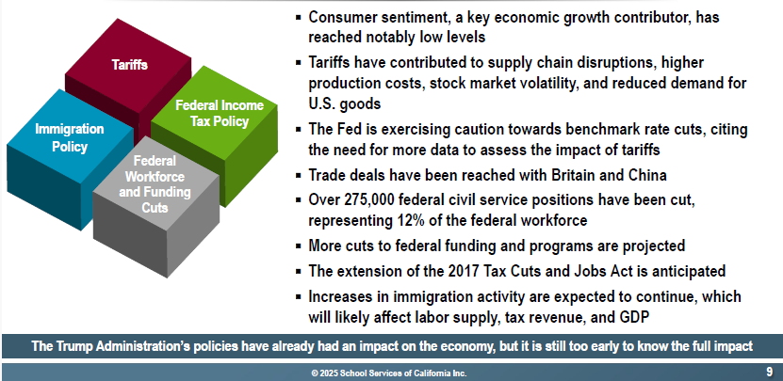
ECONOMIC IMPACT OF FEDERAL POLICIES

Slide 7
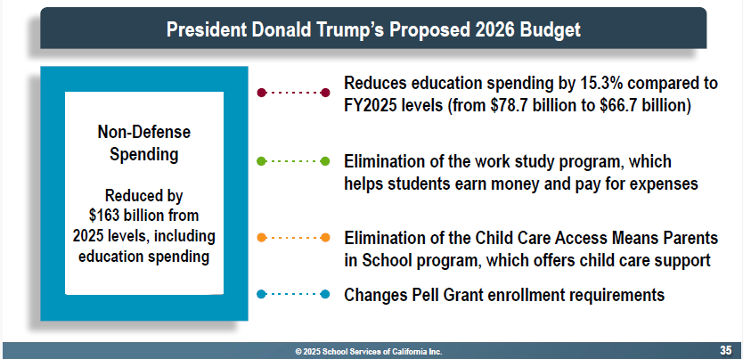
FEDERAL EDUCATION BUDGET

Slide 8
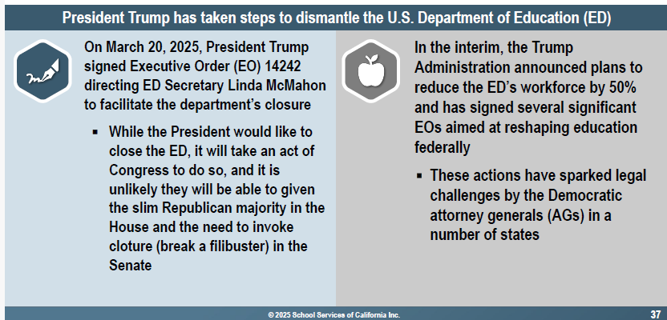
FEDERAL EDUCATION POLICIES AND LOCAL IMPACTS

Slide 9
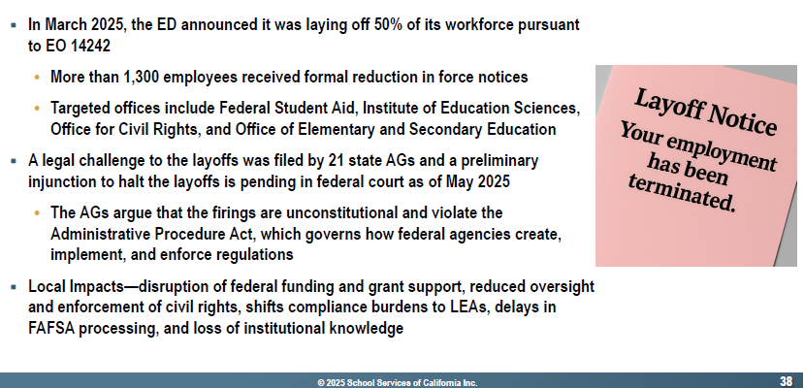
FEDERAL EDUCATION POLICIES AND LOCAL IMPACTS –ED LAYOFFS

Slide 10
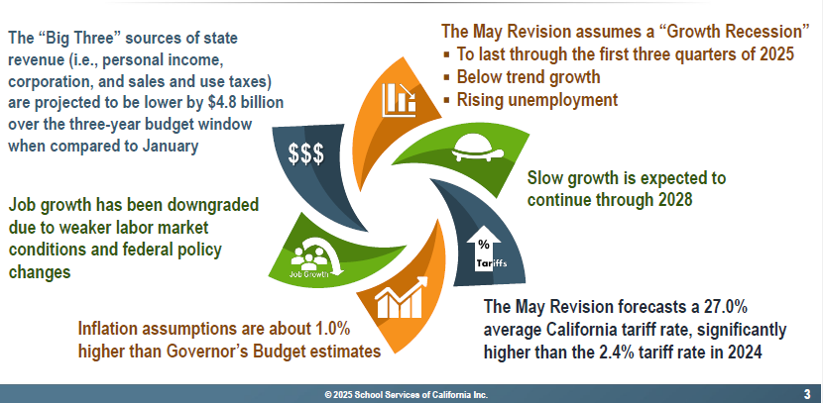
STATE ECONOMIC OVERVIEW

Slide 11
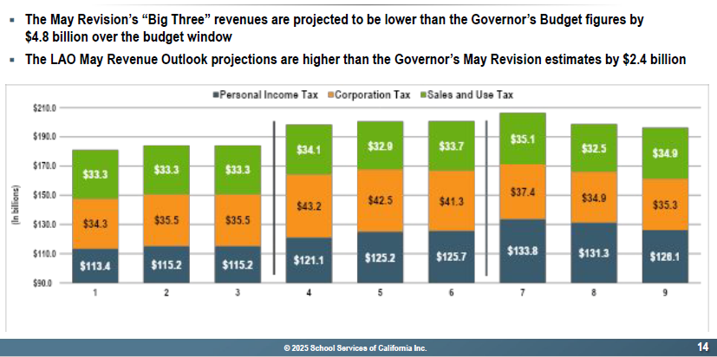
“BIG THREE” TAXES

Slide 12
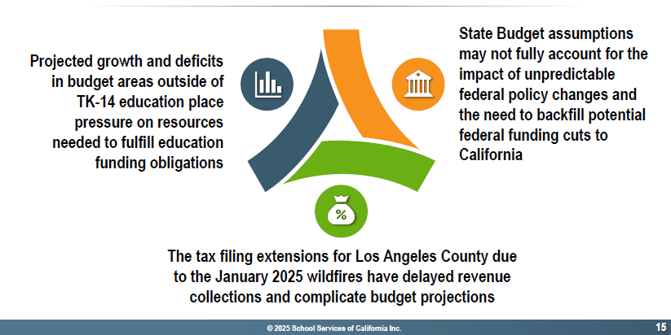
MAJOR STATE BUDGET ISSUES AND CONSIDERATIONS

Slide 13
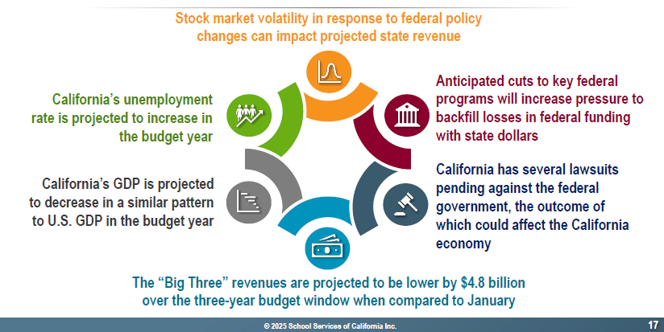
RISKS TO THE ECONOMY AND STATE BUDGET

Slide 14
2) May Revise

Slide 15
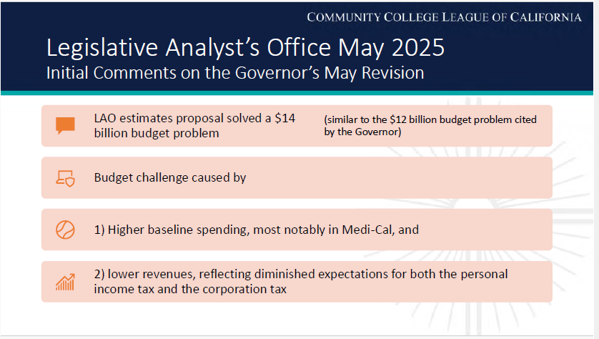

Slide 16
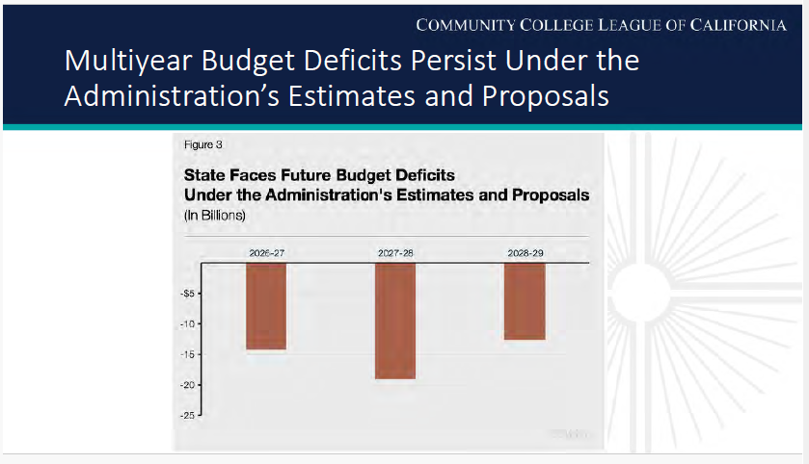

Slide 17
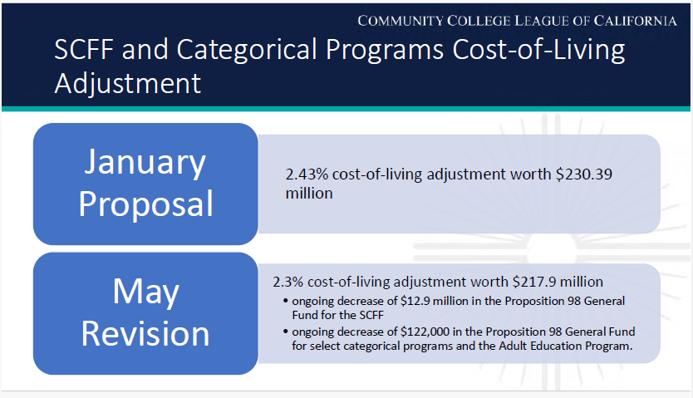

Slide 18
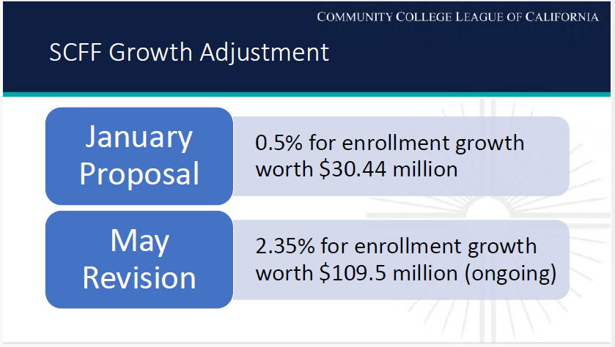

Slide 19
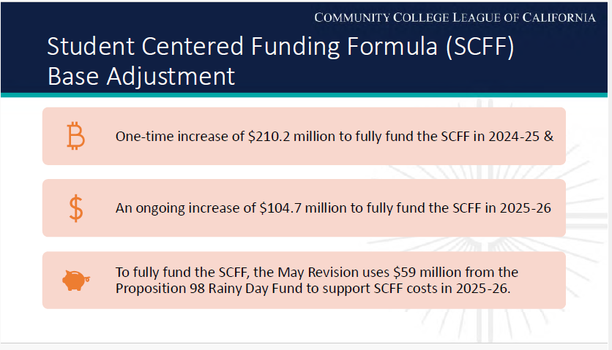

Slide 20
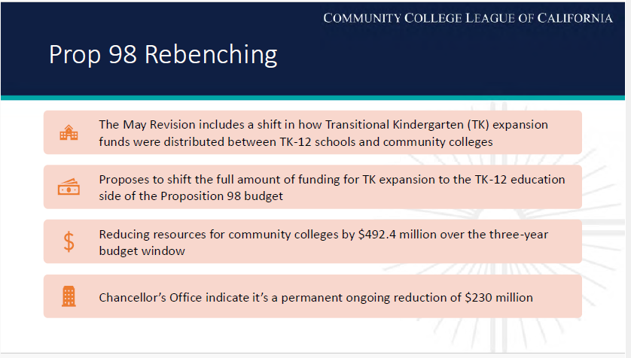

Slide 21
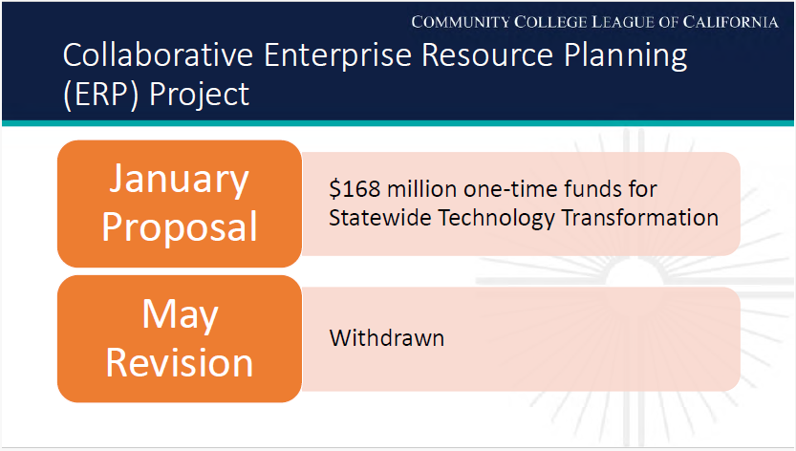

Slide 22
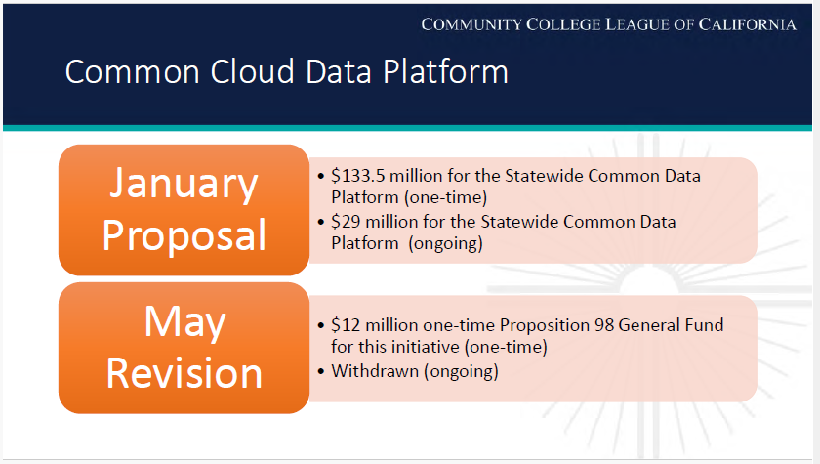

Slide 23
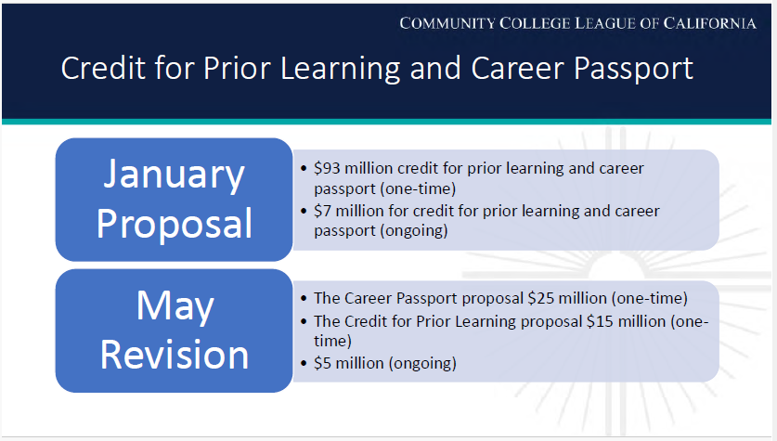

Slide 24
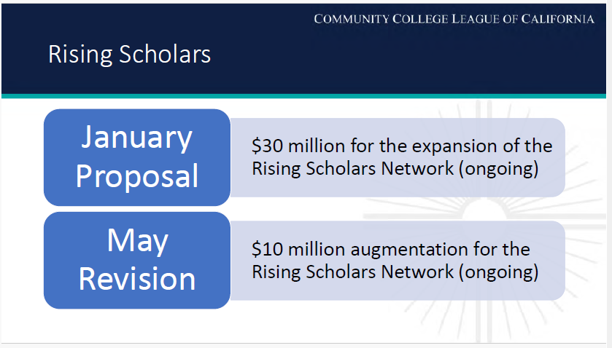

Slide 25
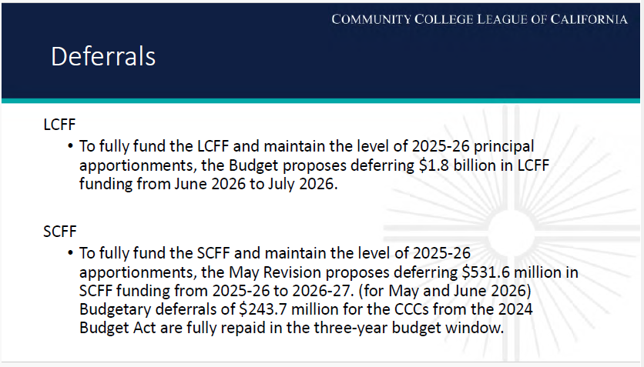

Slide 26
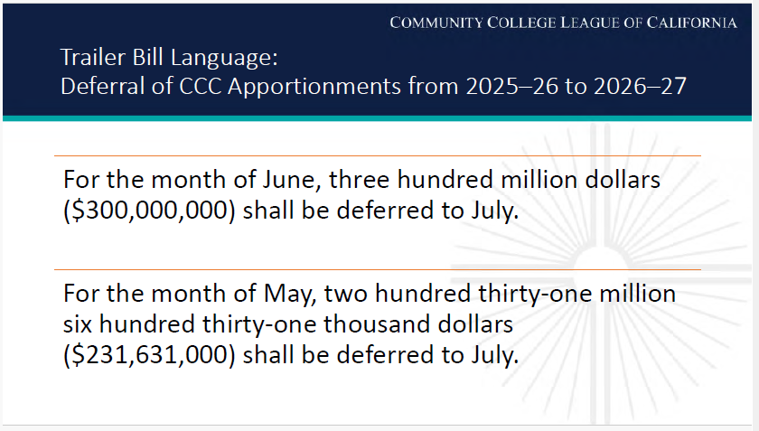

Slide 27
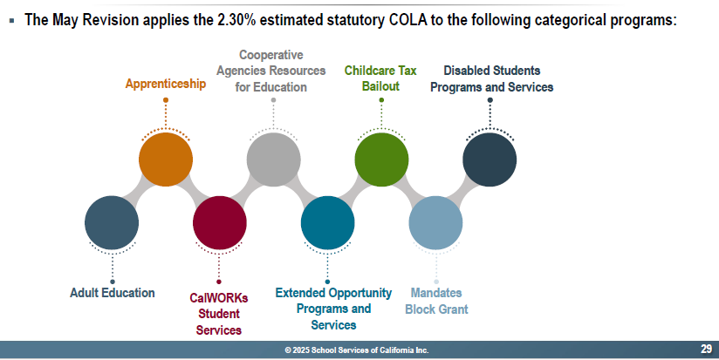
CATEGORICAL PROGRAMS RECEIVING COLA

Slide 28
3) Tentative Budget Summary

Slide 29
May Revise: Statewide Budget Outlook
California faces a budget deficit of $12 billion.
Constrained budget environment shaped by continued economic uncertainty and lower revenue expectations related to stock market volatility and tariff impacts.
Despite deficit, the Governor maintains core support for community colleges.
Funding for community colleges is stable compared to the 2024-25 enacted budget.
Budget shortfall addressed through program reductions (e.g. health care), borrowing and funding shifts, and deferrals.

Slide 30
May Revise: Implications for Hartnell
No immediate cuts to funding or base apportionments.
A revised Cost-of-Living Adjustment (COLA) of 2.3% for apportionments.
COLA of 2.3% for the Adult Education program and selected categorical programs (e.g. Apprenticeship, CalWORKs, EOPS, CARE, Childcare Tax Bailout, DSPS, and Mandates Block Grant).
2024-25 funding amount, or SCFF generated revenue amount, is our new funding “floor.”

Slide 31
Tentative Budget Summary
The Unrestricted General Fund Budget is balanced at ~$76 M.
Includes proposed COLA revenue and revenue deficit factor of 2.8%.
Salary and benefits account for 82% of total expenditures.
Estimated year-end Fund Balance (Reserve) is 21% or $16.3 M.
All identified requirements have been funded, including adjustments to employee benefits.
Step and column increases.
STRS rate remains at 19.10%
PERS rate decreases to 26.81% (down from 27.05% in 2024-25).
Health and Welfare benefits increase by an estimated 16%.
All District funds are projected to have a positive ending balance at the end of 2025-26.

Slide 32
Proposed Tentative Budget 2025-26

Slide 33
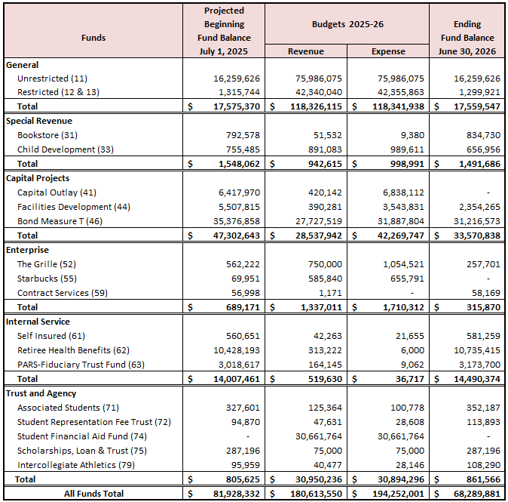
Budget Summary
By Fund

Slide 34
4) Multi-Year Projections

Slide 35
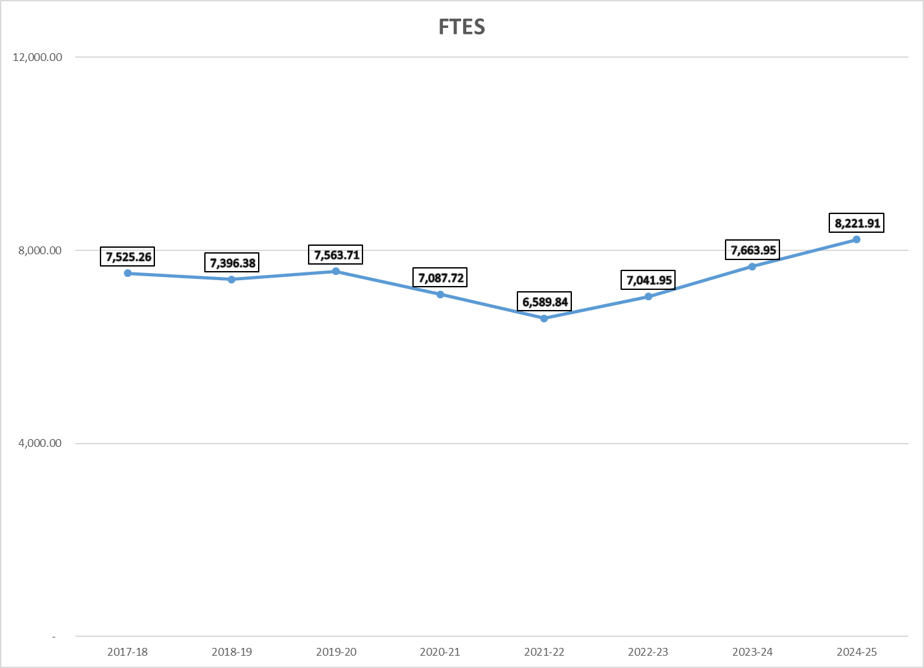
ENROLLMENT TRENDS

Slide 36
REVENUE ASSUMPTIONS
FY 25-26 thru FY 29-30 => 2.3%, 3.02%, 3.42% and 3.31%
(School Services of California Inc., as of May 21, 2025)
FY 25-26 thru FY 29-30 => 2.35%, 0.5%, 0.5%, 0.5% and 0.5%

Slide 37
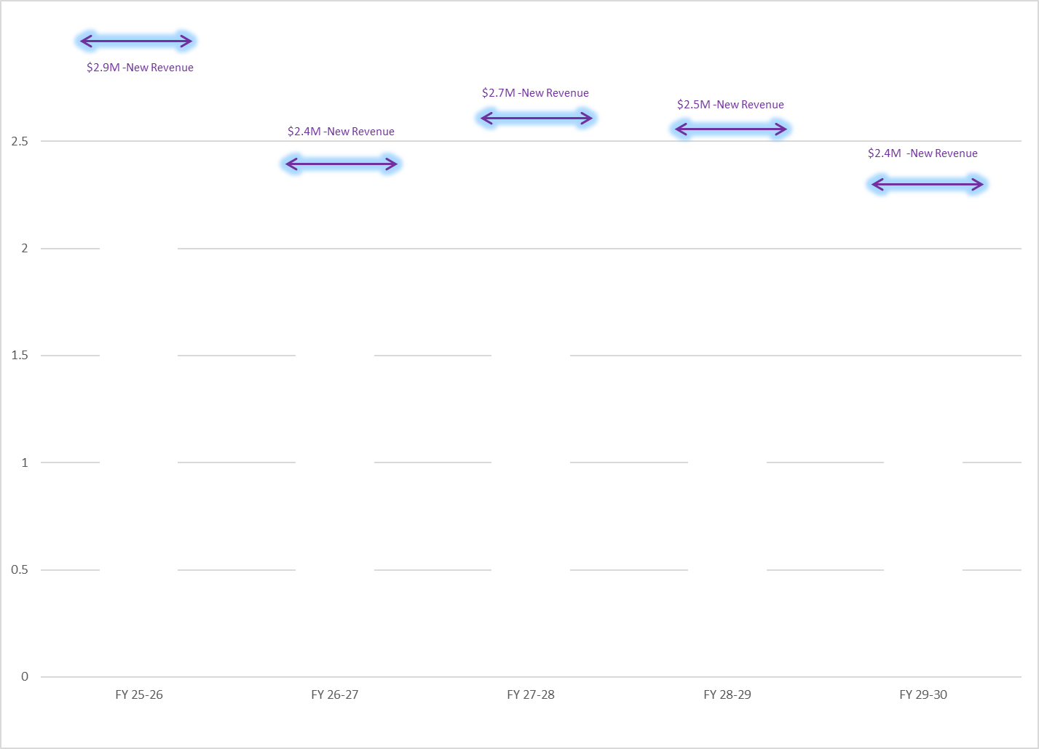
REVENUE PROJECTIONS

Slide 38
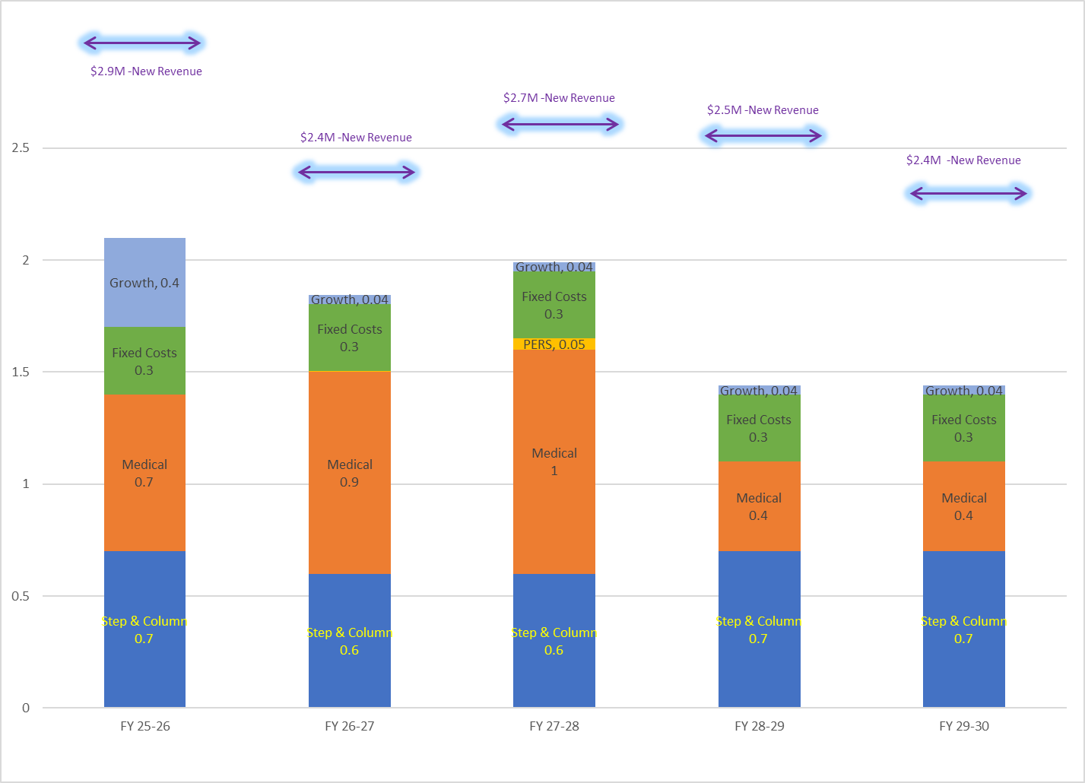
MULTI-YEAR PROJECTIONS

Slide 39
MULTI-YEAR PROJECTIONS

Slide 40
5) Considerations, Recommendations and Reminders

Slide 41
Future Considerations
Vulnerable to National and State Economic Fluctuations
Unknown Effects from Federal Changes to Education
Enrollment and FTES targets must be monitored closely as funding continues to be enrollment-driven
Maintain structural balance in consideration of flat or slightly declining revenues.
Prepare contingency plans for potential mid-year adjustments and deferral payments.
Monitor final budget passage by legislature and Governor.
Adjust district budget as necessary based on finalized allocations and data.

Slide 42
Recommendations and Reminders
Recommendations:
Approve proposed 2025-26 tentative budget by July 1st.
Reminders:
Approval of the tentative budget provides authorization to spend district funds at the start of the fiscal year.
Includes projected revenue and expenditures based on the Governor’s May Revision and adjustments for District operations.
Adoption of a final budget must be done by September 15th.

Slide 43
Questions?
Thank you!

