Slide 1
Graciano Mendoza
David Techaira
Fiscal Fundamentals
Administrative Services
November 3, 2023

Slide 2
AGENDA
1) Regulatory and Compliance Requirements
2) Overview of Funding Sources
3) Overview of State Reporting: CCFS Annual 311 Report

Slide 3
1. Regulatory and Compliance Requirements

Slide 4
REGULATORY AND COMPLIANCE REQUIREMENTS
Generally Accepted Accounting Principals
Governmental Accounting Standards Board (Statements, Interpretations and Technical Bulletins)
Generally Accepted Auditing Standards
AICPA Practice Bulletins, Issue Papers
Federal Accounting Standards Advisory Board Statements, Interpretations, Technical Bulletins and Concept Statements
Education Department General Administrative Regulations (EDGAR)
State Chancellor’s Budget and Accounting Manual (BAM)

Slide 5
OVERSIGHT
Annual Independent Audit (Contracted District Audit Manual)
General Obligation Bond Audit Requirement
Citizens Bond Oversight Committee
State Audits
Federal Audits
IRS Audits
Accreditation Review

Slide 6
2) Overview of Funding Sources

Slide 7
FUND TYPES
General Funds: Primary Operating Fund
Special Revenue: Used to account for the proceeds of specific revenue sources whose expenditures are legally restricted.
Capital Projects: Used to account for financial resources to be used in acquisition or construction of major capital facilities and other capital outlay projects.
Enterprise: Used to Account for an operation when it is intended to operate as a business.
Internal Service: Used to account for the financing of goods or services provided by one department or organizational unit to other units on a cost-reimbursement basis.
Trust & Agency: Used to account for assets held by the district in a trustee or agency capacity.

Slide 8
GENERAL FUND
Fund 11 – Unrestricted
Fund 12 & 13 – Restricted

Slide 9
SPECIAL REVENUE
Fund 31 –Bookstore
Fund 33 –Child Development

Slide 10
CAPITAL PROJECTS
FUND 41 –Capital Outlay
Fund 44 –Facilities Development
Fund 46 –Bond Measure T

Slide 11
ENTERPRISE
Fund 52 –The Grille
Fund 55 –Starbucks
Fund 46 –Contract Services

Slide 12
INTERNAL SERVICES
Fund 61 –Self Insured
Fund 62 –Retiree Health Benefits
Fund 63 –PARS-Fiduciary Trust Fund

Slide 13
TRUST and AGENCY
Fund 71 –Associated Students
Fund 72 –Student Representation Fee Trust
Fund 74 –Student Financial Aid Fund
Fund 75 –Scholarships, Loan & Trust
Fund 79 –Intercollegiate Athletics

Slide 14
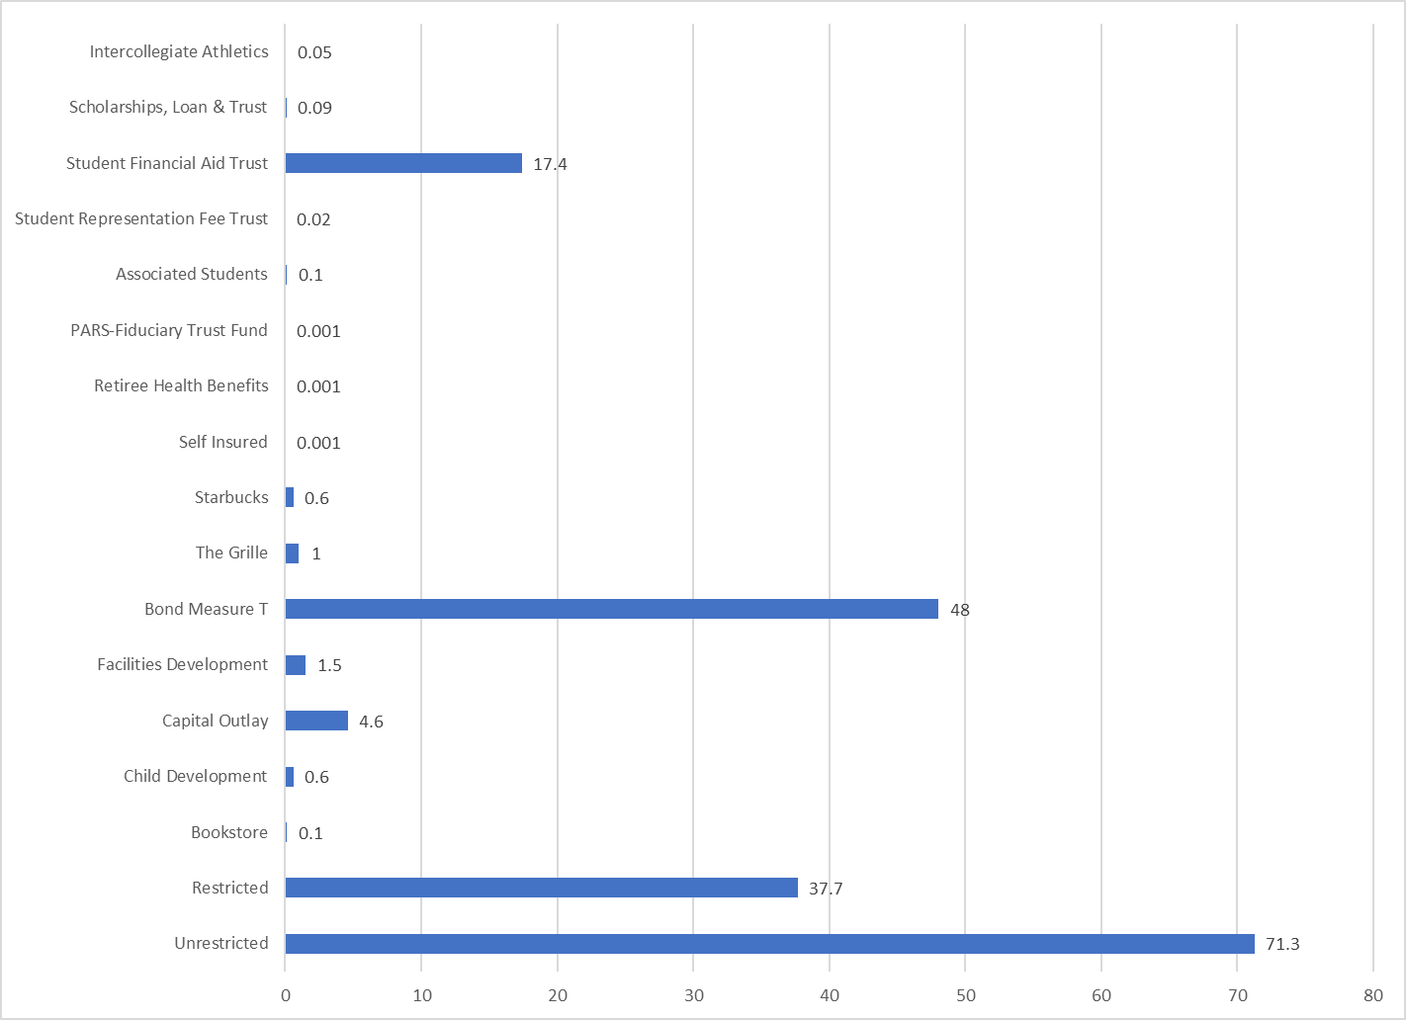
FY 2023-24 TOTAL EXPENSE BUDGETS SHOWN by FUND
(in millions)

Slide 15
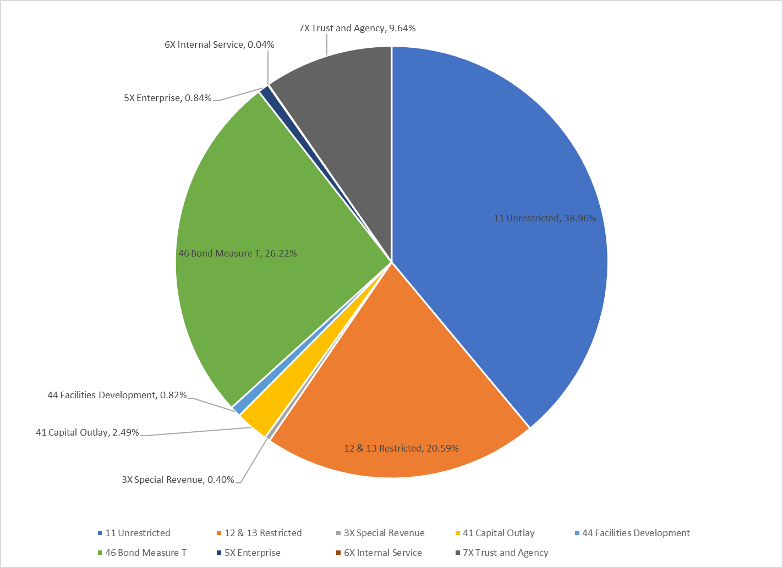
FY 2023-24 Total Expense Budget Shown as Percent of Total Expenses for All Funds

Slide 16
3) Overview of State Reporting: CCFS Annual 311 Report

