Slide 1
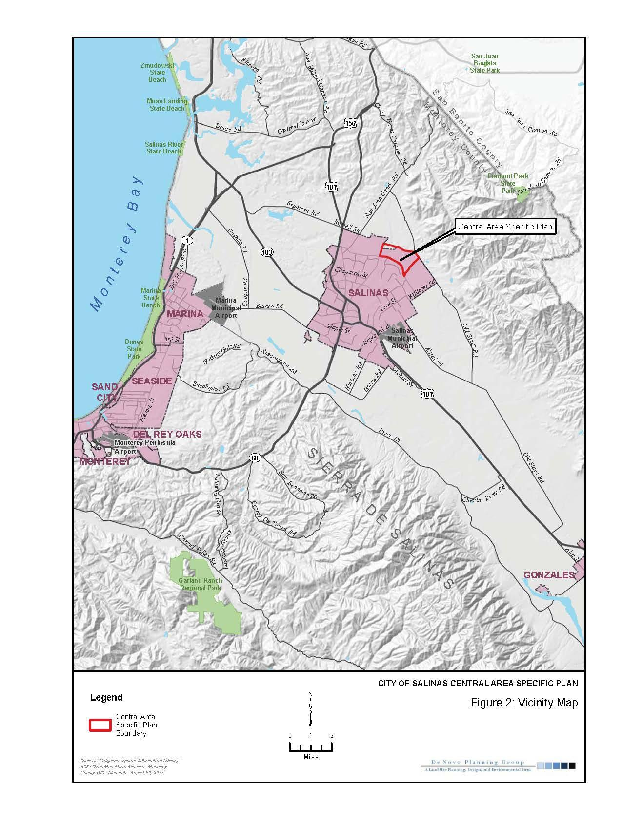
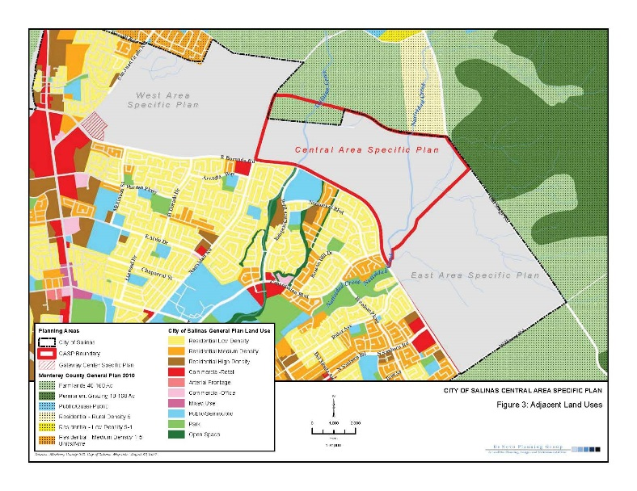

Administrative Services Council
MATSUI LAND GIFT
Status of Property-
June 18, 2019 Board of Trustees Update
October 1, 2019 Board of Trustees Update
June 25, 2020 Administrative Services Council Update

Slide 2
Purpose of Presentation
To Provide Hartnell College Administrative Council an Up to Date Informational Presentation on the Matsui Land Gift
Acceptance process for a gift of this magnitude
Current status of the land gift from Andy and Yasuko Matsui
What to expect in the upcoming years both short term and in the long term
SOURCE: Alliance for Excellent Education, “The High Cost of High School Dropouts: What the Nation Pays for Inadequate High Schools,” (Washington, DC: 2008).

Slide 3
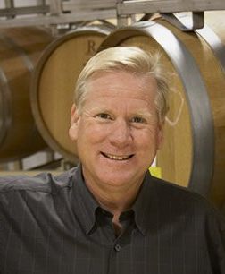
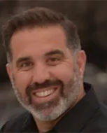
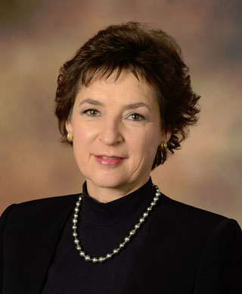
Introduction of Leadership Team
Kurt Gollnick,
Chief Operating Officer
Scheid Family Wines
Oversees over 40,000 acres of land
Hartnell College Foundation
Immediate Past President
William A. Silva,
President & Managing Broker
Woodman Development, Inc.
Legacy Real Estate Group, Inc.
Century Construction Group, Inc.
Hartnell College
Hired Expert
Anne Secker,
Attorney
Noland Hamerly, Etienne & Hoss
Hartnell College Foundation Past President
Oversight of Gift Acceptance Process and due diligence on the land

Slide 4
Facts about the Gift
The largest gift received in the history of the Foundation
The largest gift to a single community college district in California
In the top 25 gifts in the Country for Community Colleges

Slide 5
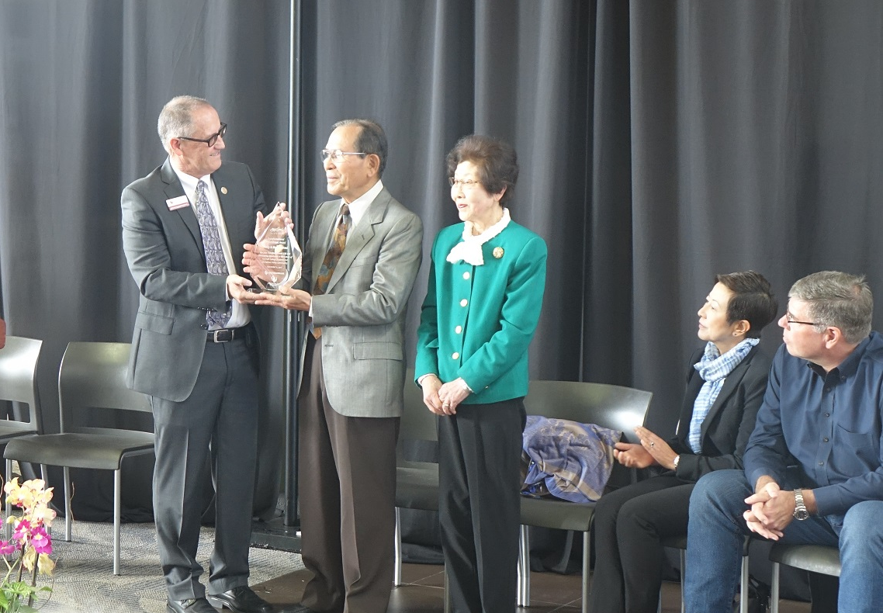
About Our Donors
Andy and Yasuko Matsui
Andy traveled the world researching and mastering the techniques of growing orchids and became a pioneer in the industry.
Today, Matsui Nursery is the nation’s largest orchid grower, and consumers can buy potted orchids in supermarkets everywhere.
In 1969, Andy bought 50 acres of land near Salinas, and began erecting his greenhouses. He grew chrysanthemums, then roses.
In 1998 at age 63, after nearly 30 years of ups and downs as a commercial flower grower, Andy took a chance and transitioned all of Matsui Nursery’s production to growing orchids.

Slide 6
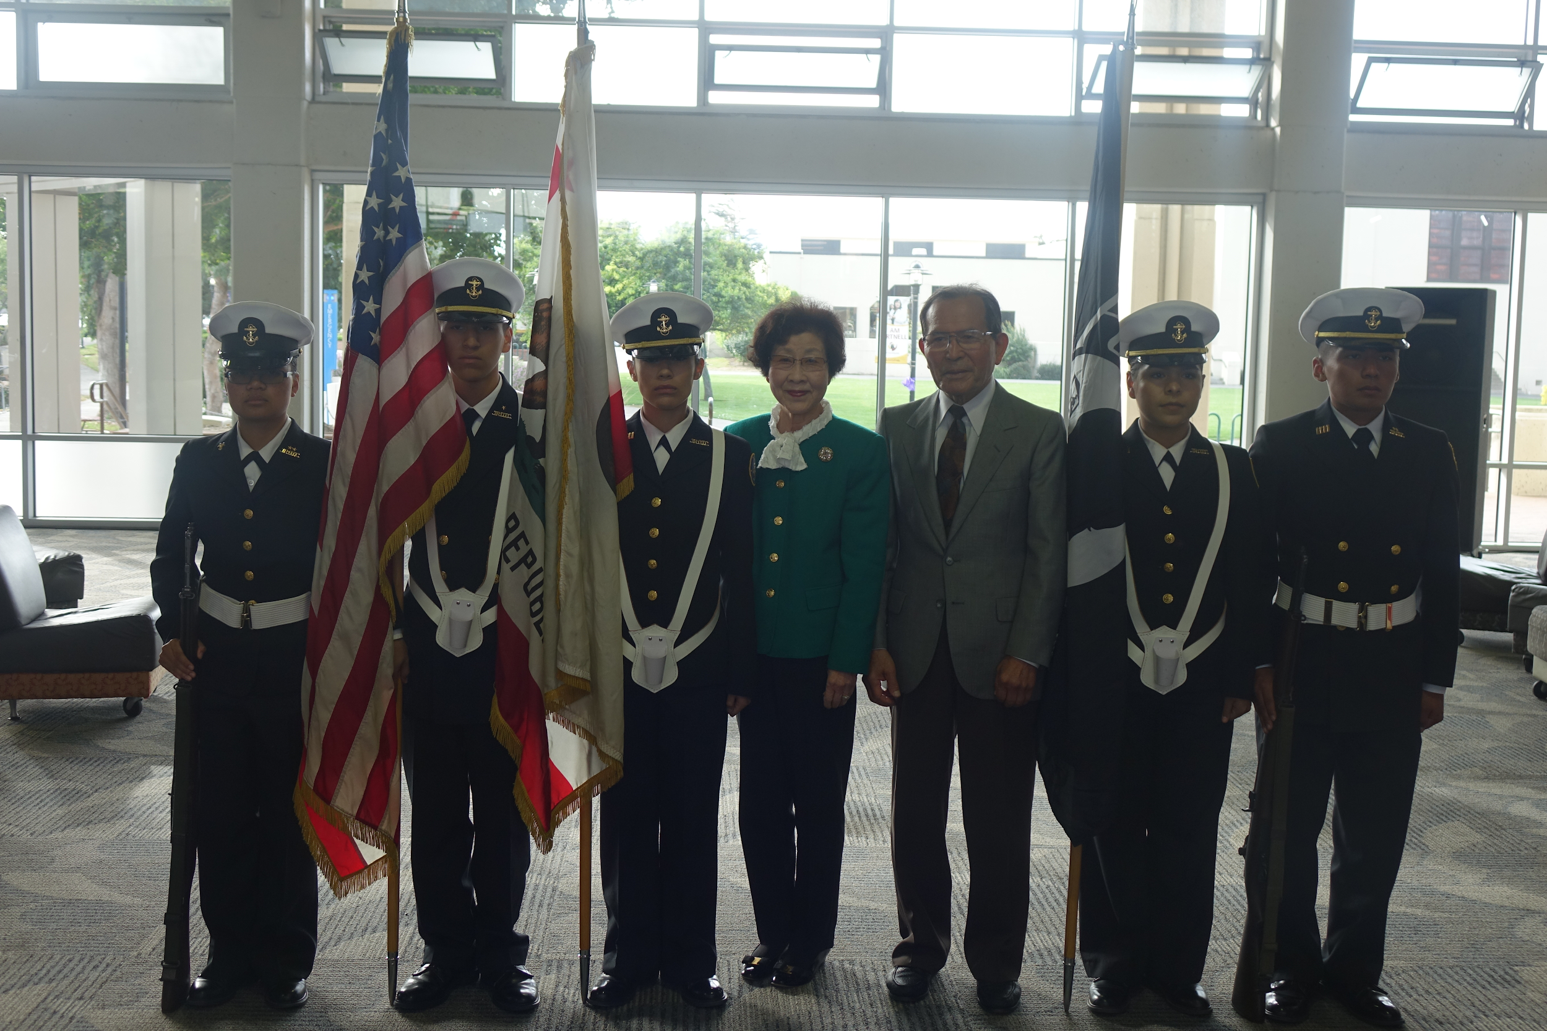
About Our Donors
Andy and Yasuko Matsui
The surprise success and rise in popularity of orchids has been a profitable adventure for Andy, and he decided he wanted to give back to those who had given to him.
His three children are all Gonzales High graduates
All his children went on to succeed at Harvard

Slide 7
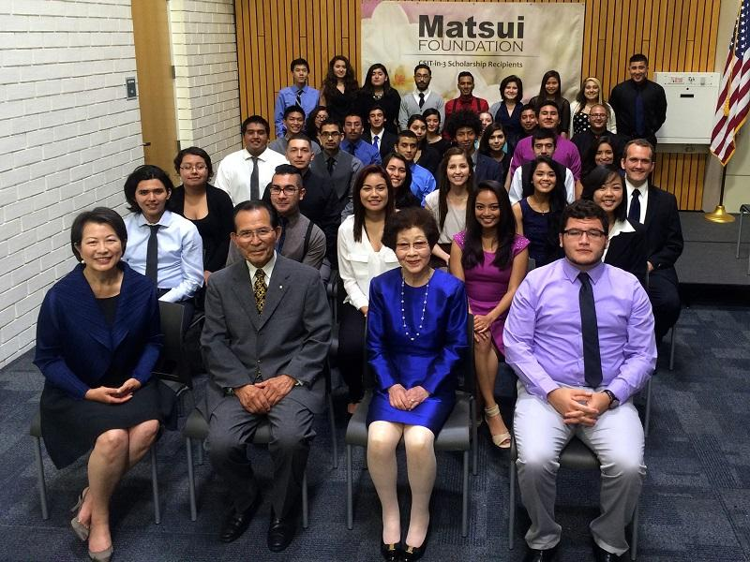
About Our Donors
Andy and Yasuko Matsui
Their philanthropic vision has been to help more students get through college and in the workforce
His focus is local students with financial needs, and local careers to support Monterey County economic development
Refocus to local workforce and local jobs
Inspired accelerated college completion
Inspired Hartnell and CSUMB to develop the first 3-year BS degree in computer science, creating a national model
Intent to sunset support for CSin3 after Cohort 5

Slide 8
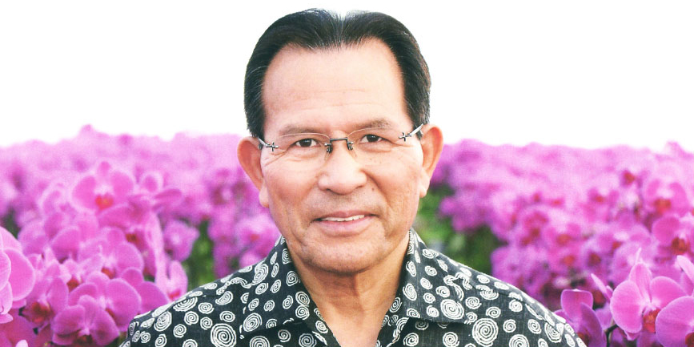
Philanthropic Impact
Gifted $9M in scholarships specifically $4M to CSin3 scholarships
“Hard work, education and opportunity can change everything.”
- Matsui Nursery and Matsui Foundation founder Andy Matsui

Slide 9
Body of Work Provided Pro Bono by Anne Secker

Slide 10
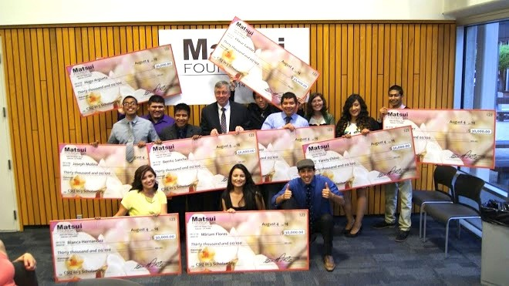
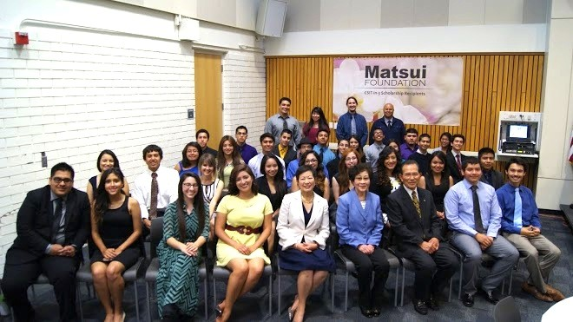
Acceptance of the Gift
Foundation Actions in Accepting Gift
Hartnell College Foundation Formal Gift Acceptance Policy
Due Diligence Conducted
Approval of Foundation Board after Due Diligence
SOURCE: Alliance for Excellent Education, “The High Cost of High School Dropouts: What the Nation Pays for Inadequate High Schools,” (Washington, DC: 2008).

Slide 11
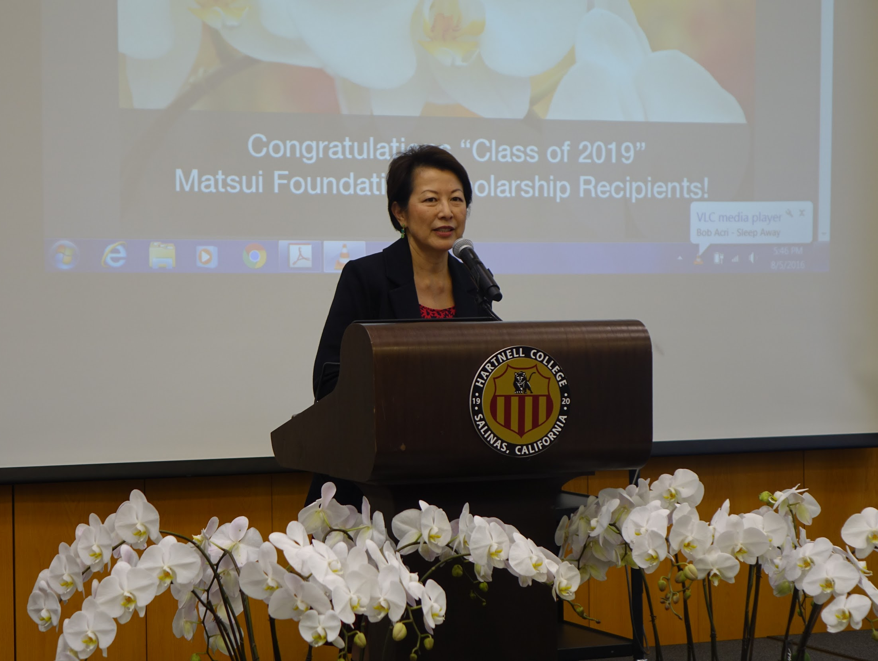
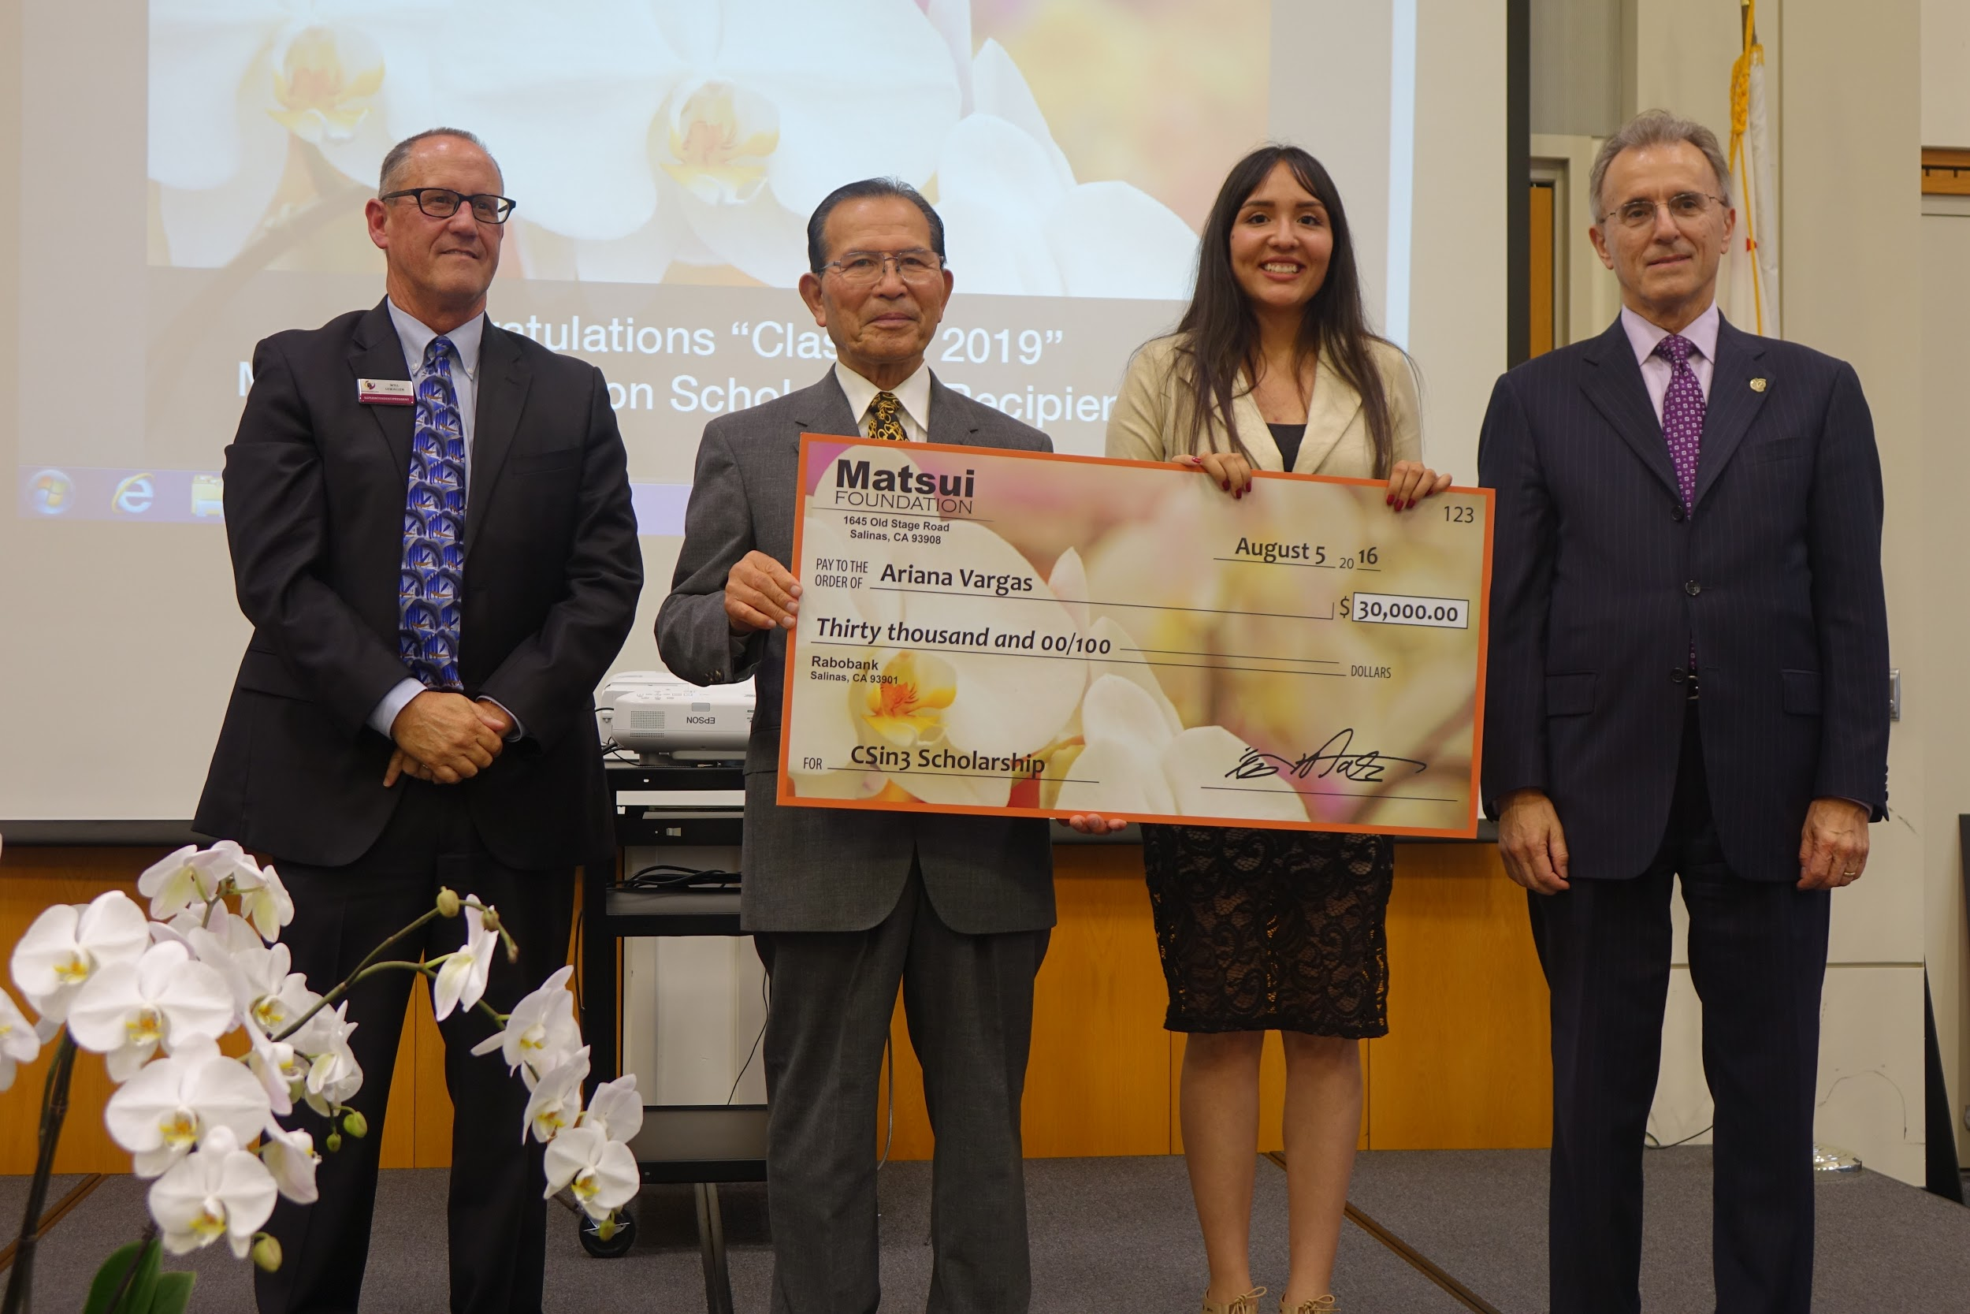
Acceptance of the Gift
Importance of Gift to Hartnell College Foundation
Establish and affirm Hartnell College Foundation’s credibility to manage gifts of this magnitude and complexity
Eventually yield significant amounts to Foundation for student benefit
SOURCE: Alliance for Excellent Education, “The High Cost of High School Dropouts: What the Nation Pays for Inadequate High Schools,” (Washington, DC: 2008).

Slide 12
Body of Work Provided Pro Bono by Kurt Gollnick

Slide 13
How Gift is Being Managed
Foundation Investment Committee
Name | Affiliation
Kurt Gollnick, Chief Operating Officer (Chair) | Scheid Family Wines
Susan Black, Founder and Chairman of the Board | Pinnacle Bank
David Warner, Former CEO of Pinnacle Bank | Community Leader
Teri Belli, CPA | Belli Architectural Group
Mike Avila, Partner | Avila Construction Company
Kerry Varney, Executive Vice President | Tanimura & Antle
Scott Brubaker, Wealth Advisor, CFA | Hayashi Wayland
Albert Fong, Financial Advisor | Wedbush Securities
SOURCE: Alliance for Excellent Education, “The High Cost of High School Dropouts: What the Nation Pays for Inadequate High Schools,” (Washington, DC: 2008).

Slide 14
How Gift is Being Managed
Matsui Leadership Gift Committee
Name | Affiliation
Kurt Gollnick, Chief Operating Officer (Committee Chair) | Scheid Family Wines & Hartnell College Foundation Board President
Susan Black, Chairman of the Board | Pinnacle Bank & Hartnell College Foundation Board Member
David Warner, Community Leader | Hartnell College Foundation, Vice President
Teri Belli, CPA | Belli Architectural Group & Hartnell College Foundation Board Member
Mike Avila, Partner | Avila Construction Company & Hartnell College Foundation Board Member
Kerry Varney, Executive Vice President | Tanimura & Antle & Hartnell College Foundation Board Member
Scott Brubaker, Wealth Advisor, CFA | Hayashi Wayland
Albert Fong, Financial Advisor | Wedbush Securities
Candi DePauw, Business Owner | Hartnell College Board of Trustees
Erica Padilla Chavez, Chief Executive Officer | Pajaro Valley Prevention and Student Assistance, Inc., Hartnell College Board of Trustees & Hartnell College Foundation Board Member
SOURCE: Alliance for Excellent Education, “The High Cost of High School Dropouts: What the Nation Pays for Inadequate High Schools,” (Washington, DC: 2008).

Slide 15
How Gift is Being Managed
Matsui Leadership Gift Hired Expertise
Name | Affiliation
Will Silva, President & Managing Broker | Woodman Development Company, Inc., Hired Expert
John Bridges, Attorney | Fenton & Keller, Hired Expert
John Piini, President, MAI | Piini Realty, Hired Expert to appraise the fair market value of the rental
SOURCE: Alliance for Excellent Education, “The High Cost of High School Dropouts: What the Nation Pays for Inadequate High Schools,” (Washington, DC: 2008).

Slide 16
How Gift is Currently Being Managed
Explanation
Will Silva was hired as consultant to the foundation to advise the committee through the development process
John Bridges, attorney and legal counsel
John Piini, Lease Market Analysis
SOURCE: Alliance for Excellent Education, “The High Cost of High School Dropouts: What the Nation Pays for Inadequate High Schools,” (Washington, DC: 2008).

Slide 17
How Gift is Currently Being Managed
Current Use of Property
Property is currently being leased for farming row crops by Mendoza Farms
Conducted a rent market analysis in determining current lease value
Professional farm managers’ input/advice
  Monitor farming practices to make sure land is not adversely affected
  Active dialogue with farmer/good communication, etc.
SOURCE: Alliance for Excellent Education, “The High Cost of High School Dropouts: What the Nation Pays for Inadequate High Schools,” (Washington, DC: 2008).

Slide 18
How Gift is Currently Being Managed
Current Use of the Funds
Rental income is used to fund CSin3 scholarships (this was the last year of the payout for CSin3)
The commitment to the donor was to support CSin3 until fiscal year 2019-2020 for Cohort 5.
Over the first two years of the gift a total of up to $415K will be awarded to students. The total income from the property is $400K over 2 years.
Property Taxes are paid 50% by the tenant and 50% by the foundation.
Post year 2, the rent funds will continue to support student scholarships, refocusing on local students, jobs and careers.
2020-2021 Revenue has been earmarked to pay for the COVID 19 Student Emergency Response Fund to support Crisis Counseling, Emergency Scholarships, and Access to laptops and hotspots.
Total Revenue that can be used for support to students after paying for property taxes, property management expenses, etc. is approximately 125k a year.
SOURCE: Alliance for Excellent Education, “The High Cost of High School Dropouts: What the Nation Pays for Inadequate High Schools,” (Washington, DC: 2008).

Slide 19
How Gift is Currently Being Managed
Matsui Leadership Committee hired Will Silva for his expertise in real estate development and land use.
He will provide an explanation of the development process that will lead us to materialize the potential benefits of this transformational gift.
SOURCE: Alliance for Excellent Education, “The High Cost of High School Dropouts: What the Nation Pays for Inadequate High Schools,” (Washington, DC: 2008).

Slide 20
Presented by Will Silva

Slide 21
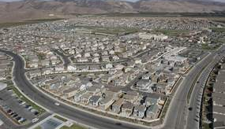
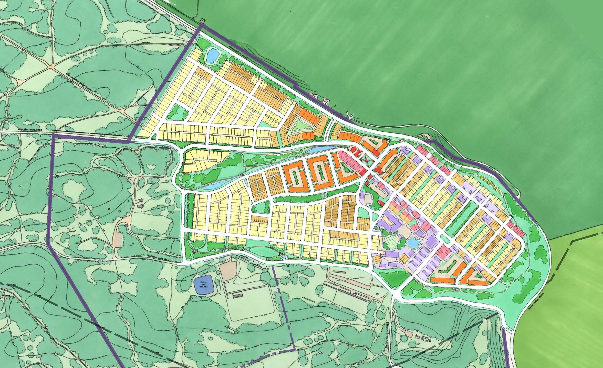
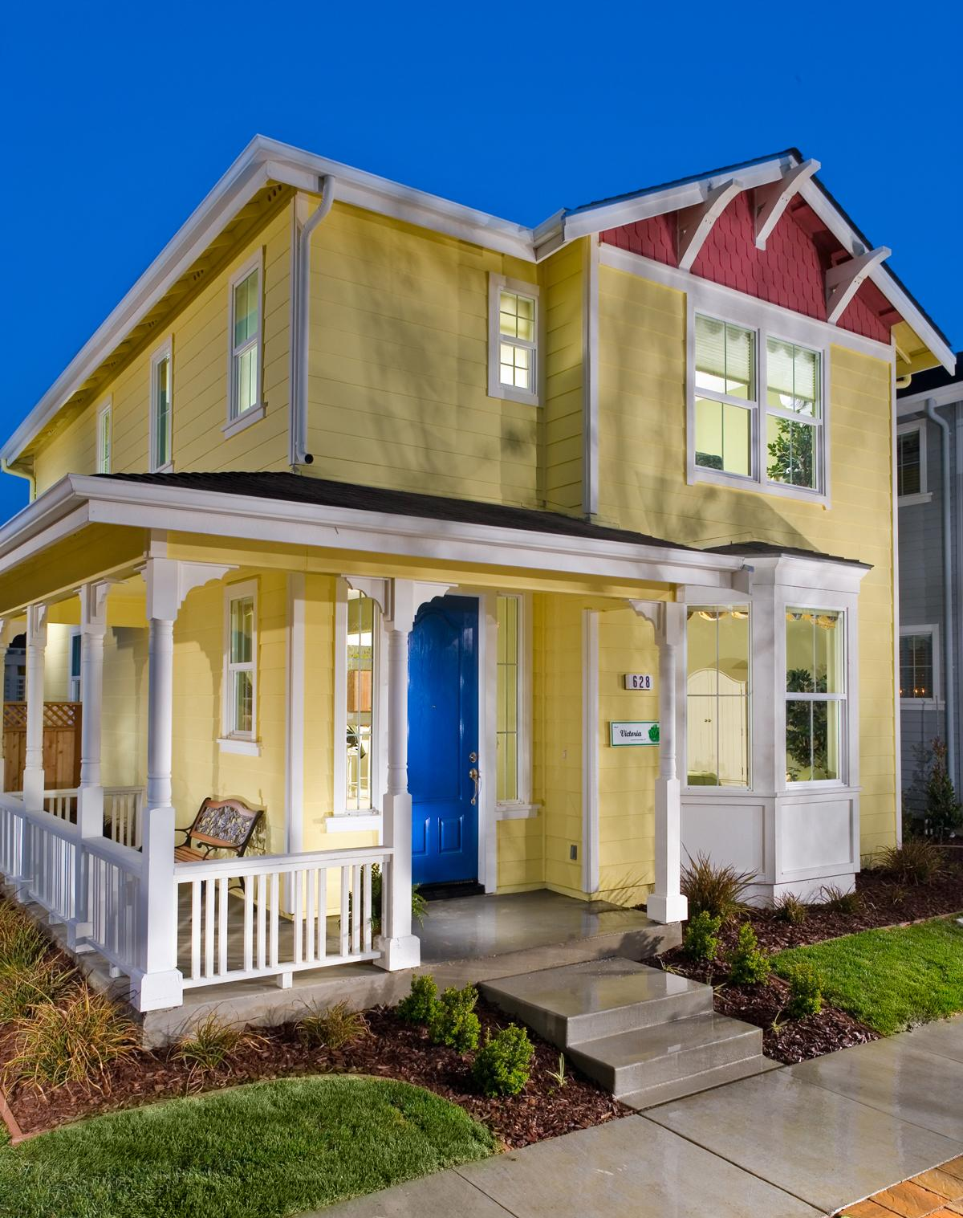

Professional Highlights
28 Years Industry Experience
Nearly 3,000 Residential Units Developed Regionally
More than 750 Homes Built Locally
East Garrison Original Developer
Experienced Market Rate Affordable Housing Solutions
Part of Development Team for MPUSD Student Housing Initiative
City of Seaside Planning Commissioner
SOURCE: Alliance for Excellent Education, “The High Cost of High School Dropouts: What the Nation Pays for Inadequate High Schools,” (Washington, DC: 2008).

Slide 22
Property Location
SOURCE: Alliance for Excellent Education, “The High Cost of High School Dropouts: What the Nation Pays for Inadequate High Schools,” (Washington, DC: 2008).

Slide 23
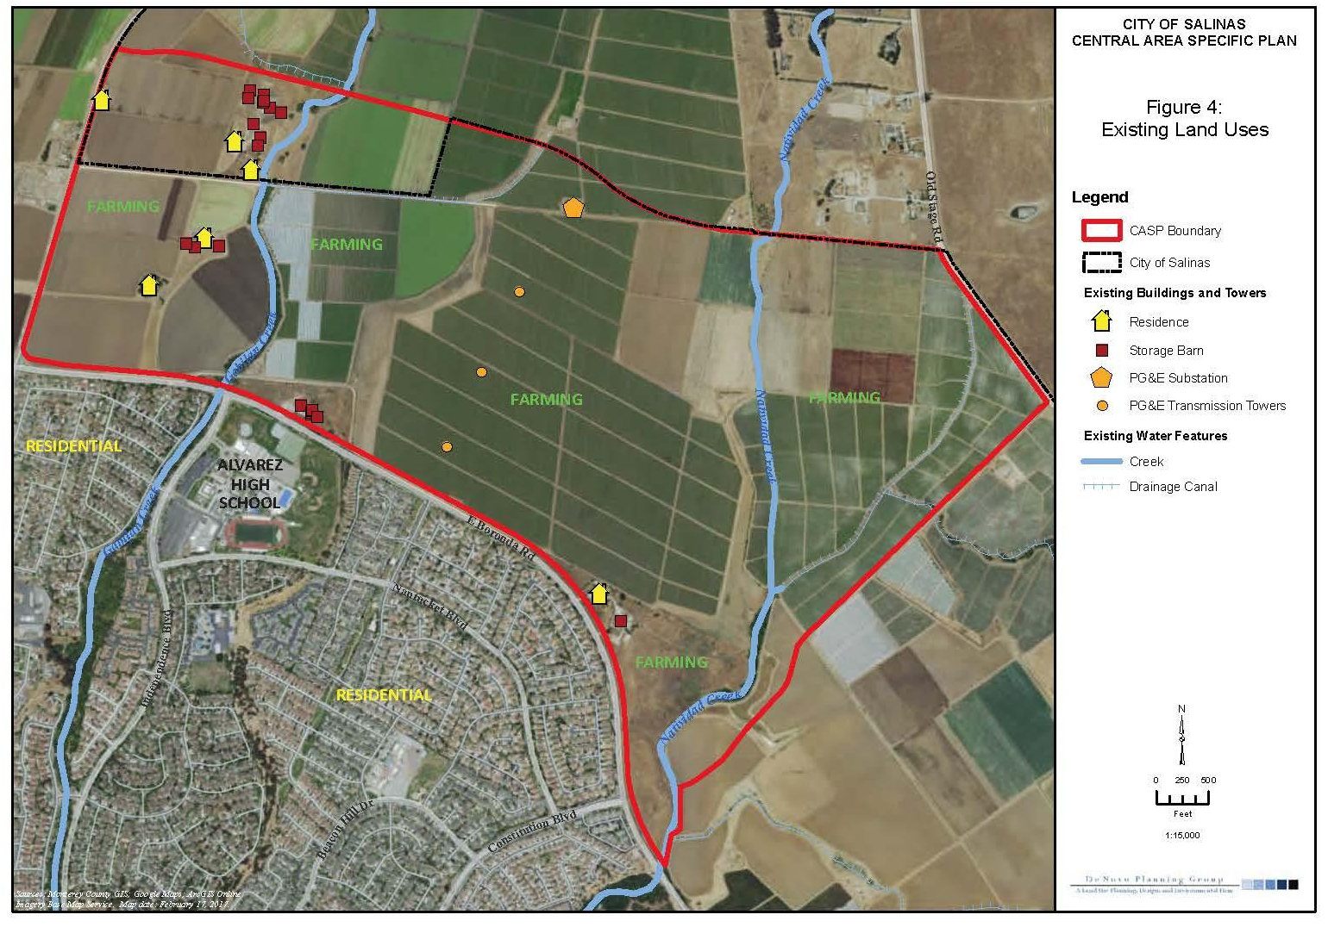
Current Uses
SOURCE: Alliance for Excellent Education, “The High Cost of High School Dropouts: What the Nation Pays for Inadequate High Schools,” (Washington, DC: 2008).

Slide 24
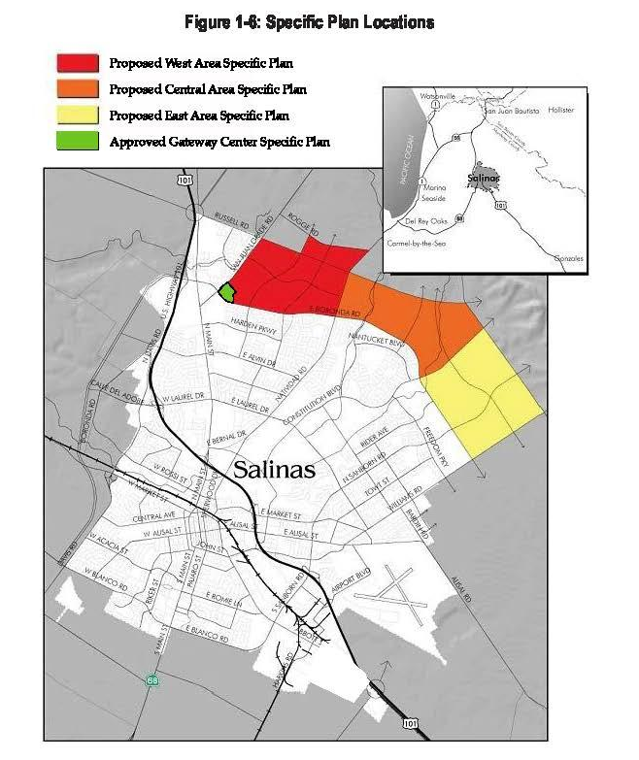
Property Location
FUTURE GROWTH AREA
Northeast Salinas
North of Boronda
East of San Juan Grade Rd.
West of Williams Rd.
Divided into 4 Areas
SOURCE: Alliance for Excellent Education, “The High Cost of High School Dropouts: What the Nation Pays for Inadequate High Schools,” (Washington, DC: 2008).

Slide 25

Property Location
CENTRAL AREA SPECIFIC PLAN
North of Boronda Rd.
East of Natividad Rd.
West of Constitution Blvd.

Slide 26
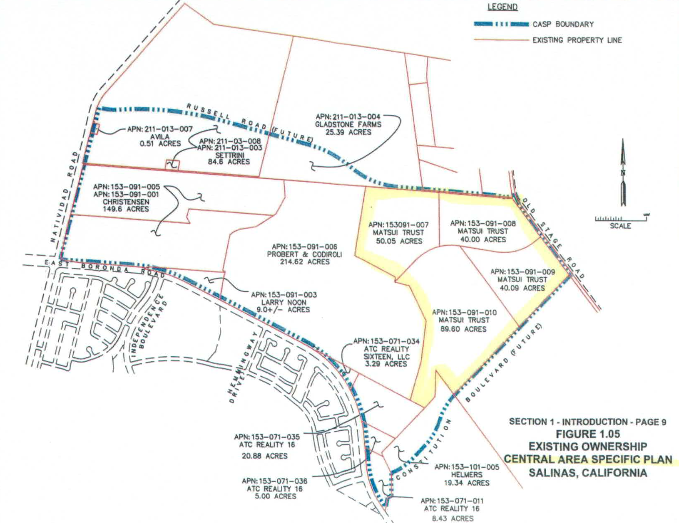
Property Details
HARTNELL FOUNDATION PROPERTY
4 Parcels
Northwest Corner of CASP
219.74 Acres
Bordered by:
  Constitution Blvd. Extension
  Old Stage Rd.
SOURCE: Alliance for Excellent Education, “The High Cost of High School Dropouts: What the Nation Pays for Inadequate High Schools,” (Washington, DC: 2008).

Slide 27


Real Property Principals
WHAT IS REAL ESTATE?
Not Just Physical Asset
Rights Not Absolute
Bundle of Rights or “Sticks”
Rights or “Sticks” can be:
  Decreased or Taken Away
  Increased: Value Add Events
    Land Use Entitlements
    Physical Improvements
SOURCE: Alliance for Excellent Education, “The High Cost of High School Dropouts: What the Nation Pays for Inadequate High Schools,” (Washington, DC: 2008).

Slide 28
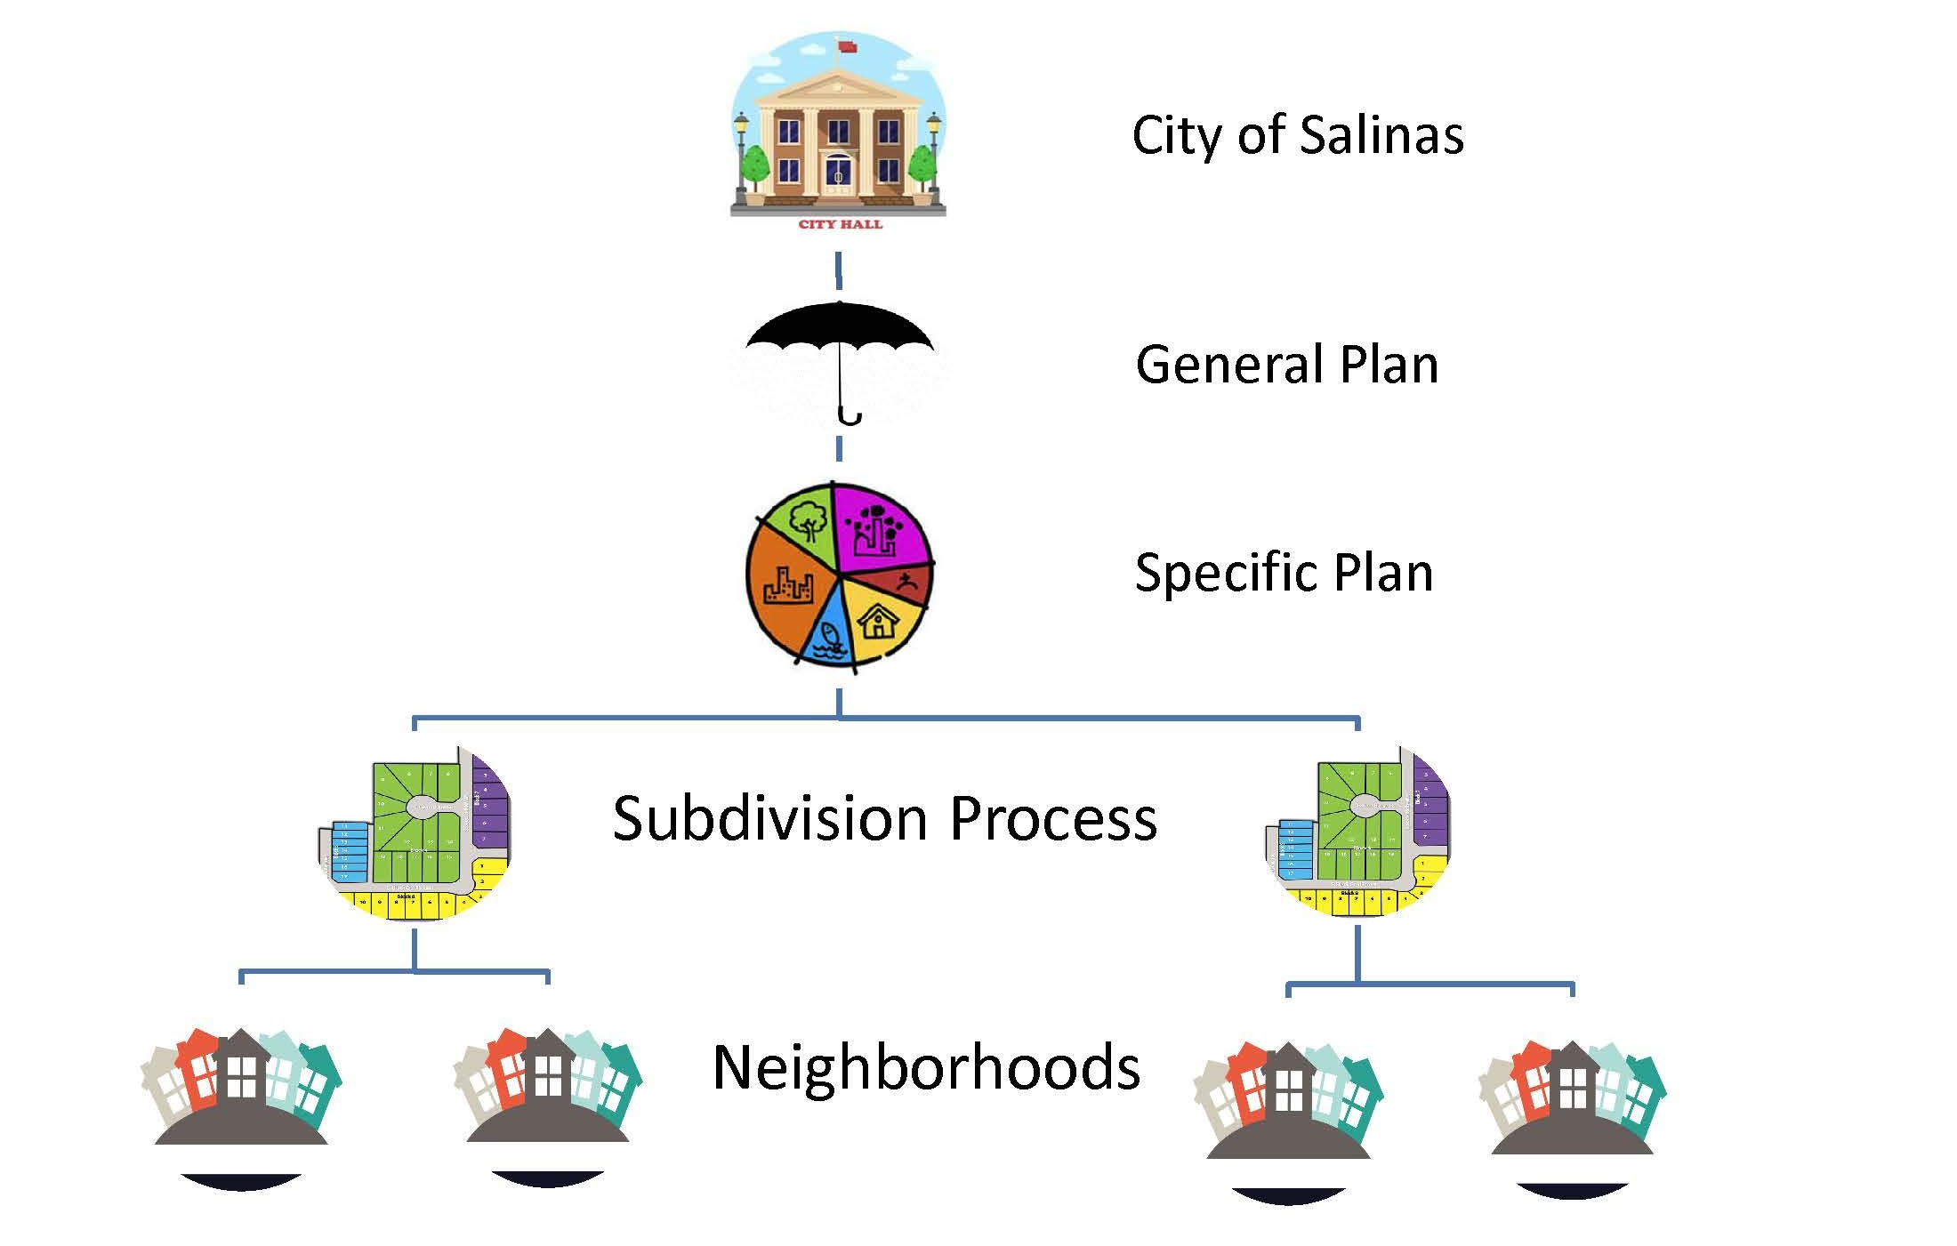
Land Use Hierarchy
SOURCE: Alliance for Excellent Education, “The High Cost of High School Dropouts: What the Nation Pays for Inadequate High Schools,” (Washington, DC: 2008).

Slide 29

General Plan Requirements
General Plan is…
Required by State
Citywide Requirements
Governing Land Use Document
Overarching Objectives & Policies
Without Design Details or Development Standards
SOURCE: Alliance for Excellent Education, “The High Cost of High School Dropouts: What the Nation Pays for Inadequate High Schools,” (Washington, DC: 2008).

Slide 30
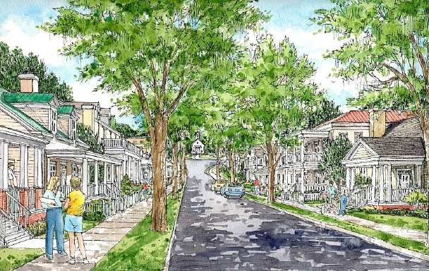
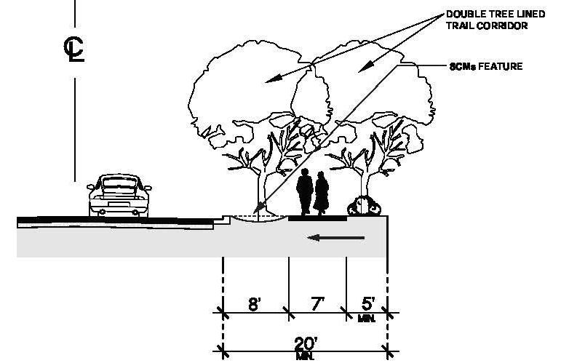
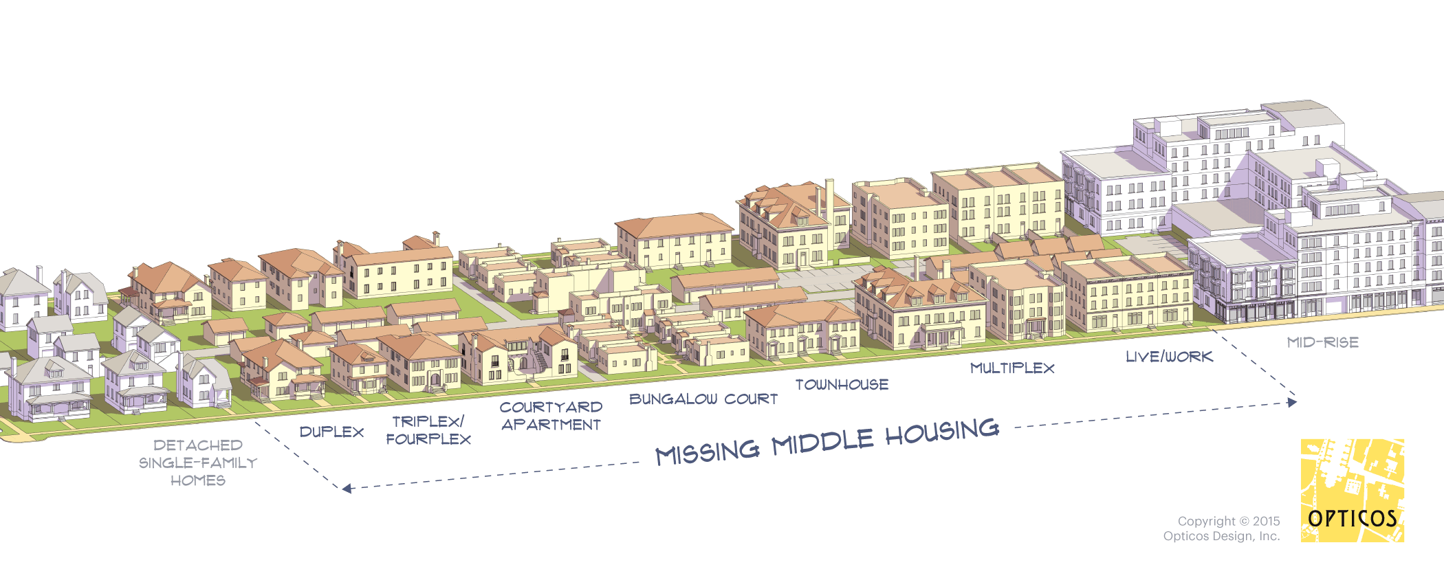
General Plan Requirements
General Plan Requires…
New Urbanist Design Features:
Walkable Community
Town Center
Integrated Mix:
  Land Uses
  Lot / Products Types
Park Strips / Setback Sidewalks
Alley Loaded Garages
Front Elevations / Curb Appeal
Eyes on Street
SOURCE: Alliance for Excellent Education, “The High Cost of High School Dropouts: What the Nation Pays for Inadequate High Schools,” (Washington, DC: 2008).

Slide 31
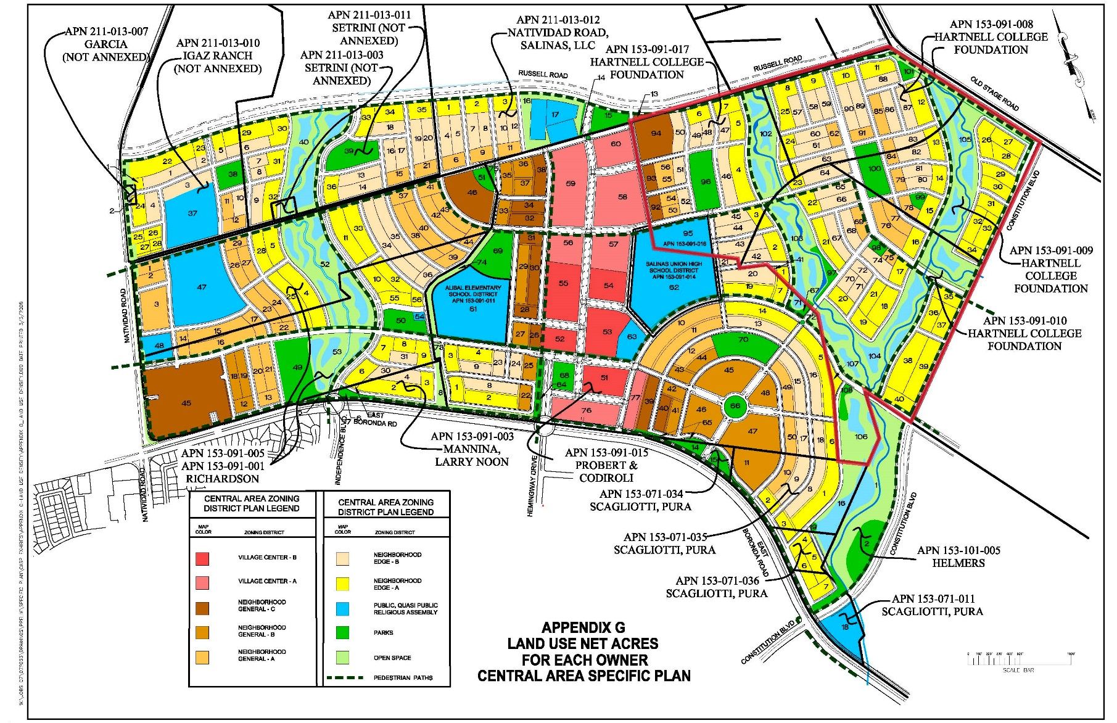
Central Area Specific Plan (proposed)
SOURCE: Alliance for Excellent Education, “The High Cost of High School Dropouts: What the Nation Pays for Inadequate High Schools,” (Washington, DC: 2008).

Slide 32
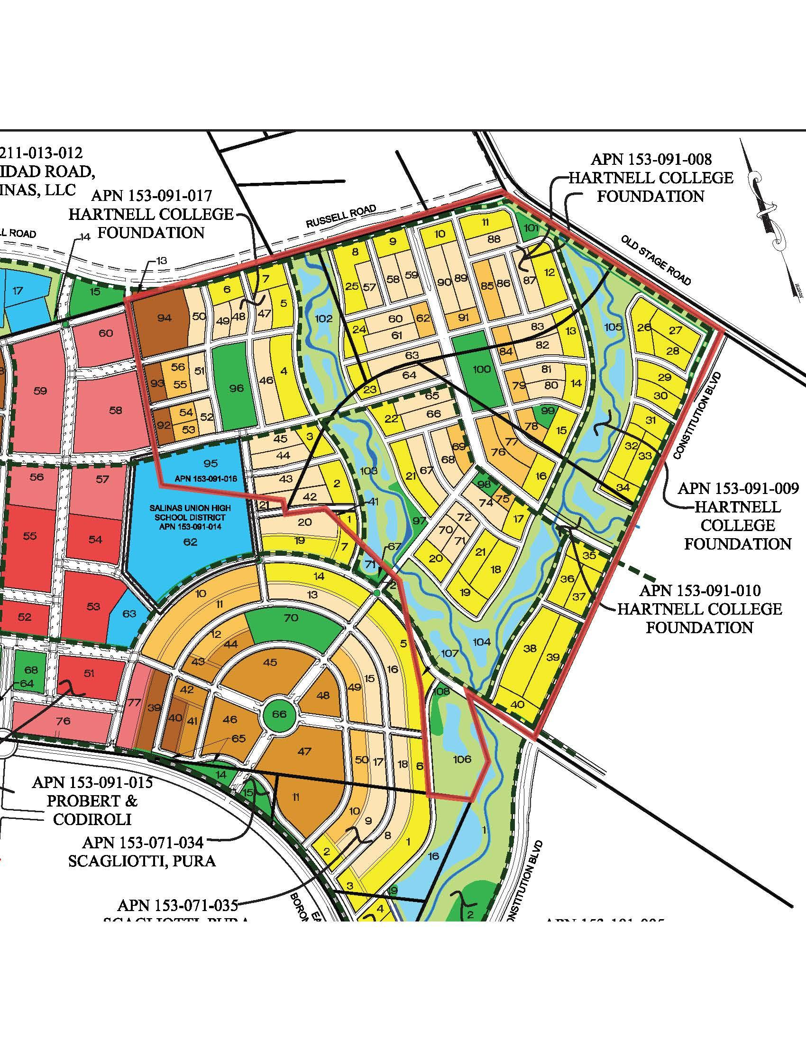
Central Area Specific Plan (proposed)
HARTNELL FOUNDATION PROPERTY
4 Distinct Residential Designations:
  Neighborhood Edge A
  Neighborhood Edge B
  Neighborhood General A
  Neighborhood General C
School and Open Space
SOURCE: Alliance for Excellent Education, “The High Cost of High School Dropouts: What the Nation Pays for Inadequate High Schools,” (Washington, DC: 2008).

Slide 33
Central Area Specific Plan (proposed)
HARTNELL FOUNDATION PROPERTY
Neighborhood Edge A
  46.28 Acres
  231-278 Units
Neighborhood Edge B
  38.7 Acres
  271-310 Units
Neighborhood General A
  11.21 Acres
  90-101 Units
Neighborhood General C
  5.07 Acres
  71-81 Units

Slide 34
Central Area Specific Plan (proposed)
HARTNELL FOUNDATION PROPERTY
663 (min.) – 769 (max.) Residential Units
2 Single-Family Districts
  84.98 Acres (84%)
  502-588 Units
  MOST VALUABLE
2 Multi-Family Districts
  16.28 Acres (16%)
  161-182 Units
Density Range
  5 DUA minimum
  16 DUA maximum
SOURCE: Alliance for Excellent Education, “The High Cost of High School Dropouts: What the Nation Pays for Inadequate High Schools,” (Washington, DC: 2008).

Slide 35
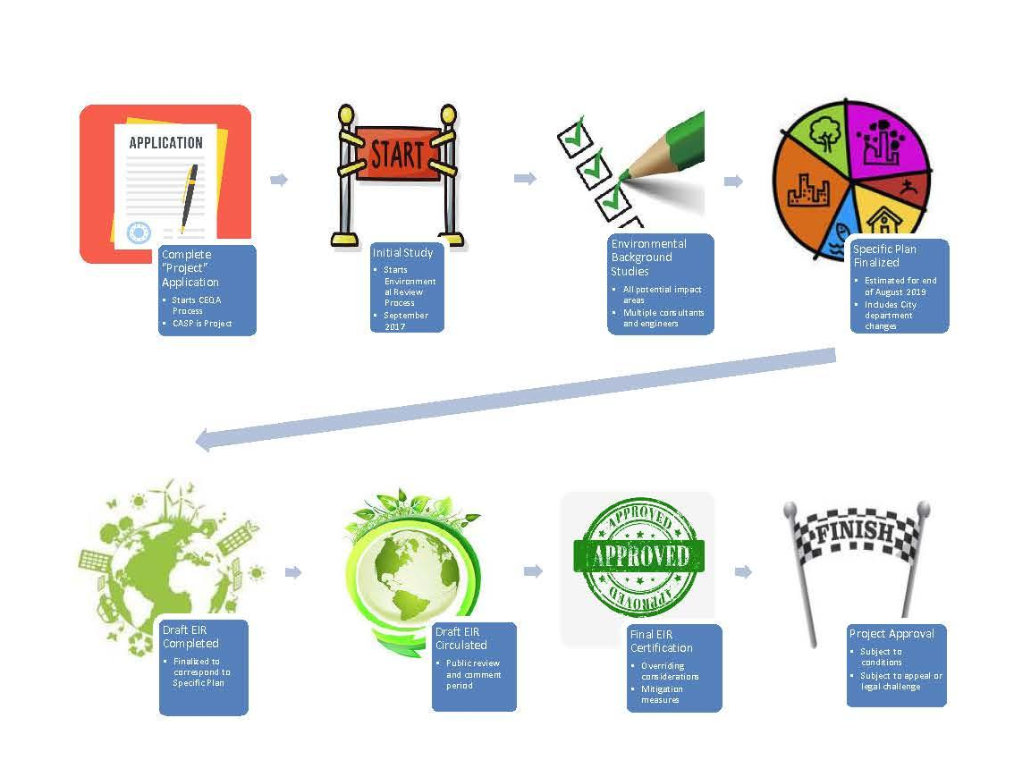
Entitlement Process (with CEQA)
SOURCE: Alliance for Excellent Education, “The High Cost of High School Dropouts: What the Nation Pays for Inadequate High Schools,” (Washington, DC: 2008).

Slide 36
History – Project Timeline
18 YEARS AND COUNTING
2002
Salinas
GP
Update
2020
Begin
CEQA
Review
2006
Project Application
Submitted
2014
Reimb.
Ordin.
Approved
2002
First
Design Charrette
2008
Annexation
Complete
(Began
2005)
2017
Matsui
Gift to
Hartnell
Foundation
SOURCE: Alliance for Excellent Education, “The High Cost of High School Dropouts: What the Nation Pays for Inadequate High Schools,” (Washington, DC: 2008).

Slide 37


History – Key Facts
KEY HISTORIC FACTS:
18 Years in Development Process
“Sponsors”: ≈ $5 Million (2017)
  Thrust IV
  Harrod Construction
Reimbursement Ordinance
  “Pay to Play”
  Triggered by Project Application
Hartnell’s Portion
  ≈ $1.5M (2017)
  8% Interest
  City Reimbursements
SOURCE: Alliance for Excellent Education, “The High Cost of High School Dropouts: What the Nation Pays for Inadequate High Schools,” (Washington, DC: 2008).

Slide 38
Future – Development Milestones
LOOKING FORWARD
2020
Summer
CASP
Final
2021
Fall
CFDs &
Subdiv.
2020
Winter
Public
Hearings
2021
Winter
CASP
Approval
2020
Fall
Begin
Draft
EIR
Review
2021
Winter
Certify
EIR
2021
Spring
Devel.
Agmt.
SOURCE: Alliance for Excellent Education, “The High Cost of High School Dropouts: What the Nation Pays for Inadequate High Schools,” (Washington, DC: 2008).

Slide 39



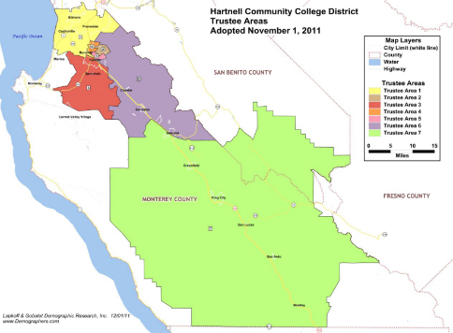

Principal Objectives
GOALS FOR USE OF
MATSUI GIFT PROPERTY
Students First!
Maximize Asset Value
Monetize Investment
  No Excessive Costs
  No Development Risk
  No Threat to Student Program Funding
Fund Future Student Programs
SOURCE: Alliance for Excellent Education, “The High Cost of High School Dropouts: What the Nation Pays for Inadequate High Schools,” (Washington, DC: 2008).

Slide 40
Investment Committee- Matsui Leadership Gift Committee Future Decisions
Once Specific Plan is adopted, Hartnell College Foundation will be in position to decide to sell all or part of the land (phased to capture best market conditions-- but reimbursement of development costs obligation needs to be weighed against that sort of phased sales)
Overriding goal is to obtain the most reasonable benefit from the land for Hartnell College students and programs
SOURCE: Alliance for Excellent Education, “The High Cost of High School Dropouts: What the Nation Pays for Inadequate High Schools,” (Washington, DC: 2008).

Slide 41
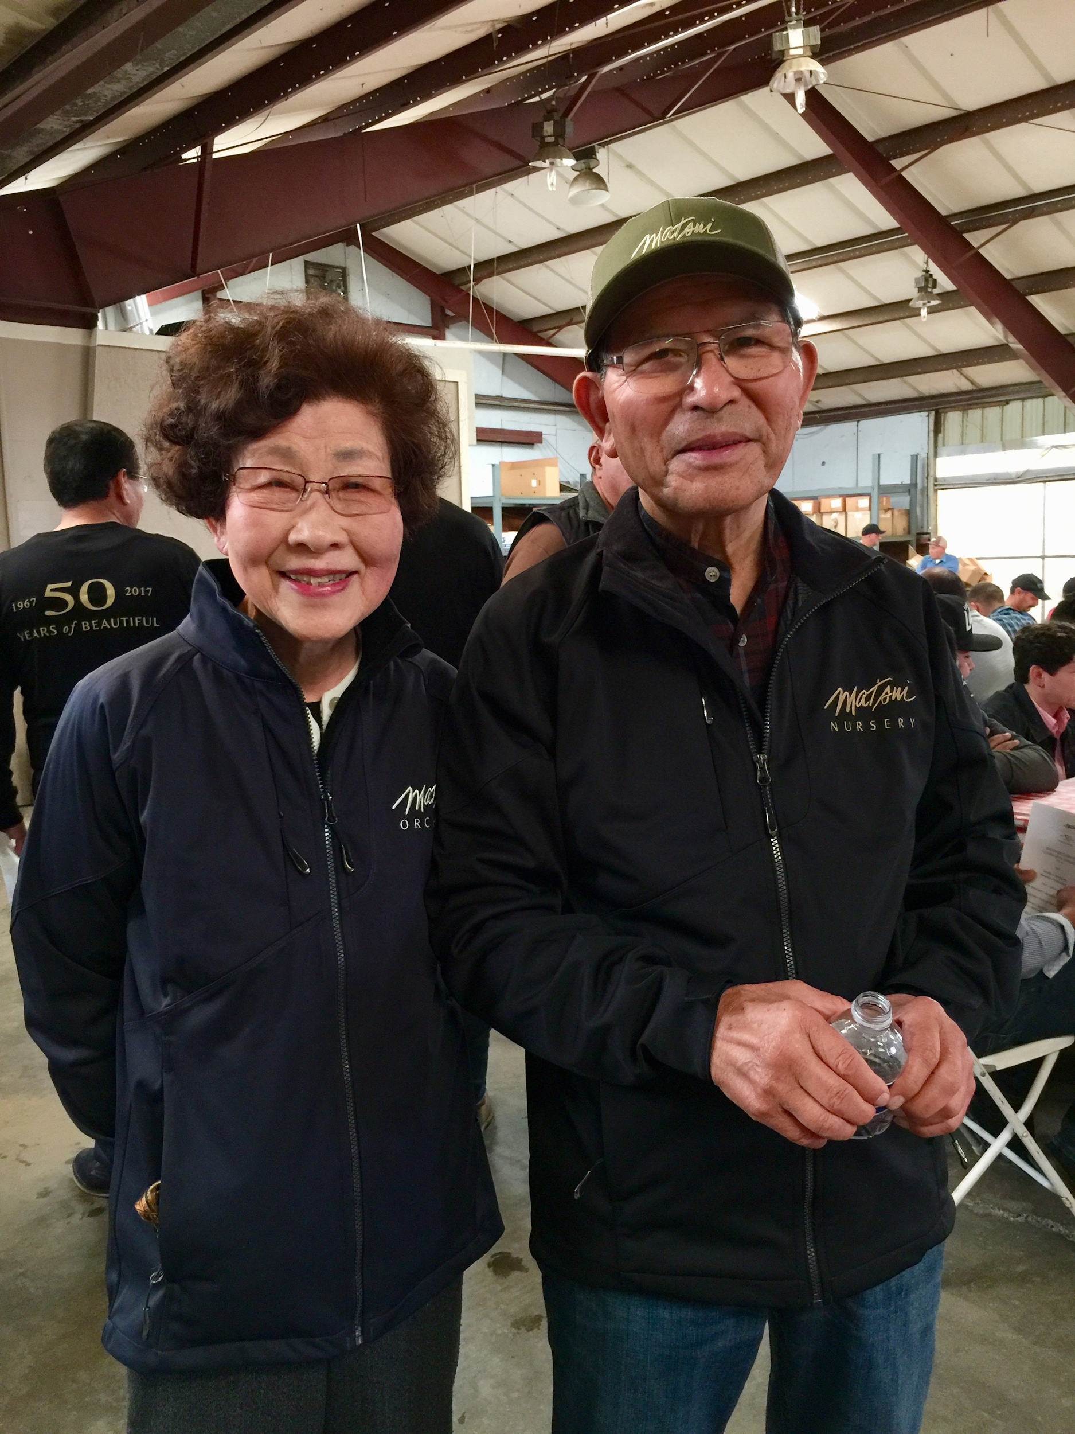

Thank You
Buy Orchids!

