Slide 1
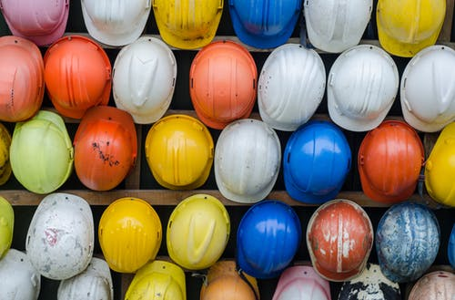
HCCD Construction Improvement Program Update
Board Presentation
Presented by:
Joseph Reyes (Director of Construction)
Rick Bennett (Interim VPAS)
Dec 17, 2019

Slide 2


Bond Ratings & Issuances
Phase II & III Projects
Bond Ratings
AA
Aa2
First issuance: September 2017
$70,000,000
Second issuance: Late Spring 2020:
$70,000,000 (Proposed)
Third issuance Fall 2022:
$27,000,000
Bond Issuances

Slide 3
HCCD Construction Program
Sources of Funds
Measure T Funding | $167,000,000
~Interest Funding through Dec. 2019 | $3,021,690
Potential 2020 State GO Bond Matching Funds Conditions: Statewide Nov election and award dependent | $13,866,000
Potential State High School Matching Funds | $4,500,000
Total Funding If Matches are Met | $188,023,690
Unexpended 10% Owner's Contingency | tbd

Slide 4
HCCD Construction Program Refresh
Phase I (2018-2022) | 2016 Project Budget-Architect Analysis
South County Education Center (Soledad) * | $13,180,636
King City Education Center Expansion * | $8,175,155
North Monterey County Education Center (Castroville) | $10,890,176
Architect Fees | $767,444
Main Campus Buildings D & E + Quad Renovation * | $14,382,866
Hartnell College Nursing & Health Science | $21,207,321
Secondary Effects Remodel Building B | $2,000,000
Phone System & Internet Refresh | $422,026
Master Architect (Planning, Standards, Budget) | $750,000
Solar Panel Relocation | $621,945
Main Campus Building H Roof Replacement | $904,873
Main Campus Building K Roof Replacement | $465,480
Property Acquistion-Castroville | $850,000
Main Campus Bldg K - Ticket Booth/Lobby reno | $516,750
Subtotal Phase I | $74,367,228
*Measure H
Holdover
ddddd

Slide 5
HCCD Construction Program Refresh
Phase II (2021-2025) | 2016 Project Budget-Architect Analysis
New Building Alisal Campus | $13,735,281
Bldg J (Visual Arts) * | $9,442,433
Bldg K (Performing Arts) * | $16,372,248
Football Fields | $2,000,000
High School Partnerships | $2,250,000
Subtotal Phase II | $43,799,962
Phase III (~2023-end)
Bldg N (Merrill Hall) * | $16,188,436
Bldg F,G,H (Athletics Building)* (50% State Match, dependent on 2020 election & award) | $27,733,379
High School Partnerships | $2,250,000
Infrastructure Upgrades (Sustainability, Energy Efficiency, Technology, Safety) | $2,660,995
Subtotal Phase III | $48,832,810
*Measure H Holdover

Slide 6
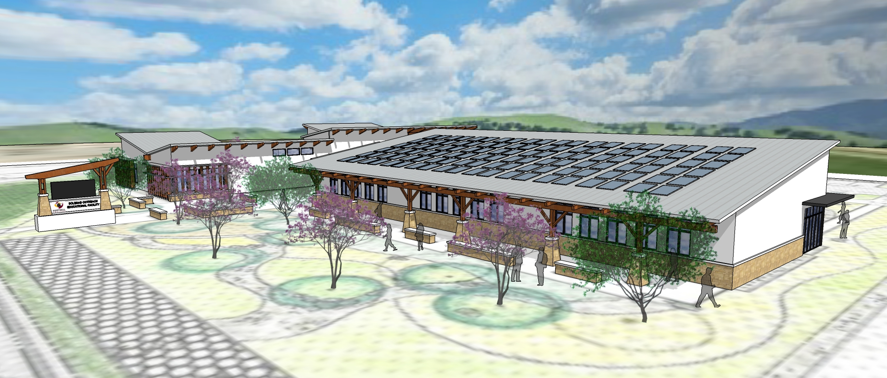
Phase 1
South Monterey County Education Center (Soledad)
2016 Budgeted Cost
$13,180,636
Projected Cost
~$15,815,090
Bid October 2019
Status: in Construction
Delivery: Spring 2021

Slide 7
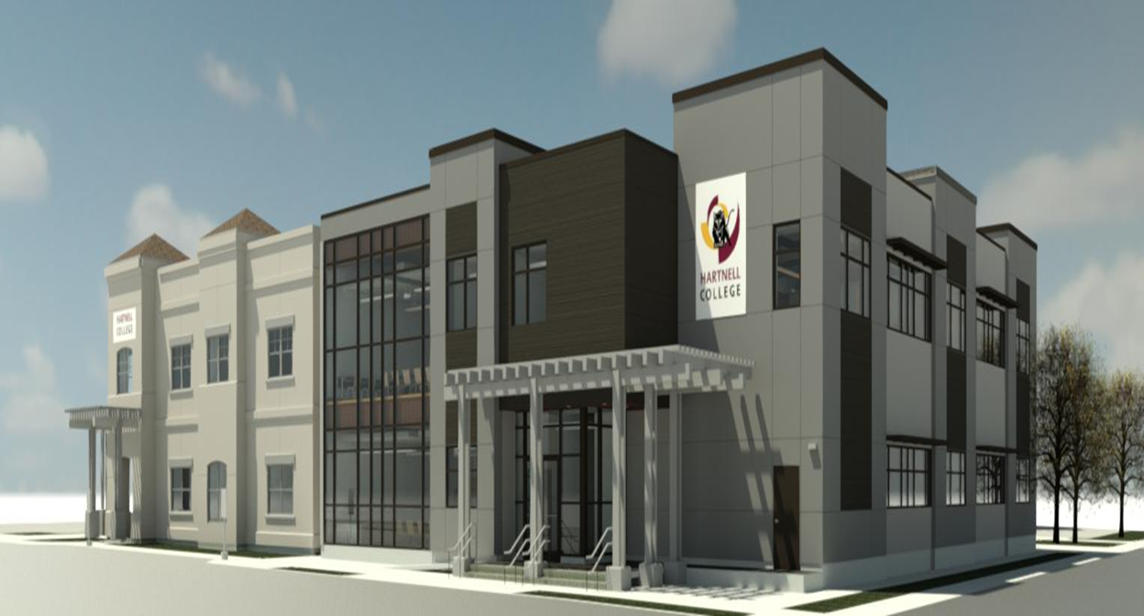
Phase 1
King City Center Expansion
2016 Budgeted Cost
$8,175,155
Projected Cost
~$ 12, 044,509
Bid Nov. 2019
Status: Construction
Delivery: Spring 2021

Slide 8
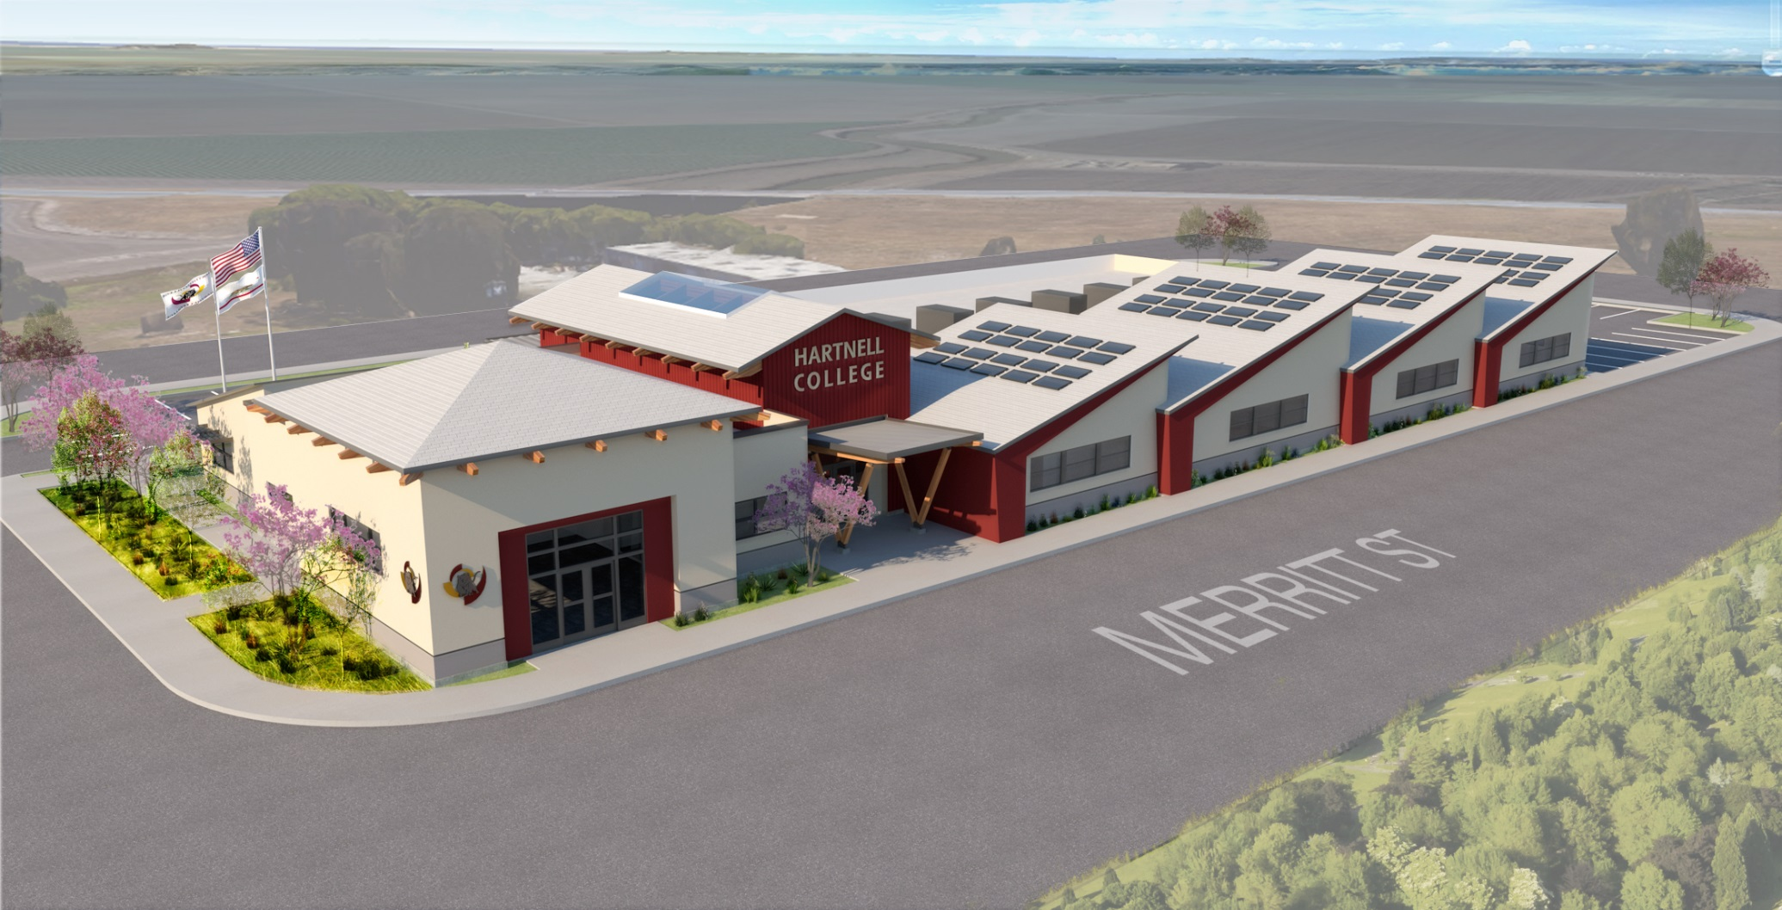
Phase 1
North Monterey County Education Center (Castroville)
2016 Budgeted Cost
$10,890,176
Projected Cost.
~$13,090,065
Design Build award spring 2019
Status: Construction Documents (CD’s)
Delivery: Spring 2022

Slide 9
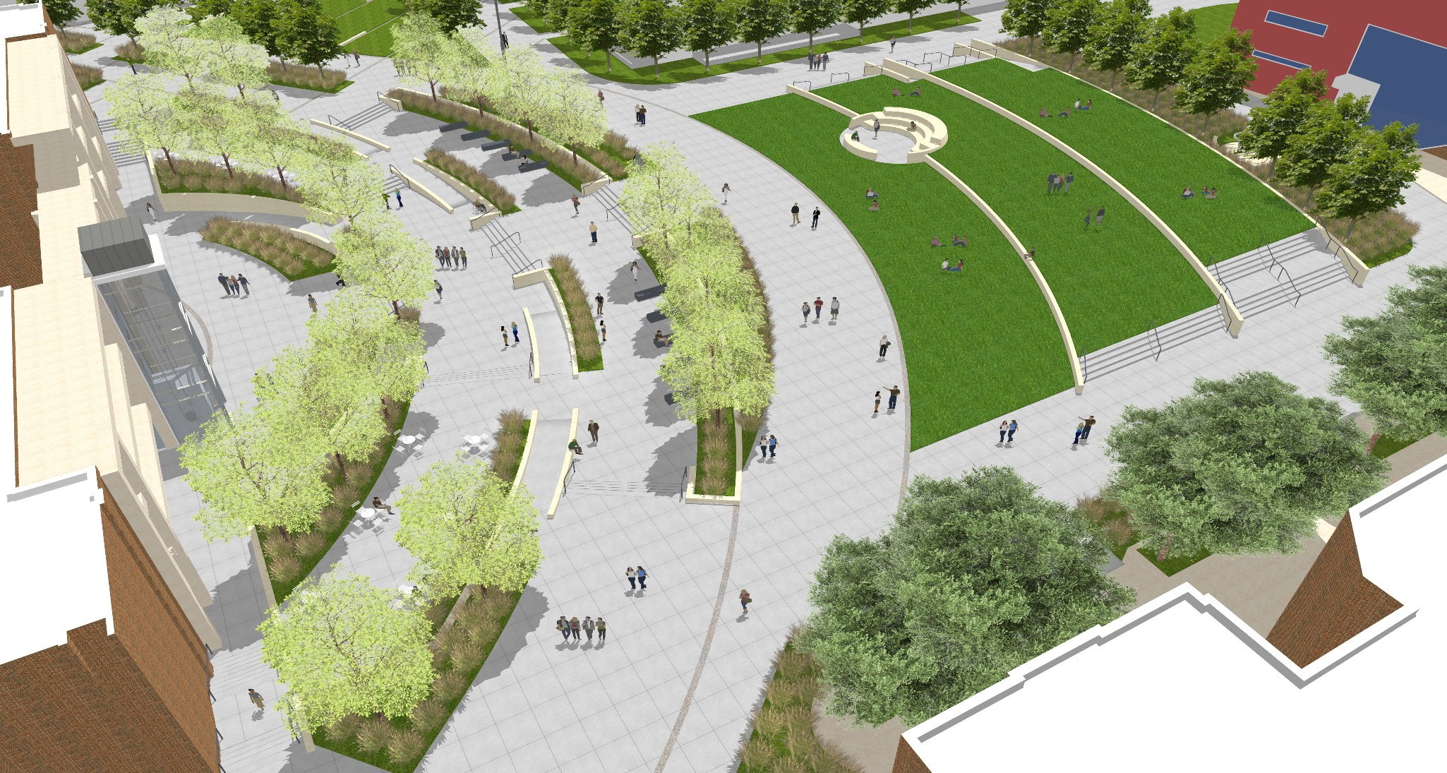
Phase 1
Buildings D & E, Quad Area Renovation
2016 Budgeted Cost
$14,382,866
Projected Cost
~$17,430,476
Bid August 2019
Status: Construction
Delivery: mid 2020

Slide 10
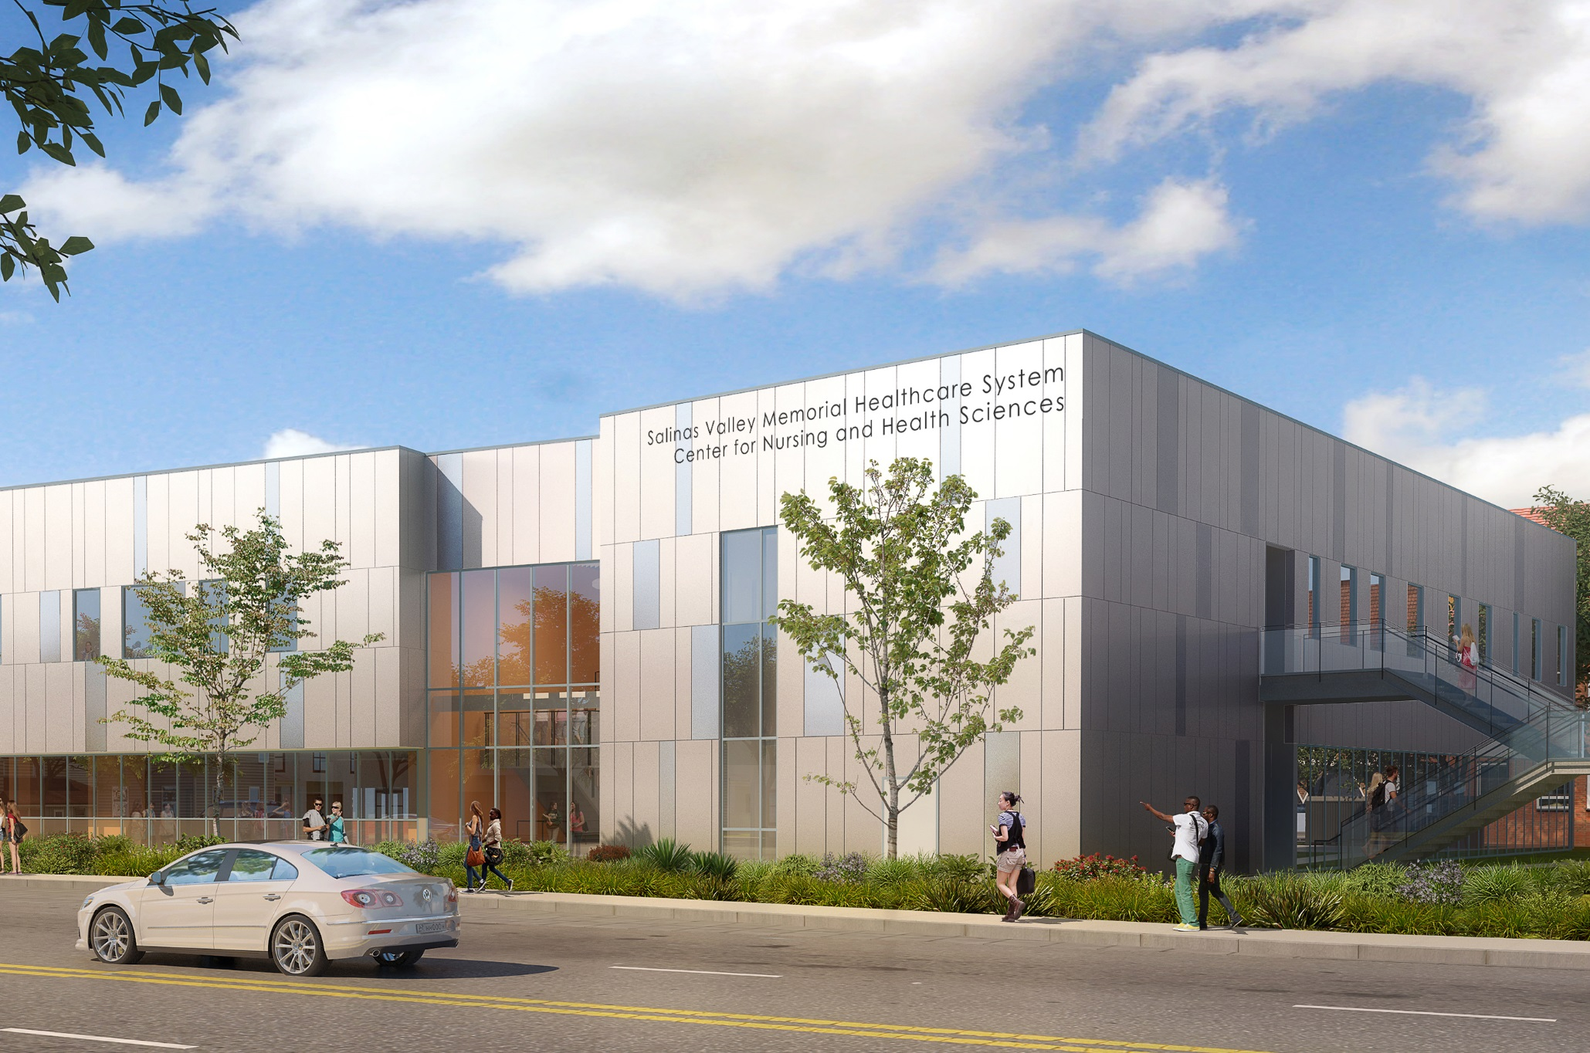
Phase 1
Nursing and Health Science
2016 Budgeted Cost
$21,207,321
Projected Cost
~$ 24,728,916
Bid received October 2019
Status: Construction
Delivery: Fall 2021

Slide 11
Phase II & III Projects (more details)
Phase II Projects – Projected Bids mid 2022
Alisal Campus: Add classrooms and laboratories (new construction) GSF 20,000
Renovation of Building J (Visual Arts, built in 1977) GSF 25,175
Renovation Building K (Performing Arts , built in 1979) GSF 43,645
High Schools Partnership (Partner with Distrct high schools to improve and renovation science classrooms and labs for support joint use to support dual enrollment)
Practice Football Field (replace grass with artifical turf)
Phase III Projects
Building F, G & H (Main Gym built in 1974, Aux Gym built 1938 & Weight room. GSF 74,017 FPP/IPP submitted in July 2019. State match 50%.
Building N (Merrill Hall former science building built 1964) GSF 43,337
High Schools Partnership

Slide 12
Cost Mitigation & Funding Strategies
General Obligation Bond (Nov 2020) State Matching funds—for Blds. FGH.
Unspent 10% contingency owner’s allowance
Interest Funding
Bundling of Projects
Continued use of in-house staffing
RDA Funding
Foundation Funding
Special Assessment District. Dolinka group.

Slide 13
HCCD Fiscal Status of Construction Program
Five projects bid to date
50% of Program
Six Projects remaining to be bid
50% of Program

Slide 14
Fiscal Health Analysis Summary
cc.
Phase I, II, III | Sources of Funds | Estimated Total Cost | Budget vs. Actual & Estimated
Total Projected HCCD Capital Improvement Program Numbers | $188,387,690 | $179,391,237 | $8,996,453

Slide 15
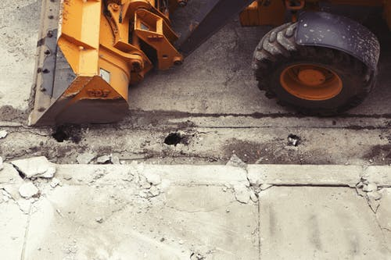
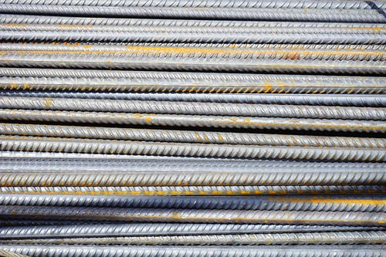
HCCD Fiscal Status of Construction Program
Thank you for your time
Questions, Comments

