Slide 1
Presented by: David Techaira Controller
Student Centered Funding Formula (SCFF)
and
2019-20 Budget
Presented October 17, 2019

Slide 2
SCFF
The new formula calculates apportionments based on three allocations:
Base (70%) – current factors, primarily credit FTES
Supplemental (20%) – counts of low-income students (PELL, CA College Promise, AB 540)
Student Success (10%) – counts of outcomes (degrees & certificates granted, transfers to 4-year, & completion of certain courses – transfer-level math & English in 1st year and 9 units of CTE)
2

Slide 3
SCFF (Continued)
2018-19 P2 Total Computational Revenue (TCR)
Base Allocation = $32,094,892 (65%)
Supplemental Allocation = $10,577,690 (21%)
Student Success Allocation = $6,764,188 (14%)
SCFF Calculated Revenue = $49,436,770 (100%)
Adjusted TCR = $46,641,570
Difference = ($2,795,200)
3

Slide 4
2019-20 Budget
Total General Fund Resources: = $51,138,576
4

Slide 5
2019-20 Budget (continued)
Total General Fund Requirements: = $51,101,213
Surplus/(Deficit) = $37,363
5

Slide 6
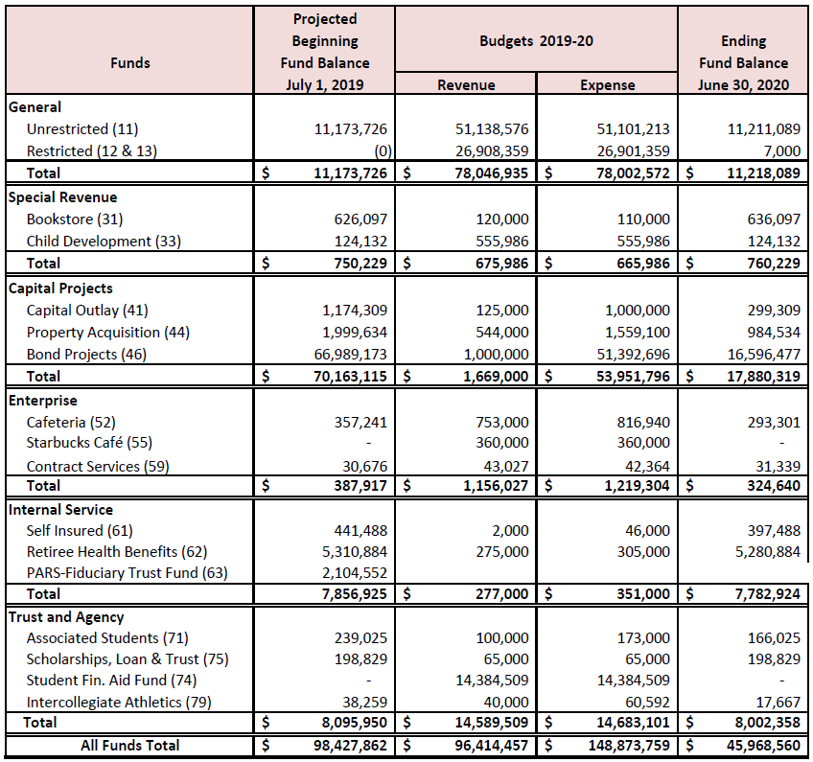
2019-20 Budget Summary by Fund
6

Slide 7
Questions?
Thank you!
7

