Slide 1
AB705 Update
College Planning Council 12/4/19
Dr. Peter Gray

Slide 2
California Statewide
Chancellor’s Content Analysis from Adoption Plans
99% of campuses submitted plans in July 2019
2/3 (59%) used default placement rules
1/3 established localized placement method for English
and/or Math
29 plans had retroactive placement recommendations

Slide 3
California Statewide - English
Completed Transfer Level English
Fall 2018: 80% increase of students who completed transfer-level English
(18,903 more than in fall 2017)
Gains: Latinx students (10,569 more)
White students (3,136 more)
Asian students (2,780 more)
F15-F18 Statewide Analysis

Slide 4
California Statewide - Math
Completed Transfer Level Math
Fall 2018: 116% increase students completed a transfer-level
stats/liberal arts math
(5,552 more than in fall 2017)
Gains: Latinx students (2,827 more)
White students (1,283 more)
Asian students (743 more).
F15-F18 Statewide Analysis

Slide 5
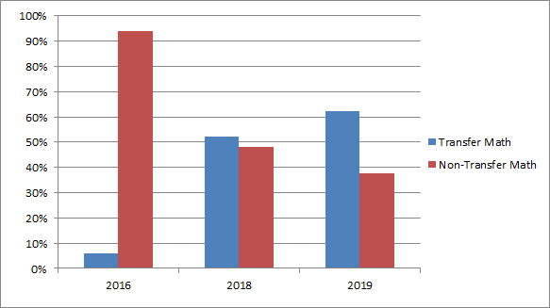
Hartnell Math Placement Changes AY16-19
Notes:
Begin with more accurate placement of students into appropriate level AND appropriate course for a student’s declared major
Began using HS gpa cutoffs and course work taken to begin revising placement. So we were ahead of AB705

Slide 6
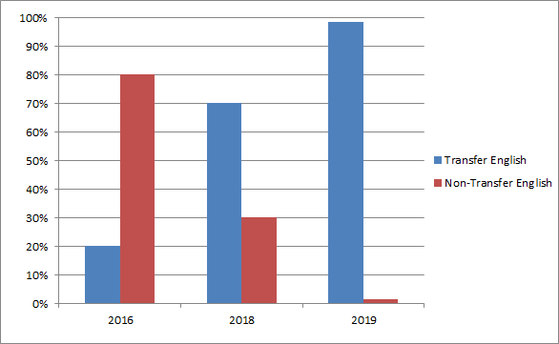
Hartnell English Placement Changes AY 16-19
Notes:
Also using HS gpa for placement like AB705 demands, again Hartnell faculty was ahead of the AB705 curve

Slide 7
California Statewide Analysis
“Overall, findings suggest that despite a substantial influx of students into transfer-level English and math courses, student success has not declined—students, it seems, are rising to the occasion.” Http://bit.ly/AccessEnrollmentSuccessRP

Slide 8
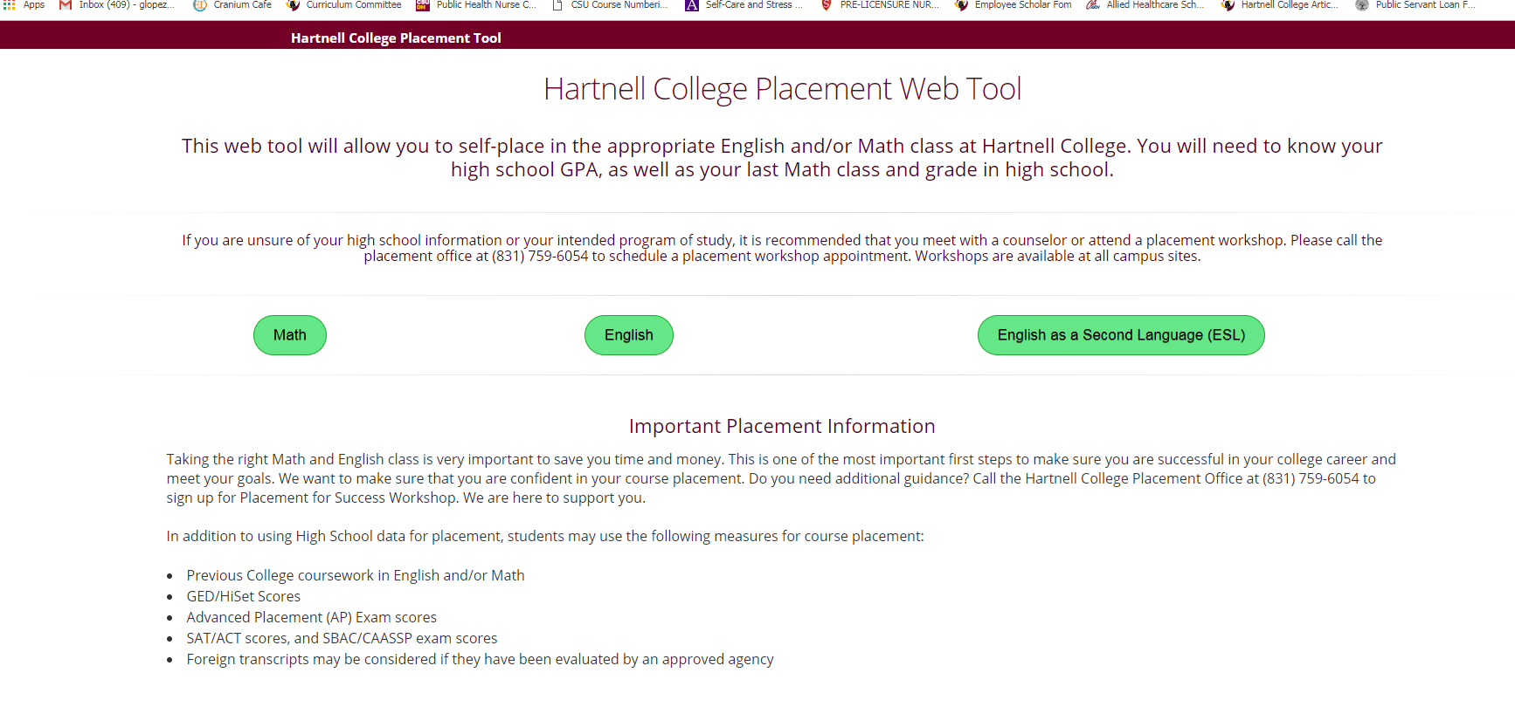
Guided Self Placement Tool Home Page
Step 1: Choose the desired discipline…...

Slide 9
Hartnell Online Placement Tool
Next up for the tool:
Adding modified language for Continuing students.
Adding GED/HiSET Data
Currently piloting ESL Placement Tool

Slide 10
Professional Development Concerns
Does having a larger number of students not passing in individual classes have negative impacts in the short and long term ON STUDENT attitudes even as the whole number of students’ passing programmatically is improving?

Slide 11
Counseling/Math/English/Panther Lab
Faculty and Staff 5x5 Reflections
My sense now is that
I need to somehow change
my classroom’s culture. How do
I move beyond connection to:
We work hard and excel?
After this conversation I feel
encouraged that we are coming
together as an institution to
help our students succeed and
accomplish their career/academic goals.

Slide 12
Counseling/Math/English/Panther Lab
I see all the faculty
and staff here who want
to help our students succeed.
We will find new tools
and new approaches that work.
Synergy and dialogue were
motivating and I am hopeful
that this can lead to
shifts in perspectives and action
to benefit all students here.

Slide 13
Our Philosophy
We are a community of educators dedicated to supporting every student who chooses the potentially life-changing work that a college education offers.
We teach, we tutor, we talk; we wonder and imagine together; we ask a lot of hard questions and seek out answers together. We engage with any student, regardless of past educational experiences.
We are Hartnell.
Notes:
Add Next steps: ESL use slide from Friday.
Add Challenges slide about future decisions.
Map the philosophy needs to align to master plan/institutional priorities./strategic plan
Do we want to point to Hartnell faculty doing work prior to AB705? REwork order?
Address Equity gaps - huge benefit of vision of success fo closing equity gaps.
Tracker - will show?
Because equity is important focus here,
Accuplacer was a major barrier, When they do enter transfer level, they were successful. We’ve gotten rid of the test.
Spell out additional support is built into and that there is a cost to building in the support. It will require us to understand how we will lose FTEs by getting. More students into the pipeline, but...we anticipate a better throughput/success/gradutaion rate. The help is not free. We will need help going forward as we adjust.
Add What ARE the current supports that will be used. LIST the academic supports, we are building and future needs. Place after the bar slides.
Frame the resource question as a state and district need to step up.
New funding formula and equity numbers: 700s, transfer in 900s,Shannon;’s point?
Challenges:
Hit on the fact that supports need to be built not on soft money.
Non-instructional work IS instructional work.
Future pres: get into the support piece; why it is integrated.
How to make the support sustainable.
In early AB705 summary, it is part of a state wide CSU, etc also doing their version.
We knew this was happening so we started the work before AB705. Statway, for example.

