Slide 1

Carol Kimbrough, MA, MFT
Crisis Counseling/
Mental Health Services
Clinical Supervisor, Psychology Instructor
October, 2019

Slide 2

Quick Facts*
1 in every 4-5 American adults will experience a mental health illness this year.
Statistics show that 75% of mental illnesses develop before age 25, making colleges ideal locations for early identification.
The World Health Organization has compared the relative impact of illnesses around the world. According to their data, mental, behavioral, and neurological disorders together rank as the biggest health problem in North America, ahead of cardiovascular disease and cancer.
*Mental Health First Aid USA- National Council on Behavioral Health, 2016

Slide 3
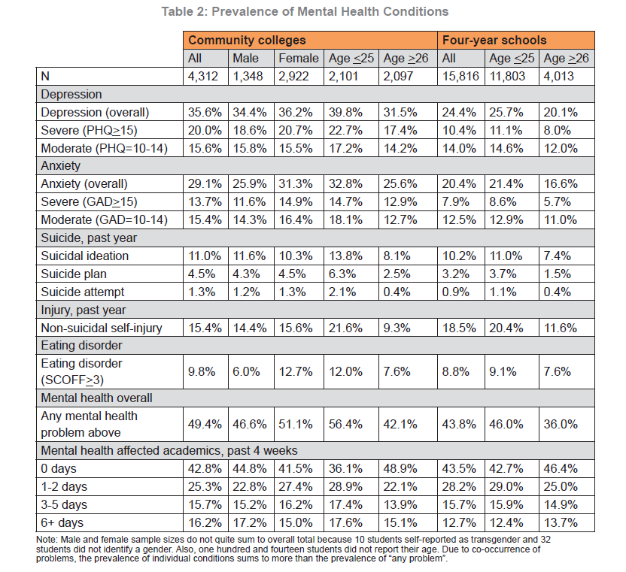
Survey Data: Mental Health on Campus
“Too Distressed to Learn – Mental Health Among Community College Students”, March 2016
Notes:
Wisconsin Hope Lab Study of 4k cc students, March 2016

Slide 4

CRISIS: anything that interferes with academic success
We know that many Hartnell students attempt to cope with studies, full-time jobs and raising children while they attend Hartnell.
Many feel overwhelmed, depressed, anxious, and hopeless.
A high percentage of our students are the first in their family to attend college; although the family system may support the concept of college, the reality of college life may not be understood by family members.

Slide 5
RECOGNIZING STUDENTS IN DISTRESS
What are some signs a student may need help?
  Level 1: (Distress). Behaviors do not necessarily disrupt others, but indicate that something is troubling the student and he or she is having difficulty coping.
  Level 2: (Crisis). Exhibit more significant changes in mood and behavior but may be reluctant/resistant to seeking help.
  Level 3: (Disruptive students). Exhibit more intense expression of emotions without regard for classroom learning environment and rights of others.
  Level 4: (Emergency!) Psychological Emergency. Danger to self and/or others

Slide 6
RECOGNIZING STUDENTS IN DISTRESS
Students in distress may have:
  Decreased academic achievement and motivation
  Increased absences
  Difficulties with concentration and focus, seem indecisive, confused
  Marked changes in interaction patterns with instructor and peers (avoidance or increased dependency); social isolation
  Changes in mood states: persistent sadness, anxiety, irritability, lethargy

Slide 7

RECOGNIZING STUDENTS IN DISTRESS
Students in distress may have:
  Fatigue and sleeping in class
  Requests for special considerations (extensions of deadlines, make-up exams, grade changes)
  Missed deadlines or incomplete work; poor academic performance
  Diminished self-care including poor hygiene
  Reluctance to accept help, denial of significance of problem(s)

Slide 8

RECOGNIZING STUDENTS IN CRISIS
(Level 2): Possible Signs
  May exhibit more significant changes in mood and behavior or mood swings
  May behave in ways that are disruptive to the classroom (for example, angry outbursts, walking out, attacking the opinions of others)
  May state: “I’m going to withdraw from all my classes.”
  Alcohol/drug abuse
  Suicidal statements or thoughts, (without current plan, method, means)
  Written or verbal threats (without current plan, method, means)
  Victim of rape, assault, domestic violence, sexual abuse
  Other students may report changes in behavior or social isolation

Slide 9
Level 3: Disruptive Students
Disruptive students may pose a threat to the campus community and the classroom learning environment; they MAY pose a threat to themselves and/or others. They may:
  regularly fail to attend class, be tardy, leave early with little regard for the role of instructor or consideration for learning environment
  be least likely to accept help and may view efforts to assist as intrusive and unwanted
  be verbally antagonistic to staff/instructors/peers
  engage in inappropriate forms of contact such as threatening emails or stalking behaviors
  threaten the safety/security of others
Behaviors may stem from emotional/mental health issues

Slide 10

Level 4: Emergency!
Severely troubled students MAY:
  demonstrate loss of contact with reality
  have difficulty communicating, have abnormal speech or confused content
  be hyper-vigilant or over-reactive to other’s opinions
  make verbal or written statements about suicide or killing others with current intent, plans, method, means

Slide 11
Helping Students in Distress: Interventions
STUDENT IN EMOTIONAL DISTRESS OR CRISIS (Levels 1 & 2)
NOT life threatening; student is troubled, confused, very sad, anxious, irritable; has thoughts about not wanting to live; difficulties in interacting with others; change in academic performance and attendance.
REFER TO Crisis Counseling Services
DISRUPTIVE STUDENT
Safety is NOT an immediate concern
May violate standards of student conduct (AP 5500)
Report to Behavior Intervention Team
DANGEROUS STUDENT
Safety IS an immediate concern; verbal or physical threats to harm self or others; active threats of suicide with imminent plan, method and means, may resist help
EMERGENCY!
Walk with student to D-123, 124, 126, 127 and complete intake
Walk-in hours: 11:00am -12:00 M-F
Call VP of Student Affairs 755-6822
Free and confidential
Consultation: Crisis Counseling Services Clinical Supervisor 755-6856 and/or
Document!
Appointment basis
CALL 911
Behavior Intervention Team
DSP&S 755-6760
Call VP Student Affairs 755-6822
Call Director Student Life 755-6825
Call Director Student Life 755-6825
Phone: 770-7019
Call Campus Safety 755-6888
Call Campus Safety 755- 6888
Document!

Slide 12
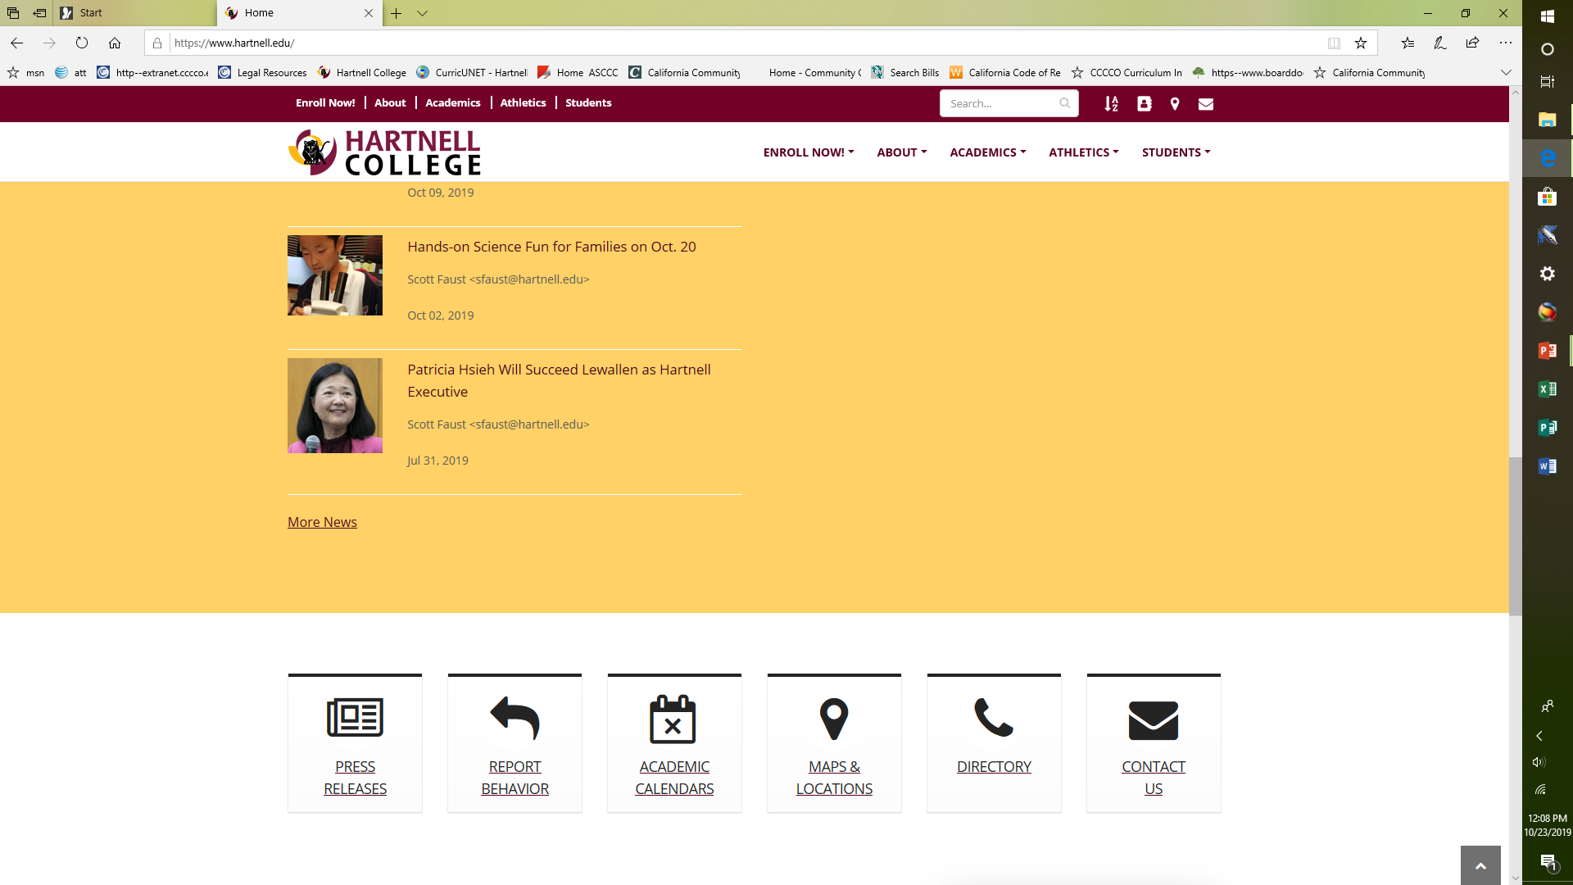
Reporting Behavior

Slide 13

Crisis Counseling/Mental Health Services
Free and confidential counseling services provided to enrolled students
  Currently four Marriage & Family Therapist (MFT) or Clinical Social Worker (CSW) associates provide counseling services
  Appointment basis (limited walk-in hours)
  Services often help students stay enrolled in their academic programs
  Screening for students who may pose a threat to themselves or others
  Interventions for students referred by BIT, DSPS, Student Life or Student Affairs
  Clinical supervision/consultation by licensed MFT/Hartnell faculty

Slide 14
Student Data

Slide 15
Student Data

Slide 16

Hartnell Crisis Counseling/Mental Health Services
HOW DO I MAKE A REFERRAL?
  The best referral involves taking the person directly to someone who can help. . . .
  Office locations: D-123, -124, -125, -126, -127 (down the hall from HR)
  Students may complete a brief intake form with contact info to schedule an appointment
  Daily “walk-in” hours, 11:00-12:00 noon M-F during the semester
  Provide student with phone information: 770-7019 (24-hour voice mail, not a hot line)
  Services are confidential and free for Hartnell students
  Follow-up

Slide 17

Questions????
Thank you!!!
Carol Kimbrough, ckimbrough@hartnell.edu; or 755-6856
Crisis Counseling Services 24-hour voicemail: 770-7019
D-123, -124, -125, -126, -127

