Slide 1


technology plan development process
Presented by Cambridge west partnership
Notes:
Welcome! Thank you for your time today! A little about me….
My experience: 20+ years CISO; 10 years faculty/Dean; 8 accreditation visits- Hartnell, Riverside, LACCD, College of Redwoods, Los Positas/Chabot etc.; ALO (1); ALO District (1); managed research, grants, IT

Slide 2
Agenda
Why a Technology Plan?
Role of Technology Committee in the Plan
Process for Creation of the Plan
Approximate Timeline for the Plan
Interview Process & Findings
Format of the Plan
Questions? Comments?

Slide 3
Why a Technology Plan?
3.9. The institution implements, enhances, and secures its technology resources to support and sustain educational services and operational functions. The institution clearly communicates requirements for the safe and appropriate use of technology to students and employees and employs effective protocols for network and data security.
3.10. The institution has appropriate strategies for risk management and has policies and procedures in place to implement contingency plans in the event of financial, environmental, or technological emergencies and other unforeseen circumstances.
Accreditation Standards

Slide 4
Why a Technology Plan?
Optimize TECHNOLOGY to automate systems (processes, procedures, and policies) for organizational growth, stability, and effectiveness.
a. Optimize the integration of systems through use analysis and staff training:
    - Financial software
    - Donor management
    - Data management
    - Electronic document software
b. Build queries of annual data needs and solidify the collection and integration processes:
    - Donor relationships
    - Student-centered impact
    - Finance
    - Program outcomes
    - Market & labor data
    - Student basic needs
c. Automate impact reports for the College and donors.
d. Refresh and implement a process to evaluate all activities and prioritize high-impact activities.
e. Monitor the Strategic Plan’s relevance and implementation and redirect at regular intervals.
Strategic Plan Objective

Slide 5
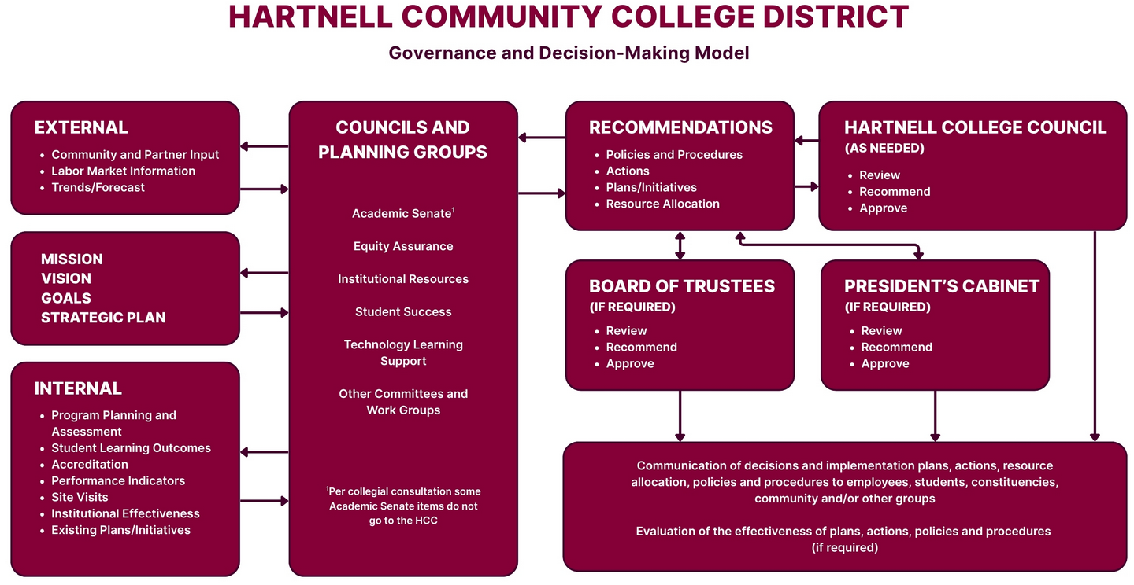
Why a Technology Plan?
Planning Groups

Slide 6
Why a Technology Plan?
The Office of Information Technology provides the foundational and enabling infrastructure, hardware, software, and systems that provide support for institutional activities at Hartnell College. These include, but are not limited to, the data warehouse, virtualization, system administration, service desk help, project management, identity and access management, email, telecommunications, networking, website hosting, academic applications, and cybersecurity.
Information Technology Services Mission

Slide 7

Why a Technology Plan?
Current Plan will end in 2027

Slide 8
Role of the TECHNOLOGY LEARNING SUPPORT COUNCIL
Guide the development of the Technology Plan
Help to ensure that resources are available when needed to complete the project
Provide feedback on the effectiveness of the process
Act as advocates for the process and report out to others in the institution regarding the progress, findings and recommendations
Assist in the annual review and update of the plan
Notes:
The Technology Committee plays a key role in the success of the project. Once the plan is completed the Technology Committee monitors progress.

Slide 9
Process for Creation of a plan
Review District Mission, Vision, Board Policies & Administration Regulations
Review:
Strategic Plan
Accreditation documents
Master Plans & other pertinent documents
To find technology-based initiatives required to meet the goals in each
Interview and review surveys of key stakeholders
COMPLETED
COMPLETED
COMPLETED
Review previous Technology Plan & Technology Trends in Higher Ed
Hold a Technology Summit to develop Themes, Goals and Initiatives
COMPLETED
Engagement of the entire College Community is the Key to Success
Consolidate Information gathered to create a draft plan
Present to Technology Learning Council, Circulate to College constituents for input,
revise plan
Present to President and Board of Trustees

Slide 10
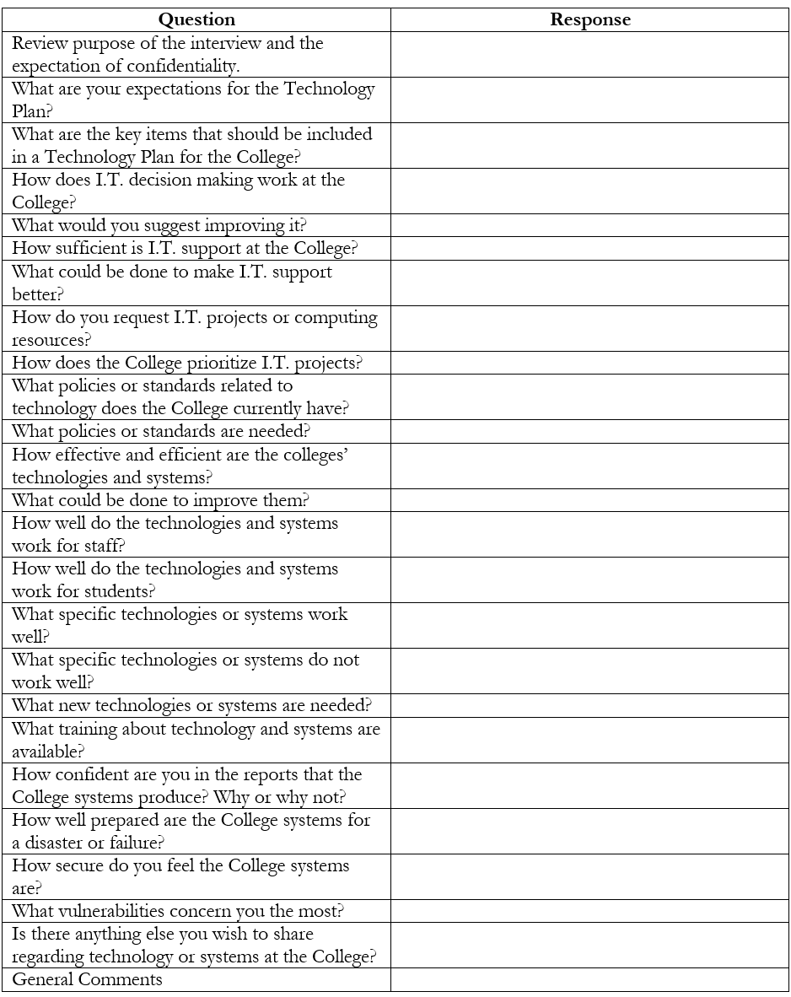
example interview Questions
Notes:
Covers topics such as support, projects, policies, standards, systems and technologies, security

Slide 11
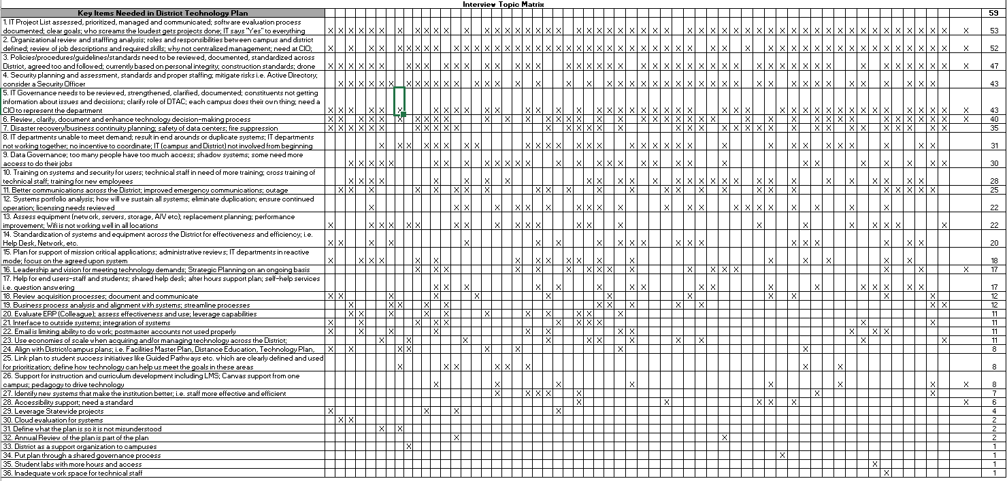
Example Interview/survey Findings Analysis
Notes:
Results are coded and ranked

Slide 12
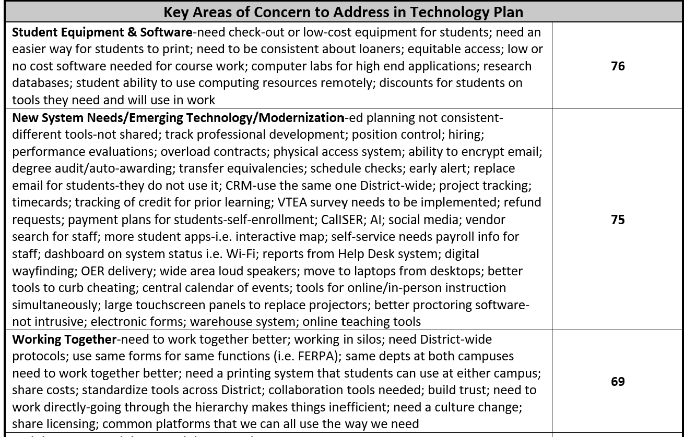
Example Key areas of concern – technology Plan

Slide 13
Example
Summit Format
Set the stage – review environment, survey & interview findings – 1 hour
Break – 10 minutes
Draft themes withing the framework of the District Strategic Priorities
  Small group breakout to develop themes – 20 minutes
  Large group report out & consolidate – 30 minutes
Break – 10 minutes
Draft technology objectives within the themes
  Small group breakout to develop objectives – 20 minutes
  Large group report out – 30 minutes
Day 1 – 4 Hours
Notes:
Usually done on the Thursday afternoon and Friday morning format

Slide 14
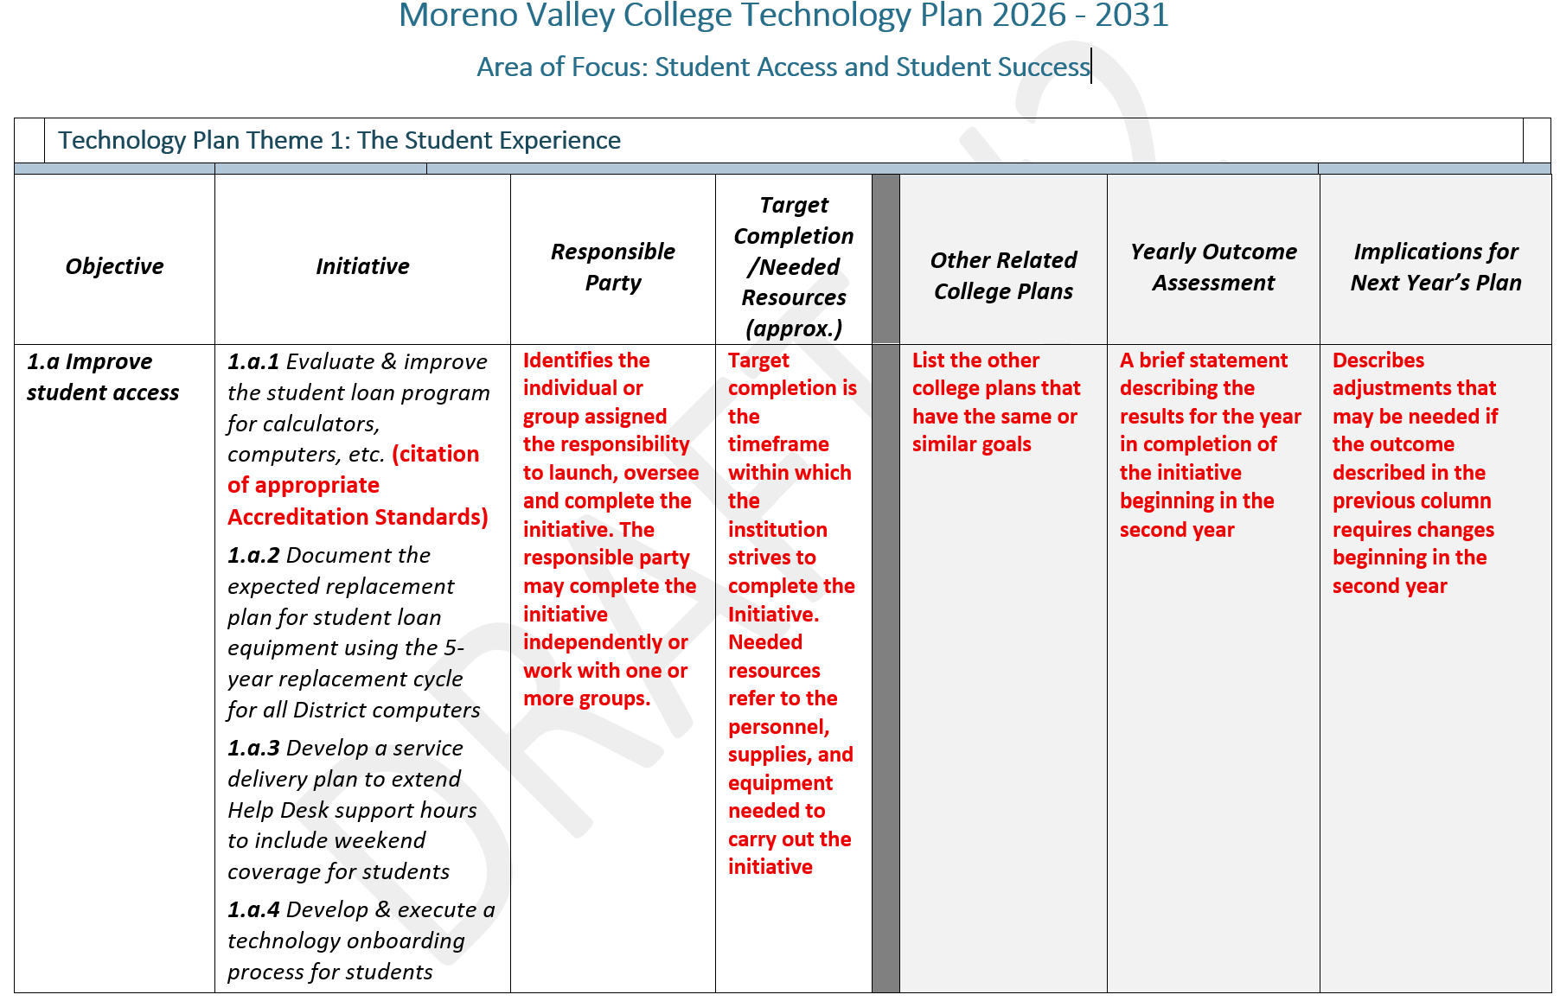
EXAMPLE FORMAT FOR TECHNOLOGY plan

Slide 15
Questions?
Comments?

